Slide 1

Introduction to graduate project Nutrition health mobile app HEALTH-ABS

Slide 2
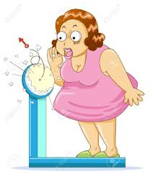
Outline
why nutrition app!!
Purpose of HEALTH-ABS
Why Android!!
Feature of HEALTH –ABS
System Analysis
UI prototype
Results of UI prototype

Slide 3
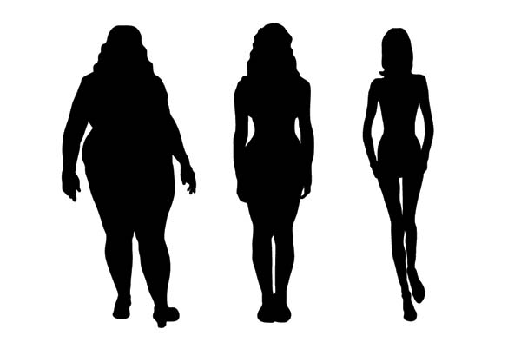
Why nutrition app ?!
Recently, the weight management is a very hard problem to control it.
Lose Maintain Gain

Slide 4

Overweight
Because it may have a negative effect in health side.
Obesity is most commonly caused by a combination excessive food intake , lake of physical activity.

Slide 5
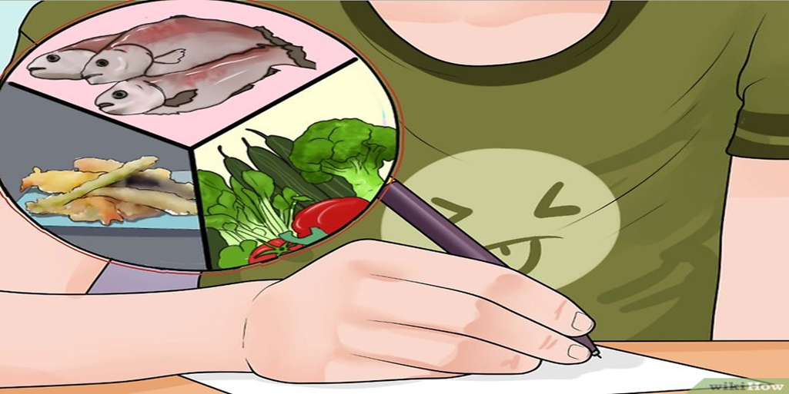
What the problem ?!!
it’s very hard to calculate their daily meals calories manually .

Slide 6
So, because there is many categories are interested in nutrition field, and because they follow special diet program. (nutrition health centers) .
but almost of them will not pay attention for this programs for a long time .

Slide 7
The aim of the app
So this app will help the users to monitor their weight , by calculating the calorie counter tracker, depends on the user’s foods and exercises. With effective algorithms from specialist nutritionist.

Slide 8

Mobile Application
With the advancement of technology and the proliferation of mobile phones, we have received great demand for applications and the most important health to maintain their health and Followed daily.

Slide 9
Why using app and android!!
Android: it is the most popular mobile platform, its power hundreds of millions of mobile devices more than 190 countries around the world.
Android 7.0 Nougat: display multiple app on-screen at once.
Android Studio 2.3: productivity when building Android apps

Slide 10
Features
online and offline.
It help the user lose, gain or maintain weight.
It can make weekly calorie analysis.
contains timer .
contain a calorie counting, calculating IBW, find BMI.
The application has reminders.
provide social site.
contains a photo album.

Slide 11

Required Data
Age
Height
Current Weight
Target weight
Gender
Physical Activity level

Slide 12
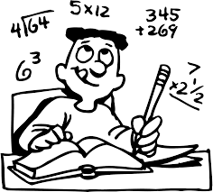
Work principle
Equation for total energy rate
TER=RMR*PAL factor
Equation for Resting Metabolic Rate
RMR for women=(10*weight)+(6.25*height)
-(5*Age)-161.
RMR for men=(10*weight)+(6.25*height)
-(5*Age)+5.

Slide 13
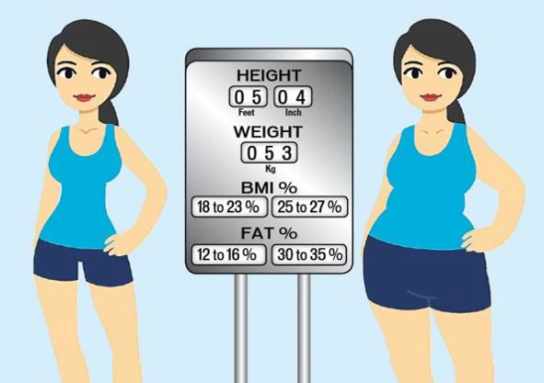
After finding TER Algorithm will decide user Body Mass Index By using this equation:
BMI=weight/Height*Height .
Results
BMI<18.5 → under weight
BMI 18.5-24.9 → Normal
BMI 25-29.9 → over weight
BMI >30 → Obese class

Slide 14
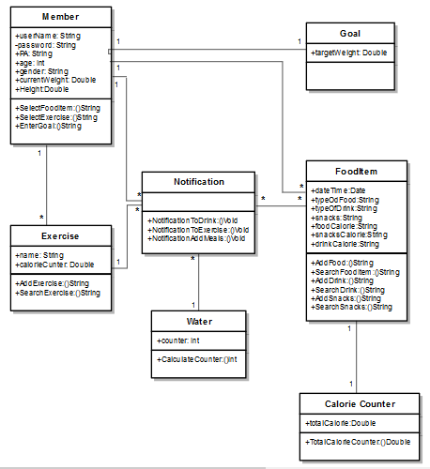
System Analysis

Slide 15
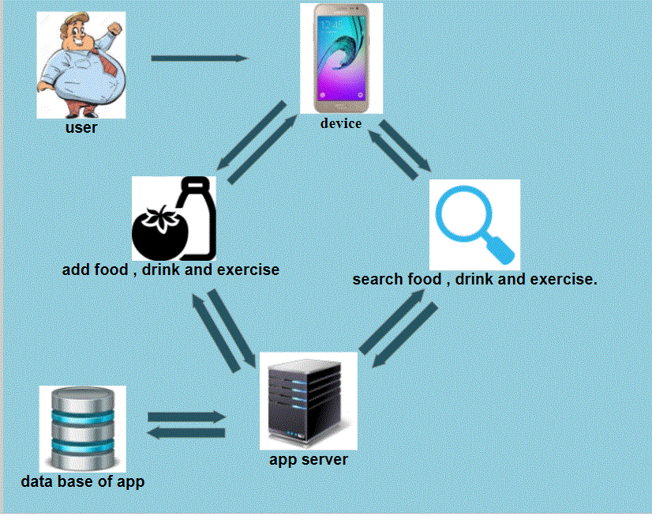
Add activity!!!

Slide 16

Other related Apps

Slide 17
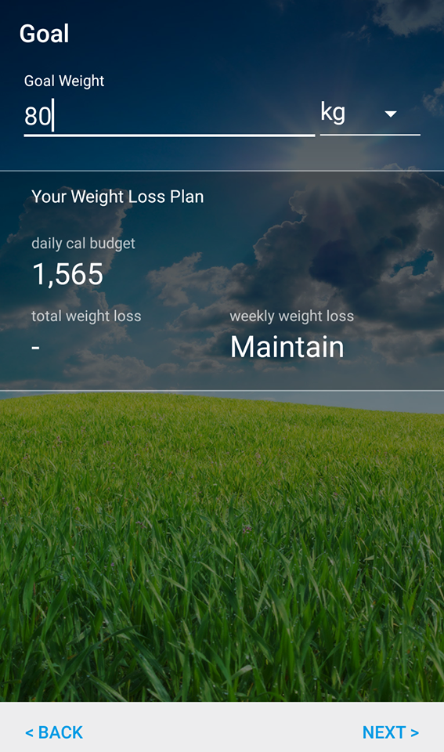
lose It
After filling the data entry it
calculate daily calories, every day
the user must search for meals
and drinks per the day and the
exercise to be controlling his/her
weight, this App work just in one
domain to lose weight.

Slide 18
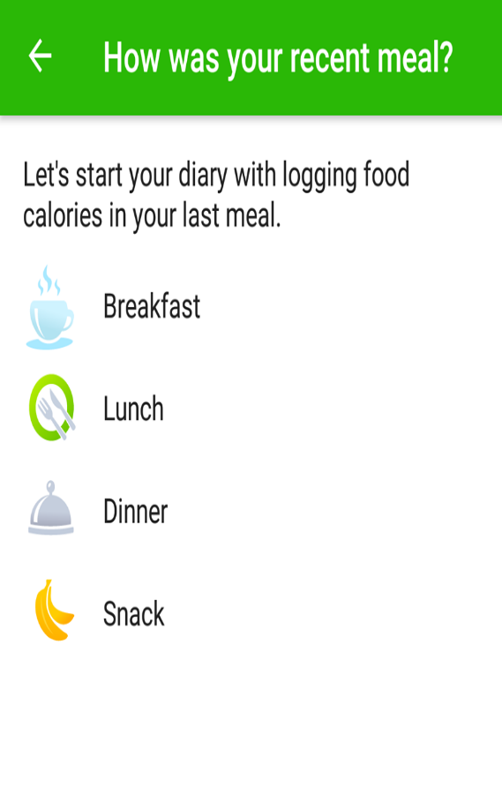
MyNetDiary App
This App works in the same way after
Adding the data entry it calculates the
Daily calorie, every day the user must
Search his/her meals and drinks exactly
to let him/her Achieve the goal, this App
don’t contain the exercise.

Slide 19
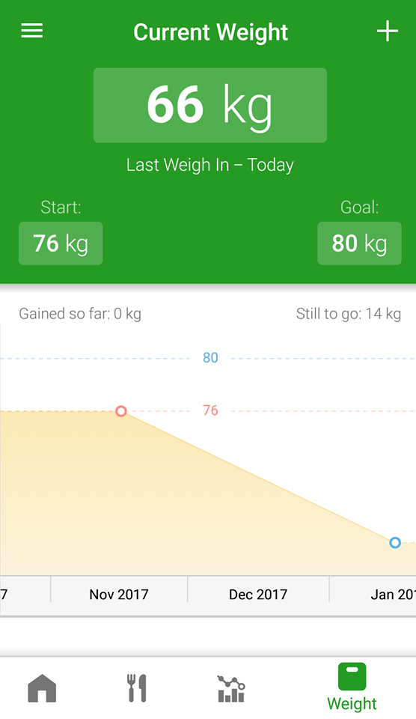
FatSecret App
This App too after filling the data entry
and calculating the daily calorie, every
day he/she must search to meals, drink
and exercise exactly to achieve the goal,
This App does not depend in calculation
on BMI and it does not limit the
Category if he/she is over weight,
under weight or normal.

Slide 20
How our App will be different:
The user interface will be friendly as possible ,simple to use in any time and any condition.
Contain the ability to manage lose weight, gain or maintain by depending on your goal and your idol wait.
Help user to add the meals and snacks the user eat per a day and help them to follow their weight and control their foods.
Notify the user many times per a day if he/she don’t fill the meals, do exercises 5 times weekly, and drink water.
Provide activity tracking service, Diet and nutrition service and Workout or exercise tracking service together.

Slide 21
Prototype Design

Slide 22
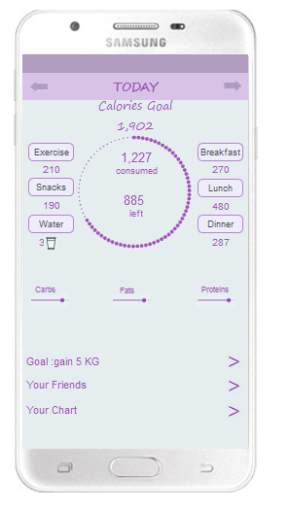
We learning about axure rp program and use it to develop our prototype.

Slide 23
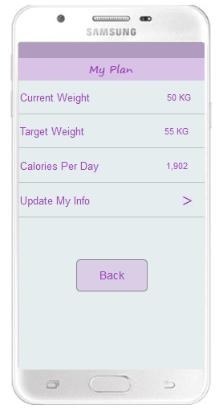
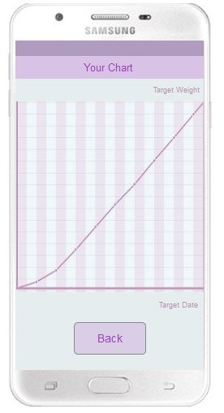

Slide 24
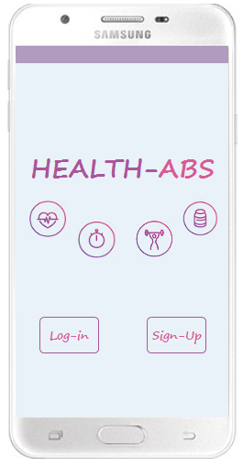
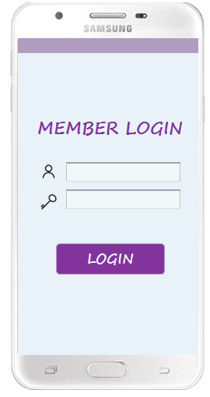

Slide 25
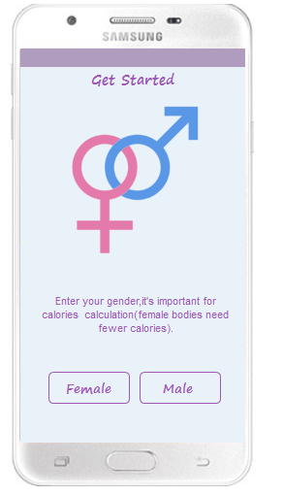

Slide 26
Survey Question
The survey questions to measure usability and friendly of our prototype
Could be used by one hand
easy and simple to use
easy to understand the content of main interface
consistent of view in form
consistent of colours in form
distribution of content increase the speed of reach ability.

Slide 27

Results of UI prototype

Slide 28
Use by one hand

Slide 29
Understandable

Slide 30
Simple and easy to use

Slide 31
Form consistent

Slide 32
Color consistent

Slide 33
Time to reach content.

Slide 34
Future work

