Slide 1

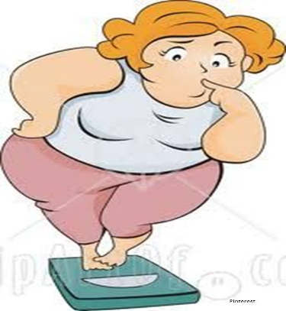
Nutrition Mobile Application COMP 411
Group Names: Sandra Fawadleh, Aya Owde, Bara Abu Sharbak.
Supervisor Name: Dr. Samer AL_Zein .
Introduction
Features
Our application works online and offline.
It can make weekly calorie analysis based on the specific algorithms which developed based on the user current weight.
The application contain a calorie counting, calculating IBW, find BMI.
The application help the user lose, gain or maintain weight.
Notifications (meals, water).
Abstract
Objectives
We start reading about nutrition terminologies, health techniques which we will use in our app, android nutrition that have a good rate and usable, learning algorithms, equations and how it work and we start using the most spread nutrition apps.
Build an algorithms that calculates total calories” (TER) by using the physical activity level (PAL) factor, the resting metabolic rate (RMR)., the percentage of each nutrient the body need such as (carbohydrates, fat, protein) which can plan your daily diet.
Develop a prototype for UI which is friendly and easy to use then we test those prototypes to chick it ta make any changing later on.
Develop server side web app and nutrition health app.
Conclotion

