Slide 1

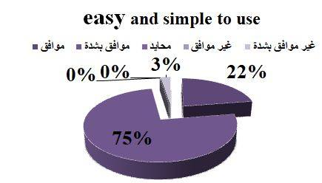
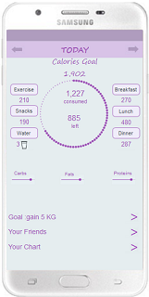
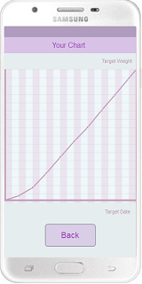
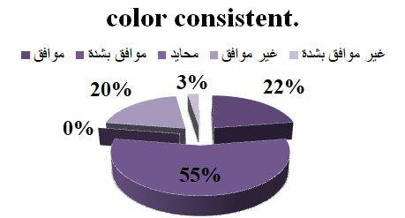
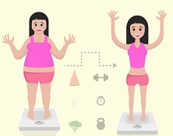

Nutrition Health Mobile Application(HEALTH-ABS)
Bara’ Abu Sharbak , Aya Owda , Sandra Fawadleh
Supervisor name : Dr. Samer Al-zain
ABSTRACT
METHODOLOGY
RESULTS
Because it’s hard for any person to calculate their daily calories. Our project idea will help the user to calculate the calories for each meals or snacks. Although it will help them to promote healthy life by maintaining perfect weight.
Our application will use the user’s data to calculate the main algorithms which help the user to get the calories counter.
By entering the gender, PA, age , height and weight ,the following algorithms will calculate the total calories.
RMR for women= (10*W)+(6.25*H)-(5*A)-161
RMR for men =(10*W)+(6.25*H)-(5*A)+5
(total calories) TER = RMR*PAL Factor.
We create a questioner about our prototype to be sure that our prototype is user friendly and usable.
INTRODUCTION
Recently, the smartphones are the most spread tecnologies,and it’s usable in many categories apps .One of them is the health care apps,which is required by all category ages to help them regulate their health behavior.
So, our project will be an effective way for the user to get the main goal of using the nutrition app, by calculating his/her daily calories, and follow what they do exercises .
OBJECTIVES
CONCLUSIONS
We will build nutrition health app that will monitor the users ‘ weight .
Our app will instructs the user to get the daily calories counter.
Our app will be easy to use and has friendly UI.
We will develop a client and server side.
The study include the main aim of project which is develop a nutrition mobile app help user maintain a good diet and exercise routines ,the main features in this app, the technology that will be use in development and specification about related topic ideas and system requirements.

