Slide 1

Mobile Application
With the advancement of technology and the
proliferation of mobile phones, we have received
great demand for applications and the most
important health to maintain their health
and Followed daily.

Slide 2
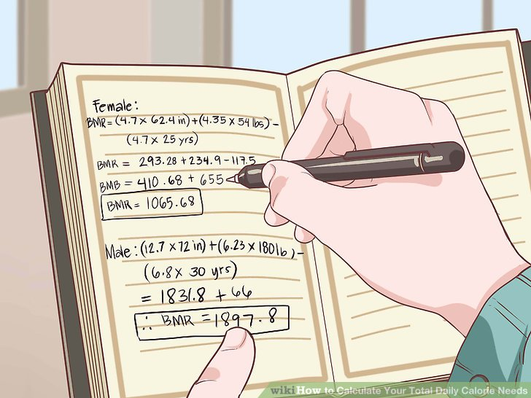
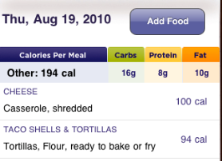
According to our study we found that
a large number of people care to calculate
they daily calorie to be attention of his/her
Goal.
No secure.

Slide 3
Features
online and offline.
It help the user lose, gain or maintain weight.
It can make weekly calorie analysis.
contains timer .
contain a calorie counting, calculating IBW, find BMI.
The application has reminders.
provide social site.
contains a photo album.

Slide 4
Why using Apps and Android?
Android: it is the most popular mobile platform, its power hundreds of millions of mobile devices more than 190 countries around the world.
Android 7.0 Nougat: display multiple app on-screen at once.
Android Studio 2.3: productivity when building Android apps

Slide 5
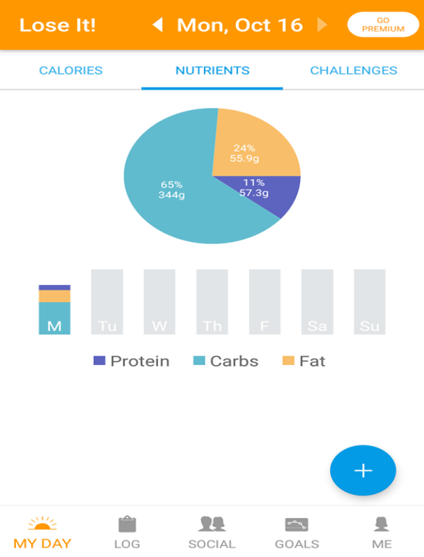
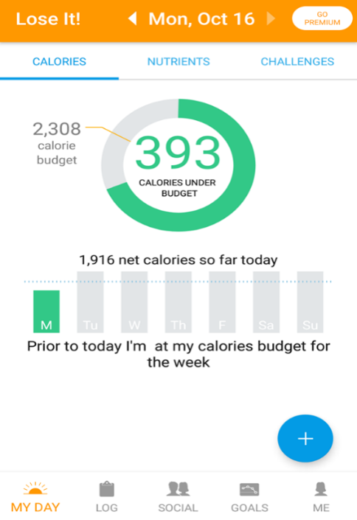
We search some apps to see the UI and the app like
Lose it App
This app to lose weight, you
enter the data entry and then
It calculate more than one
health result like body fat,
hydration, , exercise calories,
blood glucose, top food, its
easy to use and have friendly UI.

Slide 6
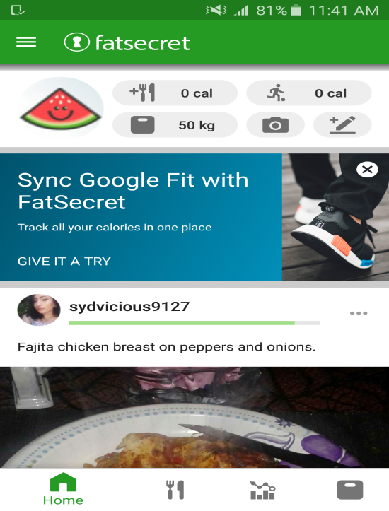
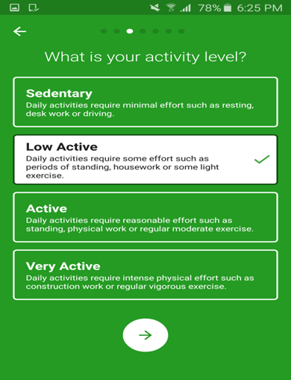
FatSecret App

Slide 7
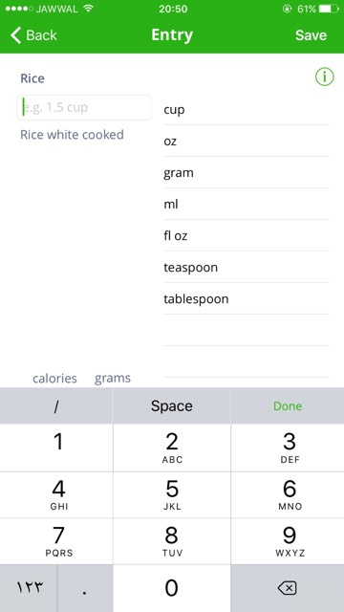
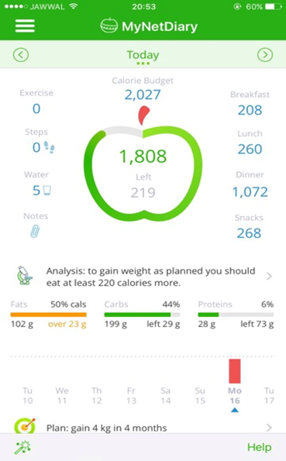
MyNetDiary App

