Slide 1

AIMS SENEGAL
12th March, 2022

Slide 2
Data Mining and Big data Analytics
GROUP 6
Supervised by Pr. Ndeye N. Keita

Slide 3
OUTLINE
1. UNSUPERVISED MINING
1.1. PCA
1.2. CLUSTERING
2. SUPERVISED MINING
2.1. NEURAL NETWORK
2.2. RANDOM FOREST

Slide 4
UNSUPERVISED MINING
DATASET
This dataset consists of features of handwritten numerals (0 to 9) extracted from a collection of Dutch utility maps.
200 patterns per class (for a total of 2,000 patterns) have been digitized in binary images. These digits are represented in terms of the following six

Slide 5
UNSUPERVISED MINING (continuation)
1. mfeat-fou: 76 Fourier coefficients of the character shapes;
2. mfeat-fac: 216 profile correlations;
3. mfeat-kar: 64 Karhunen-Love coefficients;
4. mfeat-pix: 240 pixel averages in 2 x 3 windows;
5. mfeat-zer: 47 Zernike moments;
6. mfeat-mor: 6 morphological features.

Slide 6
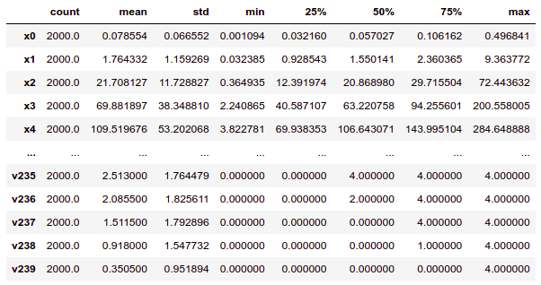
Statistic descriptive of Dataset

Slide 7
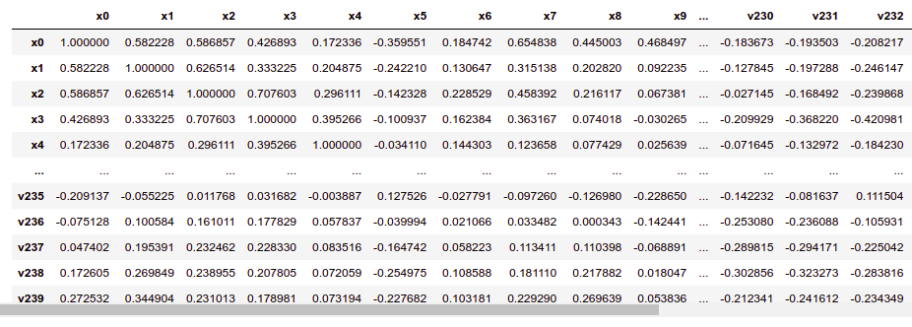
The correlation matrix

Slide 8
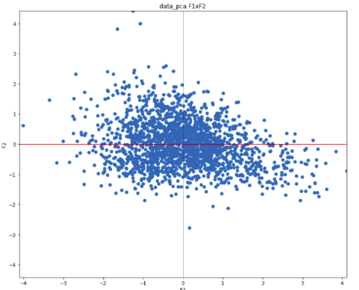
Principal Component Analysis Projection

Slide 9
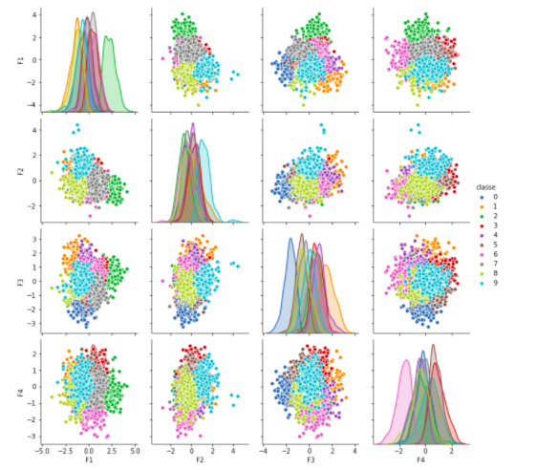
Clustering with K-means

Slide 10
SUPERVISED MINING
PREPOCESSING DATA
Creation of Dataset
Creation of Variable class «target »
Standarization of Data
Spliting Data into Training and Testing set
  Traing Data = 70 % (1400) and Test 30 % (400)
Spliting Testing Data into Test and Validation set
  Testing Data= 80 % (480) and Validation Data 20 % (120)

Slide 11
SUPERVISED MINING
NEURAL NETWORK
Paramaters :
  Batch_size=10
  Epochs=80
  Optimizer='adam',
  Activation = 'relu'
  Loss="sparse_categorical_crossentropy"

Slide 12
SUPERVISED MINING
TRAINING MODEL
  Score: 0.985
  Accuracy: 0.9854
  Loss: 0.2083

Slide 13
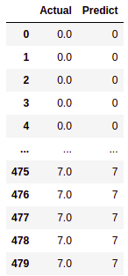
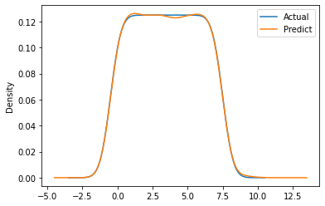
SUPERVISED MINING
TRAINING MODEL

Slide 14
SUPERVISED MINING
RANDOM FOREST
  model used : RandomForestClassifier()
  Accuracy : 0.99
  Size data : 480
  Number of classes: 8

Slide 15
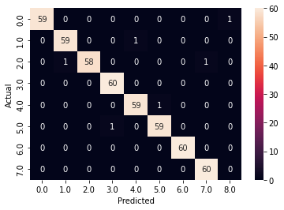
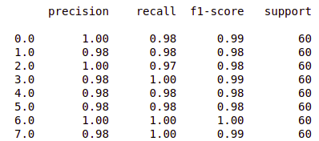
SUPERVISED MINING
TESTING MODEL

Slide 16
Thanks

