Slide 1
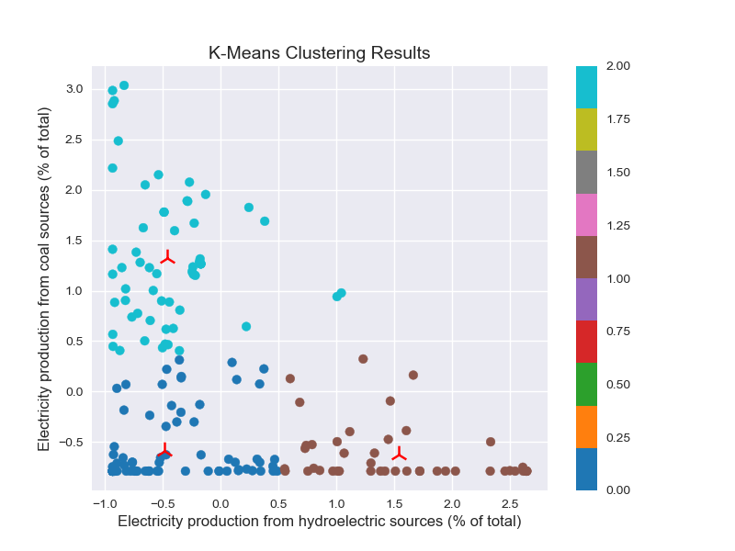
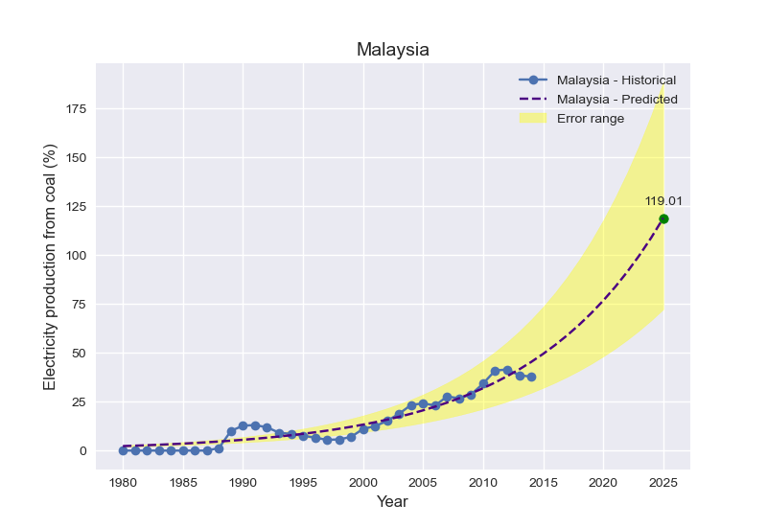
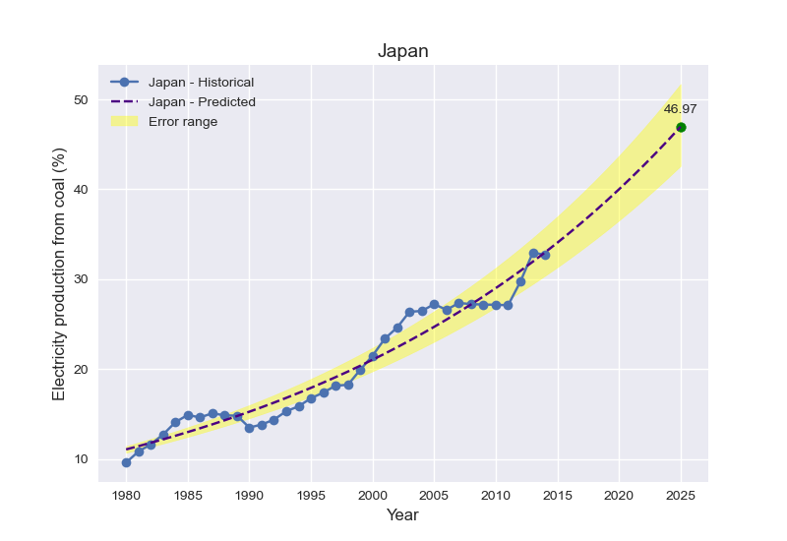
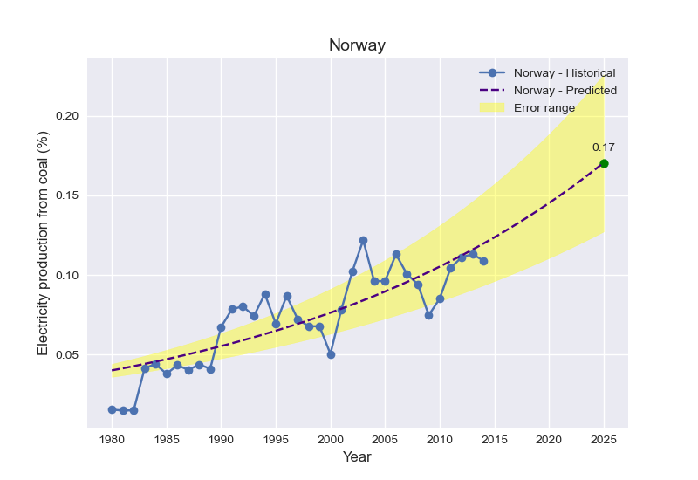
Unveiling Global Energy Pathways: Clustering Nations Based on Energy Sources and Future Prediction of Dependance on Coal Sources
Abstract: This poster investigates the energy landscapes across the world. Focused on indicators related to hydroelectric and coal sources, clustering . By scrutinizing fitted parameters and confidence intervals, the study provides a concise yet informative overview, facilitating a nuanced understanding of energy trends and aiding informed decision-making.
Introduction: Unraveling the dynamics of electricity production is pivotal for sustainable energy planning. This study employs exponential growth modeling to analyze key indicators, including hydroelectric and coal sources, across nations. By scrutinizing growth rates and projecting future trends, our exploration lays the foundation for informed decision-making in the realm of global energy sustainability.
Cluster Analysis: K-Means clustering identifies patterns in normalized data. Similarities and differences in electricity production trends among the selected countries are revealed. This allows for a nuanced understanding of how countries group based on their electricity production profiles.
Future Predictions:
Exponential growth modeling predicts future values for electricity production indicators. These predictions offer a glimpse into the expected trajectory of hydroelectric and coal sources.
Example Interpretation (for European Union - Coal Sources):
The predicted growth rate of -0.0109, with confidence intervals [-0.0109 ± 2.27], suggests a relatively stable, but slightly decreasing trend in coal-based electricity production in the European Union.
Exponential Growth Modeling:
Fitted Parameters: The fitted parameters (a and b) for each country and indicator reveal key insights into the initial values and growth rates of electricity production. For instance, in India, the initial value for hydroelectric sources is 35.41, and the growth rate is -0.0405.
Confidence Intervals: Confidence intervals provide a measure of uncertainty around the growth rates. For India, the confidence interval for the growth rate is [-0.0405 ± 7.00], emphasizing the variability in the predictions.
Conclusion:
This analysis provides a comprehensive and interpretable overview of electricity production trends. The combination of exponential growth modeling, clustering, and correlation analysis offers valuable insights for stakeholders involved in shaping sustainable energy futures.
Name: Sandra Binu
Student ID: 22029960
GitLink:

