Slide 1

GUIDED BY:
Mr Chandu
DROWSINESS DETECTION SYSTEM
NAME :SANDRA MARIA GEORGE
REG NO :41731108
CSE WITH SPECIALIZATION IN ARTIFICIAL INTELLIGENCE

Slide 2
Presentation Outline
Course Certificate
Introduction
Objectives
Flowchart
Project Implementation
Software and Hardware Requirements
Module Implementation
Results and Discussions
Conclusion
References

Slide 3
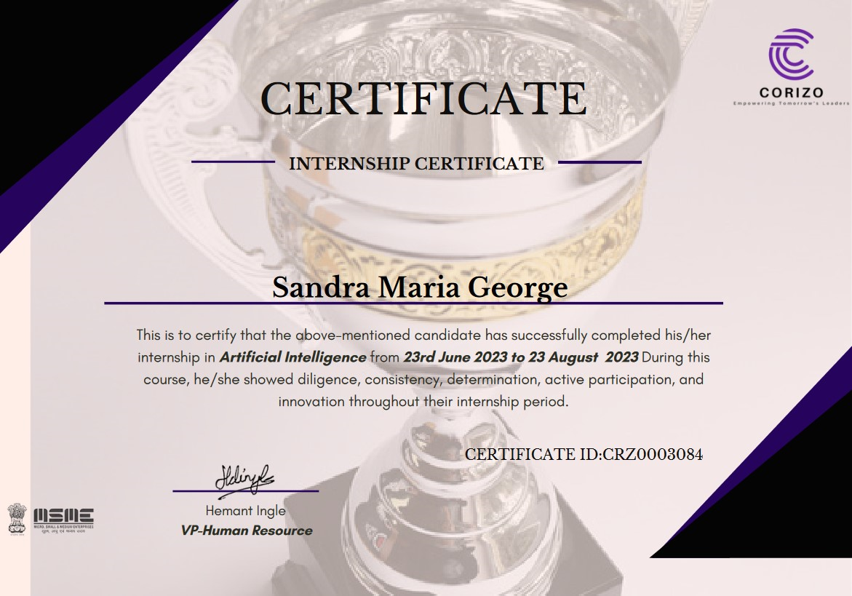
Course Certificate

Slide 4
Introduction
We now travel at a rate that not even our grandparents could have anticipated. Almost everyone in the world now uses some kind of conveyance to get to work or to other daily activities. Many people use public transport while others can afford to acquire cars. Nevertheless, there are some laws and norms of conduct for drivers, regardless Keeping your body and mind active while driving is one of them. Because we disregarded our responsibilities to encourage safer travel, this wonderful invention is responsible for hundreds of fatalities each year. Although it may seem unimportant to the majority of people, following traffic laws and regulations is essential. A car is the most potent object on the road. When used recklessly, it can be dangerous and occasionally put other road users' lives in jeopardy. One example of being irresponsible is not realising when we are too sleepy to drive. In an effort to monitor and avert a disastrous conclusion from such irresponsibility of socioeconomic standing, numerous academics have authored study articles on driver tiredness monitoring systems. This project has been carried out in order to provide data and a different perspective on the existing situation in order to improve their implementations and further optimise the solution. A automotive safety system called driver drowsiness detection works to stop accidents when the driver is about to nod off.

Slide 5
Objectives
The objective of our project is to put into practise a technique that may instantaneously alert users via a buzzer, speaker, or other output devices when they start to nod off. Being tired or being more inclined to feel sleepy at night are two examples of the many causes of being sleepy, which is a common aspect of human behaviour.
By focusing on the driver's eye movements, an IoT-based system is intended to prevent innumerable accidents caused by fatigued drivers' altered behavioural and psychological patterns. It is necessary to record the location for taking supportive action in addition to monitoring the severity of collision effects during traffic accidents.

Slide 6
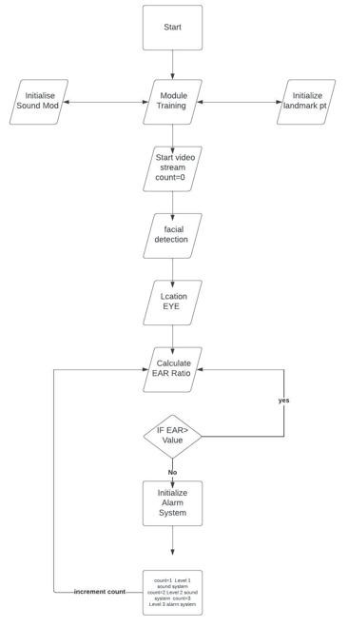
Flowchart

Slide 7
Project Implementation
The integration of the Scipy Euclidean function with the AI camera that detects tiredness requires a deliberate approach. The following gives a general outline of the implementation process:
The first step in putting this technology into use is choosing the appropriate hardware. The hardware must be able to run the necessary software, assess data from the camera and sensors, and execute the required programme. It is possible to add a camera, a computer or mobile device for processing, and any necessary sensors.
After deciding on the hardware, the creation of the software that will combine the AI camera that recognises drowsiness and the Scipy Euclidean function follows. An intentional strategy is needed to integrate the Scipy Euclidean function with the AI camera that recognises fatigue. A general description of the implementation procedure is provided below:
Choosing the right hardware is the first step in putting this technology to work. The hardware must be able to execute the appropriate programming, run the essential software, and analyse data from the camera and sensors

Slide 8
Project Implementation
The system can be installed in the appropriate cars or locations once it has been tested and shown to function as expected. This could entail putting the necessary hardware and software on the cars or integrating the system with the current network.To guarantee that the system keeps working correctly, it must also be monitored and maintained. To sum up, it takes careful design and execution to implement the combination of the Scipy Euclidean function and the AI camera that detects drowsiness. An intentional strategy is needed to integrate the Scipy Euclidean function with the AI camera that recognises fatigue. A general description of the implementation procedure is provided below:Choosing the right hardware is the first step in putting this technology to work. The hardware must be able to execute the appropriate programming, run the essential software, and analyse data from the camera and sensors. A camera, a computer or mobile device for processing, and any required sensors can all be added.
Following the selection of the hardware, the software that combines the AI camera that detects sleepiness and the Scipy Euclidean function is created.When used properly, this technology can increase road safety and lower the likelihood of accidents brought on by fatigued driving
When used properly, this technology can increase road safety and lower the likelihood of accidents brought on by fatigued driving.

Slide 9
Software & Hardware Requirements
Python: It is a general-purpose, interpreted programming language. Python's design philosophy, which makes prominent use of substantial whitespace, places a focus on code readability
Digital image processing:It is the application of computer algorithms to the image processing of digital images in computer science
Webcam:It is a digital video device that is usually included with a computer. Its primary use is to send photos over the Internet. It's popular for recording photos and using with instant messaging applications
This chapter discusses the software used in this project, and the technology applied to design the drowsiness detection system. The software used for coding the drowsiness detection system were selected and used after a lot of research and deliberation

Slide 10
Module Implementation
Module 1 : Face Recognition
This camera employs a pretrained programme called dlib that was created using the HELEN dataset to recognise human faces using the predefined 68 landmarks. The AI camera is a digital camera with a built-in software programme that scans a person's facial features for signs of tiredness. Using the 68 predetermined indicators, the software maps a person's facial features, such as their eyes, nose, and mouth, to determine whether they are sleepy. When a person's face is detected, the software analyses their pupil size ratio, distance between their eyes, and head tilt to decide whether or not they are human.
Module 2 : Eye feature Recognition and EAR calculation
This camera employs a pretrained programme called dlib that was created using the HELEN dataset to recognise human faces using the predefined 68 landmarks. The AI camera is a digital camera with a built-in software programme that scans a person's facial features for signs of tiredness.

Slide 11
Module Implementation
Using the 68 predetermined indicators, the software maps a person's facial features, such as their eyes, nose, and mouth, to determine whether they are sleepy. When a person's face is detected, the software analyses their pupil size ratio, distance between their eyes, and head tilt to decide whether or not they are human
Module 3 : Integration of face and EAR
There are several benefits to the Scipy Euclidean function. One of its key features is its capacity to efficiently and swiftly process large datasets. Because of the function's great precision, the distance between the two points may be calculated with complete accuracy. The function can be used in a variety of contexts, including physics and machine learning, and is also extremely customizable.

Slide 12
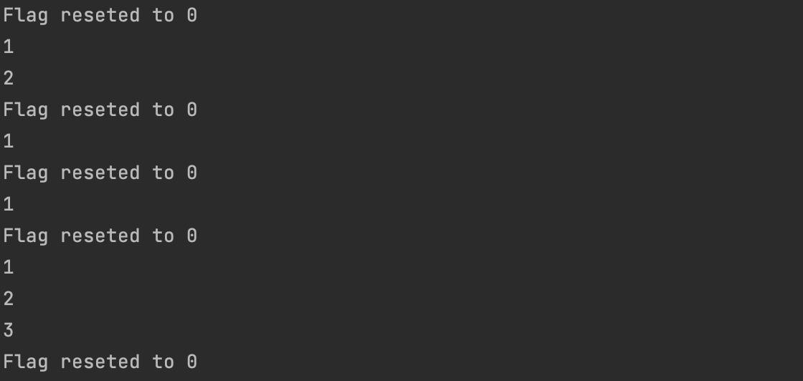
Module Implementation
Main dart

Slide 13
Results and discussion
Results and discussion
This work provides an effective method for the detection of driver fatigue in collision impact systems now in use. The suggested approach is used to develop a nonintrusive tool for assessing the severity of a collision brought on by braking or an accident, as well as the amount of driver fatigue.
Software will regularly use dlib facial recognition to record the user's face and compare the eye ratio to a preset setting. The system will give one of three kinds of alerts using various preprogrammed noises if the value deviates from the threshold range.The user will hear their name called out in the first sound, a warning in the second, and then a siren that will blare nonstop until they return to normal.
Similarly, if the eyes are kept open, the device keeps working invisibly. The first level of a voice speaker is standard sound, the second level has a slightly higher pitch, and the third level alerts the driver with a loud siren

Slide 14
Results and discussion
This chapter concludes the project and talks about the targets that were set for the project and the success in achieving them. It also mentions the list of future developments that can be done to scale up the project and increase the usefulness of the system for the user.

Slide 15
Application - Snapshots

Slide 16
Application

Slide 17
Application

Slide 18
References
McHugh ML. The odds ratio: calculation, usage, and interpretation. BiochemMed. 2009;19:120–6. http://dx.doi.org/10.11613/BM.2009.011.
Mantel N, Haenszel W. Statistical aspects of the analysis of data from retrospective studies of disease. J Natl Cancer Inst. 1959;22:719–48.
https://youtu.be/8cm1x4bC610
Dart : https://dart.dev/
Flutter : https://flutter.dev/
Dart - https://youtu.be/0CTj3x6jge
Flutter Basic - https://youtu.be/pTJJsmejUOQ

