Slide 1


PresQT: Workshop Goals -
High Level Design -
Timeline of the Project
Sandra Gesing, Richard Johnson, Natalie Meyers, John Wang
presqt-contact-list@nd.edu
https://presqt.crc.nd.edu/
September 17, 2018
Hesburgh Libraries

Slide 2
Code of Conduct
PresQT is dedicated to providing a harassment-free project and workshop experience for everyone. We do not tolerate harassment of participants in any form.
All communication should be appropriate for a professional audience including people of many different backgrounds.
Be kind to others. Do not insult or put down other attendees.
Behave professionally. Remember that harassment and exclusionary jokes are not appropriate.
Thank you for helping make this a welcoming, friendly project and event for all.
Please contact presqt-contact-list@nd.edu and/or any of the PIs with concerns.
Hesburgh Libraries
Notes:
Part of the research management lifecycle
Not a standalone tool
Interoperable and platform agnostic
PresQT bridges gaps between existing digital library infrastructure, repositories and software reuse.

Slide 3

PresQT
A collaborative design effort to enhance reproducibility and more open sharing of research data through open source development (July 2018-June 2020) of Tools and RESTful Services to Improve Preservation and Re-use of Research Data & Software.
https://www.imls.gov/grants/awarded/lg-72-16-0122-16
https://www.imls.gov/grants/awarded/lg-70-18-0082-18
Hesburgh Libraries
Notes:
Part of the research management lifecycle
Not a standalone tool
Interoperable and platform agnostic
PresQT bridges gaps between existing digital library infrastructure, repositories and software reuse.

Slide 4
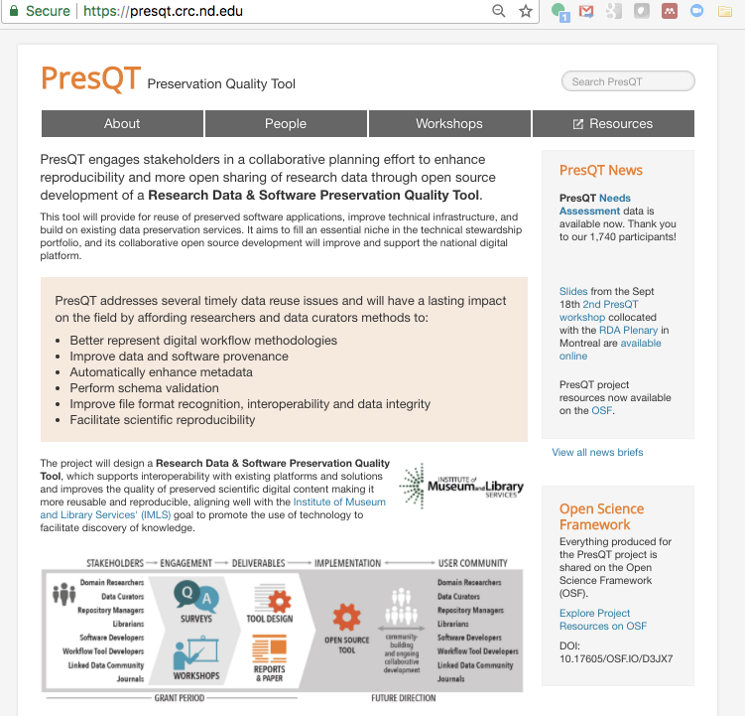
Two Workshops & the
Needs Assessment answered by 1740 stakeholders have been completed.
All Resources avail online
http://presqt.crc.nd.edu/
Hesburgh Libraries
Notes:
PresQT has been gathering stakeholder feedback through a needs assessment and two workshops - one at ND in Spring 2017 and one at RDA Plenary Montreal in Fall 2017 . The Needs Assessment was piloted at workshop one, and ran from mid-summer 2017 through fall 2018.
The Planning grant concludes this year.

Slide 5
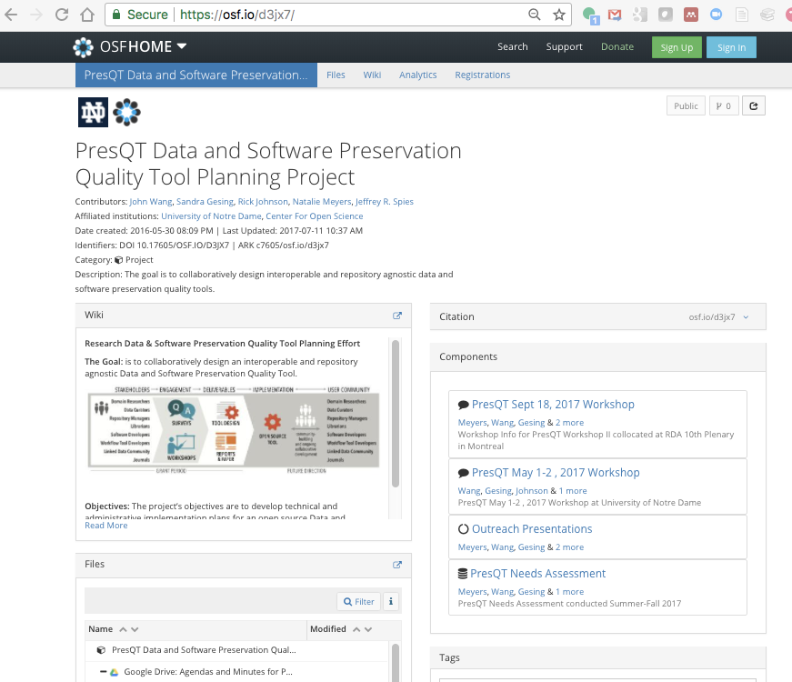

PresQT OSF Project
An open project with all stakeholder input, workshop materials, and meeting info shared on Open Science Framework.
Project Partner
https://osf.io/d3jx7/
https://cos.io/
Notes:
PresQT was conceived as a “radically open grant funded project”. We pledged to share all workshop stakeholder input, workshop materials, meeting minutes and needs assessment online during the active project - not hoarde it til the end. We created an Open Science Framework project for sharing results and gave it a DOI that we submitted with our proposal so reviewers and the funder would know where we would share the info gathered with the funding. The needs assessment questionnaire, response data, and workshop materials we’re talking about today are all available on osf.
We emphasized sharing and worked with dedicated partner, Center for Open Science.

Slide 6
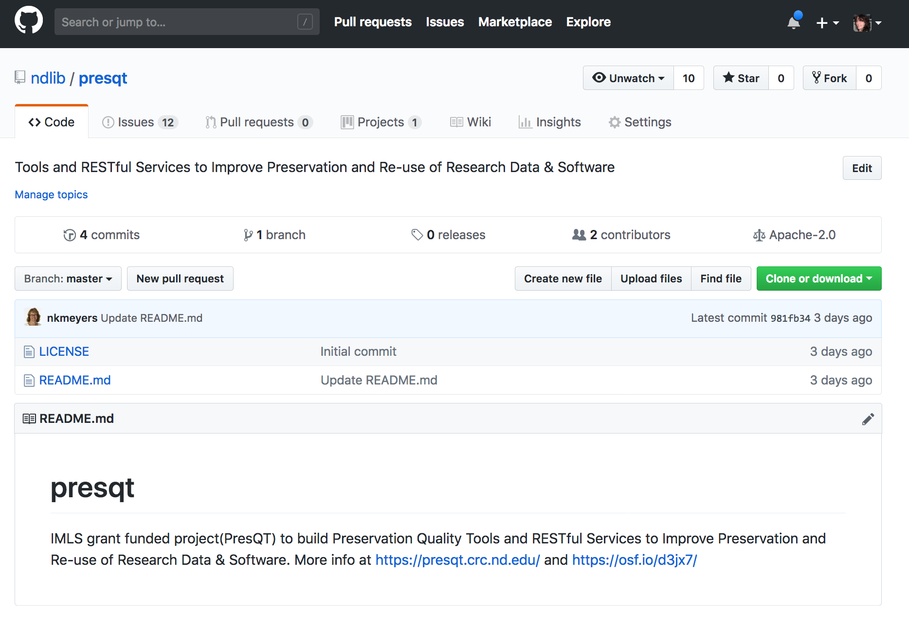
PresQT GitHub
https://github.com/ndlib/presqt
Notes:
PresQT was conceived as a “radically open grant funded project”. We pledged to share all workshop stakeholder input, workshop materials, meeting minutes and needs assessment online during the active project - not hoarde it til the end. We created an Open Science Framework project for sharing results and gave it a DOI that we submitted with our proposal so reviewers and the funder would know where we would share the info gathered with the funding. The needs assessment questionnaire, response data, and workshop materials we’re talking about today are all available on osf.
We emphasized sharing and worked with dedicated partner, Center for Open Science.

Slide 7
PresQT
A collaborative design effort to enhance reproducibility and more open sharing of research data through open source development (July 2018-June 2020) of Tools and RESTful Services to Improve Preservation and Re-use of Research Data & Software.
https://www.imls.gov/grants/awarded/lg-72-16-0122-16
https://www.imls.gov/grants/awarded/lg-70-18-0082-18
Hesburgh Libraries
Notes:
Part of the research management lifecycle
Not a standalone tool
Interoperable and platform agnostic
PresQT bridges gaps between existing digital library infrastructure, repositories and software reuse.

Slide 8
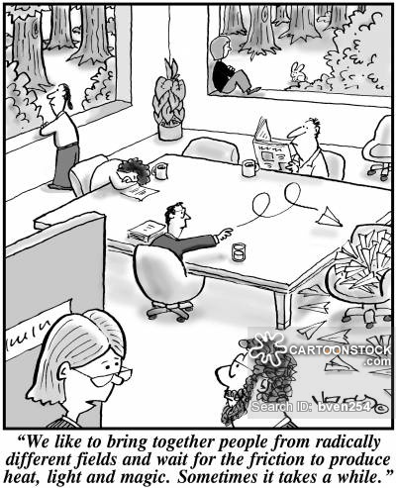
How Can We Achieve Effective Collaboration?
Hesburgh Libraries

Slide 9

How Can We Achieve Effective Collaboration?
People
Goals – Together - Work
Benefits, success and production
Tools
Communication
.
Hesburgh Libraries

Slide 10
Goals of this workshop
Getting to know the involved partners, their roles and systems
Everyone: Please introduce yourself with your name, affiliation and three words which characterizes your work/goals.
.
Hesburgh Libraries

Slide 11
Goals of this workshop
Getting to know the involved partners, their roles and systems
High-level technical design
Gathering requirements on user side
Gathering requirements on system side
Defining short-term goals: First deliverable is a technical design document by December!
Defining communication channels and point of contacts (besides email list), e.g., technical contact sandra.gesing@nd.edu
Discussions!!!
.
Hesburgh Libraries

Slide 12
Open Design
The PresQT services will not be standalone solutions but extend the preservation tool landscape in a way that stakeholders like researchers and librarians can keep working in their chosen computational environment and receive additional features instead of having to switch to a different software. PresQT services form the connection between tools, workflows and databases to existing repositories.
Additional preservation features in tools, workflows and repositories should be easily integrable via standard APIs.
To assure a wide uptake in the community and to lower the barrier for using the novel features, we will assure a user-centered design and collaborative development.
.
Hesburgh Libraries
Notes:
Part of the research management lifecycle
Not a standalone tool
Interoperable and platform agnostic
PresQT bridges gaps between existing digital library infrastructure, repositories and software reuse.

Slide 13
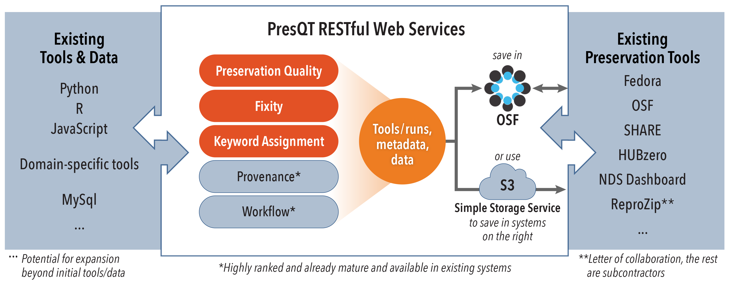
Repository and Tool Agnostic Solutions
Open design of tools and services using standards
Integrate with workflows, tools, and virtual environments
Priority Focus Areas
➔ Available for anyone to adopt what they need and build upon it!

Slide 14
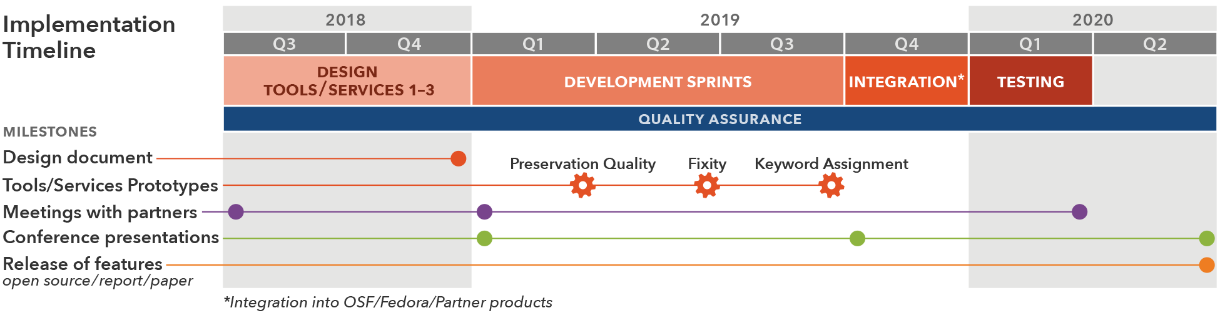
Timeline
Hesburgh Libraries

Slide 15
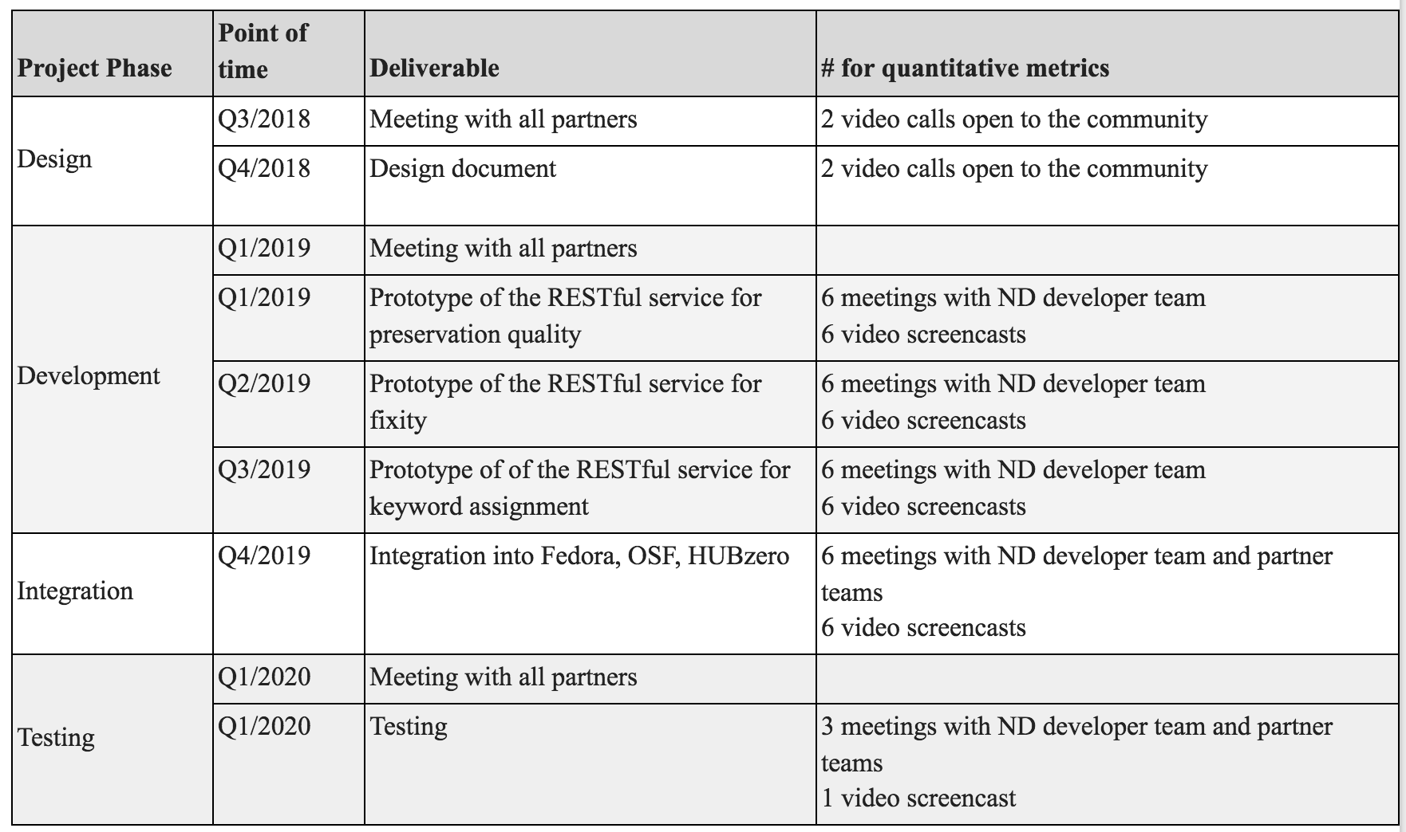
Open Design - Timeline

Slide 16
Open Design - Timeline
ND
John Hopkins
Purdue

Slide 17
SCRUM
A product owner creates a prioritized wish list called a product backlog.
During sprint planning, the team pulls a small chunk from the top of that wish list, a sprint backlog, and decides how to implement those pieces in text or software.
The team has two weeks to complete its work, and the ScrumMaster keeps the team focused on its goal.
At the end of the sprint, the work should be publishable.
The sprint ends with a sprint review and retrospective.
Next sprint begins, the team chooses another chunk of the product backlog and begins working again.

Slide 18


Technical Management Plan – Design
Definition of requirements from users during kick-off meeting and video calls
Using of open GitHub repository for collecting issues
➔

Slide 19
Technical Management Plan – Design
Definition of requirements from users during kick-off meeting and video calls
Using of open GitHub repository for collecting issues
Stakeholder Requirements Documentation
Preservation quality: what does it exactly include?
Fixity: how to secure correct information?
Keyword assignment: machine-learning for previously chosen keywords?
Design document with choice of technologies
Django web services, ember.js?
OSF, Fedora, HUBzero

Slide 20
Technical Management Plan – Development
SCRUM – two-weeks sprints
Every two weeks open video screencasts
Source code in GitHub
Organization of sprints
7-8 days dedicated to development, testing, debugging
2-3 documentation and preparation of video screencasts

Slide 21
Technical Management Plan - Integration
SCRUM – two-weeks sprints
Every two weeks open video screencasts
Source code in GitHub
Organization of sprints
7-8 days dedicated to issues and support of partner integrations
2-3 documentation and preparation of video screencasts

Slide 22
Technical Management Plan - Testing
Outreach to stakeholders
Testing, bug fixing, documentation, testing, bug fixing, documentation, testing, bug fixing, documentation, testing, bug fixing, documentation, testing, bug fixing, documentation, testing, bug fixing, documentation, testing, bug fixing, documentation, testing, bug fixing, documentation, testing, bug fixing, documentation, testing, bug fixing, documentation, testing, bug fixing, documentation, testing, bug fixing, documentation, testing, bug fixing, documentation, testing, bug fixing, documentation, testing, bug fixing, documentation, testing, bug fixing, documentation, testing, bug fixing, documentation, testing, bug fixing, documentation, …
Video screencast
Mature open-source product

Slide 23
Thank you!
PresQT on the web: https://presqt.crc.nd.edu/
Subscribe to our newsletter!
Hesburgh Libraries

