Slide 1
DATA 602 · Statistical Data Analysis · Fall 2026
Detecting Heart Disease
A comparative statistical analysis of clinical markers
Ahmed Muhammad · Divine Samuel · Joy Umejiego · Sandra Igboanugo
University of Calgary
Notes:
Good morning. Our project compares three clinical measures, maximum heart rate, serum cholesterol and exercise-induced angina, between patients with and without heart disease. For this project, we wanted to know which of these are significantly associated with the disease.

Slide 2
BACKGROUND
Why early detection matters
Cardiovascular disease is a leading cause of death worldwide (WHO, 2021).
Prioritize
Predict
Inform
Find the simple clinical measures that best flag patients for further testing.
Support risk stratification and diagnostic decision-making.
Explain to patients which health markers matter most.
Today: three comparisons of patients with and without heart disease.
DATA 602 · Detecting Heart Disease
2
Notes:
Cardiovascular disease is a leading cause of death worldwide. Accessible clinical markers, such as blood panels and exercise stress tests, can help prioritize patients for further testing. Our project aims to identify which simple measures distinguish patients, support risk stratification, and give patients clear information. In this report, we focus on one goal: determining which measurements are significantly associated with heart disease.

Slide 3
RESEARCH QUESTIONS
Three comparisons, one question each
Difference of means
Difference of means
Difference of proportions
thalch
chol
exang
Is mean maximum heart rate different between patients with and without heart disease?
Is mean serum cholesterol different between the two groups?
Is the proportion with exercise-induced angina different between the two groups?
Each question uses a conventional test and a 5,000-resample bootstrap confidence interval.
DATA 602 · Detecting Heart Disease
3
Notes:
We asked three questions. Is there a significant difference in mean maximum heart rate between patients with and without heart disease? In mean cholesterol? And in the proportion of patients experiencing exercise-induced angina? We answered each with a conventional test and a 5,000-resample bootstrap confidence interval

Slide 4
DATA AND VARIABLES
UCI Heart Disease data from four hospitals
920
4
1981–1984
patients
hospitals
records collected
Variable | What it measures | Type
thalch | Maximum heart rate during exercise test (bpm) | Numeric
chol | Serum cholesterol (mg/dl) | Numeric
exang | Exercise-induced angina (True or False) | Categorical
diseased | Heart disease present (1) or absent (0) | Binary target
Source: Janosi et al. (1989), UCI Machine Learning Repository, via Kaggle
4
Notes:
Our data is a retrospective, observational study using the UCI Heart Disease dataset. It holds records from 920 adult patients evaluated for suspected coronary artery disease between 1981 and 1984 at four hospitals. The patients are a convenience sample. Our predictors are thalch, chol and exang, and our target is diseased, a yes-or-no version of the original diagnosis.

Slide 5
DATA CLEANING
Three changes before analysis
Step 1
Step 2
Step 3
Fix impossible values
Create a disease indicator
Rename a variable
The column dataset became origin, because it shows each patient's hospital.
A cholesterol or resting blood pressure of 0 is impossible in a living patient, so we set it to NA.
num runs from 0 to 4. The new variable diseased is 1 when num is above 0, otherwise 0.
Missing values are excluded from each analysis separately.
DATA 602 · Detecting Heart Disease
5
Notes:
We made three changes. Cholesterol and resting blood pressure values of zero are impossible in a living patient, so we set them to missing. We turned the diagnosis, which runs from 0 to 4, into a binary variable, diseased. And we renamed the dataset column to origin, since it shows each patient's hospital.

Slide 6
METHODS
A standard test, checked by a bootstrap
Conventional test
Bootstrap check
Assumption checks
Pooled two-sample t-test for means. Two-proportion test (prop.test) for angina. Each gives a 95% confidence interval.
Resample each group with replacement 5,000 times. Take the 2.5th and 97.5th percentiles of the differences.
Equal spread from violin plots and the ratio of standard deviations. Normality from QQ plots and histograms.
Hypotheses for every test
H₀: the two groups are equal. Hₐ: the two groups differ (two-sided). Differences are Diseased − Not Diseased.
DATA 602 · Detecting Heart Disease
6
Notes:
For each question we used a conventional test: a pooled two-sample t-test for the two means, and a two-proportion test for angina. We also built a bootstrap interval by resampling each group 5,000 times, and compared it with the conventional interval. All differences are Diseased minus Not Diseased

Slide 7

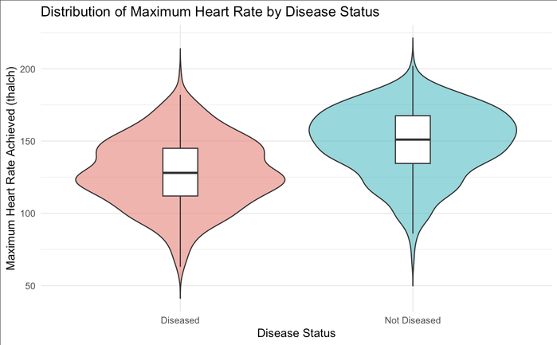
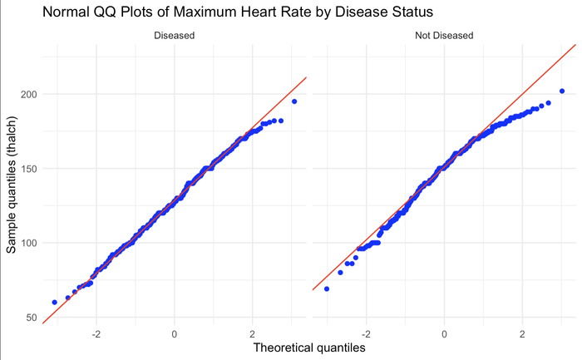
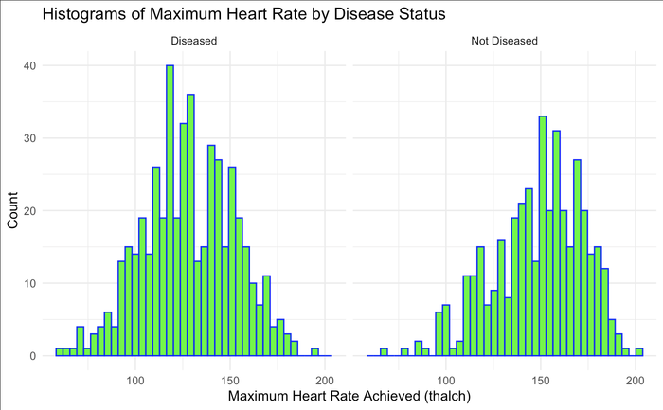
1 · MAXIMUM HEART RATE (THALCH)
The assumptions are reasonably met
Equal spread
Close to normal
Mild left skew
Standard deviations of 24.02 and 23.61 bpm (ratio 1.02).
Points follow the line, with minor departures in the tails.
Not Diseased has a longer lower tail.
Both groups are large (474 and 391), so the pooled t-test is reasonable.
DATA 602 · Detecting Heart Disease
7
Notes:
The violin and box plots show nearly identical spread, with standard deviations of 24.02 and 23.61, a ratio of 1.02, so we used the pooled test. The QQ plots follow the line closely, with minor departures in the tails, and the Not Diseased group shows a mild left skew. Both groups are large, 474 and 391, so the t-test assumptions are reasonably satisfied

Slide 8
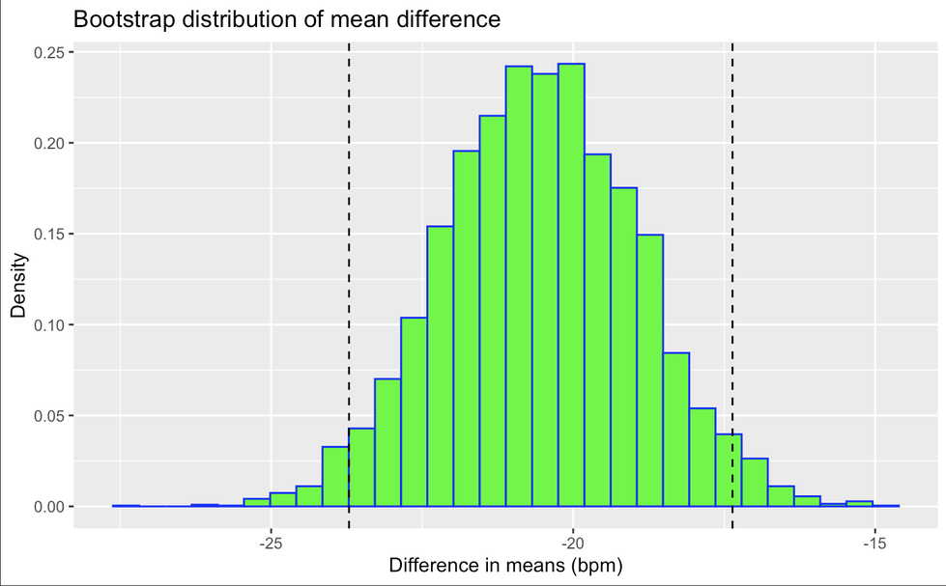
1 · MAXIMUM HEART RATE (THALCH)
Heart disease: lower maximum heart rate
Mean maximum heart rate (bpm)
128.3
148.8
Diseased
Not diseased
Difference: −20.5 bpm
t = −12.61, df = 863, p < 2.2e-16. We reject H₀.
Pooled t interval: −23.74 to −17.34
Bootstrap interval: −23.71 to −17.36
Bootstrap distribution of the mean difference. Dashed lines mark the 95% interval.
DATA 602 · Detecting Heart Disease
8
Notes:
Patients with heart disease reached a mean maximum heart rate of about 128.3, compared with 148.8, a difference of minus 20.5 beats per minute. The t statistic is minus 12.61 on 863 degrees of freedom, with p below 2.2e-16, so we reject the null. The 95 percent interval runs from minus 23.7 to minus 17.3, and the bootstrap interval is nearly identical. This fits a diseased heart having a reduced ability to speed up under exertion.

Slide 9
2 · SERUM CHOLESTEROL (CHOL)
Cholesterol: missing values and checks
202 of 920 patients (22%) have no usable cholesterol value, leaving 346 diseased and 372 not diseased.
Equal spread
SDs of 60.6 and 55.8 mg/dl (ratio 1.09): pooled t-test.
Hospital | Patients | Missing chol | % diseased
Cleveland | 304 | 0 | 45.7
Hungary | 293 | 23 | 36.2
Switzerland | 123 | 123 (all) | 93.5
VA Long Beach | 200 | 56 | 74.5
Right skew
Long upper tails, so the bootstrap is our check.
DATA 602 · Detecting Heart Disease
9
Notes:
Cholesterol is one of the first things people think of when they hear heart disease. So we asked: do patients with heart disease actually have higher cholesterol? But before we could answer, we hit a problem. Of our 920 patients, 202, about 22%, had no usable cholesterol reading. And the gaps weren't random. All 123 patients from Switzerland were missing, and that hospital also had the highest disease rate, about 93%. So whatever we found, it would only describe the other three hospitals.

Slide 10
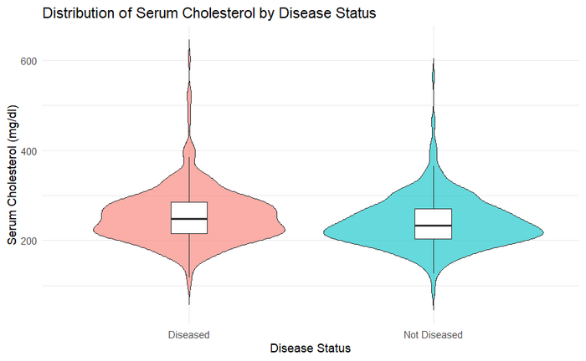
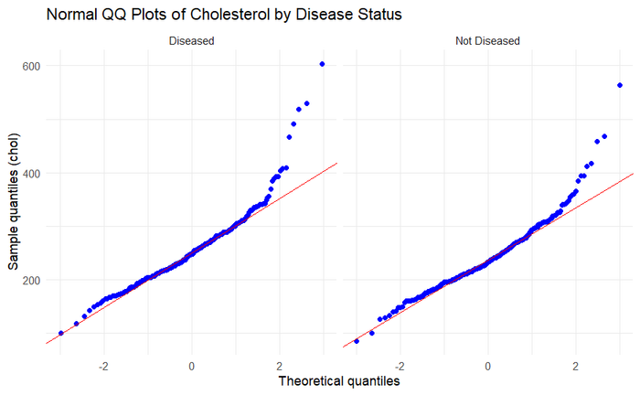
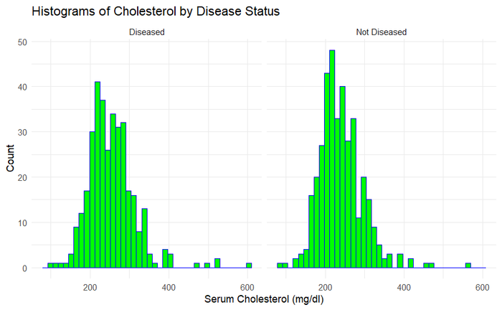
2 · SERUM CHOLESTEROL (CHOL)
Similar spread, but right-skewed
Similar spread
Right skew
A few very high readings
Standard deviations of 60.6 and 55.8 mg/dl (ratio 1.09).
Upper tails curve above the reference line.
The largest value is 603 mg/dl.
Both groups are large (346 and 372), and the bootstrap gives a further check.
DATA 602 · Detecting Heart Disease
10
Notes:
With 346 diseased and 372 not diseased patients left, we checked whether our test could be trusted. The spread was similar in both groups, so we used the pooled t-test. But the data were right-skewed, with a few very high readings, the highest being 603. Those outliers could mislead a t-test, which assumes the average behaves in a bell-shaped way. So we used a second method to confirm it. The bootstrap resamples our own data 5,000 times and assumes nothing about the shape. If the two methods disagree, we trust the bootstrap.

Slide 11
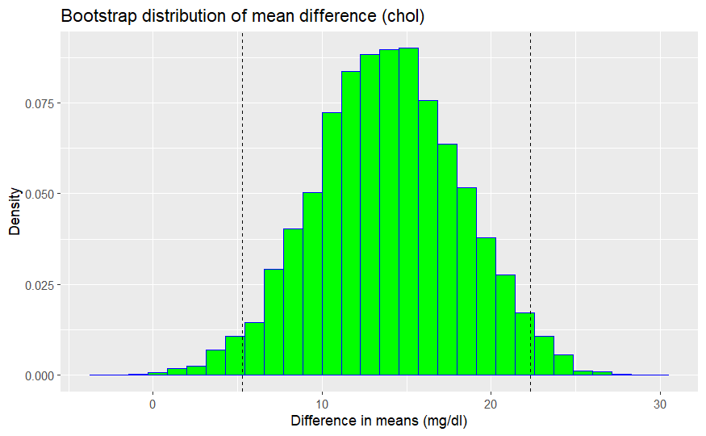
2 · SERUM CHOLESTEROL (CHOL)
Heart disease: higher cholesterol
Mean serum cholesterol (mg/dl)
254.0
240.2
Diseased
Not diseased
Difference: +13.8 mg/dl
t = 3.19, df = 716, p = 0.0015. We reject H₀.
Pooled t interval: 5.32 to 22.38. Bootstrap interval: 5.27 to 22.34.
Bootstrap distribution of the mean difference. Dashed lines mark the 95% interval.
DATA 602 · Detecting Heart Disease
11
Notes:
So what did we find? Patients with heart disease averaged 254 mg/dl of cholesterol, compared with 240 for patients without, a difference of about 14. The p-value is 0.0015, which is less than our alpha level of 0.05, so we reject the null hypothesis that mean cholesterol is the same in both groups. We are 95% confident that the true difference in mean cholesterol between the diseased and not diseased groups, using the t-based interval, is between 5.3 and 22.4 mg/dl. And here's the check: the bootstrap landed in almost exactly the same place, 5.3 to 22.3. The skew didn't fool us. From these data, patients with heart disease have higher average cholesterol.

Slide 12
2 · SERUM CHOLESTEROL (CHOL)
Consistent direction, small difference
Mean difference in cholesterol (Diseased − Not Diseased) at each hospital with data:
+9.5
+28.6
+12.5
Cleveland (mg/dl)
Hungary (mg/dl)
VA Long Beach (mg/dl)
A weak screening marker on its own
The gap is small next to standard deviations of about 56 to 61 mg/dl, so the groups overlap heavily.
DATA 602 · Detecting Heart Disease
12
Notes:
So cholesterol is higher in diseased patients, and it holds up: the difference points the same way across the 3 hospitals, so no single hospital is driving it. But here's the twist. Compare that gap of about 14 with the spread inside each group, which is 56 to 61. The two groups overlap heavily. If you picked a patient at random and knew only their cholesterol, you'd have a hard time guessing which group they were in. From these data, cholesterol alone is a weak screening marker. It's a real difference, but not a strong one.

Slide 13
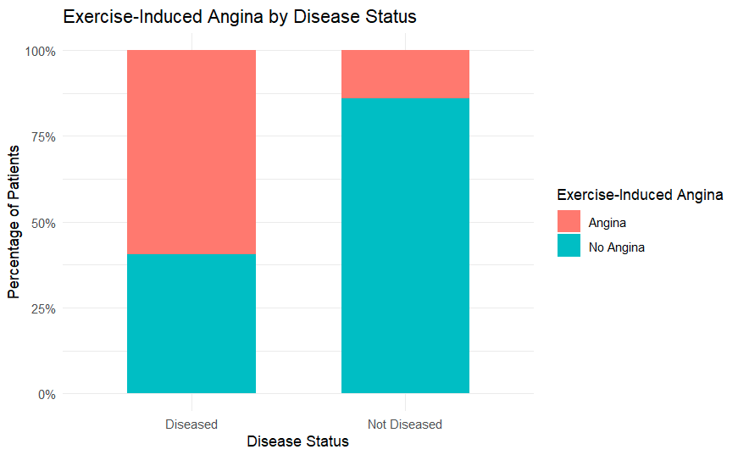
3 · EXERCISE-INDUCED ANGINA (EXANG)
Angina is far more common with disease
282 of 474
Diseased patients with angina (59.5%)
55 of 391
Not diseased patients with angina (14.1%)
Every group has at least 10 patients with and without angina (282, 192, 55, 336), so the two-proportion test applies. 55 patients had no exang value, 53 of them from VA Long Beach.
DATA 602 · Detecting Heart Disease
13
Notes:
Angina is yes or no, so we compare proportions. In the diseased group, 282 of 474 patients, 59.5%, had angina. In the not-diseased group, it was 55 of 391, only 14.1%.

Slide 14
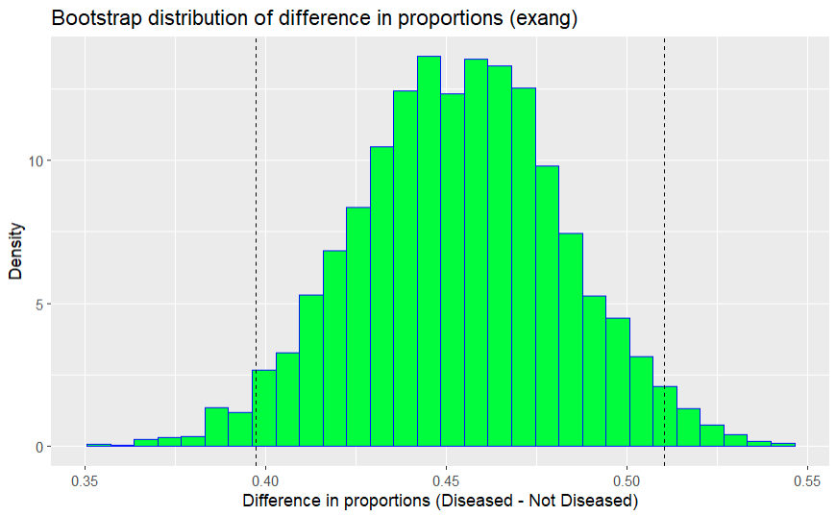
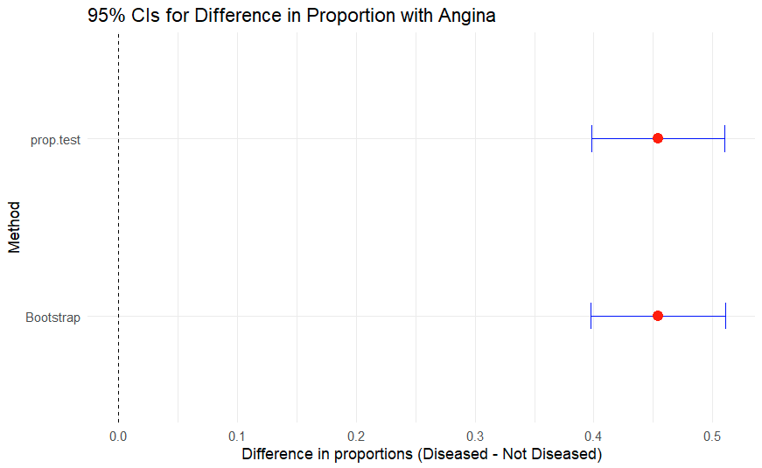
3 · EXERCISE-INDUCED ANGINA (EXANG)
Angina about four times as often
59.5% versus 14.1%: a difference of +45.4 percentage points
H₀: p₁ = p₂ vs Hₐ: p₁ ≠ p₂. X² = 185.93, df = 1 (z = 13.64), p < 0.001. We reject H₀.
p₁ = Diseased, p₂= Non Diseased
Bootstrap interval: 39.7 to 51.1 points
prop.test interval: 39.8 to 51.0 points
DATA 602 · Detecting Heart Disease
14
Notes:
That's a gap of 45.4 percentage points, about four times as often. The chi-square statistic is 185.93, with a p-value essentially zero. The intervals run from about 40 to 51 points, and both methods agree. This is the biggest separation of the three markers.

Slide 15
RESULTS AT A GLANCE
All three markers differ significantly
Marker | Diseased | Not diseased | Difference (95% CI) | p-value
thalch | 128.3 bpm | 148.8 bpm | −20.5 (−23.7 to −17.3) | < 2.2e-16
chol | 254.0 mg/dl | 240.2 mg/dl | +13.9 (5.3 to 22.4) | 0.0015
exang | 59.5% | 14.1% | +45.4 points (39.8 to 51.0) | <0.001
Measured in standard deviations, the heart rate gap (0.86 SD) is over three times the cholesterol gap (0.24 SD).
Bootstrap intervals matched the conventional intervals for all three markers.
DATA 602 · Detecting Heart Disease
15
Notes:
Putting it together: all three markers differ significantly. Heart rate and angina, the two exercise-test measures, show the largest separation. Cholesterol is statistically different but overlaps heavily. And the bootstrap matched the standard methods every time.

Slide 16
LIMITATIONS
What these results cannot tell us
Association only
Observational data show associations, not causation. Age, sex, and inter variable relationship is not accounted for.
Old, local sample
A convenience sample from four hospitals in the early 1980s. Independence cannot be confirmed, and results may not apply today.
Severity combined
Disease levels 1 to 4 were merged into one group, which hides differences between mild and severe cases.
Missing data
Zeros and missing values were excluded. This could bias results if they were not missing at random.
DATA 602 · Detecting Heart Disease
16
Notes:
This is an observational study, so our results show associations, not causation. We did not adjust for factors such as age, sex, fasting blood sugar and the number of major vessels. The data come from four hospitals in the early 1980s, so they may not apply to patients today. We combined all disease severity levels into one group. And we excluded missing and zero values, which could introduce bias if they were not missing at random.

Slide 17
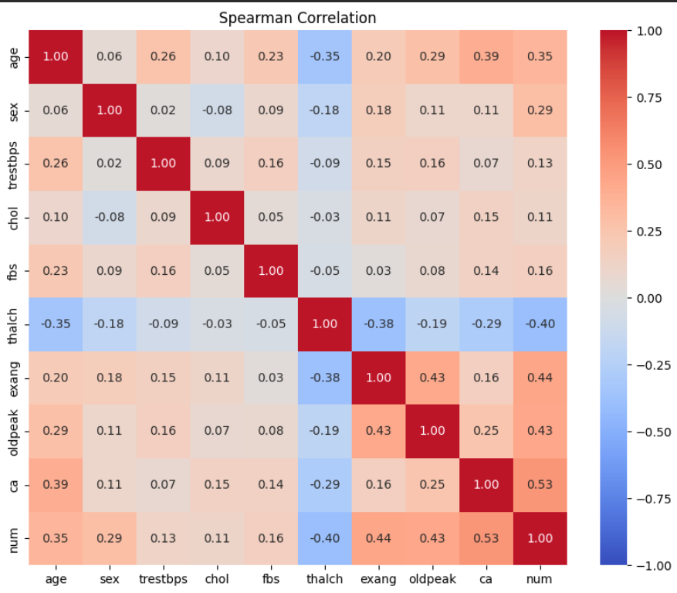
A Correlation Table
  Clinical markers rarely act alone: age, heart rate, and exercise symptoms overlap, so one can partly explain another.
  A marker can look strong because it travels with another factor, so each result is one piece of a connected picture, not independent proof.
*The correlation table was generated for DATA 601
DATA 602 · Detecting Heart Disease
17
Notes:
This is an observational study, so our results show associations, not causation. We did not adjust for factors such as age, sex, fasting blood sugar and the number of major vessels. The data come from four hospitals in the early 1980s, so they may not apply to patients today. We combined all disease severity levels into one group. And we excluded missing and zero values, which could introduce bias if they were not missing at random.

Slide 18
CONCLUSION
Exercise stress responses separate the groups more than cholesterol
−20.5 bpm
4.2×
+13.9 mg/dl
Lower average peak heart rate with heart disease
Angina rate: 59.5% versus 14.1%
Cholesterol difference, with heavy overlap
In practice, exercise stress tests give immediate, high-contrast indicators for triaging cardiovascular care.
Notes:
Diseased patients averaged a 20.5 beat-per-minute deficit in peak heart rate, and had exercise-induced angina over four times as often. Heavy overlap between the groups limits cholesterol's usefulness as a screening tool on its own. In clinical practice, prioritizing exercise stress tests provides immediate, high-contrast indicators for triaging cardiovascular care.

Slide 19
Thank you!
Questions?
Notes:
Thank you, we're happy to take questions

