Slide 1
Ecommerce Sales Dashboard Report

Slide 2
Project Overview
The Ecommerce Sales Dashboard provides a visual summary of sales performance, customer behavior, product demand, and profitability. The dashboard analyzes key business metrics such as total sales amount, quantity sold, profit, and average order value.
The main objective of this dashboard is to help businesses understand sales patterns, identify profitable products, analyze customer preferences, and support data-driven decision making.

Slide 3
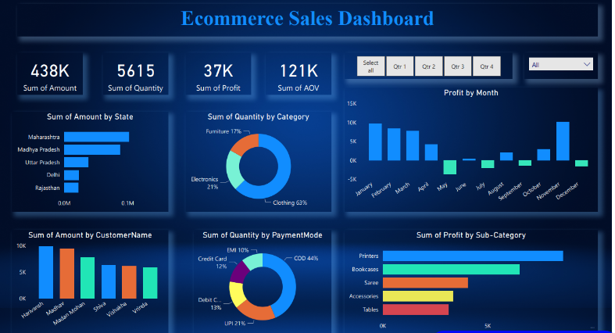
Dashboard Overview

Slide 4
Key Performance Indicators (KPI Summary)
Total Sales Amount: 438K Total Quantity Sold: 5615 Total Profit: 37K Average Order Value (AOV): 121K
Findings
The business generated 438K in total revenue.
A total of 5615 products were sold.
The total profit recorded is 37K, showing moderate profitability.
Insights
The sales volume is strong, but profit can still be improved.
Increasing product margin or focusing on high-profit products may improve profitability.

Slide 5
Sales by State
Findings
Maharashtra has the highest sales.
Madhya Pradesh follows as the second largest contributor.
Uttar Pradesh, Delhi, and Rajasthan contribute smaller portions of revenue.
Insights
Maharashtra is the strongest performing market.
Expanding marketing strategies in other states could increase overall salES

Slide 6
Quantity by Product Category
Findings
Clothing – 63% (highest demand)
Electronics – 21%
Furniture – 17%
Insights
Clothing products are the most popular category among customers.
Electronics and furniture have growth potential through promotions or offers.

Slide 7
Monthly Profit Analysis
Findings
High profit months include January and November.
May and December show negative profit, indicating losses.
Profit fluctuates across different months.
Insights
Sales and profit are seasonally influenced.
Businesses should analyze costs and discounts during loss months.

Slide 8
Sales by Customer
Findings
Harivansh and Madhav are the top customers contributing the highest sales.
Other customers such as Madan Mohan, Shiva, Vishakha, and Vrinda contribute moderate revenue.
Insights
A small group of customers generates significant revenue.
Loyalty programs and personalized offers can help retain these customers.

Slide 9
Quantity by Payment Mode
Findings
Cash on Delivery (44%) is the most used payment method.
UPI (21%) is the second most popular.
Debit card, credit card, and EMI are less commonly used.
Insights
Customers prefer Cash on Delivery for convenience and trust.
Encouraging digital payments through discounts or cashback offers may increase usage.

Slide 10
Profit by Sub-Category
Findings
Printers generate the highest profit.
Bookcases also contribute significantly.
Accessories, Saree, and Tables show lower profitability.
Insights
High profit products should receive more marketing focus and inventory support.
Low performing products may require pricing or cost adjustments.

Slide 11
Conclusion
The Ecommerce Sales Dashboard provides valuable insights into sales performance, customer behavior, and product profitability. Clothing is the most demanded product category, while Maharashtra is the leading sales region. Cash on Delivery remains the most preferred payment method among customers.
By focusing on high-performing products, expanding strong markets, improving digital payment adoption, and optimizing low-profit months, the business can enhance its overall profitability and growth.

