Slide 1

E-Commerce Analytics Dashboard Using AWS
Objective of the Project : Analyzing solution for ecommerce data using AWS Services.
Tools Used : Amazon S3 , AWS Glue, Amazon Athena, SQL and Tableau
Presented By : Sandra Raj P

Slide 2
PROJECT DESCRIPTION
The E-Commerce Analytics Dashboard project focuses on building a cloud-based data analytics solution that leverages Amazon Web Services (AWS) and Tableau to analyze and visualize sales performance across various business dimensions such as products, customers, and regions — specifically tailored for the UAE market.
The project begins with data storage in Amazon S3, where raw e-commerce transaction data is uploaded and organized. Using AWS Glue, the data undergoes cleaning, transformation, and cataloging into a structured format, ready for analysis. Amazon Athena is then used to query the processed data directly from S3 using SQL, providing a serverless and cost-efficient analytics solution.
Finally, the queried data is connected to Tableau, where an interactive dashboard is developed to visualize key metrics such as total sales, top-performing products, revenue by category, customer demographics, and sales trends over time.

Slide 3
OVERVIEW
Project workflow integrates Data Ingestion, Transformation , Querying, Visualization.
Flow Diagram :
1.Data Source: S3 Bucket
2.AWS: Glue (ETL)
3.Athena: SQL Queries
4.Visualization : Tableau

Slide 4
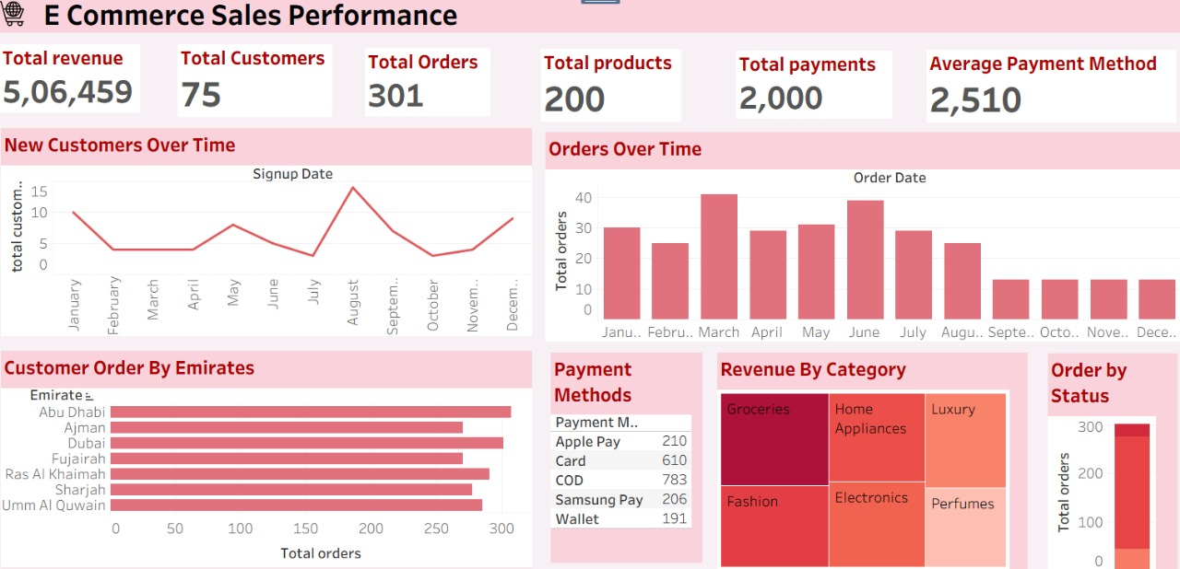
DASHBOARD
Tableau Dashboard for E- Commerce using AWS Services.

Slide 5
DATA & METHODOLOGY
1.Data Collection & Storage (Amazon S3)
2.Data Cleaning & Preprocessing (Amazon Glue)
3.Data Analysis (Amazon Athena)
4.Dashboard Creation (Tableau)

Slide 6
DASHBOARD FEATURES
KPI Cards: Revenue, Customer, Order, Products, Payments,
Charts: New Customer over time
Customer Order by Emirates
Payment methods
Revenue by Category
Order by Status.

Slide 7
INSIGHTS
Total Revenue: 5,06,459
Total Customers: 75
Total Orders: 301
Total Products: 200
Total Payments: 2,000
Average Payment Method Value: 2,510
Dubai and Abu Dhabi lead in total orders among Emirates.

Slide 8
RECOMMENDATIONS
Boost Sales in Low-Performing Emirates
Promote High-Revenue Categories
Enhance Payment Flexibility
Improve Customer Retention

Slide 9
CONCLUSION
Dashboard enhances operational efficiency by automating data workflows with AWS services.
Supports strategic planning, customer retention, and sales optimization in the UAE market.
Provides a scalable and cost-effective solution for continuous business monitoring.

Slide 10
THANK YOU
Email –sandraraj36@gmail.com LinkedIn – www.linkedin.com/in/sandrarajp Github - https://github.com/sandrarajp

