Slide 1
UNIVERSITY OF EUROPE FOR APPLIED SCIENCES • DUBAI • DATA ENGINEERING
An End-to-End ETL Pipeline
for Brazilian E-Commerce Retail Analytics
Automated Data Ingestion • Quality Assurance • Business Intelligence
Python + Pandas
PostgreSQL 18
Apache Airflow 2.9.2
Power BI Desktop
99,441
9
0
3
4
Orders Processed
Relational Tables
FK Violations
BI Dashboard Tabs
Airflow Tasks
Renato Silva | Sandra Raj Pattuvakkaran | Sudarsh Mekkampurath Sajeev
Prof. Dr. Nor Azizah Hitam • June 2026 • Final Submission
Notes:
This is the final checkpoint presentation combining all work from checkpoints 1 and 2. We built a complete end-to-end ETL pipeline: Kaggle API ingestion → Python/Pandas transformation → PostgreSQL 3NF load → Airflow orchestration → Power BI dashboard.

Slide 2
Problem & Objective
THE PROBLEM
THE OBJECTIVE
9 separate CSV files — no enforced relationships between them
Automated ETL pipeline via Kaggle API — no manual downloads
Cannot answer a single business question from raw data alone
3NF PostgreSQL schema with enforced referential integrity
Missing values, duplicates, and type inconsistencies throughout
Zero FK violations across all 99,441 orders
No automation — manual scripts are error-prone and non-reproducible
Apache Airflow DAG on daily schedule with retry logic
Latin-1 encoding issues on Brazilian city/product names
Power BI dashboard — delivery, revenue & review KPIs
Notes:
The core engineering problem: 9 separate files that cannot answer any business question on their own. You need joins across multiple tables to calculate delivery time, revenue by region, or seller performance.

Slide 3
3-Layer Data Architecture
LAYER 1 — SOURCE & INGESTION
Kaggle API — programmatic download, no manual steps
9 CSV files: UTF-8 & Latin-1 encoding handled
pd.read_csv() with encoding fallback logic
Raw files stored in local /data/raw/ folder
LAYER 2 — TRANSFORM & STORE
Pandas: null fills, dedup, type casting, enrichment
Feature engineering: DeliveryDays = delivered − purchase
3NF PostgreSQL schema — 9 tables, FK enforcement
SQLAlchemy to_sql() with method='multi' for performance
LAYER 3 — ORCHESTRATE & VISUALIZE
Apache Airflow DAG: extract → clean → validate → notify
@daily schedule, 1 retry per task, audit log trail
Power BI connected via native PostgreSQL connector
3 dashboard tabs — Overview, Delivery, Commerce & Reviews
Notes:
Three clear layers matching the IBM data architecture model from your checkpoint 1. Source → Integration/Transform → Access & Consumption. Each layer has one job and hands off cleanly to the next.

Slide 4
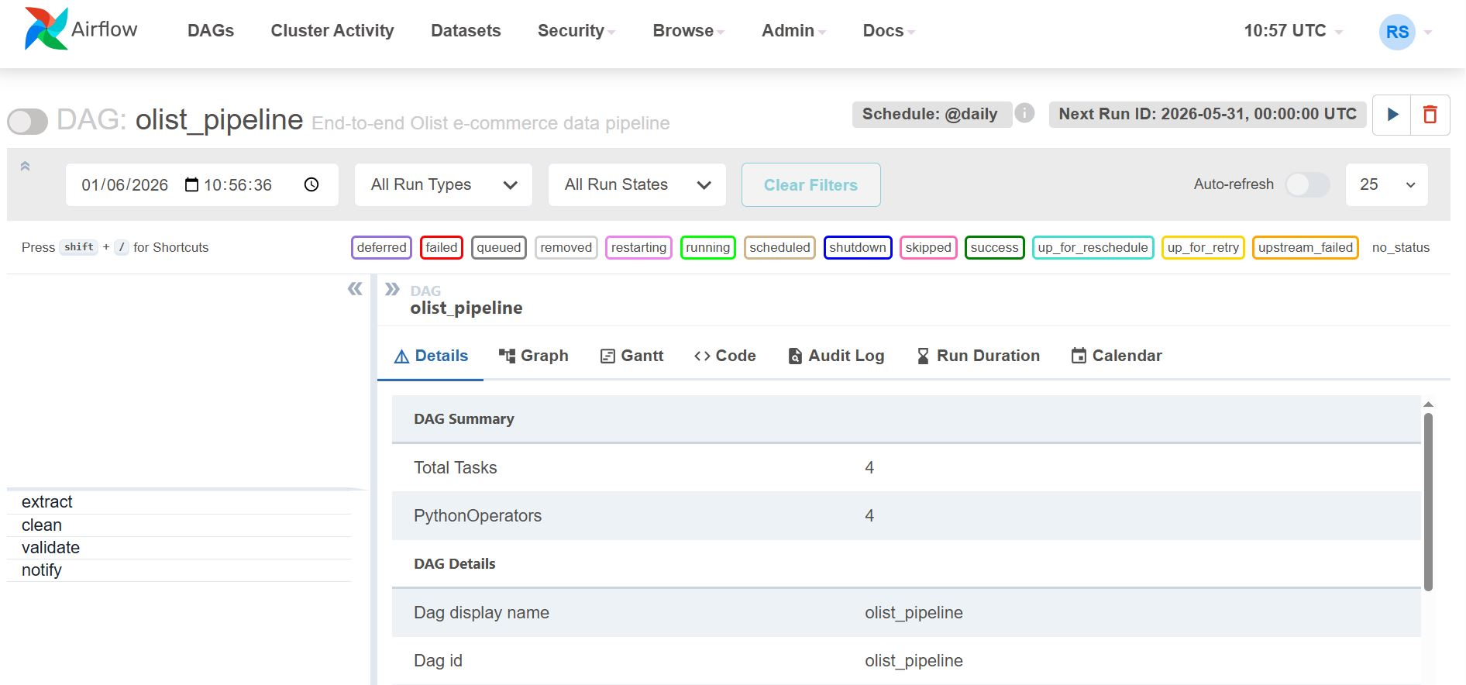
End-to-End Pipeline Architecture
1
2
3
4
5
6
7
SOURCE
INGEST
TRANSFORM
LOAD
VALIDATE
ORCHESTRATE
VISUALIZE
Kaggle API
9 CSVs ~100K
Python/Colab
pd.read_csv()
Pandas
Null/Dedup/Cast
SQLAlchemy
PostgreSQL 18
SQL Checks
FK + ACID
Airflow DAG
@daily
Power BI
KPI Dashboard
Notes:
7-stage pipeline. Each stage has one responsibility. The architecture diagram at the top is the actual diagram from your project. Below is a recreation with the key detail for each stage.

Slide 5
Data Quality — What We Found & Fixed
Table
Issue
Scale
Decision
Reason
orders
Null delivery dates
2,965
Preserved
Valid undelivered orders — dropping distorts KPIs
products
Missing category names
610
Fill 'unknown' + add to
translation table
FK constraint requires category to exist
products
Missing dimensions (H/W/L)
2
Median fill
Median avoids skew; mean distorted by outliers
reviews
Missing comment titles
87,656
Fill 'No title'
Expected — Olist platform doesn't mandate text
reviews
Missing comment messages
58,247
Fill 'No comment'
Same platform behavior — optional text field
reviews
Duplicate review IDs
varies
Keep first, drop rest
Upstream Olist bug — same ID reused on resubmit
category_translation
Missing FK categories
pc_gamer
+ others
Added programmatically
Pre-flight check before PostgreSQL load
Feature Engineering: DeliveryDays = order_delivered_customer_date − order_purchase_timestamp | Revenue = price + freight_value
Notes:
Every decision has a documented reason. Nothing dropped without justification. The feature engineering step creates two derived KPIs directly in the transform stage so Power BI queries are simpler.

Slide 6
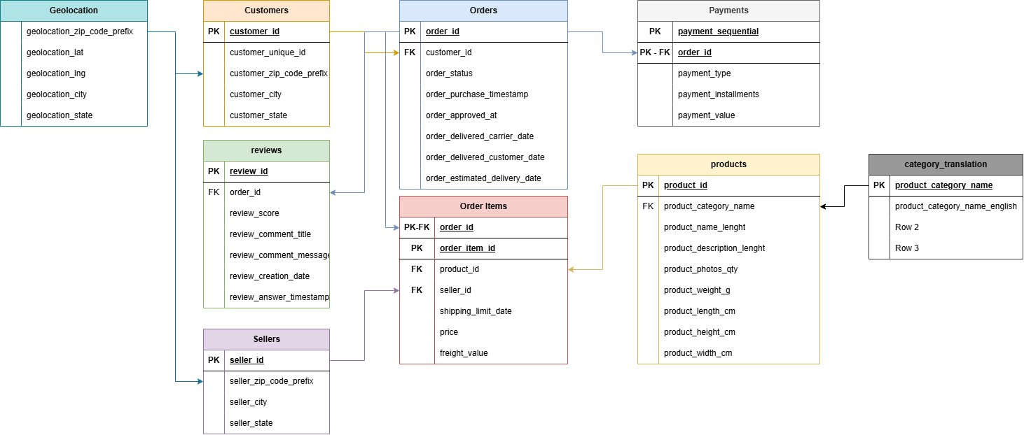
Schema Design — 3NF Entity Relationship Diagram
3NF Schema
🔑
Each fact in exactly one table. No redundancy — a seller's city stored once, not repeated on every order row.
Composite PKs
🔗
order_items: (order_id, item_id)
payments: (order_id, payment_seq)
Neither column alone is unique.
No PK Geoloc.
📍
Same zip prefix maps to multiple lat/lng points. Making it PK would force data loss.
Load Order
📦
Reference tables first (products, sellers, categories), then transaction tables — FKs require it.
9 Tables • 3NF • 0 FK Violations • 74 Categories
Notes:
The ER diagram is the actual one from your project. Walk through: Customers → Orders → Order Items (bridge table connecting to Products and Sellers) → Payments and Reviews branch off Orders. Geolocation connects via zip code prefix.

Slide 7
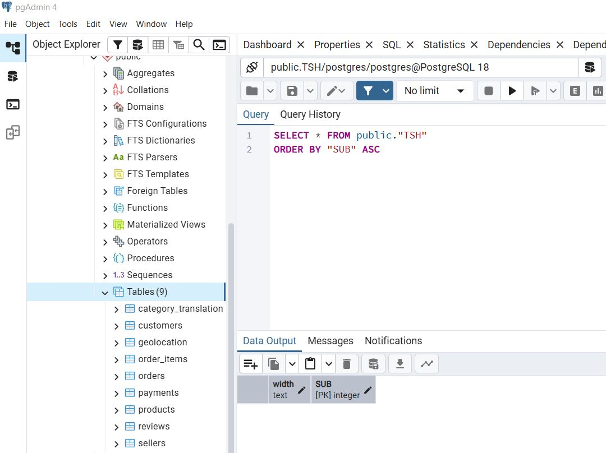
PostgreSQL 18 — All 9 Tables Loaded
Table
Dev Set
Test Set
orders
74,581
24,860
customers
74,581
24,860
order_items
84,439
28,143
payments
77,931
26,060
reviews
73,804
24,785
products
32,951
32,951
sellers
3,095
3,095
geolocation
1,000,163
1,000,163
category_translation
74
74
75% Dev (74,581) • 25% Test (24,860)
Split anchored on orders → cascaded to all FK-dependent tables
Notes:
Note why order_items (84,439) > orders (74,581): one order can contain multiple products. Payments (77,931) > orders because some customers split across credit card + voucher. Products and Sellers don't split — they serve both sets.

Slide 8
Apache Airflow — Scheduled, Monitored, Self-Healing
DAG ID
olist_pipeline
Schedule
@daily (00:00:00 UTC)
Retries
1 per task (before fail)
Executor
SequentialExecutor
Version
Airflow 2.9.2
Python
3.11 (WSL venv)
✓
✓
✓
✓
EXTRACT
CLEAN
VALIDATE
NOTIFY
PythonOperator
PythonOperator
PythonOperator
PythonOperator
Kaggle API download, file unzip, path validation
Null fills, dedup, type casting, FK pre-flight
SQL ACID assertions, FK checks, row count proof
Pipeline status notification on completion
Notes:
Why PythonOperator and not BashOperator? Because the logic requires Pandas and SQLAlchemy — Python libraries needing a full Python environment. The @daily schedule means the pipeline runs without anyone pressing a button.

Slide 9
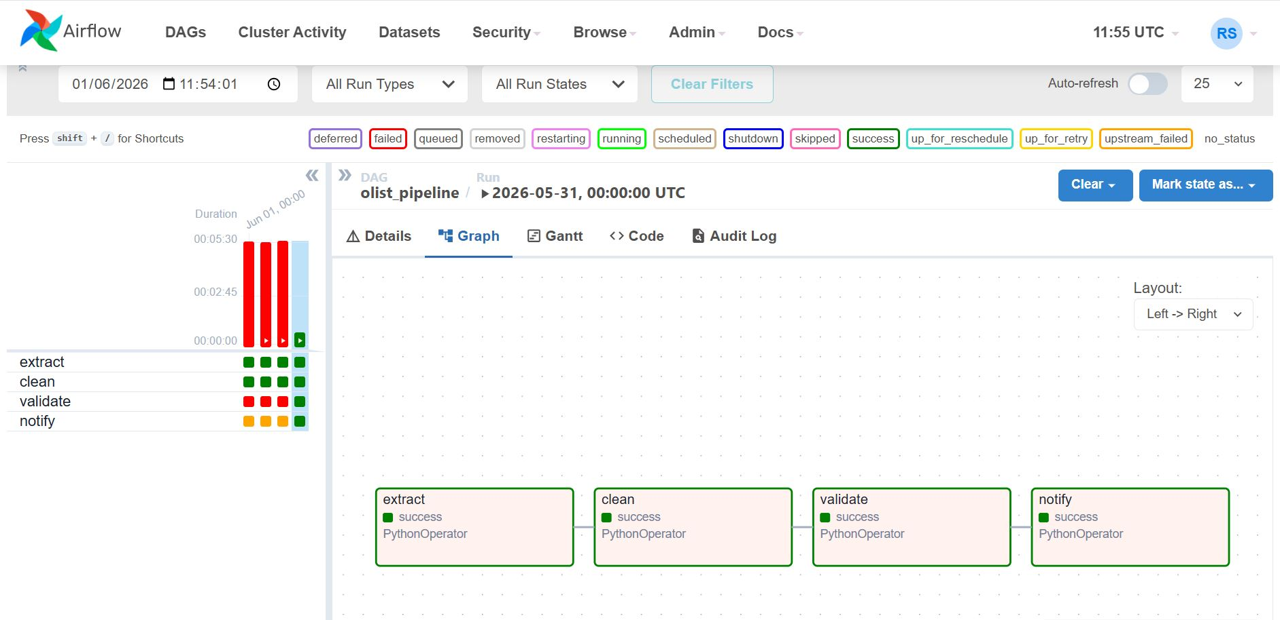
Airflow Orchestration — All 4 Tasks Green ✓
extract ✓ success
clean ✓ success
validate ✓ success
notify ✓ success
Run: 2026-05-31 • All 4 PythonOperator tasks succeeded • Graph view: Left → Right
Notes:
This is the actual Airflow screenshot from your project — all four tasks show green success status. The left panel shows prior runs with the validate task having some red runs (earlier failures before fixes) then going green.

Slide 10
ACID Validation — Zero Violations on Unseen Test Data
A
Atomicity
C
Consistency
I
Isolation
D
Durability
Each table load completes fully or rolls back — no partial loads
FK constraints enforced before and after every insert
Each pipeline run operates independently via @daily trigger
PostgreSQL WAL ensures committed data survives failures
Test Set Validation Results — 25% Unseen Data (24,860 orders)
Integrity Check
Result
Status
Order items with invalid order_id (order_items → orders)
0 violations
✓ PASS
Orders with invalid customer_id (orders → customers)
0 violations
✓ PASS
Order items with invalid product_id (order_items → products)
0 violations
✓ PASS
Order items with invalid seller_id (order_items → sellers)
0 violations
✓ PASS
Test orders row count matches expected 25% split
24,860 rows ✓
✓ PASS
🎯 Zero broken FK references on unseen data — pipeline generalises correctly to new input
Notes:
The ACID validation proves the pipeline is not just working once — it works on data it has never seen. 4/4 checks pass, row count matches exactly. This is the key quality proof of the project.

Slide 11
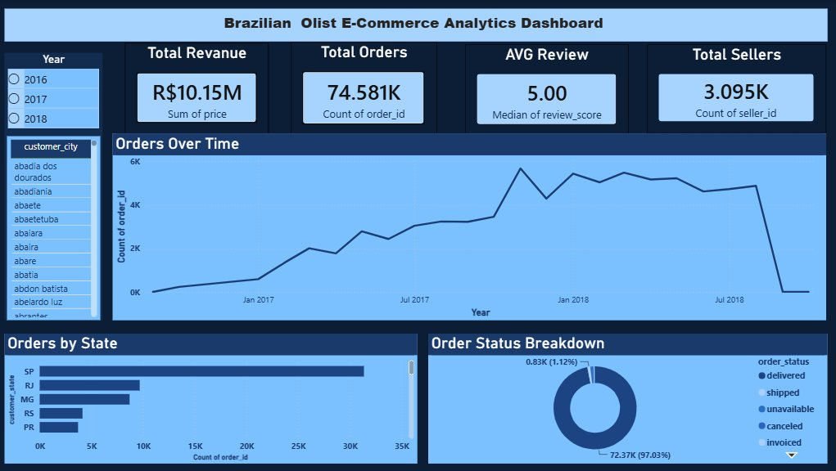
Power BI Dashboard — Tab 1: Overview & Order Trends
R$10.15M
Total Revenue
74,581
Total Orders
5.00
Median Review Score
3,095
Total Sellers
SP dominates with 42% of orders • 97% delivered • Steady growth Jan 2017 → mid 2018
Notes:
Overview tab. The year slicer (2016/2017/2018) on the left filters all visuals. Orders over time shows a clear growth curve from ~250/month to 6,000+/month. São Paulo alone accounts for 42% of all orders.

Slide 12
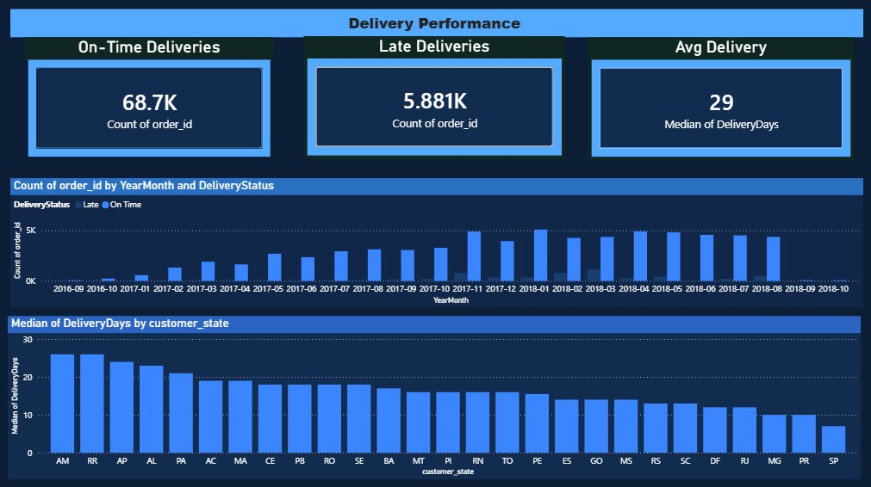
Power BI Dashboard — Tab 2: Delivery Performance
68.7K
On-Time Deliveries
5.881K
Late Deliveries
29
Median Delivery Days
92%
On-Time Rate
AM (Amazonas) slowest — 27 day median • SP fastest • Monthly trend shows consistent on-time majority
Notes:
Delivery tab. The DeliveryDays column was calculated in the transform stage as a derived feature — this is where the feature engineering pays off. Amazonas is slow because of geography; São Paulo has same-day fulfilment centres.

Slide 13
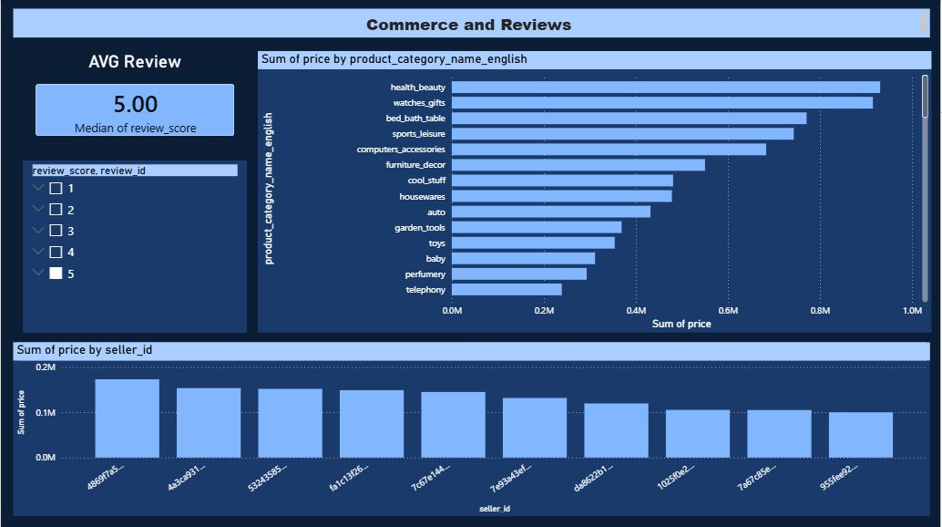
Power BI Dashboard — Tab 3: Commerce & Reviews
Health
& Beauty
Top Revenue Category
5.00
Median Review Score
~R$200K
Top Seller Revenue
74
Product Categories
5-star most common • 1-star is 3rd most common (bimodal distribution) • Watches & Gifts second category
Notes:
Commerce tab. Health & Beauty tops revenue at ~R$1M. The median review score of 5.00 is technically accurate but masks a bimodal distribution — 5-star is most common but 1-star is third most common. The chart shows this clearly.

Slide 14
Key Results & Analytical Insights
99,441
0
R$10.15M
Orders loaded
FK Violations
Total Revenue
Across 9 tables with zero constraint violations
Both dev (74,581) and unseen test set (24,860)
Health & Beauty #1 at ~R$1M; Watches & Gifts #2
92%
~42%
5.00
On-Time Delivery
Orders from SP
Median Review Score
68.7K on-time vs 5.9K late; median 29 days
São Paulo dominates; RJ 13%, MG 10%, others 35%
Bimodal: 5-star most common, 1-star third most common
Notes:
These six numbers are the headline deliverables. The zero FK violations on unseen data is the most important engineering proof. The business insights are only possible because the pipeline correctly structured the data.

Slide 15
Challenges Encountered & Engineering Solutions
Challenge
Root Cause
Solution
!
SSL proxy blocking pip & Kaggle API
Network proxy intercepting HTTPS
✓
--trusted-host flags on all pip installs and API calls
!
Python 3.14 ≠ Airflow 2.9.2
System Python too new for Airflow reqs
✓
Created Python 3.11 venv inside WSL
!
WSL can't reach Windows PostgreSQL
localhost in WSL → Linux, not Windows
✓
Found Windows host IP via /etc/resolv.conf, added WSL subnet to pg_hba.conf
!
FK violations on product load
Products reference categories not in translation table
✓
Pre-flight detection + programmatic insert of missing categories
!
Duplicate review IDs — PK violation
Olist upstream bug: same ID reused
✓
drop_duplicates(keep='first') on review_id before load
Notes:
Every challenge had a root cause and a concrete fix. The most technically complex was the WSL → Windows PostgreSQL networking. The pg_hba.conf and /etc/resolv.conf solution is a real production networking skill.

Slide 16
Recommendations — Production Roadmap
🔄 UPSERT Logic
☁️ Cloud Object Storage
Replace if_exists='replace' with PostgreSQL ON CONFLICT DO NOTHING. Enables incremental batch loads without dropping and reloading the entire database. Makes the pipeline idempotent.
Move raw CSV storage from local paths to AWS S3 or Azure Blob. Removes single point of failure, enables distributed processing, and decouples the pipeline from the local machine.
01
02
🔍 Automated QA Task
🔒 Proper SSL Certs
Promote the current manual notebook quality checks into a dedicated Airflow task between 'clean' and 'validate'. Data quality checks should be first-class pipeline citizens.
In production, install trusted certificates rather than bypassing SSL verification with --trusted-host. The current workaround is acceptable in dev/test but is a security risk in production.
03
04
Notes:
Four concrete improvements prioritised by impact. UPSERT is the highest priority — without it the pipeline cannot run incrementally. Cloud storage is second — it removes the biggest operational dependency.

Slide 17
What We Built
We turned 9 raw, disconnected CSV files into a fully automated, validated ETL pipeline connected to a live Business Intelligence dashboard — end to end, with zero foreign key violations on unseen data.
Kaggle API extraction — no manual downloads
7-stage pipeline architecture documented
✓
✓
9-table 3NF PostgreSQL schema enforced
5 data quality issues resolved with justification
✓
✓
75/25 dev/test split — referentially consistent
4/4 FK integrity checks PASSED on unseen test data
✓
✓
Airflow DAG — @daily, 4 tasks, all green
Power BI — 3 tabs, 4 KPI areas, live DB connection
✓
✓
Thank You — Questions Welcome
Renato Silva • Sandra Raj Pattuvakkaran • Sudarsh Mekkampurath Sajeev | Prof. Dr. Nor Azizah Hitam | June 2026
Notes:
Close by emphasising the two engineering proofs: (1) the Airflow DAG ran successfully with all 4 tasks green, and (2) zero FK violations on the 25% unseen test set. The business insights are the output — the pipeline is the product.

