Slide 1

E-commerce Project Overview

Slide 2
Problem Statement
A leading Ecommerce company specializes in online clothing sales and offers in-store style and clothing advice sessions. Customers engage in personalized sessions with a stylist at the physical store, followed by the option to place orders through either the mobile app or the website. The company faces a strategic dilemma, pondering whether to optimize the mobile app or the website to enhance customer engagement and drive sales. Our mission is to assist them in making an informed decision.
Dataset Details
The dataset features numerical columns:
Avg. Session Length: Represents the average duration of in-store style advice sessions (in minutes).
Time on App: Signifies the average time spent on the mobile app (in minutes).
Time on Website: Indicates the average time spent on the website (in minutes).
Length of Membership: Reflects the customer's membership duration in years.
Yearly Amount Spent: Denotes the total annual spending by the customer in dollars.
Business Objective
Our goal is to decipher the key variables influencing annual income predictions. By constructing a robust prediction model, we aim to provide valuable insights that guide the company in directing their focus effectively—whether towards refining the mobile app experience or optimizing the website. This analysis aligns with the overarching objective of maximizing customer spending and satisfaction.

Slide 3
Data Preparation Process
Variable Check
Null Value Check
5 Continues numerical features
Not there
Duplicate Row Check
Redundant Column Check
Not there
Not there

Slide 4
Exploratory Data Analysis (EDA) and Auto EDA Using Sweetviz
EDA with Visualizations
Automated EDA with Sweetviz
EDA was conducted with a wide array of visualizations, including correlation plots, relationship plots, distribution plots, histograms, and Q-Q plots. These visualizations provided valuable insights into the data distribution and underlying patterns.
By leveraging Sweetviz, our automated EDA process became even more efficient and insightful. Sweetviz provided comprehensive visualizations that accelerated exploratory data analysis and revealed meaningful patterns.

Slide 5

Outliers
1
Boxplot Visualization &
Cook's Distance
2
IQR and Cook's Distance Treatment
Employed boxplots to identify and analyze outliers, aiding in the determination of anomalous data points within the dataset. This visualization technique provided a clear representation of data distribution and identification of potential outliers.
Robust handling of outliers was carried out through the implementation of Interquartile Range (IQR) treatment and evaluation of Cook's distance. These mechanisms facilitated the identification and treatment of influential data points in the dataset.

Slide 6
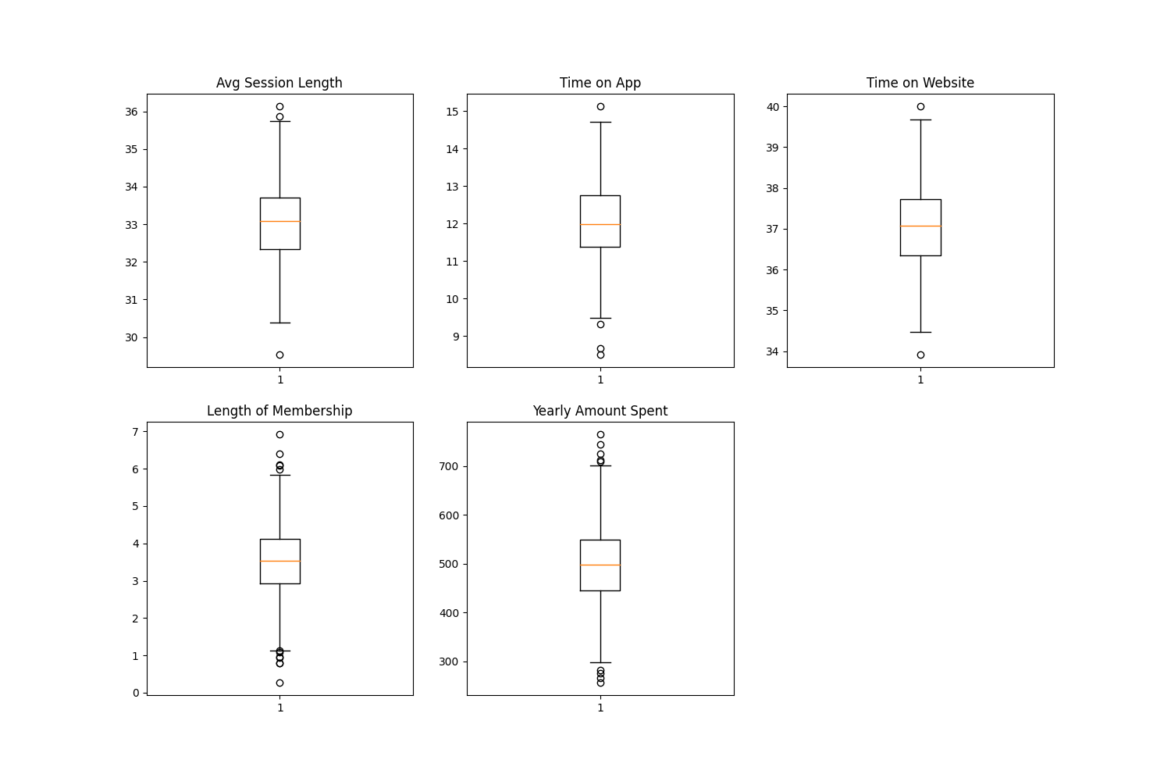
Outliers

Slide 7
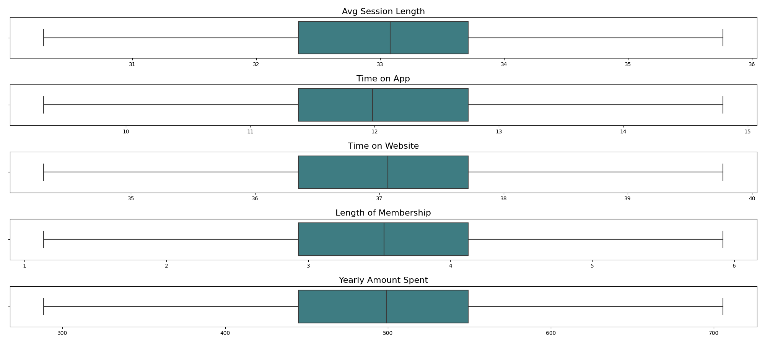
Outliers
After IQR Treatment

Slide 8
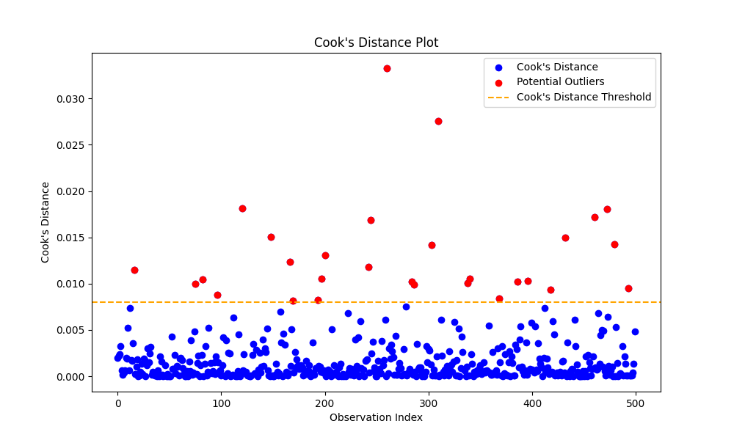
Outliers
No of potential outliers :29

Slide 9
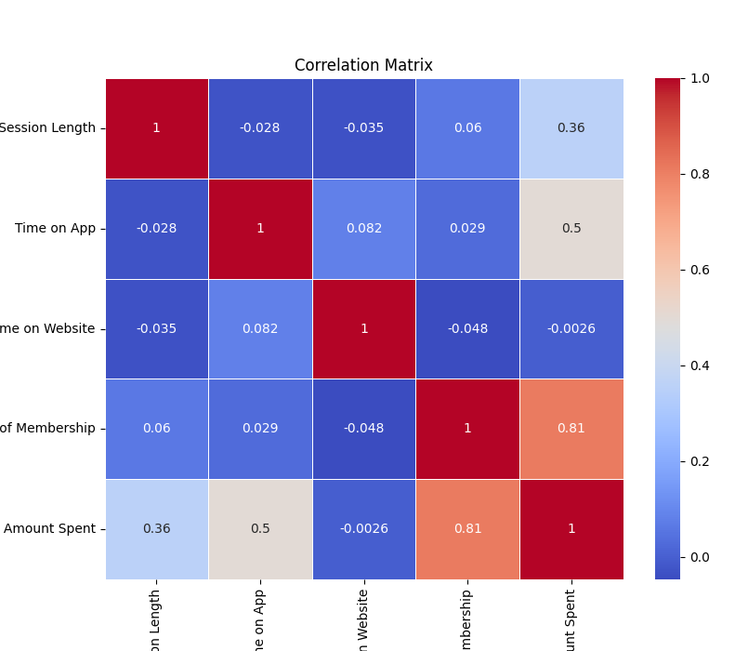
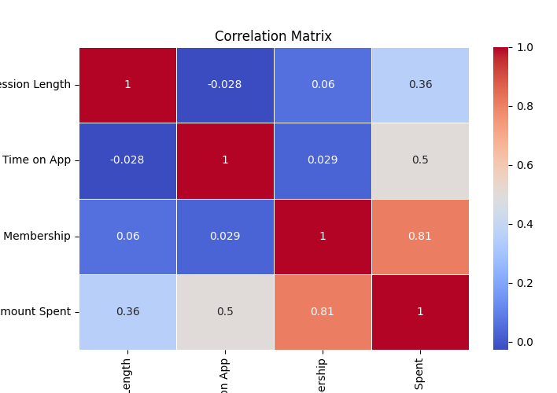
Correlation Plot
Correlation matrix of raw data
Correlation matrix without
“Time on Website”

Slide 10
Feature, outlier treatment and Normalization technique
Selections
by checking accuracy
Raw Data: 0.98431
Outlier- IQR treated data: 0.981
Outlier- Cooks distance treated data: 0.987
With out ‘Time on website’: 0.98428
With Standard scalar transformation: 0.98431
All other Normalization (Train-Test Split data):
Without Normalization: 0.98540
Standard Scalar: 0.98540
MinMax Scaler: 0.98540
Square Transformation: 0.95578
Log Transformation: 0.95982

Slide 11
Feature, outlier treatment and Normalization technique
Selections
Conclusion
We can exclude the feature "Time on website".
Without outlier treatment, the model is showing higher accuracy compared to IQR treatment.
With Cooks distance outlier treatment, the model shows higher accuracy.
Normalization does not lead to improvement in accuracy.

Slide 12
Model Evaluation & Performance
MSE
R2
Mean Squared Error
R2 Values
Linear regression and ridge regression exhibited the least MSE, signifying superior predictive accuracy and precision in the models.
The R2 values for linear regression
and ridge regression were observed to
be notably high, indicating strong model fitness and proportion of variance in
the target variable captured by the predictors.

Slide 13

Automated Machine Learning
(Auto ML)
1
Pycaret
Utilized Pycaret to automate the machine learning process, enabling streamlined model building, evaluation, and comparison across multiple algorithms.
2
H2O
Integrated H2O for AutoML, allowing for automated model selection, hyperparameter tuning, and model performance assessment, enhancing the efficiency of the machine learning workflow.
3
Auto Sklearn
Auto Sklearn was employed to automate hyperparameter optimization, algorithm selection, and model assessment, optimizing the machine learning pipeline.

Slide 14
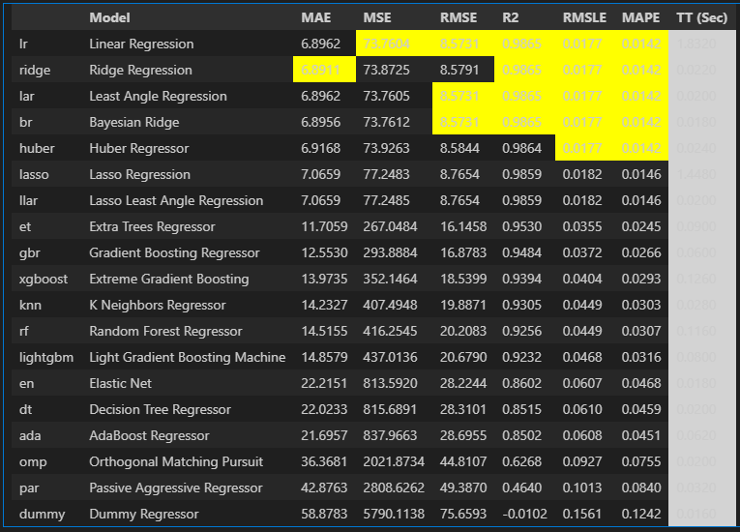
PyCaret

Slide 15



Manual Machine Learning Techniques
Linear Regression
Ridge Regressor
GB Regressor
Applied linear regression to model the relationship between predictor variables and the target variable, providing valuable insights into the data patterns.
R2: 0.9882998347488763
MSE: 68.39396760288521
Utilized the ridge regressor to mitigate multicollinearity and overfitting, enhancing the stability and accuracy of the regression model.
R2: 0.9882998347488763
MSE: 68.66037202183814
Implemented the Gradient Boosting (GB) regressor to iteratively improve the predictive performance, ensemble learning, and model generalization.
R2: 0.9882998347488763
MSE: 178.9702662429623

Slide 16
Lasso Regressor
SVR & K-Neighbors
Random Forest
The Lasso regression technique was utilized to perform feature selection and regularization, enhancing the interpretability and robustness of the model.
R2: 0.987409650565665
MSE: 73.59758882364584
Utilized Support Vector Regression (SVR) and K-Nearest Neighbors (K-Neighbors) algorithms to model nonlinear relationships and complex data patterns, enhancing the model's predictive capability.
SVR R2: 0.9869082284351609
SVR MSE: 76.52867981364447
K-Neighbors R2: 0.9558183070834207
K-Neighbors MSE: 258.26654659317086
Random Forest is an ensemble learning method that combines multiple decision trees to make more accurate predictions, achieving robustness and scalability.
R2: 0.9882998347488763
MSE: 295.3321534608596
XGBoost
Elastic Net
Employed XGBoost, an efficient gradient boosting algorithm, to improve model accuracy, computational speed, and handle complex dataset structures effectively.
R2: 0.9761321977526524
MSE: 139.52056732706222
The Elastic Net algorithm combines the strengths of L1 (Lasso) and L2 (Ridge) regularization techniques, allowing for feature selection and handling multicollinearity in the data.
R2: 0.9469098434432505
MSE: 310.34146694857105

Slide 17



Deployment: User Interactive Web App
Pickle for Model Persistence
1
Utilized pickle for model serialization, ensuring the trained model's persistent storage and retrieval for seamless deployment.
Flask Web Application
2
After developing the machine learning model, I deployed it as a Flask web application, allowing users to interact with it through a user-friendly interface accessible via a web browser.
Streamlit Web Application
2
Leveraged streamlit to develop a user interactive web application, enabling users to predict the Yearly Amount Spent based on the deployed machine learning model.

Slide 18
Final Insights and Conclusions
We can exclude the feature "Time on website".
Without outlier treatment, the model is showing higher accuracy compared to IQR treatment.
With Cooks distance outlier treatment, the model shows higher accuracy.
Normalization does not lead to improvement in accuracy.
Linear regression is selected over other models due to its ability to yield a lower Mean Squared Error (MSE) and a higher R-squared (R2) value, indicating superior predictive performance.
Getting accuracy of 98.82%
A company can increase its profits by prioritizing user engagement on its mobile application rather than the website.
.

