Slide 1


Health Care Fraud Detection
Final Presentation
Date
8 April 2025

Slide 2

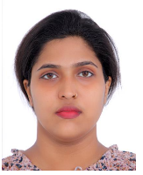


Our Team Members
Devika Dileep
Sandra Sajimon
John Hanok
Reduces waiting times for consultations and follow-ups.
Real-time chats between patients and professionals.
Increases access to specialists and resources across distances.

Slide 3
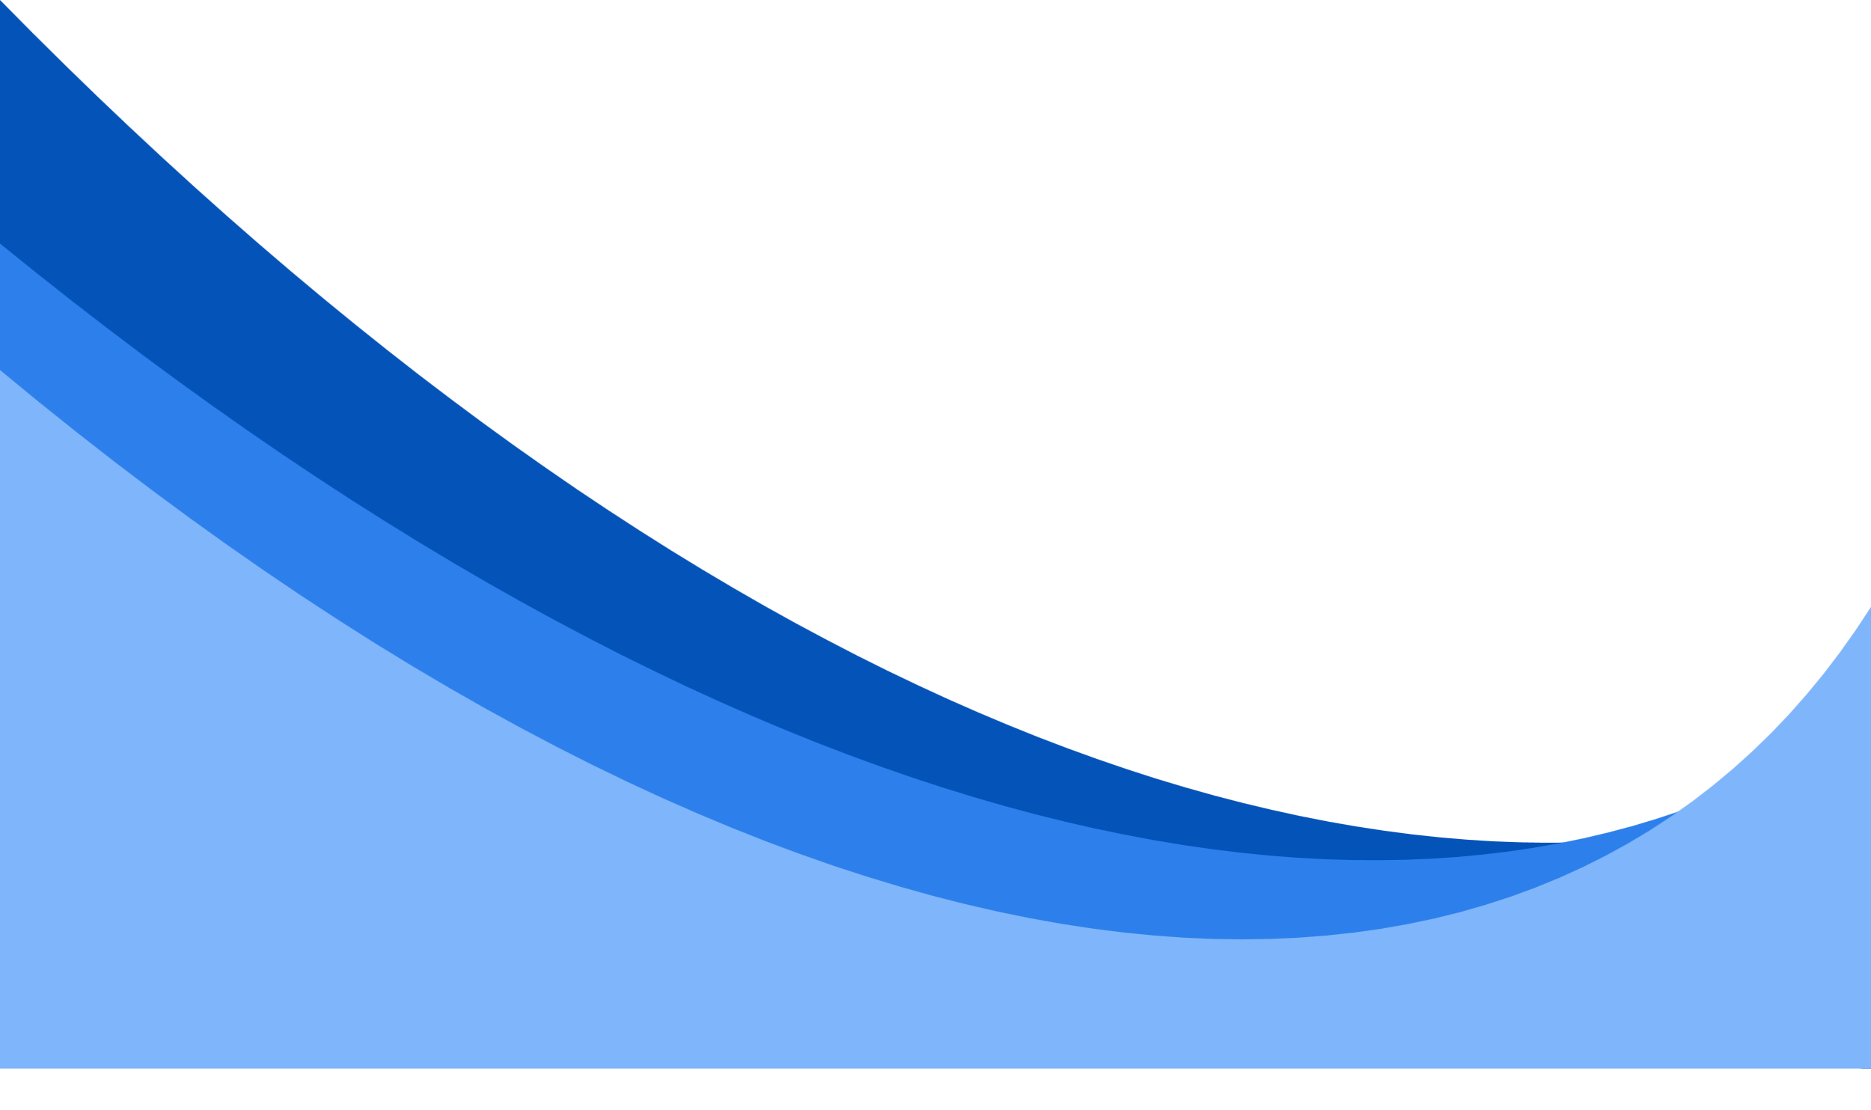

Overview
In the healthcare industry, fraudulent claims cost billions of dollars annually, affecting both insurers and patients. Our project aims to detect fraudulent prescribing behaviors using machine learning and AI-driven analytics. By analyzing vast datasets of prescription claims, we will identify high-risk prescribers and prevent unnecessary financial losses . This project is not just about data and algorithms but it’s about making a real impact on healthcare efficiency, cost savings, and patient care.

Slide 4
Tools and Environment
Environment: Google Colab for preprocessing, Streamlit for the web app.
Libraries Used:
Preprocessing: pandas, google.colab.files.
Web App: streamlit, pandas, joblib, plotly.graph_objects, plotly.express.
Programming Language: Python.

Slide 5
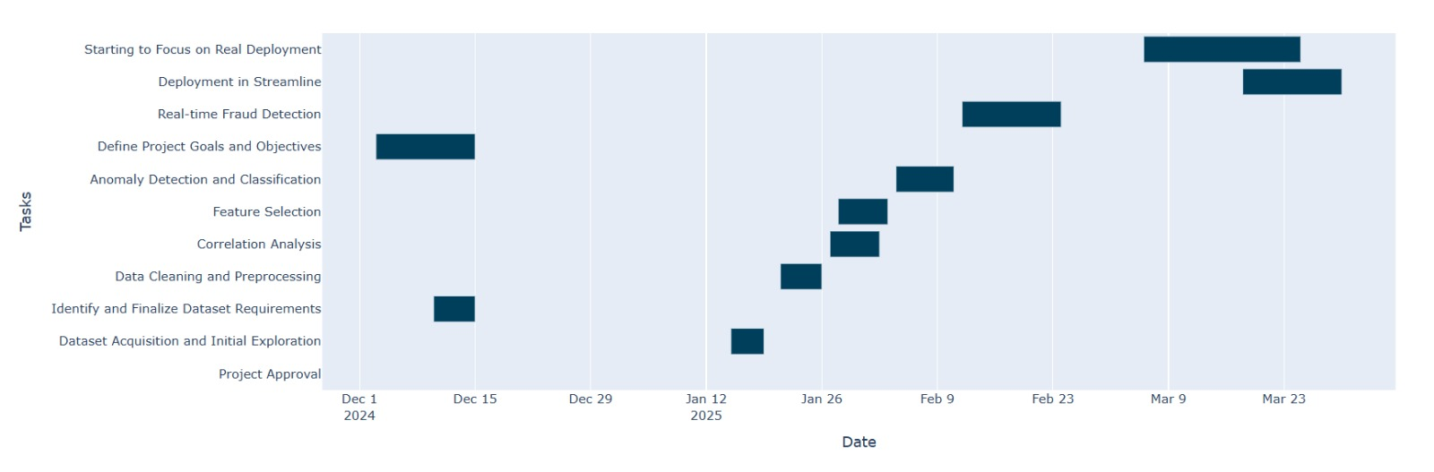
Gantt Chart
Cost-Effective
Reduces travel and associated costs for patients.

Slide 6
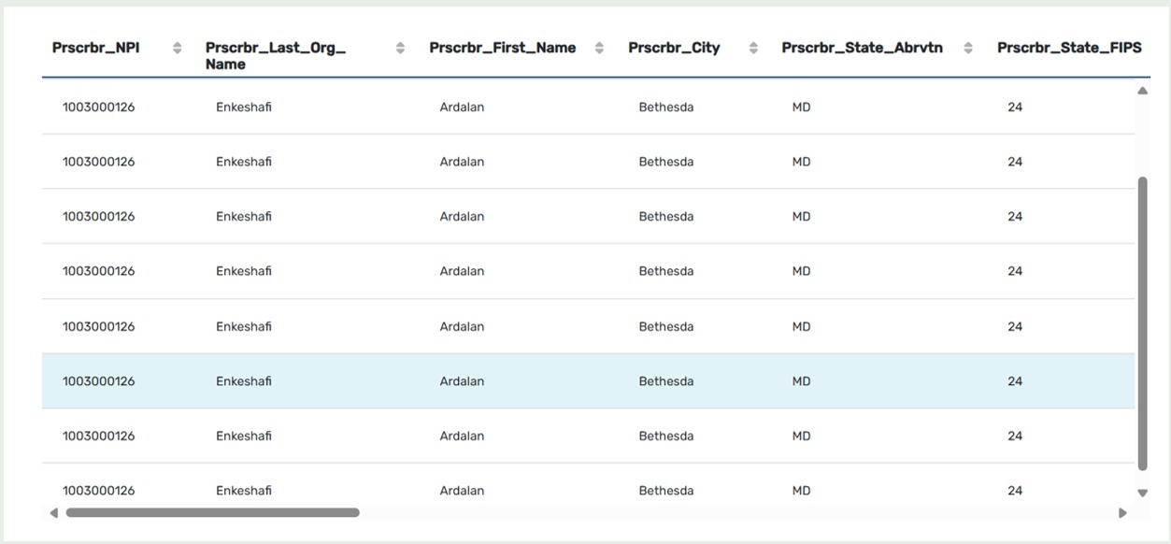

Dataset Description
Source: Medicare Part D Prescriber Data (publicly available dataset).
Key Columns:
Prscrbr_NPI: National Provider Identifier (unique prescriber ID).
Prscrbr_Full_Name, Prscrbr_City, Prscrbr_State_Abrvtn: Prescriber details.
Tot_Clms, Tot_Drug_Cst: Total claims and drug cost.
Initial Size: 1,048,575 rows, 22 columns.

Slide 7
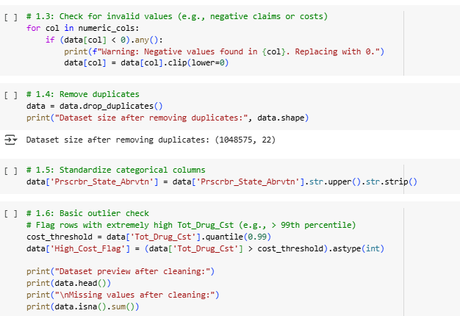
Data Preprocessing
Load the Dataset
Remove Duplicates
Uploaded fully_cleaned_data.csv using google.colab.files.upload().
Loaded into a pandas DataFrame.
Dropped duplicates, reducing the dataset size to 1,048,575 rows and 22 columns.
.
Handle Missing and Invalid values
Standardize categorical columns
Standardized columns like Prscrbr_State_Abrvtn and Prscrbr_Type (uppercase, stripped whitespace).
Filled missing values in numeric columns (e.g., Tot_Clms, Tot_Drug_Cst) with 0.
Replaced negative values with 0 using clip(lower=0).

Slide 8
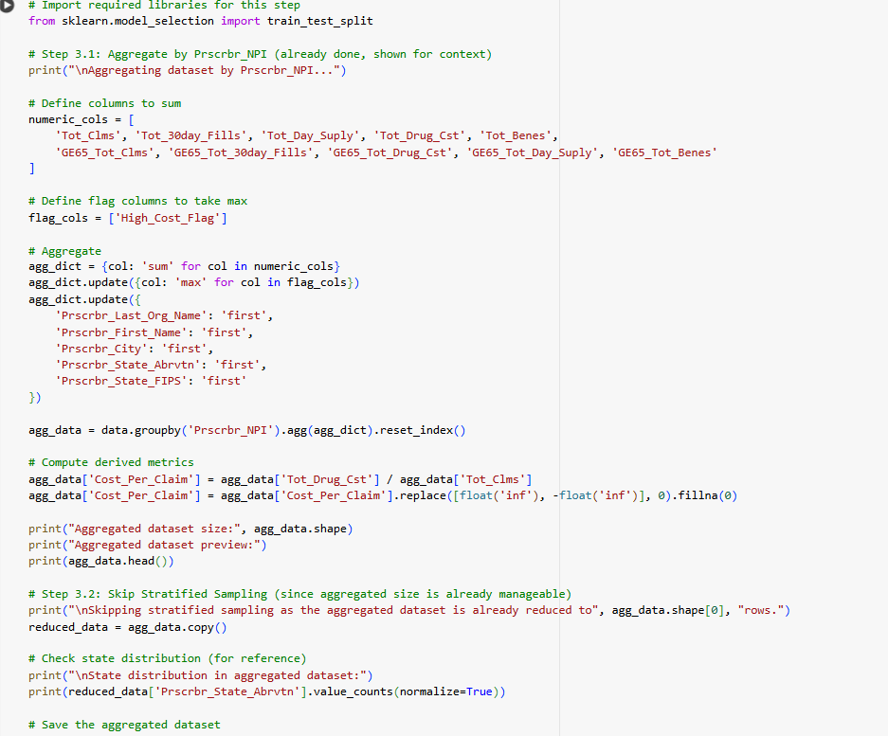
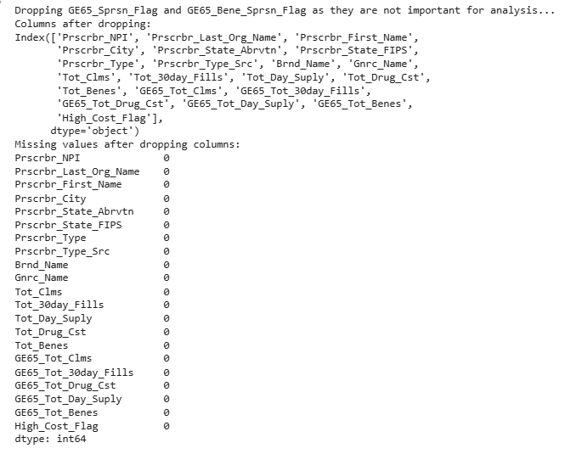
Data Preprocessing
Flag Outliers
Aggregate by Prescriber
Flagged high drug costs using a High_Cost_Flag column.
Grouped by Prscrbr_NPI, resulting in 42,673 rows (unique prescribers), 18 columns.
.
Drop unnecessary columns
Model Integration
Dropped suppression flag columns (GE65_Sprsn_Flag, GE65_Bene_Sprsn_Flag)
Calculated Cost_Per_Claim, Claims_Per_Beneficiary, GE65_Claims_Ratio

Slide 9
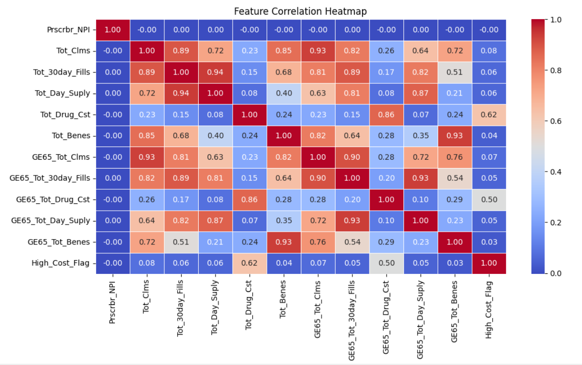
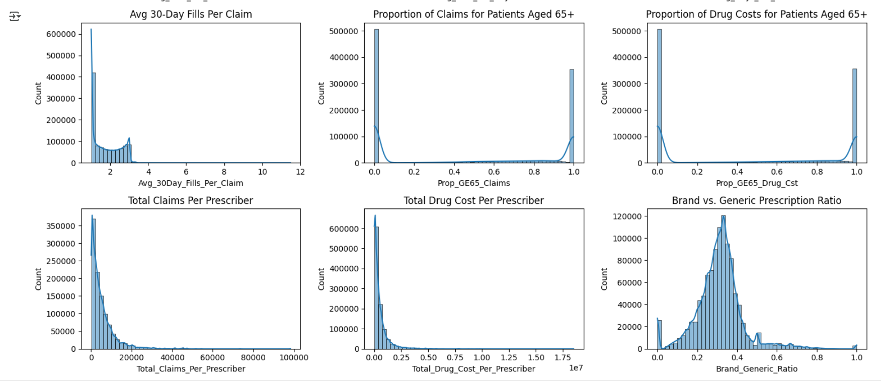
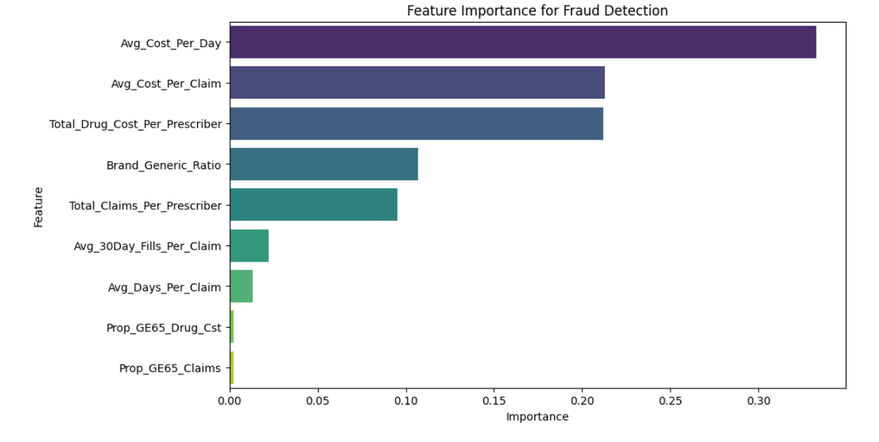
Visualizations

Slide 10
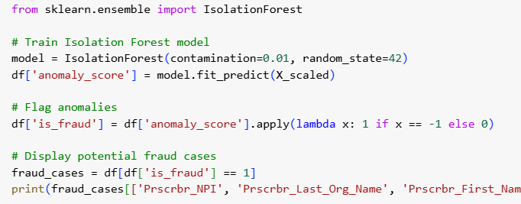
Fraud Detection Model
We explored multiple models for fraud detection, including Random Forest and Isolation Forest.
Ultimately, we chose Isolation Forest for the web app because it’s designed for anomaly detection and works well in unsupervised settings.
:
Isolation Forest Implementation
The Isolation Forest model uses features like Tot_Clms, Tot_Drug_Cst, Avg_Cost_Per_Claim, and Brand_Generic_Ratio to identify prescribers with unusual patterns.

Slide 11


Web App Development
Prescriber Fraud Analyzer
Objective
Key features
Built an interactive web app using Streamlit to analyze prescriber fraud risk..
Visualize fraud risk with gauges, maps, histograms, and leaderboards.
Key Features
Purpose
Search prescribers by NPI or name with flexible matching.
Filter by state and fraud probability range..
Enable healthcare auditors to identify and investigate potentially fraudulent prescribers.

Slide 12
Web App Features
Search and filtering content
Search by NPI or name (e.g., Semonche, Amanda).
Flexible name matching using normalization (e.g., handles “Last, First” format, removes titles like “Dr.”)
State filter (multiselect).Fraud probability range slider.
User Experience : Clear button to reset search input.
Spinner during analysis for better UX.

Slide 13
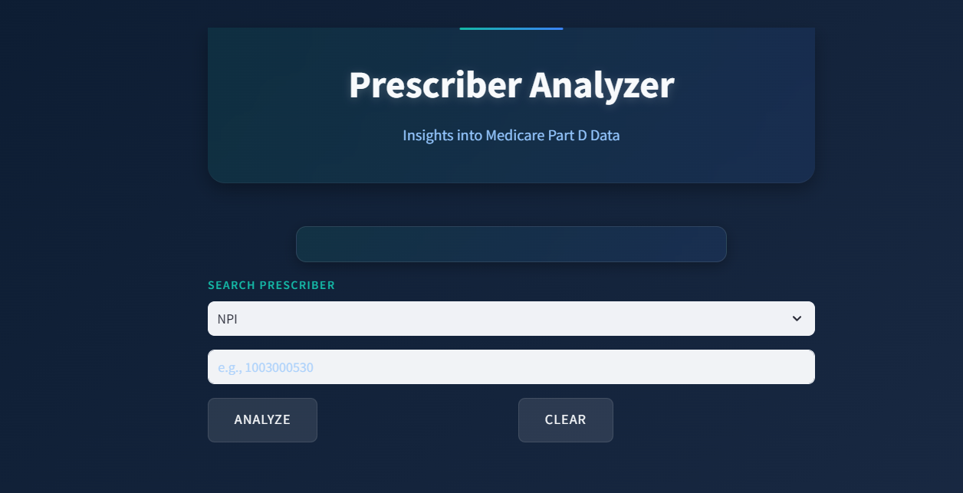

Web App Features
Geographical Distribution Map
Monitors steps taken and calories burned throughout the day.
Fraud Probability Distribution
Provides continuous heart rate data for better health insights.
Top Risky Prescribers Leadership
Tracks sleep duration and quality to improve sleep habits.

Slide 14


Conclusion
We built a web app to analyze Medicare Part D data, using an Isolation Forest model to detect fraud. The app provides actionable insights through a user-friendly interface.
The project shows how data analysis can identify fraud in healthcare, offering a tool for real-time monitoring

