Slide 1
Impact of Covid-19 on Working Professionals IST 687 : Intro to Data Science : Final Project
Team 3: Matthew Woods, Avi Kazassi, Dan Myers, Sandra Suresh, Ty Hall

Slide 2
Purpose
Covid-19 was an unprecedented event that forced most of the world to shut down and shelter in place.
This led to many jobs utilizing work from home technologies in order to maintain employment and create a semblance of normality.
In this project we wanted to understand the various impacts that Covid-19 had on different sectors in the work force and used a simulated data set from Kaggle to do this.

Slide 3
Goal
Business related questions regarding reported work changes due to the COVID-19 pandemic. Specifically :
Did any sectors have to work significantly more hours due to COVID-19
Did changes in working hours due to the pandemic affect stress levels?
Do changes in productivity due to the pandemic affect stress levels?
Could the features presented here be used to predict an employee’s stress level accurately?

Slide 5
Why is this important?
Real World Applicability
Identify stressed indivimitigate the effects of chronic stress and prevent burnout.
Impact
Increased productivity
Increased retention rates
Increased job satisfaction and engagement of employees
Improved mental health of employees.
Understanding an employees stress levels is the first step in unleashing creativity, enabling potential and supporting sustainable productivity!

Slide 6

ABOUT THE DATASET
The data set we used was found on Kaggle and linked below.
https://www.kaggle.com/datasets/gcreatives/impact-of-covid-19-on-working-professionals
The data is not a real-world data set and has been simulated to contain noise to mimic data that we would find in real life.

Slide 7
Step 1 : Data Modification & Cleaning
Quick Exploration of the data
In the column "Meetings Per Day", some of the data points were negative values, so to fix this, those points were changed to 0
2 continuous variables
2 variables with more than two classes
Remaining variables binary

Slide 8
1A. Descriptive Statistics of the continuous variables
 | Avg Hours Per Worked per Day | Avg Number of Meetings Per Day
Mean | 8.007 | 3.98
Median | 8.011 | 3.98
Range | 0.29-16.9 | 0-9.59
Standard Deviation | 1.978 | 1.515
Skewness | 0.014 | 0.036
Kurtosis | 2.968 | 2.88

Slide 9
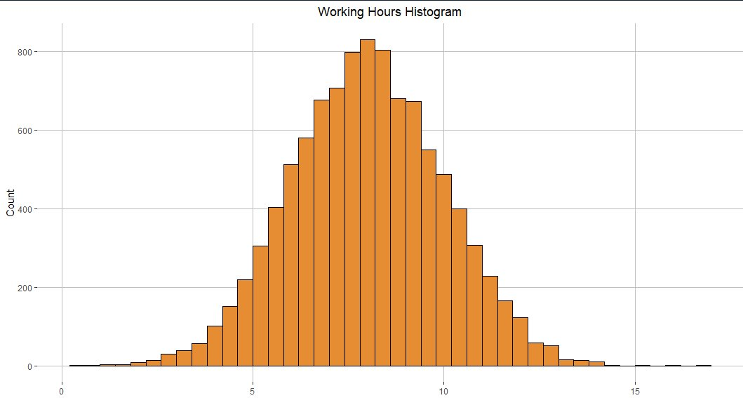
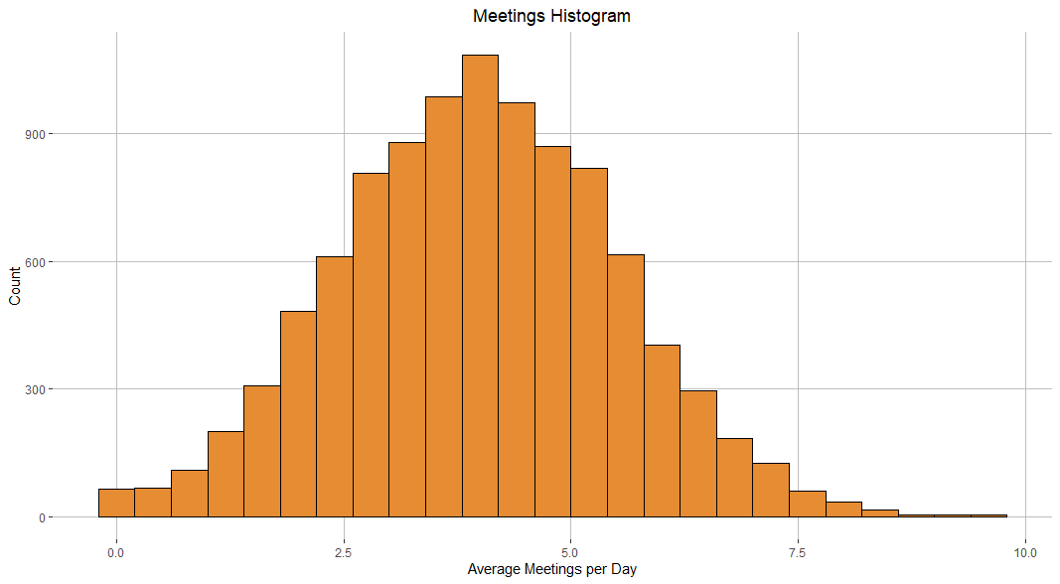
1B. Histograms of the Continuous Variables
Then we plotted the continuous variables graphically so that we can see whether or not they are normally distributed.
Figure 1. Histogram Average Hours worked per Day
FIgure 2. HISTOGRAM AVERAGE MEETINGS PER DAY

Slide 10
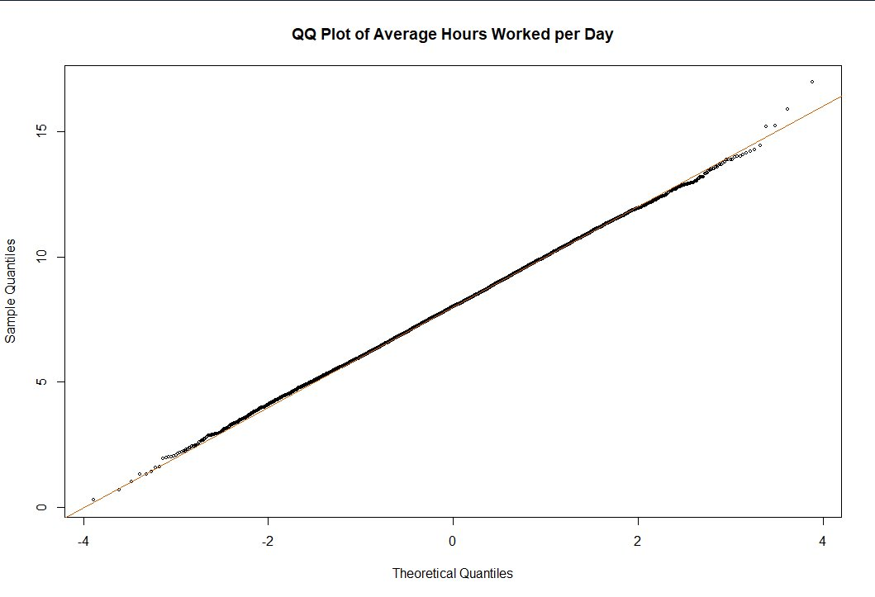
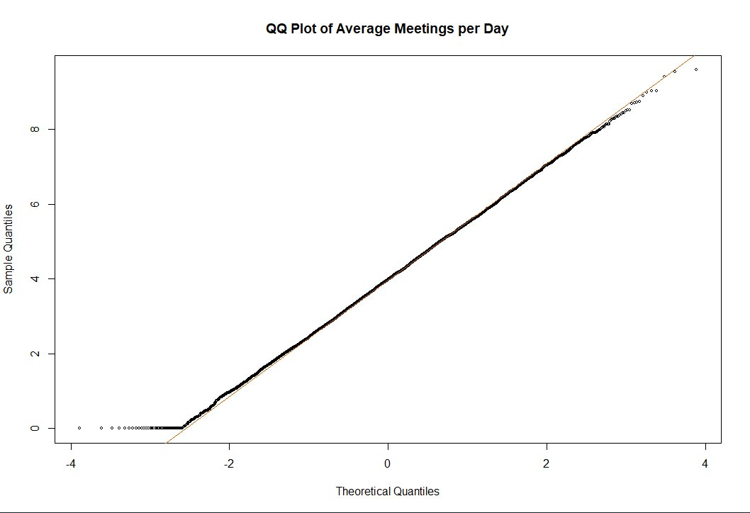
1C. QQ Plots of the Continuous Variables
Next we ran QQ Plots of the continuous variables in order to check that they are normally distributed.
Figure 1. QQ Plot of Average Hours Worked per day
Figure 2. QQ Plot of Average Meetings per day

Slide 11
Step 2 : Feature Engineering
Problem
Many features binary when they could contain more information
Example
Productivity_Change – response 1 for change, 0 for no change
Solution: Engineer/Impute some variables
Feature engineering helps us transform a dataset and make it more suitable for a data scientists needs.

Slide 12
Step 2 : Feature Engineering (Continued..)
Awada M. Becerik Gerber B, L. G. (n.d.). Stress appraisal in the workbplace and its associations with productivity and mood: Insights from a multimodal machine learning analysis. PLoS ONE. doi:https://doi.org/10.1371/journal.pone.0296468
Pencavel, J. (2018). Diminishing Returns at Work: The consequences of Long Working Hours. Oxford Academic, Online edition. doi:https://doi.org/10.1093/oso/9780190876166.001.0001
Yerkes, R. D. (1908). The relation of strength of stimulus to rapidity of habit-formation. J. Comp. Neorol. Psychol., 18, 459-182. doi:https://doi.org/10.1002/cne.920180503
Published works
Impute Productivity_Change_Direction
(1, 0, -1)
Sampled BLS 2020 salary data where productivity increased and salary changed
Sampled BLS 2019 salary data everyewhere else
Log Normal distribution

Slide 13
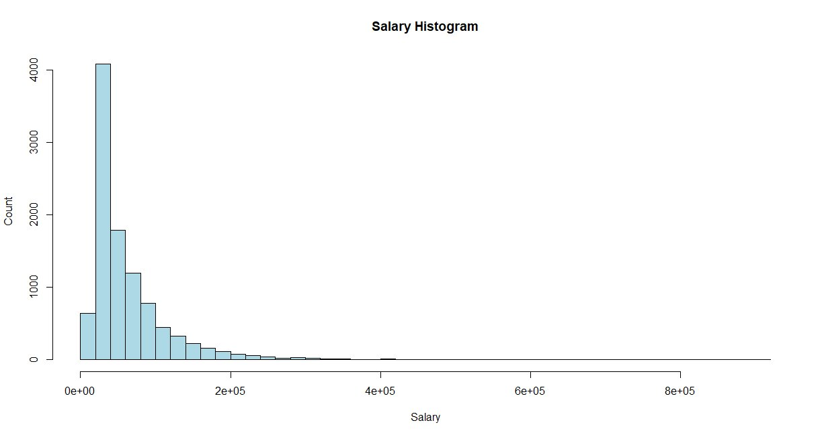
2A. Histogram of simulated salaries
Figure : Histogram of simulated salaries showing a log normal distribution.
Look at that! Our simulated data was a success!

Slide 14
Step 3 : Exploratory Data Analysis
After cleansing and modifying the data, we can begin to understand some of the relationships between the variables by using Exploratory Data Analysis (EDA).
A. Hours Worked By Sector
B. Stress Levels By Increased Working Hours
C. Productivity by stress levels
Did any sectors work significantly more hours?
Were stress levels affected by increased working hours?
Were stress levels affected by changes in productivity? st

Slide 15
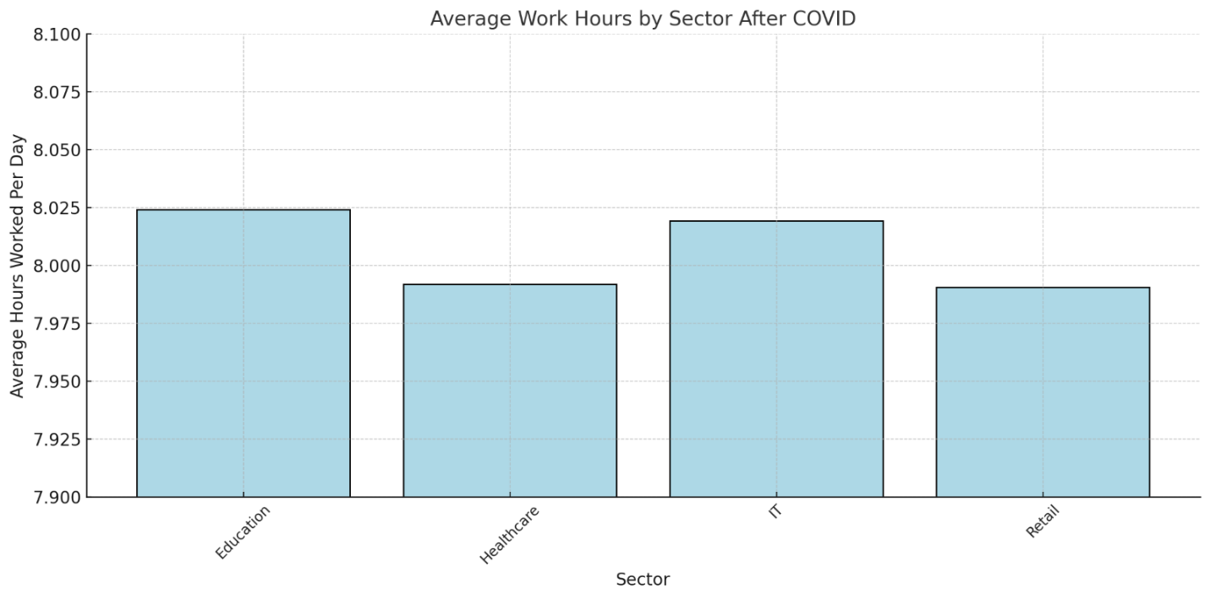
3A. Hours Worked By Sector
Results
Varying levels of average working hours
Analysis of variance p = 0.897.
Figure 3A. Bar Plot of Average Working Hours by Sector

Slide 16
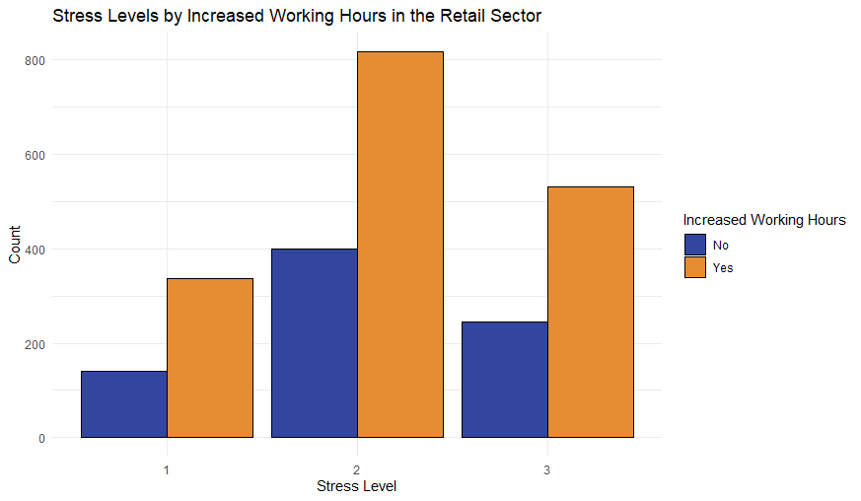
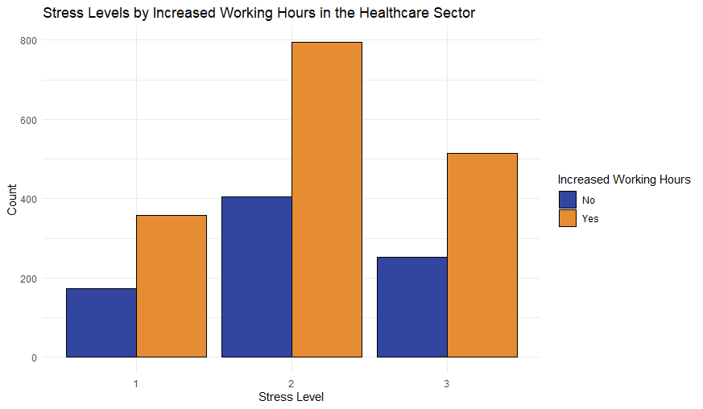
3B. Stress Levels By Increased Working Hours
Figure 3B. Stress Levels by Increased Working Hours in each Sector (Retail & Healthcare)
Results
The Bar Plot suggests that both the education & IT Sector worked slightly more hours than the healthcare and retail sections.
After running a statistical test ( ANOVA) we found that there is not enough evidence that supports that this difference is statistically significant.

Slide 17
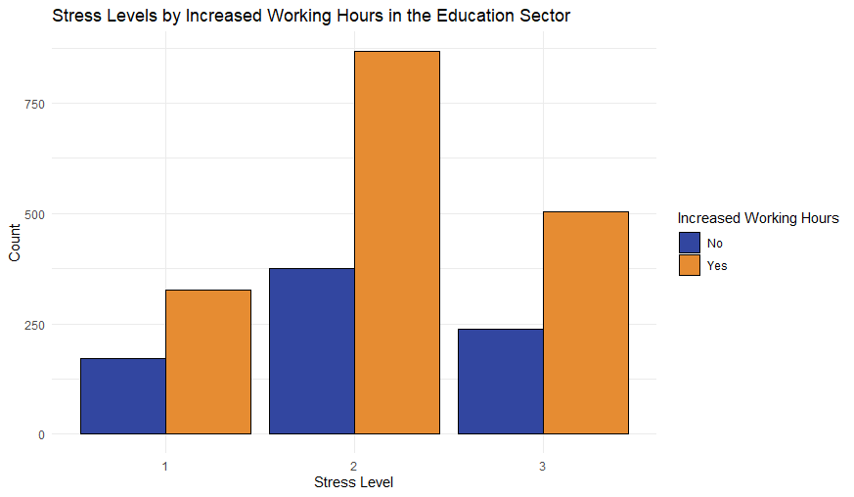
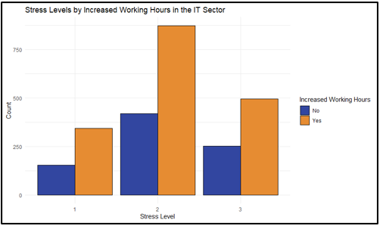
3B. Stress Levels By Increased Working Hours (Cont...)
Figure 3B. Stress Levels by Increased Working Hours in each Sector (Education & IT)
Results
The Bar Plot suggests that both the education & IT Sector worked slightly more hours than the healthcare and retail sections.
After running a statistical test ( ANOVA) we found that there is not enough evidence that supports that this difference is statistically significant.

Slide 18
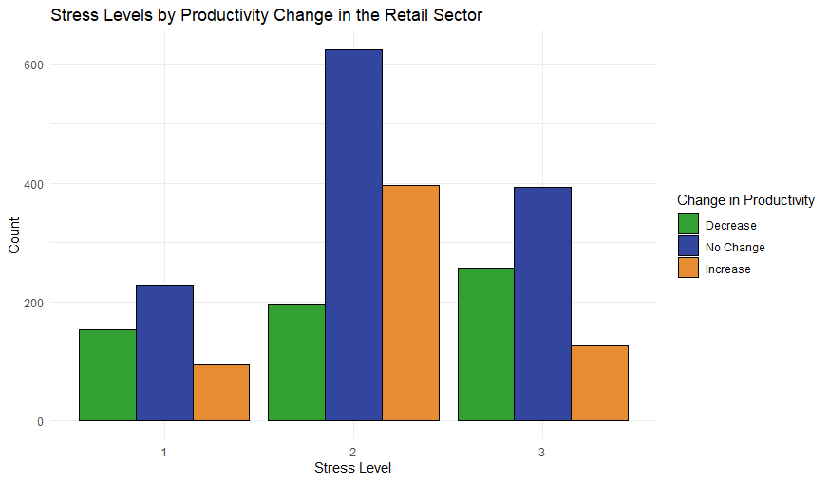
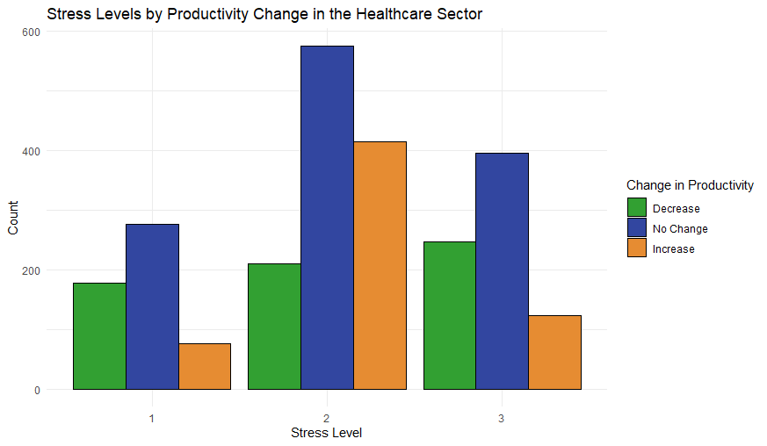
3C. Stress Levels By Productivity Change
Figure 3C. Stress levels by productivity change direction in each sector (Retail & Healthcare)
Results
The Bar Plot suggests that both the education & IT Sector worked slightly more hours than the healthcare and retail sections.
After running a statistical test ( ANOVA) we found that there is not enough evidence that supports that this difference is statistically significant.

Slide 19
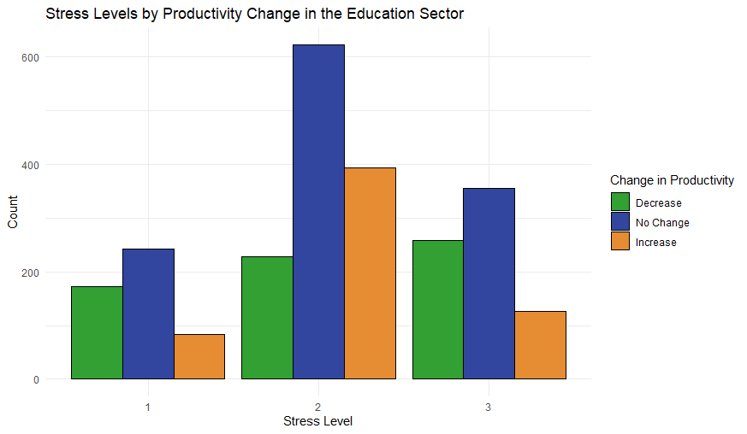
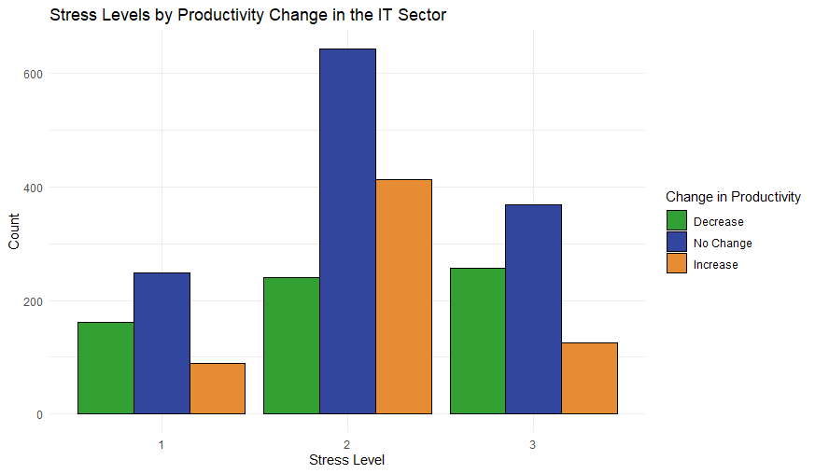
3C. Stress Levels By Productivity Change (Cont..)
Figure 3C. Stress levels by productivity change direction in each sector (Education & IT )
Results
The Bar Plot suggests that both the education & IT Sector worked slightly more hours than the healthcare and retail sections.
After running a statistical test ( ANOVA) we found that there is not enough evidence that supports that this difference is statistically significant.

Slide 20
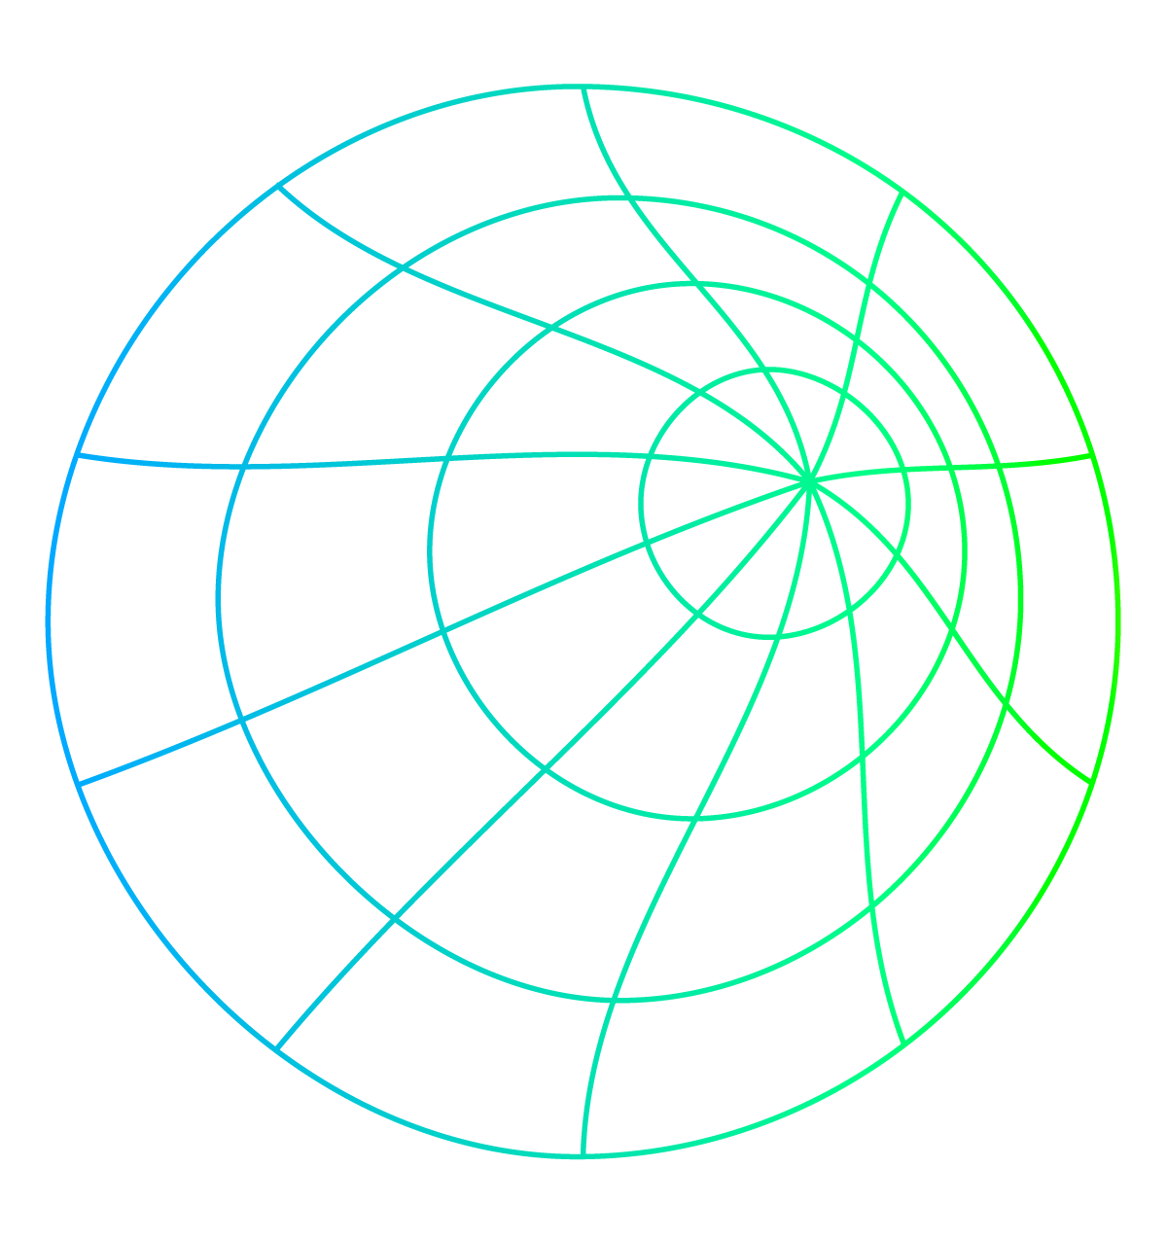
Step 4: Predicting Stress Levels
Is it feasible to use the features presented in this data set to predict the stress levels of an employee?
SVM Model
Good with highl dimensional data
Used all features in the data including engineered features except
Affected by Covid
66% Train - 34% Test split
Random Forest Model
Feature importances
Handful of features
Robust model insensitive to overfitting
70% Train - 30% Test split

Slide 21
4A. SVM Model
Results
Accuracy: 58%
F1 Score: 0.61
F1 Scores for Low Stress Level: 0.265
F1 Scores for Medium Stress Level: 0.673
F1 Scores for High Stress Level: 0.550
Suggests imbalance – bias toward medium stress level class
 | High | Low | Medium
High | 622 | 90 | 335
Low | 37 | 139 | 69
Medium | 555 | 574 | 1578
Figure 4A. Confusion matrix for SVM prediction of stress level.

Slide 22
4B. Random Forest Model
Results
Feature importance estimation
Hours_Worked_Per_Day
Meetings_Per_Day
Technology_Adaptation
Increased_Work_Hours
Job_Security
Sector
Accuracy: 52%.
F1 Score: 0.66
F1 Scores for Low Stress : 0.045
F1 Scores for Medium Stress 0.671
F1 Scores for High Stress : 0.082
Suggests imbalance – bias toward medium stress level class
 | High | Low | Medium
High | 91 | 0 | 0
Low | 0 | 32 | 0
Medium | 2035 | 1374 | 3470
Figure 4B. Confusion Matrix for Random Forest Prediction of Stress Level

Slide 23
Step 5: Interpretation
Now lets go back to our Goal and analyze the results we obtained from our analysis.
A. Business Questions
Did any sectors have to work significantly more hours due to COVID-19?
Did changes in working hours due to the pandemic affect stress levels?
Do changes in productivity due to the pandemic affect stress levels?
Could the features presented here be used to predict an employee’s stress level accurately?
B. Interpretation
Bar chart and ANOVA indicate no evidence of significant differences
Side-by-side bar charts show some correlation but no causation
Side-by-side bar charts show some correlation but no causation
Models didn’t prove accurate enough for predicting stress.

Slide 24
Step 6. Challenges/Improvements
Challenges
Binary variables where more information could have been gathered
Imbalanced stress level class
Model accuracy
Potential solutions
Gather more data
Resample/Bootstrap minor classes
Optimization, hyperparameter tuning, grid search
Try other algorithms

Slide 25
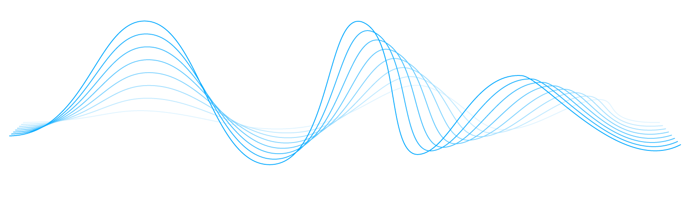
Thank you! Questions?

