Slide 1
Nutrient Analysis of Food Items
BIG DATA ANALYTICS MINI - PROJECT
A PySpark-Based Analytical Approach
Department of Computer Science and Engineering
Presented By:
Roll No: 2211cs010517
Name: Sandhya Kumari

Slide 2
Problem Statement & Objective
Problem Statement:
Modern dietary analysis requires scalable systems for large nutritional datasets.
Manual evaluation of nutrient data is time-consuming and error-prone.
Objective:
To design a data-driven system that performs nutrient-based clustering and pattern recognition using PySpark for efficient computation.

Slide 3
Dataset Overview
Dataset: food.csv
Contains various food items with multiple nutrient attributes (e.g., protein, fat, carbs, vitamins: K, D, K1, Minerals, Soluable_fats...etc).
Attributes prefixed with 'Data_' represent nutrient values.
Data Size: Moderate to large-scale (handled using PySpark).
row_size : 7083, column_size: 38
Key Tasks:
Column name cleaning
Basic Operations( spark initialization, loading, creating dataframe, cleaning, visualization, comparision of energy levels )
Type conversion
Missing value handling

Slide 4
Methodology / Workflow
1. Initialize PySpark Session
2. Load Dataset (food.csv)
3. Clean & Preprocess Data
4. Assemble Features using VectorAssembler
5. Apply PCA for Dimensionality Reduction
6. Perform K-Means Clustering
7. Visualize Correlations and Clusters using Matplotlib

Slide 5
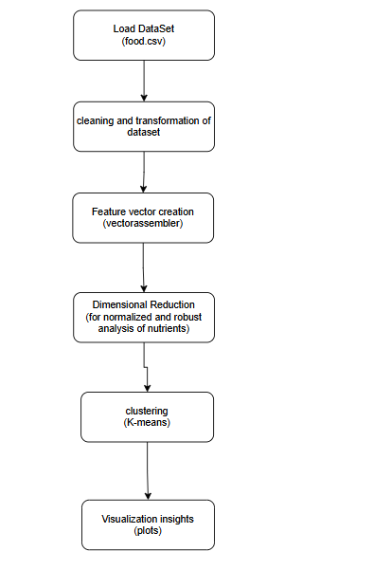
Application Flow Diagram
Nutrient Analysis

Slide 6
Results & Conclusion
PCA and K-Means successfully grouped similar food items based on nutrient content.
Strong correlations observed among major nutrients like proteins and fats.
The system enables faster and scalable analysis using PySpark.
Future Scope
Integration with real-time food databases.
Predictive nutrient recommendation system using machine learning.

