Slide 1


Symbol Generator
Presented by : Olga Liberman & Yoav Shvartz
Supervisor : Moshe Porian
01.05.13

Slide 2
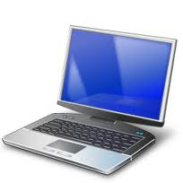
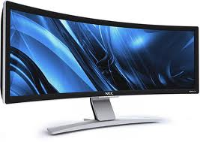
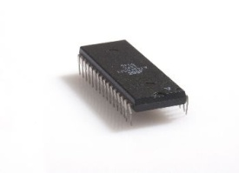
Project’s Goals
1. Building a symbol generator block for FPGA in VHDL environment which:
1. receive commands from Host.
2. apply to external memory (SDRAM).
3. dispatch new display onto screen.
2. Integrating the block into an existing platform FPGA.
Symbol Generator
Platform
Data
Generators
Storage Devices
Displays

Slide 3
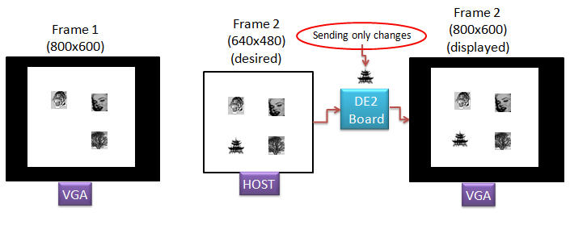
Implementation
The system supports sending only the changes between consecutive frames, such as adding or deleting symbols from different locations on screen.
Notes:
הערות:
מי אנחנו. תזכורת ...

Slide 4
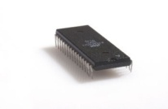
Integration
RX Path
TX Path
WBS
WBM
WBM
Wishbone
INTERCON
WBS
Display
Controller
WBS
Memory
Management
WBS
SG WBM IF
WBS
SG TOP
WBM
SDRAM Controller
DC
FIFO
VESA
Ctrl
100MHz
40MHz
Notes:
הצגת תוכן המצגת:
- לדבר בקצרה על מה אנו עומדים להציג במצגת זו.

Slide 5
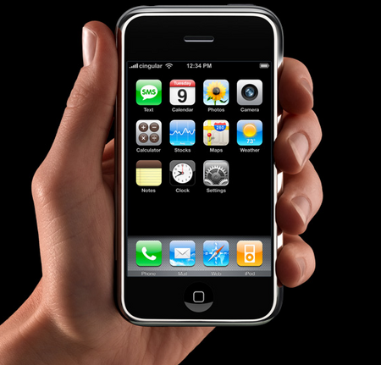

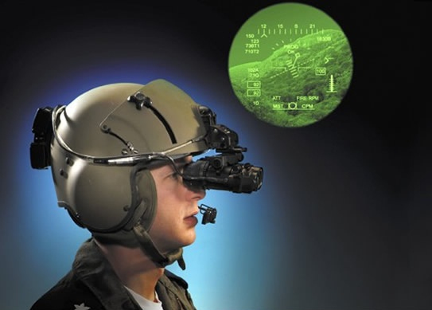
Possible Applications
Generating symbols on display screens can be found in any system that uses them. It can be mobile phones, TV screens and even military applications. The main issue, which our project deals with, is how to display the images fast and in real time.
mobile phones | TV screens | military applications

