Slide 1
System clock 100Mz
Pixel clock 40Mz
WBM
SG
VESA
DC FIFO

Slide 2
Idle
SDRAM read request
The debug address is written to the register in Memory Management
Write debug address
Write
un-debug type
Clean debug type register in Memory Management
Received all data from SDRAM
Write debug type
Receive data from SDRAM
The debug type is written to the register in Memory Management
Counting the received data, should be 32 pixels

Slide 3
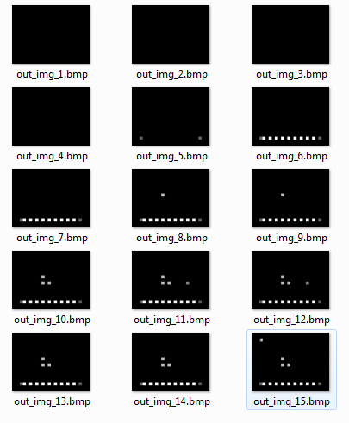
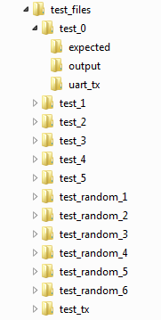
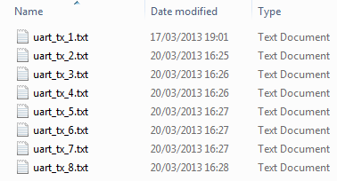
Expected
Output
TX files

Slide 4
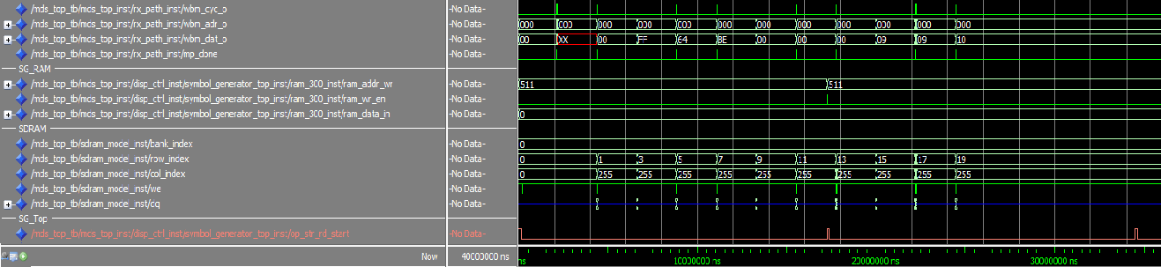
UART chunk to SG block with black symbols, to fill RAM with zeros
Loading SDRAM:
UART chunk to SDRAM with values of pixels for all the symbols
Video frame width

Slide 5
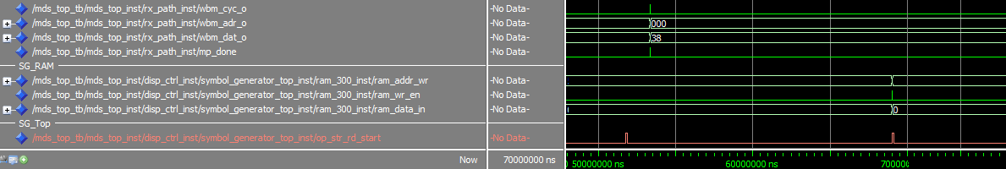
UART chunk to SG block with changes in the display
Updating the RAM only after new VSYNC
Video frame width

Slide 6
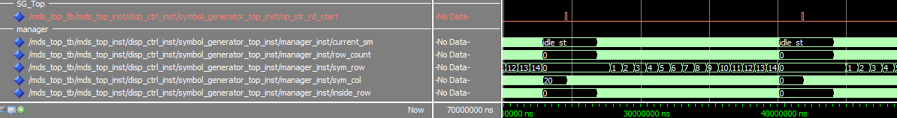
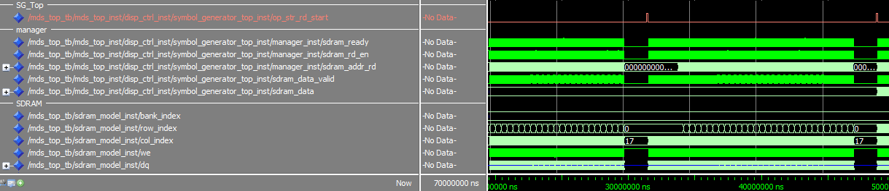
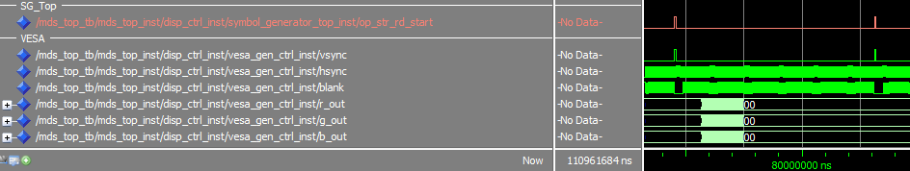
Video frame width
Video frame width
Video frame width

