Slide 1


WBS
WBS bus
Opcode Unite
OPU
VESA Bus
Data bus
RAM
Write
bus
Opcode Store
Vsync
VESA
Controller
valid
Read
bus
Data
FIFO A
Dual Clk FIFO
Write bus
Manager
Data A
MUX
Data
WBM
Rd _en A/B
Data B
WBM bus
FIFO B
Write bus
sel
Req_in_trg
- 100 MHz
40 MHz

Slide 2
Opcode Unite
Opcode Unite TB
Opcode Store
Opcode Store TB
RAM
RAM TB
Manager
Manager TB
FIFO A/B
FIFO A/B TB

Slide 3
Opcode Unite
OPU
Data bus
RAM
Write
bus
Opcode Store
Vsync
valid
Read
bus
FIFO A
Write bus
Manager
Data A
MUX
Data
Rd _en A/B
Data B
FIFO B
Write bus
sel
Req_in_trg

Slide 4
GUI
100MHz
Reset & Clocks
VESA signals
Opcode Parser
100MHz
Symbol Generator Top
SDRAM Model
40MHz
Log File

Slide 5
SDRAM Model
Symbol Generator
Top
Memory text file
read_enable
read_address
data_out
valid

Slide 6
simulation text file
Opcode Parser
Symbol Generator
Top
data_out
valid

Slide 7
Symbol Generator
Top
Log File
Log text file
data_out
valid
VSYNC

Slide 8

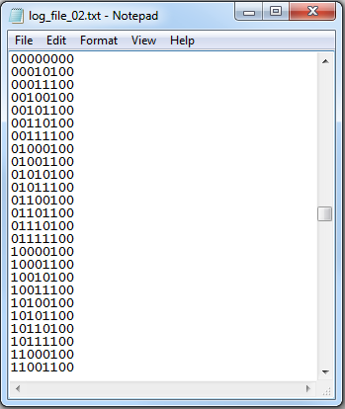

Symbol
Generator
VESA
Log file
BMP file

Slide 9
Clk
opu_wr_en
Reset_n
Opcode Unite
opu_data_out
opu_data_in
opu_data_in_valid

Slide 10
clk
RAM_addr_wr[8..0]
Reset_n
RAM_wr_en
RAM_data[12..0]
Op_cnt[9..0]
mng_en
Op_str_valid
Op_str_empty
Opcode Store
Op_str_data_in[23..0]
Op_str_full
Op_str_rd_start
Op_str_used[8..0]
Vsync_out

Slide 11
Clk
Reset_n
Ram_addr_wr [8:0]
RAM
Ram_data_out [12:0]
Ram_wr_en
Ram_data_in [12:0]
Ram_rd_en
Ram_addr_rd [8:0]

Slide 12
clk
Ram_rd_en_out
RAM_addr_rd[8:0]
Reset_n
Fifo_a_rd_en
Ram_data_out[12..0]
Fifo_a_wr_en
Req_in_trg
Fifo_a_data_in [7:0]
Manager
Mng_en
Fifo_b_rd_en
Sdram_data [7:0]
Fifo_b_wr_en
Sdram_data_valid
Fifo_b_data_in [7:0]
Sdram_addr_rd [23:0]
Fifo_a_empty
Sdram_rd_en_out
Fifo_b_empty

Slide 13
Clk
Dout [ width_g – 1 : 0]
Reset_n
Dout_valid
Din[width_g – 1:0]
FIFO
empty
Wr_en
Used [ log_depth_g : 0]
rd_en

Slide 14
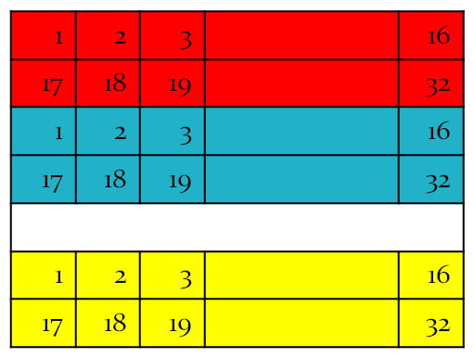
Video Frame
20
RAM
15
Address of symbol (0,0) in the SDRAM
Address of symbol (0,1) in the SDRAM
SDRAM
Address of symbol (14,19) in the SDRAM

Slide 15
0/1
Address of the symbol in the SDRAM
X
Y
20 blocks
(0,0)
(0,1)
(0,2)
(0,19)
(1,0)
(1,1)
(1,2)
(1,19)
15 blocks
(14,0)
(14,1)
(14,2)
(14,19)

Slide 16
32 pixels
32 rows
(16 symbol rows) x (32 pixels) x (8 bits)
symbol #1
symbol #2
SDRAM depth
symbol #N

Slide 17
20
0,0
0,1
0,2
0,19
1,0
1,1
1,2
1,19
15
14,0
14,1
14,2
14,19
RAM
0/1
Address of symbol (0,0) in the SDRAM
0/1
Address of symbol (0,1) in the SDRAM
15 x 20
0/1
Address of symbol (14,19) in the SDRAM

Slide 18
SDRAM
1 | 2 | 3 |  | 16
17 | 18 | 19 |  | 32
1 | 2 | 3 |  | 16
17 | 18 | 19 |  | 32
…
1 | 2 | 3 |  | 16
17 | 18 | 19 |  | 32
symbol #1
symbol #2
symbol #N

Slide 19
FIFO
1
1
SCREEN
(20 symbols) x (32 pixels) x (8 bits)
1
1
1
1
1
1
(1 symbol row) x (32 pixels) x (8 bits)
1
1
31
31
31
31
31
32
32
32
32
32

Slide 20
reset
IDLE
Finished deliver last row to display
New video frame
WRITE A
READ B
WRITE A READ B
READ A WRITE B

Slide 21
FIFO A
1
1
FIFO A read
1
1
1
FIFO B
1
1
FIFO B write
1
1
1

