Slide 1



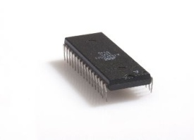
TX Path
RX Path
UART
CheckSum
MessagePack
Decoder
MessagePack
Encoder
UART RX
CheckSum
UART TX
WBS
WBM
5
WBM
Host
(Matlab)
A
D
WBM – Wishbone Master
WBS – Wishbone Slave
Wishbone
INTERCON
1
WBS
Mem Ctrl Wr
Mem Ctrl Rd
4
WBS
WBS
WBM
WBM
Display
Controller
B
C
2
SDRAM Arbiter
Symbol
Generator
Memory
Management
WBM
E
SDRAM
3
VESA
Controller
WBS
SDRAM Controller
Dual Clk FIFO
Displays
- 133 MHz
- 40 MHz
FPGA

