Slide 1
Recipe Site Traffic
Popular Recipes Prediction

Slide 2
Background
Tasty Bytes has noticed that traffic to the its websites goes up by as much as 40% if a popular recipe is picked. More traffic means more subscriptions.
It is not clear how to decide if a recipe will be popular (generate high traffic).
Urgent need to find a reliable way to choose a recipe leading to high traffic (popular).

Slide 3
Objectives
To Develop a model which correctly predicts popular recipes 80% of the times.
To minimize the chance of showing unpopular recipes.
To identify the variables which influence most on a recipe’s popularity.
Notes:
Predict which recipes will lead to high traffic?

Slide 4

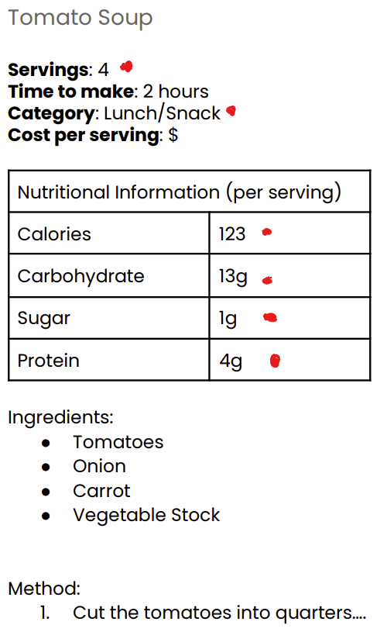
What do our visitors see in the homepage?
Data available for analysis

Slide 5
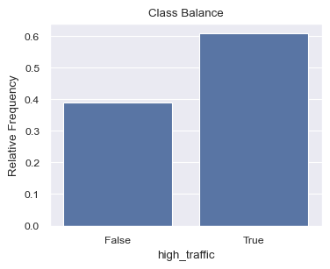
Proportion of popular recipes

Slide 6
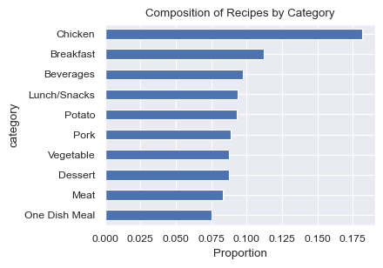
Potentially good predictor: Category

Slide 7
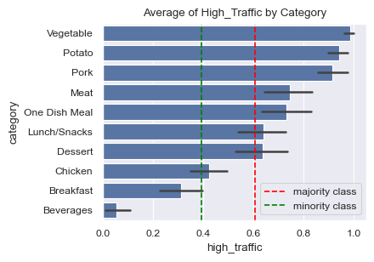
Potentially good predictor: Category

Slide 8
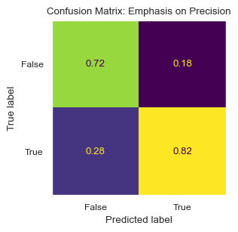
Model Selection
Best performing model: Gradient Boost Classifier
Precision: 81.75% with the test data (80% required)

Slide 9
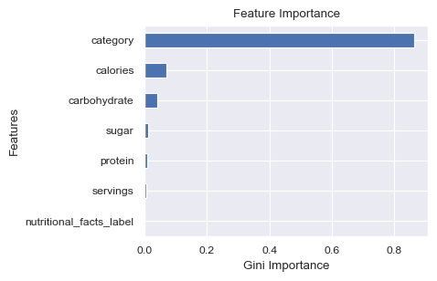
Model insights

Slide 10
Conclusions and Recommendations
Category is the most important variable that determines if a recipe will have high traffic.
Potentially relevant variables are present in recipes but unavailable in the dataset ('price per serving' and 'time to make’).
Recommended emphasis on recipes of the following categories: 'vegetable', 'potato', 'pork', 'meat', and 'one dish meal’.
Our model can predict if a recipe will have high traffic with a precision of 81.75% (over 80% required)
Notes:
- Other variables like the nutritional values or number of servings are barely relevant.
- Additional variables present in recipes but unavailable in the dataset such as displayed which may add predictive power such as 'price per serving' and 'time to make’.
- Historically, categories like 'chicken', 'breakfast', 'beverages', 'lunch/snacks' have been prevalent among recipes (around 50% of the total). According to our exploratory analysis, there is an urgent need to switch to categories such as 'vegetable', 'potato', 'pork', 'meat', and 'one dish meal', as they seem to increase the chance of a recipe to have a high traffic. Therefore, there must be an emphasis on releasing recipes of these categories.
- This means that, out of 100 recipes that we predict to have high traffic, at least 81 will have high traffic in reality.

