Slide 1


Pens & Printers
NEW PRODUCT LINE SALES
Stationery

Slide 2
Pens & Printers
Background
New line of office stationery products was launched six weeks ago.
Three sales methods have been tested: Email, Call, and Email + Call.
The three methods have different implementation costs and have produced different results over time.

Slide 3
Pens & Printers
Objectives
To identify the optimal method of sales for the new line of stationery products.
To identify other characteristics of our customers that help us produce more revenues.

Slide 4
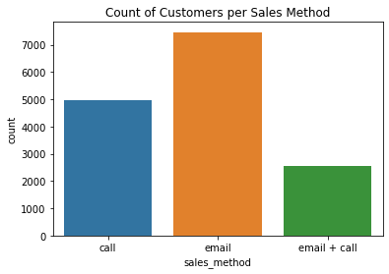
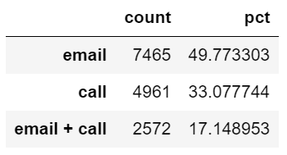
Pens & Printers
How many customers were there for each approach?
Total = 15000
Notes:
Analysis by quantity to determine changes in inventory. Sales is not considered because different products have different prices.

Slide 5
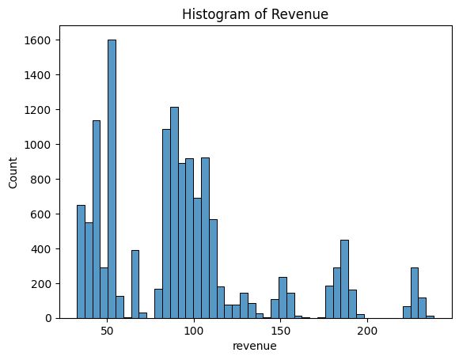
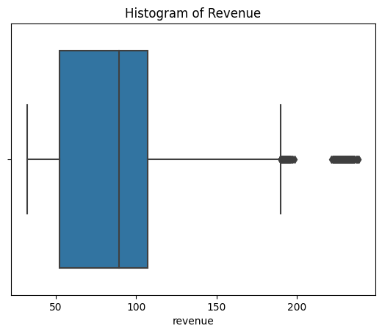
Pens & Printers
Analysis of Revenue

Slide 6
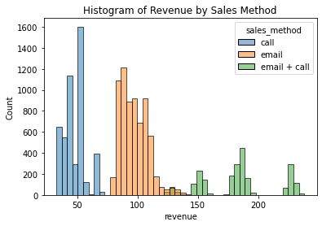
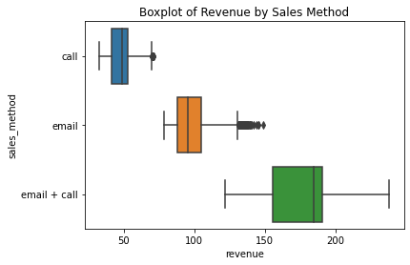
Pens & Printers
Analysis of Revenue in terms of Sales Method

Slide 7
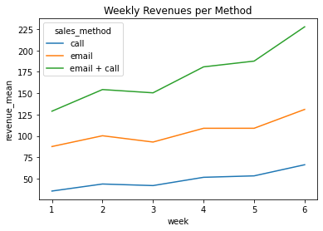
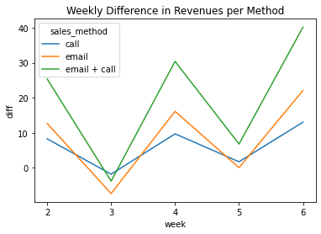
Pens & Printers
Analysis over time
Key metric to track => Weekly Diff in Revenue per Method
Notes:
All of the methods have produced positive effects on revenues over time. Email + Call has produced the best results across time, followed by Email, and Call. However it is particularly noticeable that the positive effect of all methods every second week as shown in the chart (week 3 and 5).

Slide 8
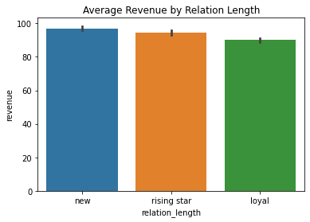
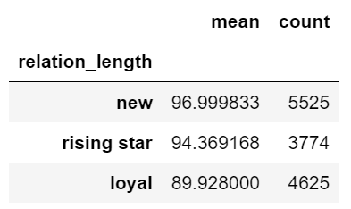
Pens & Printers
Relation Length and Revenue
Key metric to track => Average Revenue by Relation Length
Notes:
Additional information about customers can be described in terms of their state their years as customer.
The customers were classified according to their years as customers as 'new' (up to 2 years), 'rising star' (between 2 and 5), and 'loyal' (above 5). This new classification has been named Relation Length. With a confidence level of 95%, data reveals that Relation Length has an impact on Revenue. In particular, new customers produce a higher revenue than loyal customers.
The ANOVA test above clearly shows that there is evidence to indicate that the Relation Length has an impact on revenue with a 95% of confidence.
The T-test above clearly shows that there is evidence to indicate that the Revenue produced by new customers is higher than the one produced by Loyal customers with a 95% of confidence.

Slide 9
Pens & Printers
Conclusions
Sales Method has impact on Revenue (95% of confidence). In particular, the Email + call method produces much higher Revenue than Email and Call. Such a relation persists over time.
The effects of all the methods used on Revenue alternate between very high on one week and dramatically low on the other.
Email + Call method on the weeks that maximum impact on Revenue is observed.
Email method on the other weeks
Relation Length also has an impact on Revenue (95% of confidence). New customers (2 years or less) produce a higher revenue than loyal customers (5 years or above).
Prioritize publicity resources to address new customers.

