Slide 1


BizTalk: Server, Services and Apps
Microsoft MVP Showcase
Microsoft Portugal | Lisboa | 22 Abril 2015
Sandro Pereira
Senior Software Developer
Microsoft Integration MVP
@sandro_asp

Slide 2


Social Responsability
Microsoft MVP Showcase 22 Abril 2015
http://www.narizvermelho.pt/
“OS DOUTORES PALHAÇOS LEVAM ALEGRIA ÀS CRIANÇAS HOSPITALIZADAS EM PORTUGAL”

Slide 3


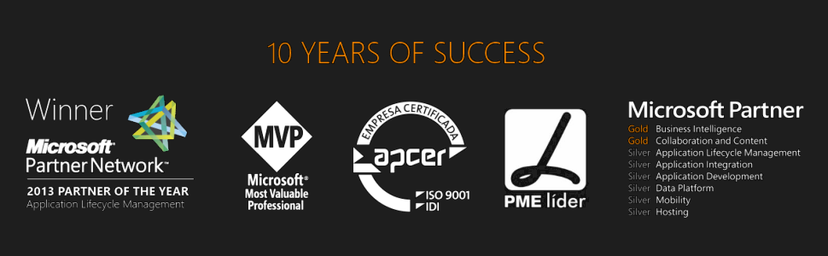



Good afternoon….
Sandro Pereira
Senior Software Developer | Microsoft Integration MVP
sandro.pereira@devscope.net
linkedin.com/in/sandropereira
@sandro_asp
sandroaspbiztalkblog.wordpress.com
+351 223 751 350
www.devscope.net
Notes:
Good morning…. Nice to see some familiar faces again and plenty of new ones…
It is a pleasure to be here for the third consecutive year and see that this event is bigger and better every year
I will not take too much time presenting myself, the time is short I will only have 30 minutes so I will try to go quickly, I think most of you already know me, if not you will have access soon to this slides.
My name is Sandro Pereira and I’m working as a BizTalk Consultant at DevScope in Portugal an amazing company and I’m a Microsoft Integration MVP since 2011

Slide 4


12 Mapper Patterns
365 pages
4 Technical Reviewers
Steef-Jan Wiggers, Nino Crudele, Michael Stephenson, José António Silva
FREE BOOK!
http://www.biztalk360.com/biztalk-mapping-patterns/
BizTalk Mapping Patterns and Best Practices
Sandro Pereira
brought to you by
Notes:
Last year I told, here, that I was writing a book about Mapping Patterns…
It is a pleasure to say that the book is already available for free… almost 400 pages about mapping
So I hope if you haven’t done yet, go there download it and hope you enjoy

Slide 5
Agenda
BizTalk Server
Azure BizTalk Services
Azure App Service - Logic Apps and API Apps
Notes:
In this session I’m going to speak about some useful and important BizTalk Tips and Tricks for developers and Administrator based on my experience gain during this years…
By the way Do you know what I mean about Administrator Tips?...

Slide 6
BizTalk Server

Slide 7

What is BizTalk Server
Business Rules Engine
Customers
Orchestration
Business Activity Monitoring
Hybrid
Partners
BizTalk Server
B2B
RFID
SAP
In-house LOB
IBM Mainframe
Siebel

Slide 8
Traditional app integration
Enterprise apps installed in a local datacenter
Specialized BizTalk server integrated common enterprise apps
Few touch points with tight coupling

Slide 9
Traditional trading partnerships
BizTalk server
Fixed set of B2B protocols/schemas
Lengthy partner onboarding
Crossing enterprise boundaries through firewalls
Hard to do resource planning to adjust for seasonal demands

Slide 10



Bring the Cloud to your Enterprise: Infrastructure
MicrosoftAzure
Active Directory
SharePoint
SQL Server
Virtual Network
Your
Data Center
applications
Storage
servers
databases
Notes:
Two major ways to bring cloud compute to your enterprise:
First is at the infrastructure level:
Virtual network,
WA AD
System Center
Cloud backup for SQL Server
Windows Server
etc.

Slide 11
Who uses BizTalk Server
10000+
10,000+ Global Customers benefit from using BizTalk Server
23
23 of 27 EU governments use BizTalk Server to provide government services
81%
81% of the Global 100 are running BizTalk Server
6
4
6 of the 8 largest U.S. Pharmaceutical Companies use Microsoft BizTalk Server
4 of the 5 largest U.S. Electronics Parts Manufacturers use Microsoft BizTalk Server
9 of 10
9 of 10
9 of 10 largest U.S. Telecommunications Companies use BizTalk Server
5
9 of the 10 largest Aerospace and Defense Companies in the U.S. run BizTalk Server
5 of the 8 largest U.S. Chemical Companies run Microsoft BizTalk Server
4
9
4 of the 5 largest Railroads in the U.S. run Microsoft BizTalk Server
9 of the 10 largest Insurance Companies in the World run Microsoft BizTalk Server

Slide 12






Evolution of BizTalk Server
BizTalk Server
2013 R2
CONTINUOUS INNOVATION EVERY 2-3 YEARS
BizTalk Server
2013
BizTalk Server
2010
Platform Support
Support for JSON
Adapter enhancements
Full integration with the cloud
Updates to HL7 Accelerator
BizTalk Health Monitor
BizTalk Server
2009
IaaS
Integrated ESB Toolkit
Integration with Windows Azure
BizTalk Server + REST
The new SFTP adapter
Per Core License Model
Tracking dependencies between artifacts
BizTalk Server
2006 R2
Workflow Integration
ESB 2.1
SharePoint 2010 BCS
Data Mapper
TPM
Secure FTP
Updated Swift and HIPAA
SQL Server 2008 R2
Windows Server 2008 R2
HIS 2010
BizTalk Server
2006
ALM Support
B2B Enhancements
RFID Mobile
Adapter Pack 2.0
ESB 2.0 Toolkit
BAM+
Hyper-V Support
HIS 2009
BAHS 2.0
BizTalk Server
2004
SOA/ESB
EDI/AS2
RFID
WCF
Adapter Pack
Adapter SDK
HIS 2006
BAHS
BizTalk Server
2002
Simple configuration
Adapters in box
Runtime+
BAM+
BizTalk Server
2000
VS + .NET
Messaging + Orchestration
BRE
Routing
BAM
Scale-out
Deployment Tools
XSD
EAI (partner adapters)
Vertical B2B
Messaging
XML tools
XLang
500 Customers
2,000 Customers
4,000 Customers
7,000 Customers
8,500 Customers
10,500 Customers
12,000 Customers
15,000 Customers

Slide 13
BizTalk Server Roadmap
→A new major release each 2 years
A new minor release (R2) each 2 years
New version of BizTalk server coming in 2016
~15 years, ~15,000 customers
9th release

Slide 14
Azure BizTalk Services

Slide 15
Today’s Azure Platform
Azure Websites
Mobile Services
Media Services
BizTalk Services
API Management
→ Standalone services with distinct hosting environment, extensibility point and management experiences
→ You stitch them together to build a ‘solution’

Slide 16
Microsoft Azure BizTalk Services
EAI Service
Drag and drop integration solution development
Out of the box support for common integration patterns
Connectivity to on-premises LOB systems out of the box
EDI - B2B Service
Trading partner management and supplier on-boarding
Support for X12 and AS2
Extensible Platform
Rich message processing
Customization with code for transforms and pipeline stages
Trading Partner Management API for custom experiences

Slide 17

Bring the Cloud to your Enterprise: Integration
Microsoft Azure
SaaS
Apps
Partners
BizTalk Service
Service Bus
Your
Data Center
BizTalk Server
BizTalk Adapter Service
applications
mainframe
servers
databases
Notes:
Another key way to use the cloud is though integration.
Windows Azure provides a great environment for running web apps and public facing services.
Also a great “DMZ” for connecting with partners.

Slide 18
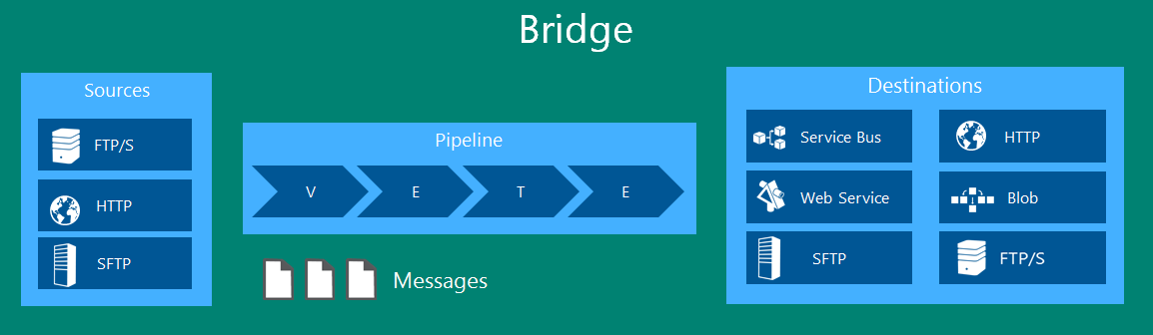
Bridges in BizTalk Services
Basic building block for building your integration platform
A Bridge is a single message processing unit with 3 parts:
Sources: From where the messages originate
Pipeline: Which processes the messages [Flat file, XML, Pass-through]
Destinations: Where the messages are sent to

Slide 19

Hybrid Connectivity
Service Bus
Month=‘July’
Cloud Application
Month <> “July”
Blob
Month = “August”
Service Bus
BizTalk Adapter Service
Server Explorer
(Visual Studio)
Lob Relay (Service Host)
Management Service
Lob Target
Lob Target
REST API
PowerShell CmdLets
Database
ERP

Slide 20
Azure App Service

Slide 21
Contoso
Modern app integration
Tailspin Air
→ Enterprise apps on-premises and in cloud
→ Many touch points with loose coupling
→ Integration is no longer a vertical solution, we believe it is core to the app platform

Slide 22
Partnering in the cloud era
New ‘cloud friendly’ protocols using XML/JSON & HTTP
Leveraging partners across the globe
Quick and simple partner onboarding
Leverage on-demand scaling to better utilize resources

Slide 23
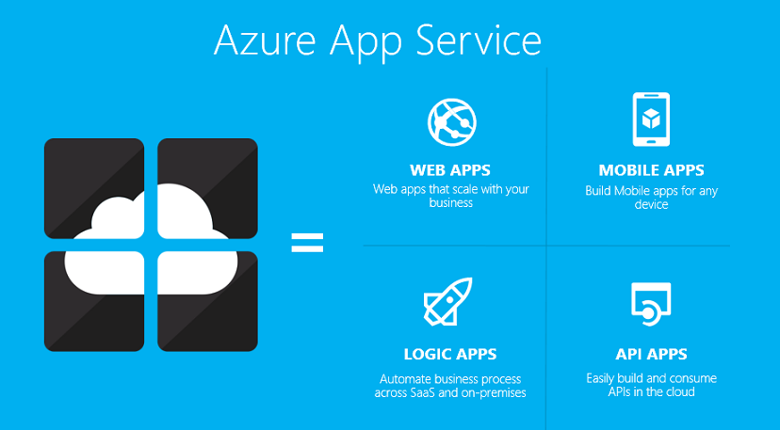
Microsoft Azure App Service

Slide 24
Logic Apps
Logic apps enable you to develop and deliver powerful integration solutions with ease.
Key scenarios:
Visually create business processes and workflows
Deliver integration capabilities in Web, Mobile and API apps
Integrate with your SaaS and enterprise applications
Automate EAI/B2B and business process
Connect to On-premises data

Slide 25
API Apps
Expose your application to 50+ popular SaaS API’s and Share your API in your organization
Key scenarios:
Integrate with SaaS and Enterprise applications
Generate client proxies or API’s in your language of choice
Automate versioning and deployment of API Apps
Secure API’s with Active Directly, Single Sign-on, and OAuth
Share API’s internally with Organizational gallery

Slide 26
>400k
300k
App Containers and Hosting
Apps Hosted
Unique Customers
120%
Building on a solid foundation
Proven cloud scale
Hybrid connectivity built-in
Open platform
Available on premises today with Windows Azure pack
Yearly Paid Subscription Growth
>500%
~2Billion
Yearly Traffic Growth
Transactions daily

Slide 27
Governance
Access Control
Built-in API Management
Hybrid connectivity
Throttle, rate limit and quota callers
Modern formats to existing APIs
Authentication + key management
Built-in analytics
Partner APIs
APIs for On-Premises and SaaS

Slide 28
runtime and development
Cross platform
Auto update
Deep logging diagnostics
Rich ecosystem with partner monetization opportunities

Slide 29
AS400
Zuora
Websphere MQ
Twitter
Chatter
SalesForce
HTTP, HTTPS (REST)
SAP
File
Office 365
Sugar CRM
Out-of-box
BOX
Microsoft Dynamics CRM Online
Siebel
IBM DB2
Standard Protocols
Common Enterprise Apps
Most Popular consumer and Enterprise SaaS
Available through the marketplace
Facebook
Informix
Microsoft Dynamics AX
SFTP
SMTP
Twilio
Twitter
OneDrive
Coupa
SQL Azure
FTP/FTPS
Marketo
Zoho
Microsoft SQL Server
Workday
Oracle Database
SuccessFactors
Azure HDInsight
MongoDB
Web Services (SOAP+WCF)
Quickbooks
Microsoft SharePoint
Microsoft Yammer
Salesforce
Microsoft Dynamics AX
Azure Services (Service Bus)
Azure Services (Mobile + Others)
Azure Services (Storage Blob +Table)

Slide 30
BizTalk features as Apps
Validation
Batching/Debatching
Format Conversion (XML, JSON, FlatFile)
Extract
Transform
Mediation Patterns (Request Response, One Way etc)
Business Rules
Trading Partner Management
AS2/X12/EDIFACT

Slide 31
Workflow engine and Web-based process designer
JSON based workflow definition
Orchestrates API execution
Supports long running processes and control flows
Provides rich logging, diagnostics
Enables developers and business users to easily define and track business process

Slide 32
Complete web + mobile experiences
Rich PaaS offer with cross-platform for .NET, Java, node.js, PHP…
Built-in autoscale and load balance
High availability and auto-patching
Continuous integration and DevOps

Slide 33
Demo

Slide 34
Questions? Thanks!
sandro.pereira@devscope.net
linkedin.com/in/sandropereira
@sandro_asp
sandroaspbiztalkblog.wordpress.com
+351 223 751 350
www.devscope.net

Slide 35
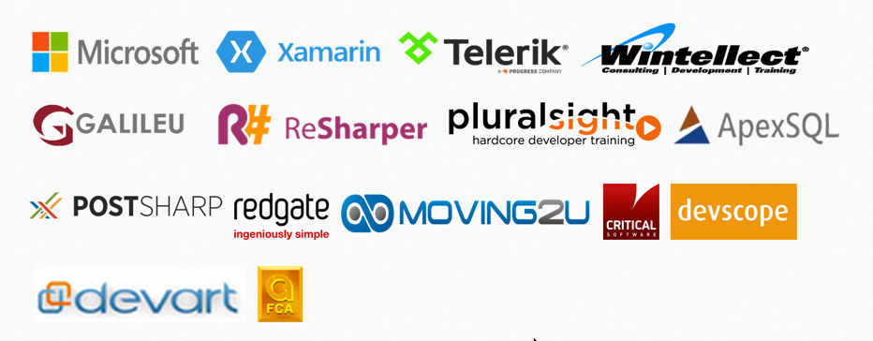
We <3 love our sponsors !
Microsoft MVP Showcase 22 Abril 2015

Slide 36
Global Azure Bootcamp http://gablx2015.eventday.com

Slide 37

THANK YOU !

