Slide 1
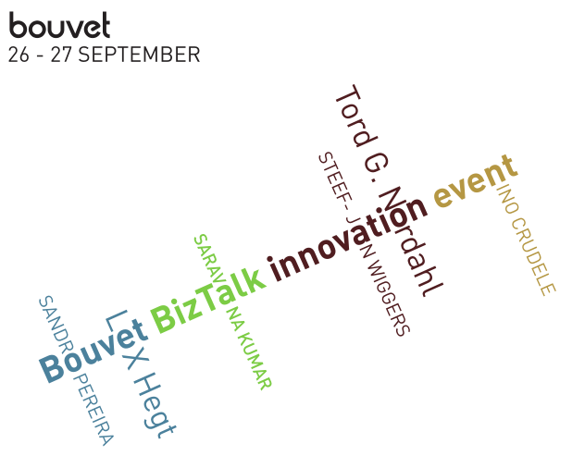
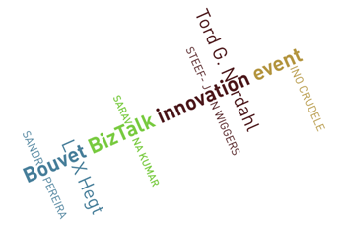




Azure Service Bus EAI/EDI
DevScope
Innovation Event
26-09-2012
Sandro Pereira

Slide 2



Sandro Pereira
Microsoft BizTalk MVP since 2011
Senior Software Developer at DevScope
sandro.pereira@devscope.net
http://sandroaspbiztalkblog.wordpress.com
http://Twitter.com/sandro_asp
http://pt.linkedin.com/in/sandropereira

Slide 3
Agenda
Introduction - Microsoft integration stack
Windows Azure Service Bus overview
Windows Azure Service Bus EAI and EDI Labs SDK
How can I get Started!
What’s next?
3

Slide 4
Microsoft integration stack
the current stack integration From microsoft

Slide 5



Current Microsoft integration stack
BizTalk Server
.NET/WCF/
AppFabric
Windows Azure Service Bus
Other

Slide 6




Evolving Integration Needs - New Challenges
Cloud services
Connected
Many applications
2010 Cloud
2000 SOA
1990 Web
1980 Client-Server
1970 Mainframe

Slide 7
Windows Azure Service Bus
The present…

Slide 8
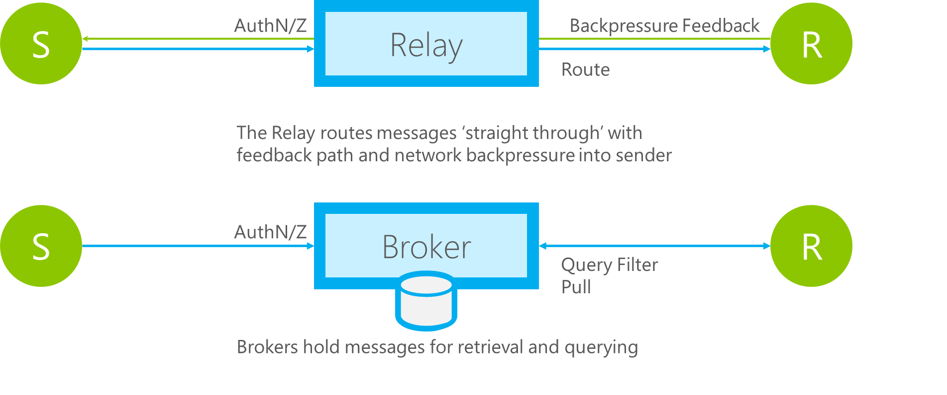
Relay vs. Message Broker

Slide 9
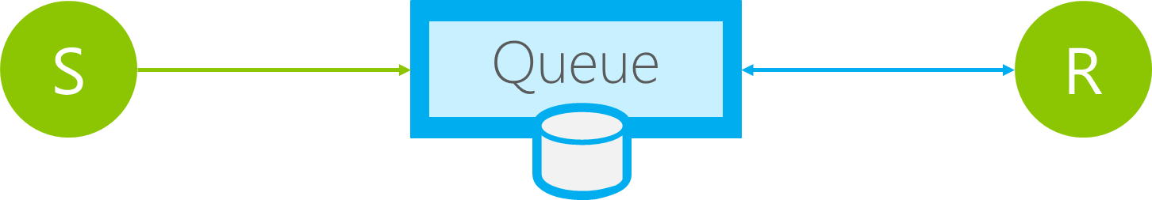
Queues
Load Leveling
Receiver receives and processes at its own pace. Can never be overloaded. Can add receivers as queue length grows, reduce receiver if queue length is low or zero. Gracefully handles traffic spikes by never stressing out the backend.
Offline/Batch
Allows taking the receiver offline for servicing or other reasons. Requests are buffered up until the receiver is available again.

Slide 10
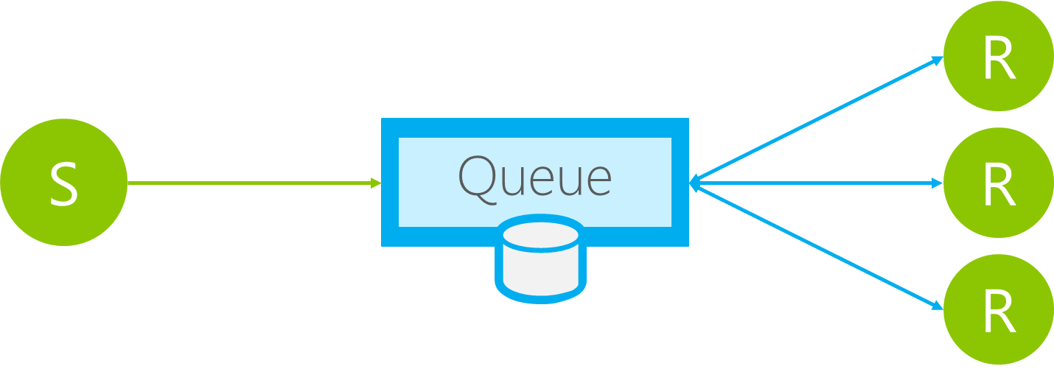
Queues
Load Balancing
Multiple receivers compete for messages on the same queue (or subscription). Provides automatic load balancing of work to receivers volunteering for jobs.
Observing the queue length allows to determine whether more receivers are required.

Slide 11
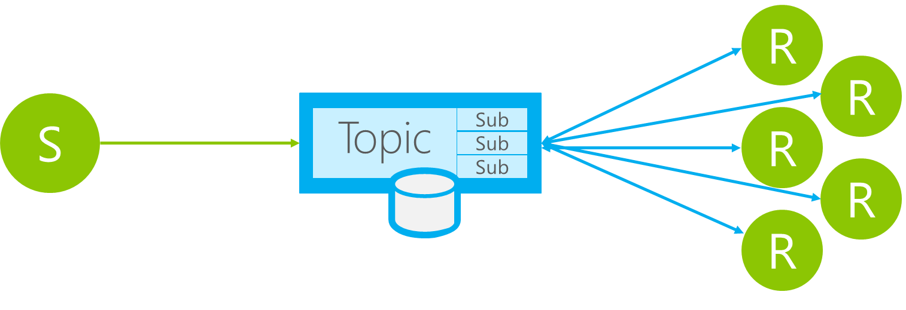
Topics
Message Distribution
Each receiver gets its own copy of each message. Subscriptions are independent. Allows for many independent ‘taps’ into a message stream. Subscriber can filter down by interest.
Constrained Message Distribution (Partitioning)
Receiver get mutually exclusive slices of the message stream by creating appropriate filter expressions.
11
www.devscope.net

Slide 12
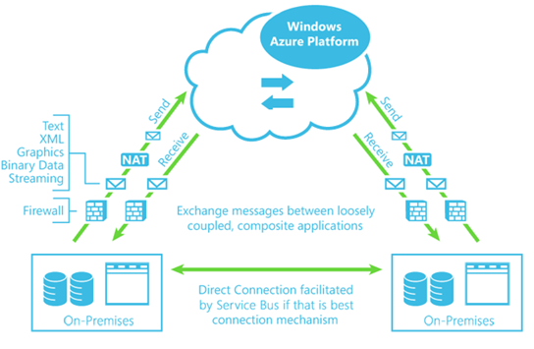
Windows Azure Service Bus overview
12
www.devscope.net

Slide 13
Windows Azure Service Bus EAI & EDI Labs
OR BizTalk as paas… or BizTalk Azure EAI & EDI Services
a glimpse into the future… CTP (Community Technology Preview) version

Slide 14
EAI Capabilities
VETER
Transform
Connect LOB
Enterprise Application Integration (EAI) which provide rich message processing capabilities and the ability to connect private cloud assets to the public cloud.

Slide 15

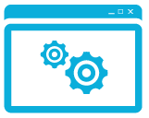



EAI – Incident Management Scenario
Web
Service
Bridge
User 1 via phone
customerType == “VIP”
EAI Bridge
(routing based on condition)
User 2 via online
LOB Relay
Behind Constoso’s Firewall
Partners
FTP Shares could be on-premise or in Cloud
customerType == “Default”
Service Bus Connect
Line of Business System
Validate – Enrich – Transform – Enrich - Route (VETER)
FTP Share 1
LOB Target
FTP Share 2

Slide 16


EDI Capabilities
B2B comm
Portal
Electronic Data Interchange (EDI) targeted at business-to-business (B2B) scenarios in the form of a finished service built for trading partner management.

Slide 17

EDI Service Order Processing Scenario
TPM Portal
EDI App
EDI
EDI Bridge
Service Bus
Hybrid Connectivity
TPM
AS2
BAM
Orders
EDIFACT
X12
FTP
10.000+ EDI schemas
Sales Dashboard
(ASP .NET)
Order Management LOB System
Northwind
Contoso

Slide 18

BizTalk Azure EAI & EDI Services are in CTP
First LABS went live in Dec 2011
LABS refresh in April 2012
Links:
Public announcement: here
Portal to provision namespaces: https://portal.appfabriclabs.com
EDI Portal: https://edi.appfabriclabs.com
SDK & Samples: here
Tutorial & documentation: here
Forum: http://social.msdn.microsoft.com/Forums/en-US/servicebuslabs/threads

Slide 19
BizTalk Azure EAI & EDI Services are in CTP
First LABS went live in Dec 2011
XML Bridge
Transforms
Service Bus Connect
B2B

Slide 20
BizTalk Azure EAI & EDI Services are in CTP
LABS refresh in April 2012
Flat File Support
Enriched the Mapper functionalities
Enriched EDI Portal functionalities
Message Tracking and send side batching
FTP Support
UTF-16, UTF-16LE and UTF-16BE

Slide 21
How can I GET STARTED?
Azure Service Bus EAI/EDI LABS

Slide 22
Requirements
You can download the Service Bus EAI and EDI Labs SDK – April 2012 Release from http://go.microsoft.com/fwlink/?LinkId=235057.
Installing the Windows Azure Service Bus EAI and EDI Labs - April 2012
http://msdn.microsoft.com/en-us/library/windowsazure/hh689760.aspx
Platform
Windows Server 2008 R2 or Windows 7, Visual Studio 2010, .NET Framework 4 and Microsoft Visual C# .NET
SQL Server, Windows Server AppFabric 1.0 or 1.1, IIS 7.0 or higher
Windows Azure Service Bus EAI/EDI April, 2012 Release
WindowsAzureServiceBusEAI-EDILabsSDK.msi
ServiceBusConnectSetup.exe
MicrosoftEdiXSDTemplates.zip
Portal to provision namespaces: https://portal.appfabriclabs.com/
EDI Portal: https://edi.appfabriclabs.com/

Slide 23
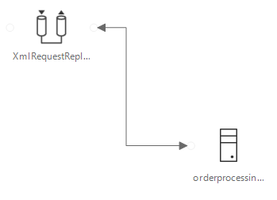
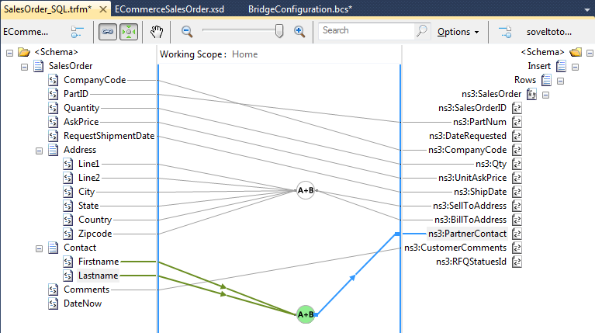
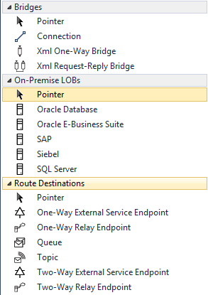
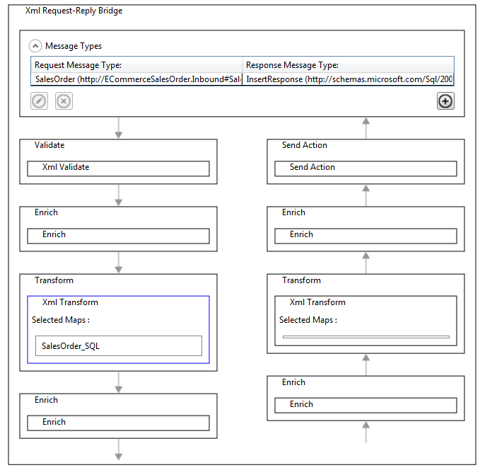
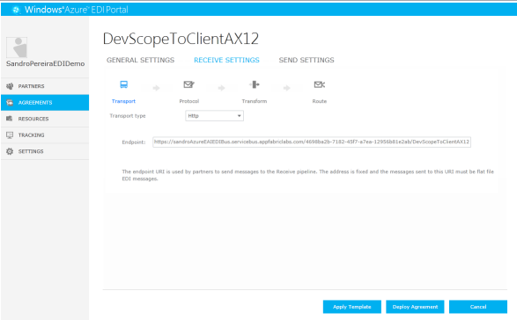
Demo
EAI Capabilities (Transform, VETER, CBR, Connect LOB)
EDI Capabilities (B2B comm, Portal)

Slide 24
What’s next?
BizTalk PaaS
Still to come... In Windows Azure Service Bus EAI & EDI Services

Slide 25
Windows Azure Service Bus EAI & EDI Services
Rich Message Processing
Platform for B2B
Build Hybrid Applications
Sequence of activities to perform impedance mismatch
Disassembly
Message Validation
Transforms
Content based Routing
Hosting custom code
Scalable EDI bridges for X12 and AS2
EDI Portal for agreement management and tracking
Include on-premises applications, services, data in cloud applications
Manage hybrid apps easily
Enable store and forward scenarios in BizTalk by enabling Service Bus queues, topics
EAI Bridges
Transforms
EDI Bridges
EDI Portal
Azure Service Bus Connect
BizTalk Service Bus Adapter

Slide 26
EAI Capabilities
Ability to author custom activities
Rich schema editor
Rich Message Processing
Ability to author custom flow of activities (i.e. build a message pattern)
Easy to build and deploy experiences
Sequence of activities to perform impedance mismatch
Disassembly
Message Validation
Transforms
Content based Routing
Hosting custom code
Out-of-box capabilities for:
Auto pull messages from FTP shares
Disassembly of messages
Processing flat files
XML message validation
Enrich message properties
Transformations: structural normalization
Operational Tracking and Archiving
Character set encoding (Receive side)
Content based routing
EAI Bridges
Transforms

Slide 27
EAI Capabilities
Simple and easy-to-use UI mechanism for creating simple/complex maps
Visual tools for common operations:
Rich Message Processing
Scripting functoid to host .NET code
Looping functoids – foreach, mapeach
Expression functoids – arithmetic , logical , conditional , if-then-else
Temporary store – Lists and related operations
String and date-time manipulation operations
Cumulative operations
Number format operations
Support for Pages in UI
Test map functionality
Sequence of activities to perform impedance mismatch
Disassembly
Message Validation
Transforms
Content based Routing
Hosting custom code
XSLT support
Taking existing investments forward
EAI Bridges
Transforms
Migrate BizTalk maps
Support XSLT maps

Slide 28
EAI Capabilities
On-premise service to expose to one or more LOB targets to Cloud
Contracts for each LOB can be exposed separately
Build Hybrid Applications
Include on-premises applications, services, data in cloud applications
Manage hybrid apps easily
Enable store and forward scenarios in BizTalk by enabling Service Bus queues, topics
Simple and easy-to-use configuration experience using Visual Studio’s Server Explorer
Power-shell command-lets to manage the service
Lob targets supported:
Service Bus adapter features
SQL Server
Oracle DB
Oracle E-business suite
SAP
Seibel eBusiness Applications
Azure Service Bus Connect
BizTalk Service Bus Adapter

Slide 29
EDI Capabilities
EDI Bridge
Platform for B2B
Support AS2 and FTP as transport
Process X12 messages upto 5030
Generate and process MDN, TA1, 997
Archiving
Batching
Tracking
Support for EDIFACT
Scalable EDI bridges for X12 and AS2
EDI Portal for agreement management and tracking
EDI Portal
EDI Bridges
EDI Portal
Metro UI for managing trading partners
Manage & Monitor AS2, X12 agreements
View Resources like Transforms, Schemas, Certificates
Delete, Redeployment of agreements

Slide 30
Questions?
...that aren't difficult to answer!

Slide 31
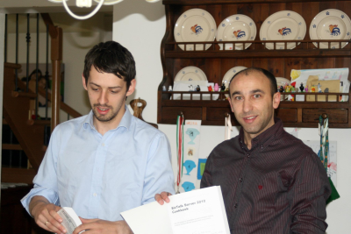




Thanks

Slide 32
Blog: http://sandroaspbiztalkblog.wordpress.com
MVP Profile: https://mvp.support.microsoft.com/profile/Sandro.Pereira
MSDN Profile: http://social.msdn.microsoft.com/profile/sandro%20pereira/
Member of BiztalkAdminsBlogging: http://www.biztalkadminsblogging.com/
Member of BizTalk Brazil Community: http://www.biztalkbrasil.com.br/
Member of NetPonto Community: http://netponto.org/membro/sandro-pereira/
Thanks
Sandro Pereira
sandro.pereira@devscope.net
+351 223 751 350
www.devscope.net
© 2012 DevScope. All rights reserved. DevScope, SmartDocumentor, myWebDrive and other product names are or may be registered trademarks and/or trademarks in the U.S. and/or other countries. The information herein is for informational purposes only and represents the current view of DevScope as of the date of this presentation. Because DevScope must respond to changing market conditions, it should not be interpreted to be a commitment on the part of DevScope, and DevScope cannot guarantee the accuracy of any information provided after the date of this presentation. DEVSCOPE MAKES NO WARRANTIES, EXPRESS, IMPLIED OR STATUTORY, AS TO THE INFORMATION IN THIS PRESENTATION.

