Slide 1




Azure Service Bus EAI/EDI
Windows Azure one day lab | Porto
DevScope
One day Lab
14-05-2012
Sandro Pereira

Slide 2



Sandro Pereira
Microsoft BizTalk MVP since 2011
Senior Software Developer at DevScope
sandro.pereira@devscope.net
http://sandroaspbiztalkblog.wordpress.com
http://Twitter.com/sandro_asp
http://pt.linkedin.com/in/sandropereira

Slide 3
Agenda
Introduction - Microsoft integration stack
Windows Azure Service Bus EAI and EDI Labs SDK
How can I get Started!
What’s next?
3

Slide 4
Microsoft integration stack
The Present

Slide 5



Current Microsoft integration stack
BizTalk Server
.NET/WCF/
AppFabric
Other

Slide 6




New Challenges
Cloud services
Connected
Many applications

Slide 7
Azure Service Bus EAI and EDI
a glimpse into the future… CTP (Community Technology Preview) version

Slide 8
EAI Capabilities
VETER
Transform
Connect LOB
Enterprise Application Integration (EAI) which provide rich message processing capabilities and the ability to connect private cloud assets to the public cloud.

Slide 9


EDI Capabilities
B2B comm
Portal
Electronic Data Interchange (EDI) targeted at business-to-business (B2B) scenarios in the form of a finished service built for trading partner management.

Slide 10
Roadmap
December, 2011 Release
April, 2012 Release
XML Bridge
Transforms
Service Bus Connect
B2B
Flat File Support
Enriched the Mapper functionalities
Enriched EDI Portal functionalities
Message Tracking and send side batching
FTP Support
UTF-16, UTF-16LE and UTF-16BE

Slide 11


Architecture
Bridge
LOB Relay
On-Premise
Service Bus Connect
Line of Business System
Sender Application
LOB Target

Slide 12
How can I get Started!
Azure Service Bus EAI/EDI LABS

Slide 13
Requirements
You can download the Service Bus EAI and EDI Labs SDK – April 2012 Release from http://go.microsoft.com/fwlink/?LinkId=235057.
Installing the Windows Azure Service Bus EAI and EDI Labs - April 2012
http://msdn.microsoft.com/en-us/library/windowsazure/hh689760.aspx
Platform:
Server 2008 R2/Windows 7, Visual Studio 2010, SQL Server, Windows Server AppFabric 1.0
Windows Azure Service Bus EAI/EDI April, 2012 Release
WindowsAzureServiceBusEAI-EDILabsSDK.msi
ServiceBusConnectSetup.exe
MicrosoftEdiXSDTemplates.zip
https://portal.appfabriclabs.com/
https://edi.appfabriclabs.com/

Slide 14
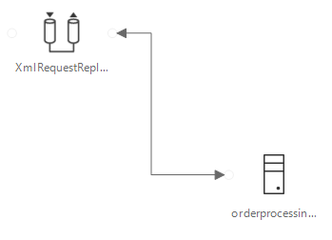
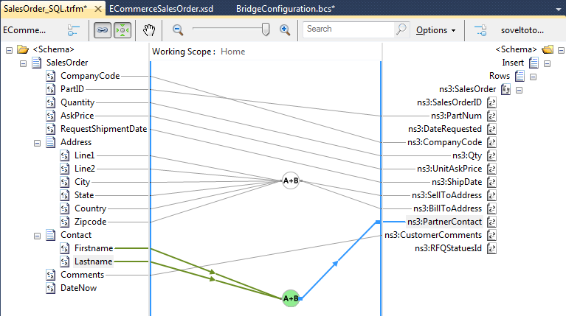
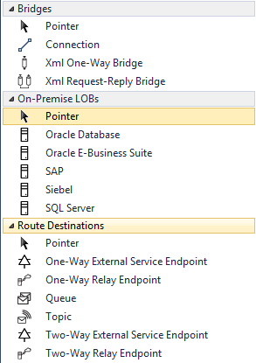
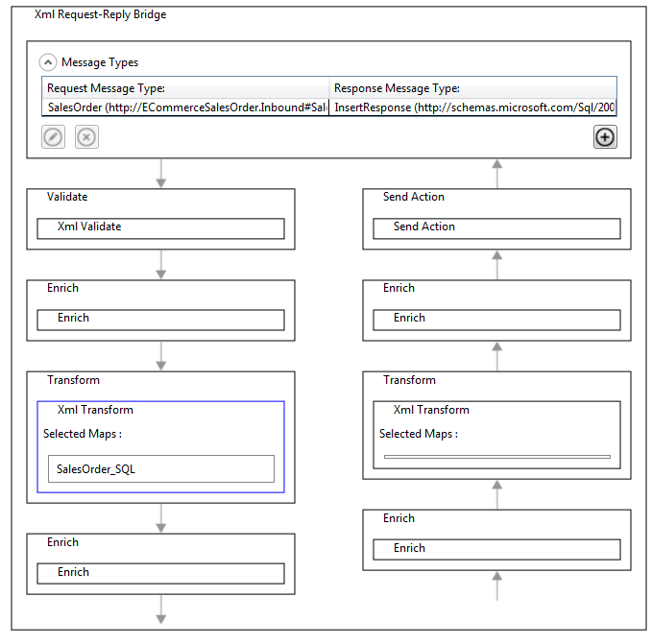
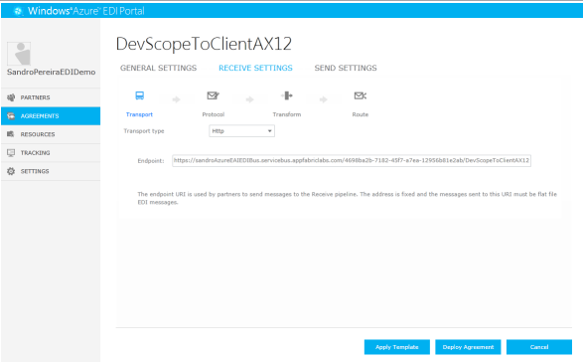
Demo
Mapping
EAI functionalities
EDI Portal

Slide 15
What’s next?
Still to come... In Azure Service Bus EAI/EDI

Slide 16
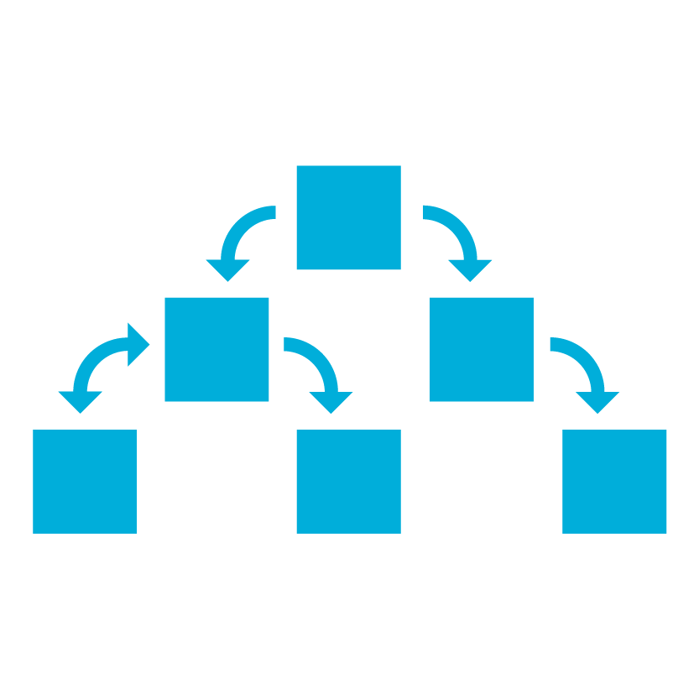
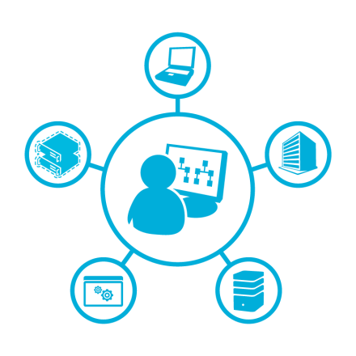
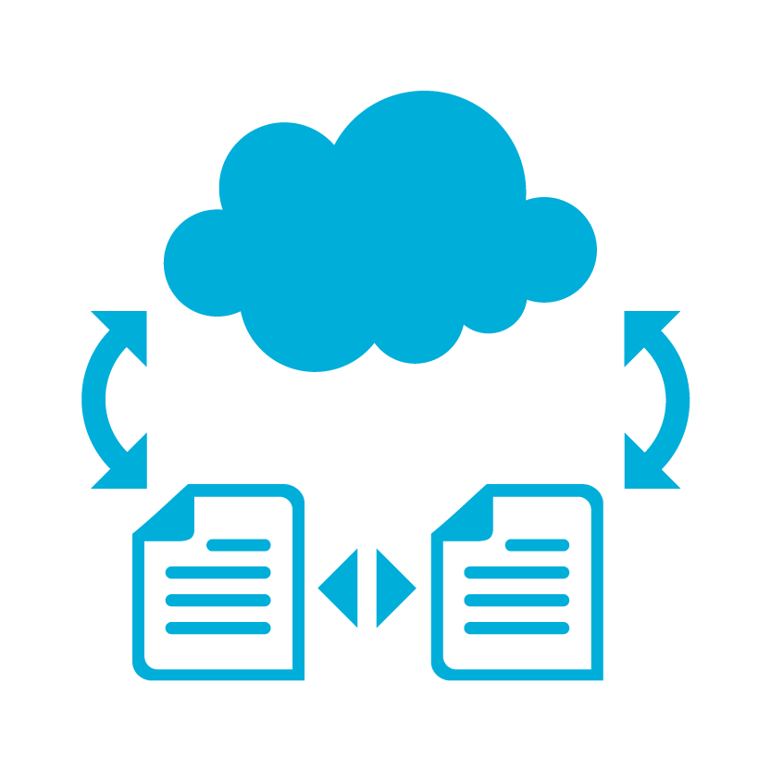
Still to come...
Formats
Process Mgr
Management
Process manager (Orchestration)
Management / Operations
EDIFACT support

Slide 17
Questions?
...that aren't difficult to answer!

Slide 18

Blog: http://sandroaspbiztalkblog.wordpress.com
MVP Profile: https://mvp.support.microsoft.com/profile/Sandro.Pereira
MSDN Profile: http://social.msdn.microsoft.com/profile/sandro%20pereira/
Member of BiztalkAdminsBlogging: http://www.biztalkadminsblogging.com/
Member of BizTalk Brazil Community: http://www.biztalkbrasil.com.br/
Thanks
Sandro Pereira
sandro.pereira@devscope.net
+351 223 751 350
www.devscope.net
© 2012 DevScope. All rights reserved. DevScope, SmartDocumentor, myWebDrive and other product names are or may be registered trademarks and/or trademarks in the U.S. and/or other countries. The information herein is for informational purposes only and represents the current view of DevScope as of the date of this presentation. Because DevScope must respond to changing market conditions, it should not be interpreted to be a commitment on the part of DevScope, and DevScope cannot guarantee the accuracy of any information provided after the date of this presentation. DEVSCOPE MAKES NO WARRANTIES, EXPRESS, IMPLIED OR STATUTORY, AS TO THE INFORMATION IN THIS PRESENTATION.

