Slide 2



Integração de aplicações com o Service Bus
Sandro Pereira
Microsoft BizTalk MVP since 2011
Senior Software Developer at DevScope
sandro.pereira@devscope.net
http://sandroaspbiztalkblog.wordpress.com
http://Twitter.com/sandro_asp
http://pt.linkedin.com/in/sandropereira

Slide 3
Agenda
Introduction - Microsoft integration stack
Windows Azure Service Bus
Windows Azure Service Bus EAI & EDI
What’s next?
on-perm
IaaS
PaaS (Windows Azure Service Bus EAI & EDI Services)

Slide 4
Microsoft integration stack

Slide 5



Current Microsoft integration stack
BizTalk Server
.NET/WCF/
Service Bus
Other

Slide 6




New Challenges
Cloud services
Connected
Many applications

Slide 7
Windows Azure Service Bus

Slide 8
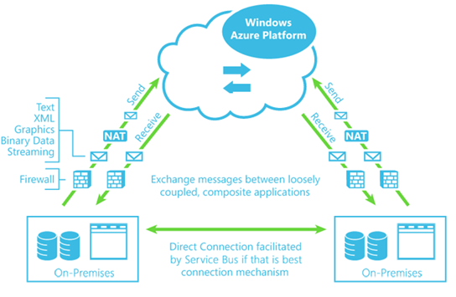
Windows Azure Service Bus overview
Load Leveling

Slide 9
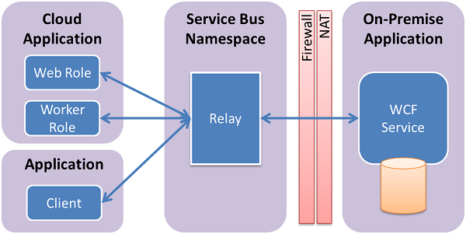

Service Bus Relay
Load Leveling
Great sample: “How to Use the Service Bus Relay Service” https://www.windowsazure.com/en-us/develop/net/how-to-guides/service-bus-relay/.

Slide 10
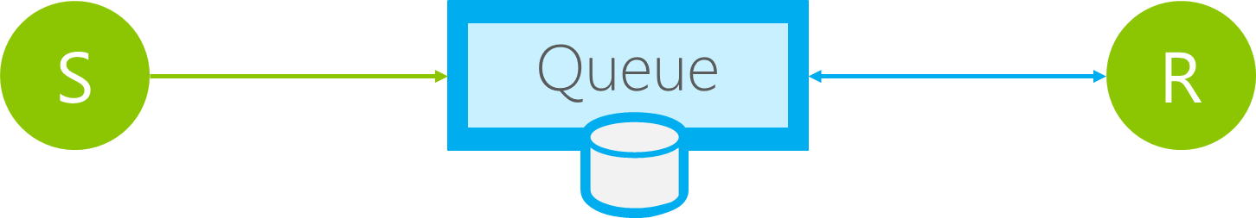
Queues
Load Leveling
Receiver receives and processes at its own pace. Can never be overloaded. Can add receivers as queue length grows, reduce receiver if queue length is low or zero. Gracefully handles traffic spikes by never stressing out the backend.
Offline/Batch
Allows taking the receiver offline for servicing or other reasons. Requests are buffered up until the receiver is available again.

Slide 11
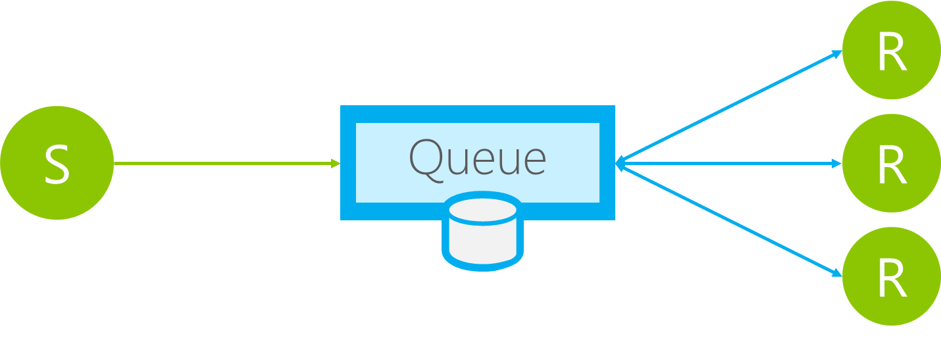
Queues
Load Balancing
Multiple receivers compete for messages on the same queue (or subscription). Provides automatic load balancing of work to receivers volunteering for jobs.
Observing the queue length allows to determine whether more receivers are required.

Slide 12
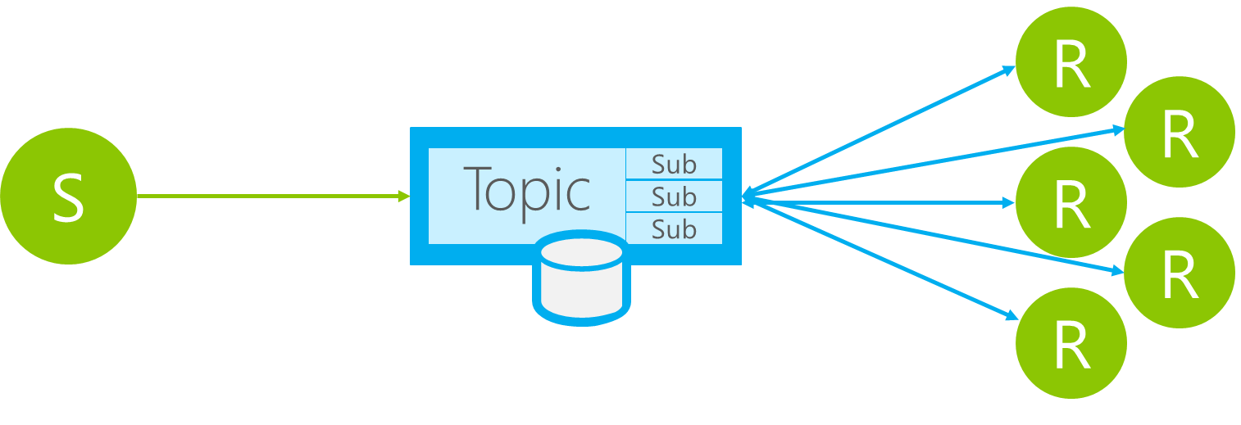
Topics
Message Distribution
Each receiver gets its own copy of each message. Subscriptions are independent. Allows for many independent ‘taps’ into a message stream. Subscriber can filter down by interest.
Constrained Message Distribution (Partitioning)
Receiver get mutually exclusive slices of the message stream by creating appropriate filter expressions.

Slide 13
BizTalk Azure EAI & EDI Services
…or Windows Azure Service Bus EAI & EDI Labs
CTP (Community Technology Preview) version

Slide 14
BizTalk Azure EAI & EDI Services are in CTP
First LABS went live in Dec 2011
LABS refresh in April 2012
Links:
Public announcement: here
Portal to provision namespaces: https://portal.appfabriclabs.com
EDI Portal: https://edi.appfabriclabs.com
SDK & Samples: here
Tutorial & documentation: here
Forum: http://social.msdn.microsoft.com/Forums/en-US/servicebuslabs/threads

Slide 15
BizTalk Azure EAI & EDI Services are in CTP
First LABS went live in Dec 2011
XML Bridge
Transforms
Service Bus Connect
B2B

Slide 16
BizTalk Azure EAI & EDI Services are in CTP
LABS refresh in April 2012
Flat File Support
Enriched the Mapper functionalities
Enriched EDI Portal functionalities
Message Tracking and send side batching
FTP Support
UTF-16, UTF-16LE and UTF-16BE

Slide 17
VETER
Transform
Connect LOB
EAI Capabilities
Enterprise Application Integration (EAI) which provide rich message processing capabilities and the ability to connect private cloud assets to the public cloud.

Slide 18


EAI Scenario
Bridge
LOB Relay
On-Premise
Service Bus Connect
Line of Business System
Sender Application
LOB Target

Slide 19


B2B comm
Portal
EDI Capabilities
Electronic Data Interchange (EDI) targeted at business-to-business (B2B) scenarios in the form of a finished service built for trading partner management.

Slide 20

EDI Service – Order Processing Scenario
TPM Portal
EDI App
EDI Bridge
Service Bus
Hybrid Connectivity
Orders
Sales Dashboard
(ASP .NET)
Order Management LOB System
Northwind
Contoso

Slide 21
How can I get Started!
Azure Service Bus EAI/EDI LABS

Slide 22
Requirements
You can download the Service Bus EAI and EDI Labs SDK – April 2012 Release from http://go.microsoft.com/fwlink/?LinkId=235057.
Installing the Windows Azure Service Bus EAI and EDI Labs - April 2012 http://msdn.microsoft.com/en-us/library/windowsazure/hh689760.aspx
Platform:
Server 2008 R2/Windows 7, Visual Studio 2010, SQL Server, Windows Server AppFabric 1.0
Windows Azure Service Bus EAI/EDI April, 2012 Release
WindowsAzureServiceBusEAI-EDILabsSDK.msi
ServiceBusConnectSetup.exe
MicrosoftEdiXSDTemplates.zip
Portal to provision namespaces: https://portal.appfabriclabs.com/
EDI Portal: https://edi.appfabriclabs.com/

Slide 23
DEMO
EAI Capabilities (Transform, VETER, CBR, Connect LOB)
EDI Capabilities (B2B comm, Portal)

Slide 24
What’s Next?

Slide 25
What’s Next?
BizTalk on-perm
BizTalk on Azure IaaS
BizTalk on Azure PaaS

Slide 26
BizTalk on-perm

Slide 27

External
customers
Business Rules Engine
Orchestration
Business Activity Monitoring
Suppliers
BizTalk Server
Partners
RFID
SAP
In-house LOB
IBM Mainframe
Siebel

Slide 28
BizTalk Server 2010 R2 feature enhancements
Platform Update: support for Visual Studio 2012, Windows 8 Server, SQL Server 2012, Office 15 and System Center 2012
B2B enhancements to support the latest standards natively
Better performance
Better manageability (ESB Toolkit as core part)
Improved Connectivity
Consume REST services directly in BizTalk
Easy connectivity to Azure Service Bus relay, queues and topics
and BizTalk running in Azure…

Slide 29
BizTalk on Azure IaaS

Slide 30
BizTalk in Azure IaaS
Provision a simple BizTalk developer environment or a multi-node test environment on Azure
Configure BizTalk & SQL IaaS
Develop integration applications, deploy and test
Deploy BizTalk solutions developed on-premise or in IaaS
Eliminate HW procurement lead times
Reduce time & cost to setup and maintain BizTalk environments

Slide 31
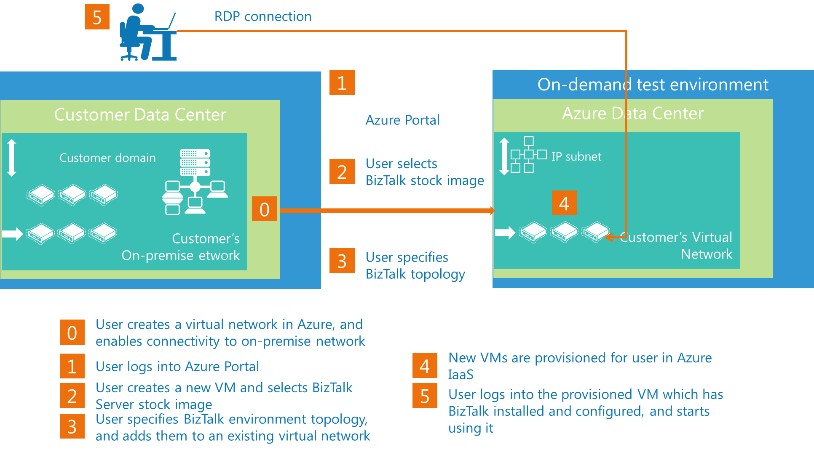

Slide 32
BizTalk on Azure PaaS
Windows Azure Service Bus EAI & EDI Services

Slide 33
Windows Azure Service Bus EAI & EDI Services
Rich Message Processing
Platform for B2B
Build Hybrid Applications
Sequence of activities to perform impedance mismatch
Disassembly
Message Validation
Transforms
Content based Routing
Hosting custom code
Scalable EDI bridges for X12 and AS2
EDI Portal for agreement management and tracking
Include on-premises applications, services, data in cloud applications
Manage hybrid apps easily
Enable store and forward scenarios in BizTalk by enabling Service Bus queues, topics
EAI Bridges
Transforms
EDI Bridges
EDI Portal
Azure Service Bus Connect
BizTalk Service Bus Adapter

Slide 34
EAI Capabilities
Ability to author custom activities
Rich schema editor
Rich Message Processing
Ability to author custom flow of activities (i.e. build a message pattern)
Easy to build and deploy experiences
Sequence of activities to perform impedance mismatch
Disassembly
Message Validation
Transforms
Content based Routing
Hosting custom code
Out-of-box capabilities for:
Auto pull messages from FTP shares
Disassembly of messages
Processing flat files
XML message validation
Enrich message properties
Transformations: structural normalization
Operational Tracking and Archiving
Character set encoding (Receive side)
Content based routing
EAI Bridges
Transforms

Slide 35
EAI Capabilities
Simple and easy-to-use UI mechanism for creating simple/complex maps
Visual tools for common operations:
Rich Message Processing
Scripting functoid to host .NET code
Looping functoids – foreach, mapeach
Expression functoids – arithmetic , logical , conditional , if-then-else
Temporary store – Lists and related operations
String and date-time manipulation operations
Cumulative operations
Number format operations
Support for Pages in UI
Test map functionality
Sequence of activities to perform impedance mismatch
Disassembly
Message Validation
Transforms
Content based Routing
Hosting custom code
XSLT support
Taking existing investments forward
EAI Bridges
Transforms
Migrate BizTalk maps
Support XSLT maps

Slide 36
EAI Capabilities
On-premise service to expose to one or more LOB targets to Cloud
Contracts for each LOB can be exposed separately
Build Hybrid Applications
Include on-premises applications, services, data in cloud applications
Manage hybrid apps easily
Enable store and forward scenarios in BizTalk by enabling Service Bus queues, topics
Simple and easy-to-use configuration experience using Visual Studio’s Server Explorer
Power-shell command-lets to manage the service
Lob targets supported:
Service Bus adapter features
SQL Server
Oracle DB
Oracle E-business suite
SAP
Seibel eBusiness Applications
Azure Service Bus Connect
BizTalk Service Bus Adapter

Slide 37
EDI Capabilities
EDI Bridge
Platform for B2B
Support AS2 and FTP as transport
Process X12 messages upto 5030
Generate and process MDN, TA1, 997
Archiving
Batching
Tracking
Scalable EDI bridges for X12 and AS2
EDI Portal for agreement management and tracking
EDI Portal
EDI Bridges
EDI Portal
Metro UI for managing trading partners
Manage & Monitor AS2, X12 agreements
View Resources like Transforms, Schemas, Certificates
Delete, Redeployment of agreements

Slide 38
Questions

Slide 39
Blog: http://sandroaspbiztalkblog.wordpress.com
MVP Profile: https://mvp.support.microsoft.com/profile/Sandro.Pereira
MSDN Profile: http://social.msdn.microsoft.com/profile/sandro%20pereira/
Member of BiztalkAdminsBlogging: http://www.biztalkadminsblogging.com/
Member of BizTalk Brazil Community: http://www.biztalkbrasil.com.br/
Thanks
Sandro Pereira
sandro.pereira@devscope.net
+351 223 751 350
www.devscope.net

