Slide 1
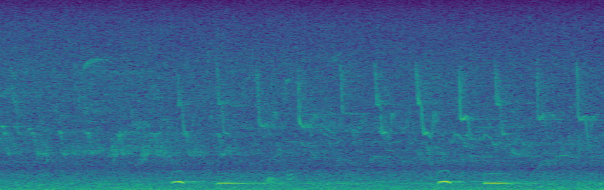
TASK 3: CLASSIFICATION
Team Vegetable
Sandro Assek
Petruța-Simina Coroian
Lukas Himmelbauer
Christoph Wittner

Slide 2
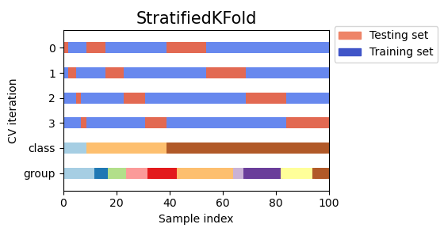
Cross Validation
Our dataset is heavily unbalanced (many more fragments where no bird is present) -> we used the „StratifiedKFold“ method from Sklearn
ensures that the relative class frequency of each sample is approximately preserved in all folds
In the scope of this project the assumption is that we only deal with the known 6 bird-species and no “new” species -> so it makes sense to have every species in the train- and test-set
If our goal was to also specify other species it would maybe make sense to exclude one species from the train-set, to better generalize to unseen data
For the number of splits we used 5 for all classifiers to make them comparable

Slide 3
Feature Selection and Preprocessing
First step was to drop all features that have a high correlation to another feature, as these won’t contain much new information
For this we used the correlation matrix and dropped all features with a value higher than 0.9, which left us with 305 features
To select the most promising out of these we used the SelectKBest method
This method ranks the features according to a provided scoring function
For this scoring function we used mutual information, which describes the amount of information one gets about one variable (in our case the labels) when observing the other (in our case features)
We used the Sklearn StandardScaler to normalize all features to mean zero and variance one as for some algorithms (e.g. KNN) we need normalized input

Slide 4
Data-Sample processing (1)
To exclude some uncertainty in the labelling process we dropped fragments where less than a specific distribution of the annotators agreed with the overall vote.
Samples have at least 3 and at most 7 different annotators. Therefore, we accept samples according to the following majority distribution:
3 annotations: accept all samples
4 annotations: accept majority 3/4 eq. annotations
5 annotations: accept majority 3/5 eq. annotations
6 annotations: accept majority 4/6 eq. annotations
7 annotations: accept majority 5/7 eq. annotations
For training a classifier to actually perform classification on new data it would probably make sense to include also labels where annotators disagreed even more, but as this task was more focused on trying different classifiers and getting a feeling for their different performances we decided to stick to the distribution from above for now on.

Slide 5
Data-Sample processing (2)
 | Original # of samples | Distribution to keep | Keep acc. to distribution | Dropped # of sampels
3 Annotations | 2,000 | 3/3 | 2.000 | 0
4 Annotations | 0 | 3/4 | 0 | 0
5 Annotations | 11,800 | 3/5 | 10,243 | 1,557
6 Annotations | 45,600 | 4/6 | 38,380 | 7,220
7 Annotations | 60,600 | 5/7 | 49,125 | 11,475
Total | 120,000 | - | 99,748 | 20,252
Excluding the described samples from above we reduced our initial 120.000 samples to 96.748, which is still enough for training and testing on our models

Slide 6
Evaluation criterions
F1-score using macro averaging was used to evaluate model performance during testing for overfitting since plain accuracy does not take class unbalance into account
To compare the different model classes we used precision-recall curves where we chose macro averaging over the seven classes since we have unequal amounts of samples for each class.

Slide 7
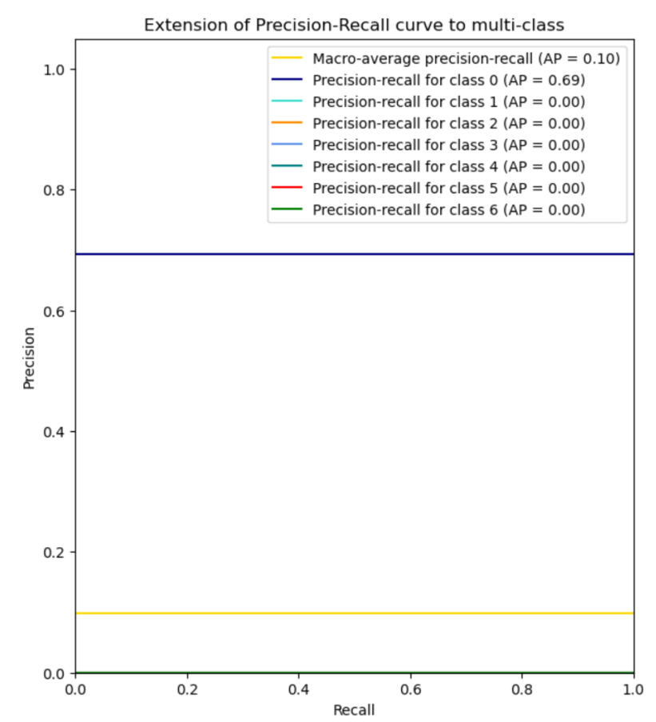
Baseline performance
our dataset is heavily unbalanced towards the class where no bird is present
Therefore a simple classifier that just predicts class “0” would have a rather high value in terms of simple accuracy
With our chosen evaluation criterion on the other side this classifier would only achieve a low score
The precision-recall curve would look like this:

Slide 8
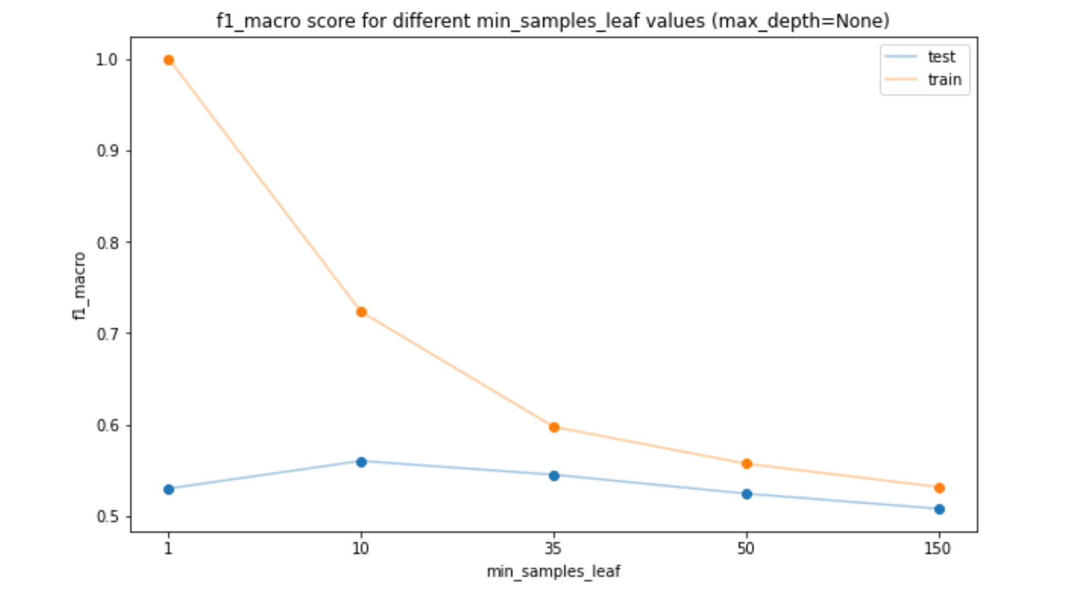
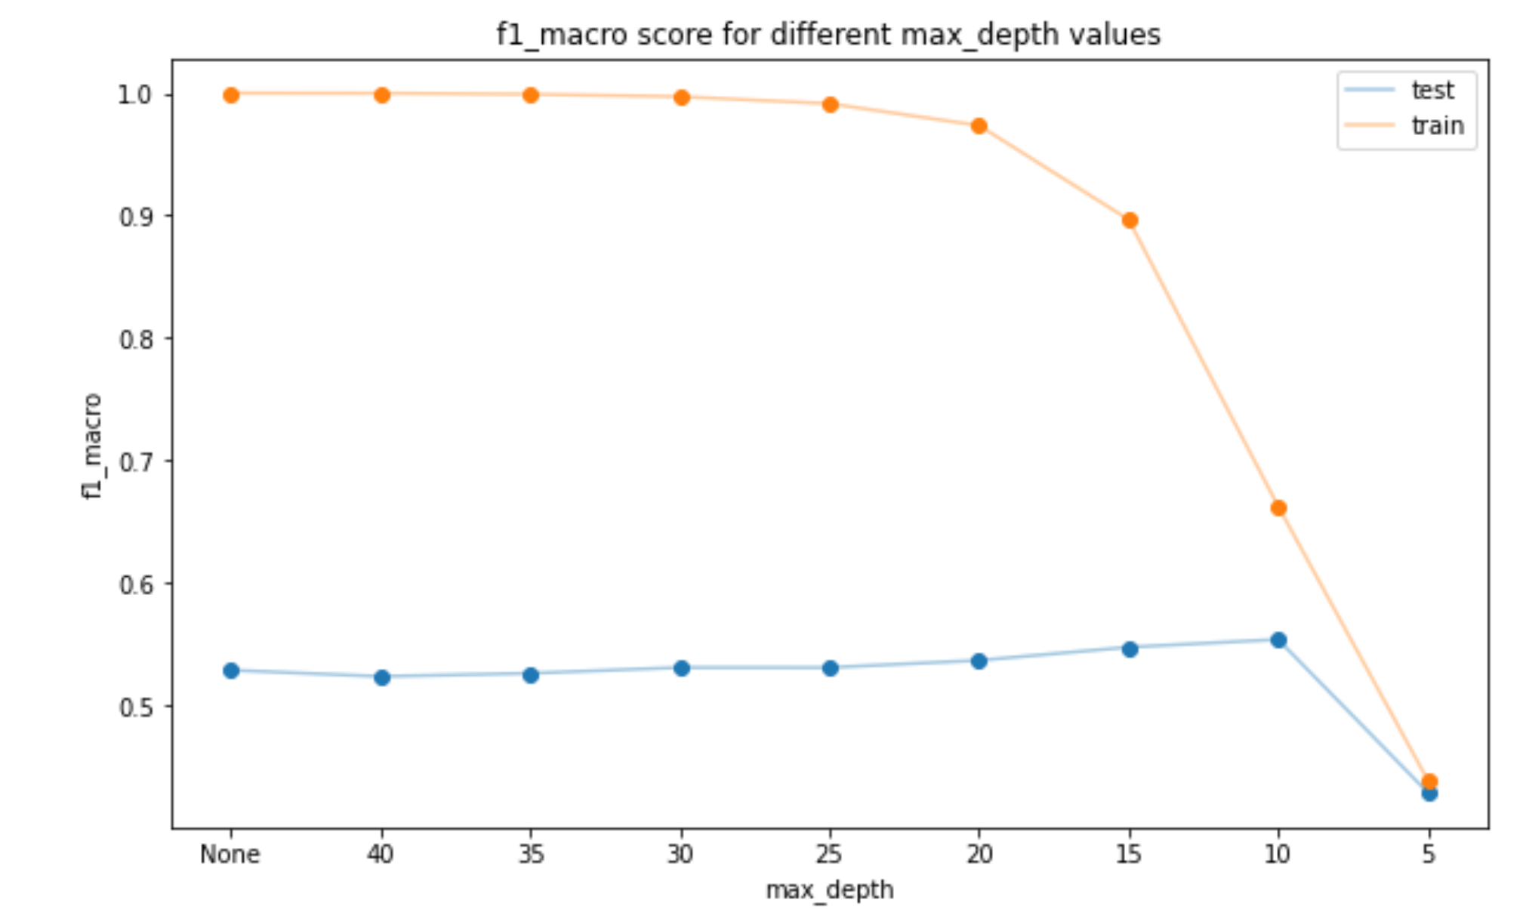
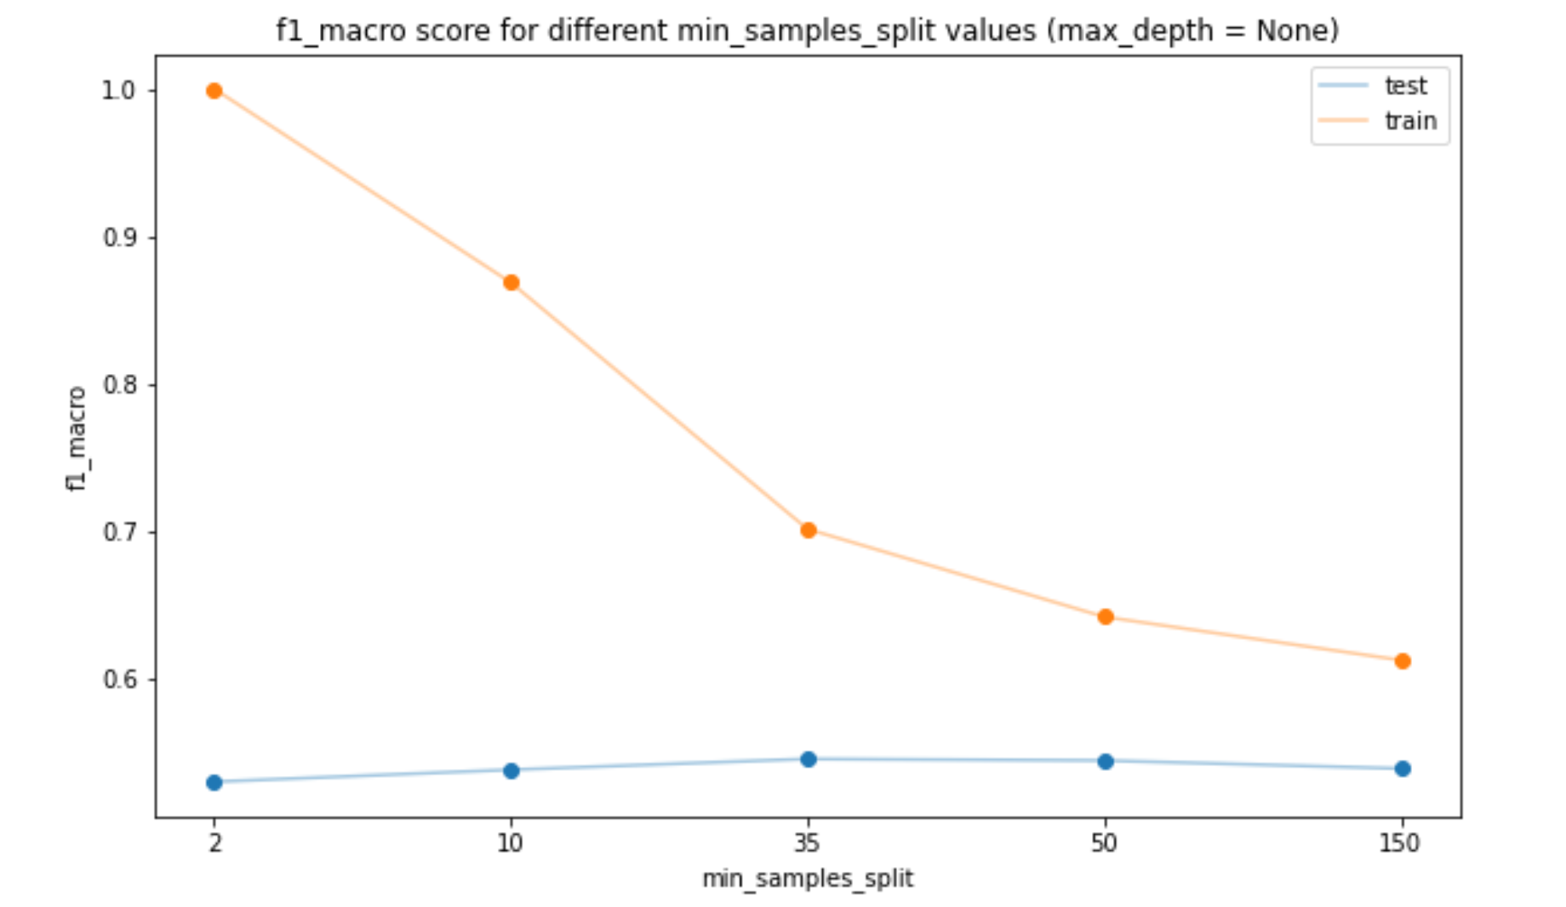
Decision tree: overfitting
max_depth: our tree will overfit when let to grow to its full depth (depth=None) or too high depth values
If we want to let our tree grow to a depth > 10 wen can look into tuning other parameters
min_samples_split and min samples_leaf: increasing the number of samples required to split a node, as well as the number of samples required to be at a leaf node prevents overfitting for high-depth trees

Slide 9
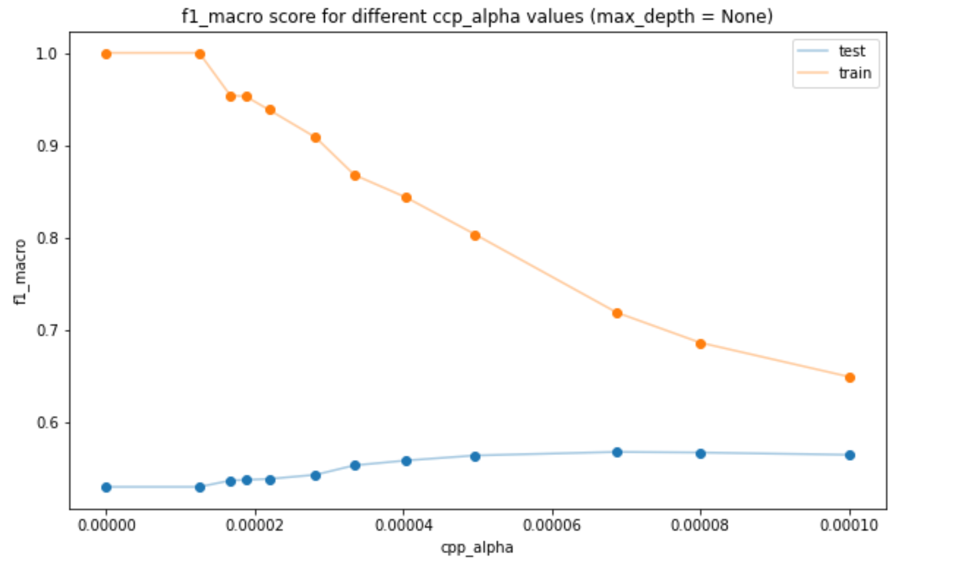
Decision tree: post-pruning
ccp_alphas: another way of generalizing our model is to let it grow to its full length and prune the tree afterwards. For this we try different values of the complexity parameter used for Minimal Cost-Complexity Pruning
We can see our model stops overfitting at around ccp_alpha=6.87450097e-05

Slide 10
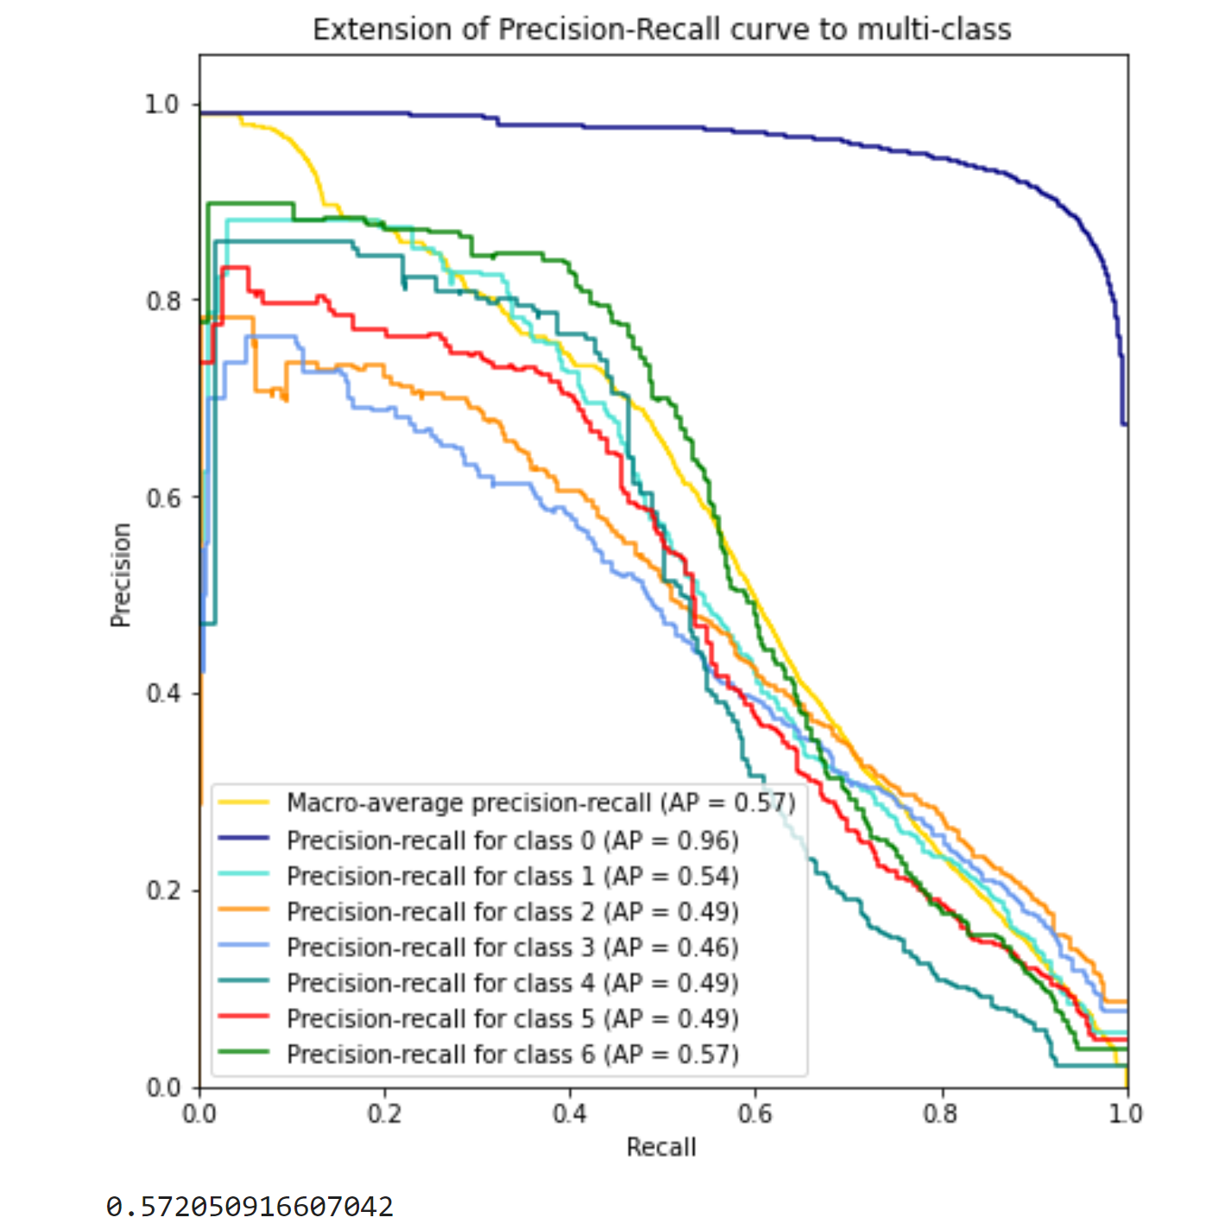
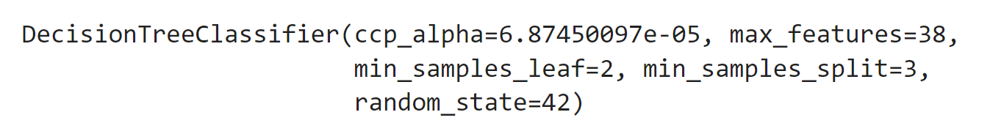
Decision tree: parameter search/best parameters
Starting GridSearchCV parameters:
'criterion’: [“gini”,”entropy”,”log-loss”]
'max_depth': [None,20,50,80],
'max_features': [None,20,40],
'min_samples_leaf': [1,50,100],
'min_samples_split': [2,50,100],
'ccp_alpha':[8e-05,6.87450097e-05,2.81961954e-05]
Based on the results subsequent grid searches with smaller intervals between values have been performed to fine-grain the parameter values
Model with best performance (with default values max_depth= None and criterion=“gini”):

Slide 11
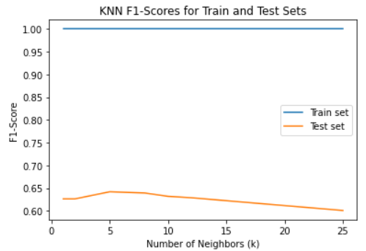
KNN: Overfitting/Underfitting
Plot showing the effect the number of neighbours has on the F1-score, the other parameters of KNN were fixed in this experiment as they don’t really contribute to overfitting
For very low k (1,2) we observe a rather bad score, as the model doesn’t generalize well(=overfitting)
For growing k up to about 5-8, we observe a increase of test-score, meaning that the model generalizes better
For larger k, test-score is going down, due to the fact that the model generalizes to strongly and can’t model smaller differences (=underfitting)
The reason for the train-score always being one in this plot is the parameter ‘weights’ which was set to distance for this experiment. With this setting the points are weighted by their distance to the point to classify and as we classify also training samples here we always have a point that is ‘infinitely’ close, which results in a high weight for this sample and so the classification nearly only depends on this, resulting in a perfect classification

Slide 12
KNN: Parameter Search / best parameters (1)
Number of features:
Several different numbers of features were tried
For 50 features the performance was already rather good
Using more features only increased the performance by a bit but heavily increased the training and prediction time
For “number of neighbours”, “weights” and “algorithm” a Randomized Search was performed to roughly find the best combination of parameters and then a Grid Search was used to find the final best parameters

Slide 13
KNN: Parameter Search / best parameters (2)
Options for Randomized Search:
Number of neighbours: [2, 5, 10, 12, 16,18]
Weights: [uniform, distance]
Algorithm: [auto, ball tree, kd tree, brute]
From this one could observe that 10/12 neighbours, distance for weights and ball tree or brute as the algorithm performed the best
Therefore a Grid-search with the following parameters was performed:
Number of neighbours: [10, 11, 12]
Weights: [distance]
Algorithm: [ball tree, brute]
Resulting best parameters: “10”, “distance” and “brute”

Slide 14
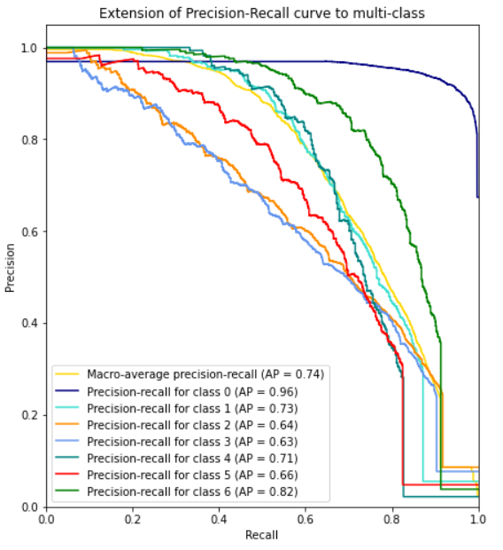
KNN: Results

Slide 15
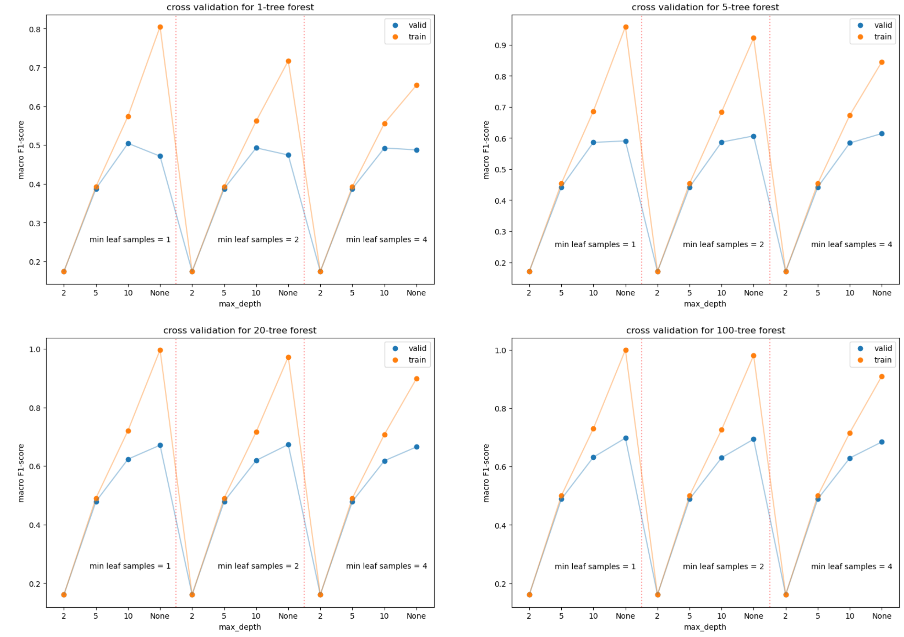
Random forest: Overfitting/Underfitting
The plots show all different parameter combinations from the grid:
Number of estimators: [1,5,20,100]
max depth: [2, 5, 10, None]
min samples per leaf: [1, 2, 4]
As expected, overfitting is not really a problem for random forests and only occurs when using a small number of trees with high depth

Slide 16
Random forests: Parameter Search / best parameters
First a randomized search was performed to narrow down parameter options for grid search
Parameters for randomized search:
'n_estimators': [1, 2, 10, 100, 200, 300, 400],
'criterion': ['gini', 'entropy', 'log_loss'],
'max_features': ['log2', 'sqrt'],
'max_depth': [1, 10, 40, 60, 80, 110, None],
'min_samples_split': [2, 3, 5, 8, 10, 15],
'min_samples_leaf': [1, 2, 4, 10],
'bootstrap': [True, False]
Then grid search was performed according to the outputs of randomized search to get fine-tuned parameters
Parameters for grid search:
'n_estimators': [200, 300, 400]
'criterion': ['entropy', 'log_loss']
'max_features': ['sqrt']
'max_depth': [40, 60, 110, None]
'min_samples_split': [2, 3, 5]
'min_samples_leaf': [1, 2]
'bootstrap': [False]

Slide 17
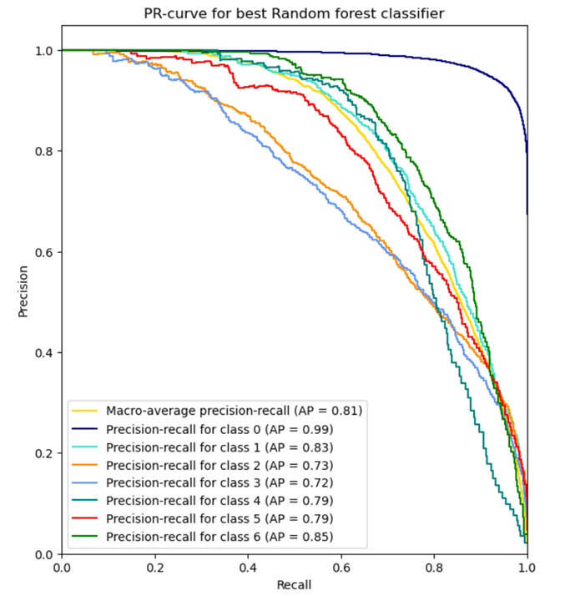
Random forests best
'n_estimators': 400
'criterion': 'log_loss',
'max_features': 'sqrt'
'max_depth': 40
'min_samples_split': 2
'min_samples_leaf': 1
'bootstrap': False
A classifier with higher number of estimators might perform even better but in order to keep training-time decent we did not consider more than 400 for now

Slide 18
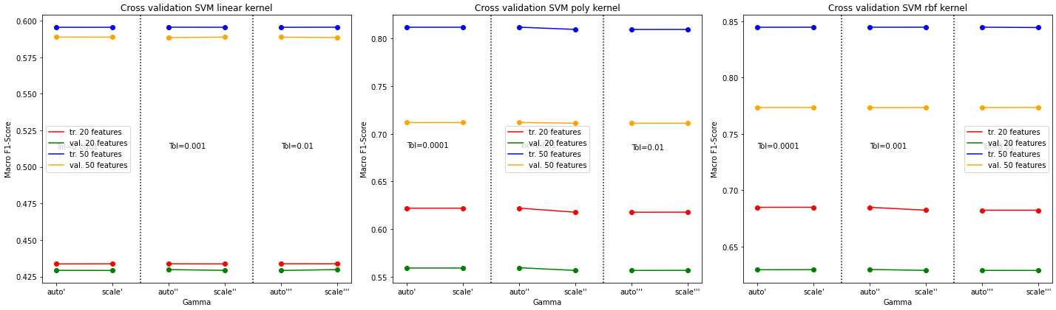
SVM Classifier: Settings
Show different Macro F1-score results of following parameter combination:
features=[20, 50]
kernel=[‘linear‘, ‘poly’, ‘rbf’]
gamma=[‘auto’, ‘scale’]
tol=[1e-4, 1e-3, 1e-2]
Plot shows differences in terms of features for each kernel split into different gamma values and chosen tolerances
No overfitting occurrence on trained combinations
In almost all cases linear kernel underperforms poly and rbf kernel -> there is no linear assumption on the data
Surprising: No real differences between different parameters for gamma and tol. throughout all kernel combinations. Expected changes for tol as it defines how quickly a model converges. Smaller tol results in more iterations but more precise results

Slide 19
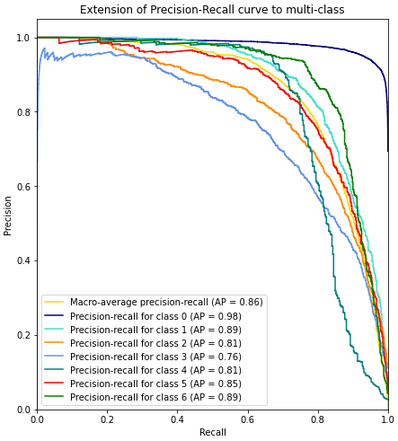
SVM Classifier: Parameter Search / Best Parameters
Run Grid-search with the following parameters:
features=[20, 50]
kernel=[‘poly’, ‘rbf’]
gamma=[‘auto’]
tol=[1e-3]
degree=[3,7,9,12] only for kernel=poly
Resulting best parameter combination:
features=50
kernel=‘rbf’
gamma=‘auto’
tol=1e-3

