Slide 1


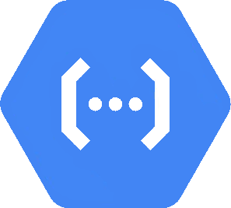




Timeframe Iteration
Controller
Cloud Scheduler Client API
Candle Processing Strategy
On trade activation it
creates a scheduler
that runs the strategy
per candle.
The runtime that executes the strategy.
Client Lib
Pub/ Sub
It is started and stopped per candle and its state is
deserialized/serialized before/afterwards.
Pub/Sub
Firebase HTTP
Other frontend technologies
Website
Trade Setup
The frontend to enter the trade setup.
The data structure that defines a trade (exchange, pair, size, strategy, time frame parameters,..).
Firebase HTTP

