Slide 1
Anti-Money Laundering Detection
with Graph Neural Networks & Manual Feature Engineering
Investigating whether manual feature engineering can improve expressiveness of GNNs
Presenter: Sandro Khizanishvili
Graph Mining and Applications · Sapienza University of Rome · 2026 ·

Slide 2
BACKGROUND
Anti-Money Laundering (AML)
Why it matters and why it's hard
$0.8–2T
<1%
3-Stage
laundered annually
(2–5% of global GDP)
of criminal proceeds
detected & seized
Placement · Layering
· Integration
Key Challenges
Why GNNs?
Severe class imbalance: 0.05% of transactions are illicit (1,941:1 ratio)
Laundering patterns span multiple hops — invisible in single transactions
Rule-based systems: >95% false positive rate
Real-time requirements, privacy constraints, evolving evasion tactics
Transactions form a financial network — naturally modelled as a directed graph
GNNs propagate suspicion signals across the network
Edge features (amounts, formats, timing) + node context jointly leveraged
Task: edge classification — predict “Is_Laundering” per transaction

Slide 3
MOTIVATION
GNNs & the 1-WL Expressiveness Ceiling
Why standard message passing fails on certain AML-critical graph structures
The 1-WL Test
Our Mitigation Strategy
Iteratively hashes multiset of neighbour colours:
Pre-compute structural information that 1-WL cannot derive and inject as input features
GFP (Graph Feature Preprocessor) — edge-level structural patterns:
Cycles, scatter-gather, vertex burst statistics
Provided as additional edge attributes before GNN runs
RWPE (Random Walk Positional Encoding) — node-level structural identity:
p(vv)^k = probability of k-step walk returning to v
Encodes cycle membership, hub status, structural role
Tested across GINe · GATv2 · PNA in 5 configurations each
c(v)ᵗ = HASH( c(v)ᵗ⁻¹, { c(u)ᵗ⁻¹ : u∈N(v) } )
Standard MP-GNNs ≡ 1-WL in expressiveness
Cannot distinguish: regular graphs with same degree sequence, equal-length cycles, symmetric substructures
Critical for AML: laundering patterns (rings, fan-outs, cycles) are exactly the structures 1-WL misses
Xu et al. HOW POWERFUL ARE GRAPH NEURAL NETWORKS? (2019): any MPNN is at most as powerful as 1-WL

Slide 4
DATA
IBM AML Dataset — LI-Small
Realistic synthetic financial transactions — Altman et al. (2023), NeurIPS Datasets & Benchmarks
6.9M
712K
0.05%
Transactions
(edges)
Bank Accounts
(nodes)
Laundering Rate
(1,941:1 ratio)
17 days
15
8
Sep 1–17 2022
(~10 active)
Payment
Currencies
Laundering
Pattern Types
Raw Data Files
LI-Small_Trans.csv: Timestamp, From/To Bank+Account, Amount Paid/Received, Currency Paid/Received, Payment Format, Is_Laundering (11 cols)
LI-Small_accounts.csv: Bank Name, Bank ID, Account Number, Entity ID, Entity Name (Corp / Individual / Partnership / Sole) (5 cols)

Slide 5
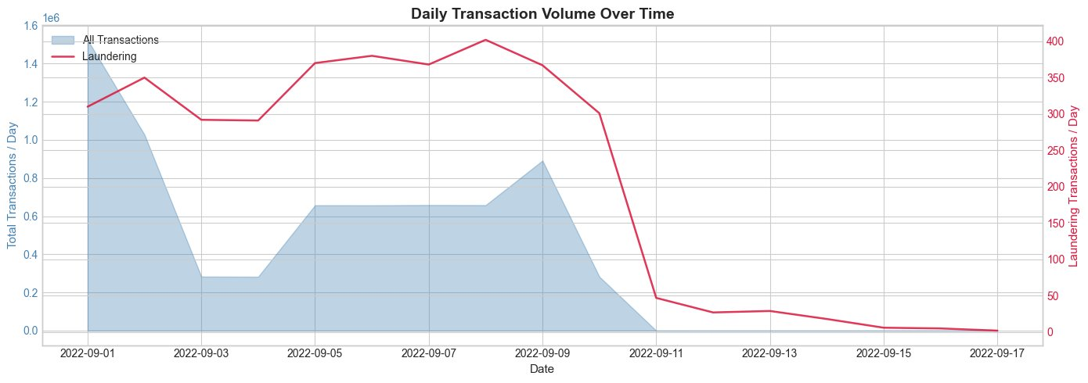
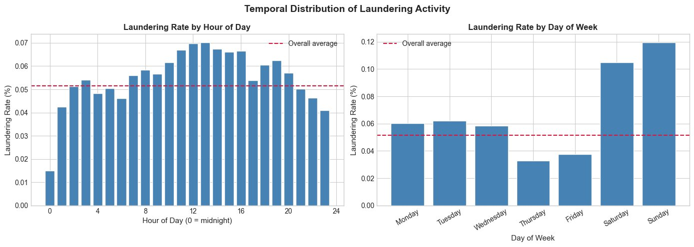
EXPLORATORY DATA ANALYSIS
Temporal Patterns
Transaction volume & laundering rate over time — daily and intraday analysis
Daily Transaction Volume + Laundering Count
Laundering Rate by Hour & Day
Peak hour: 13:00 (0.07%)
Minimum: midnight (0.015%)
Saturday: 2× average rate
Sunday: highest day (0.12%)
Cyclical sin/cos encoding used for hour + day features
⚠ Sep 11–17: only 223 total transactions — effective window is 10 days

Slide 6
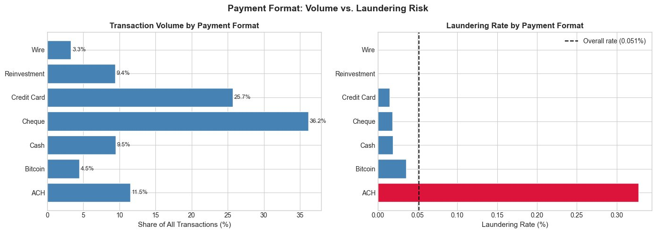
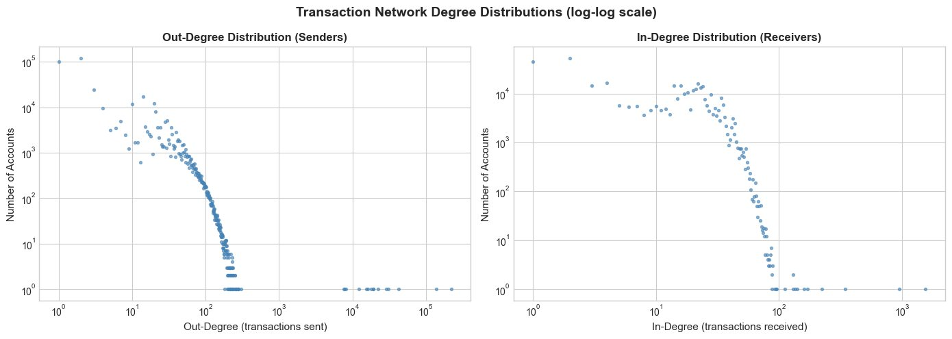
EXPLORATORY DATA ANALYSIS
Payment Format Risk & Network Structure
ACH is the dominant laundering signal · Scale-free network topology confirms graph approach
Payment Format: Volume vs. Laundering Risk
Degree Distribution (log-log)
“Scale-free”: max out-degree 222,037
Median out-degree: 2
Power-law confirms financial network realism
ACH: 0.33% laundering rate (6.4× avg) · Wire + Reinvestment: 0 laundering

Slide 7
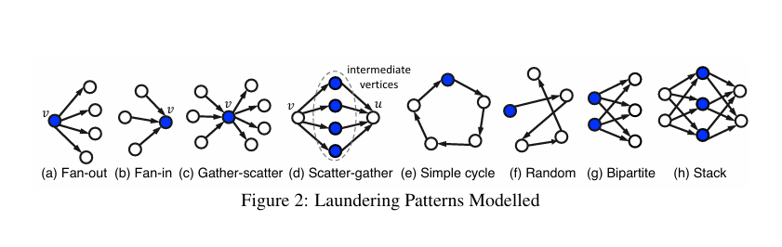
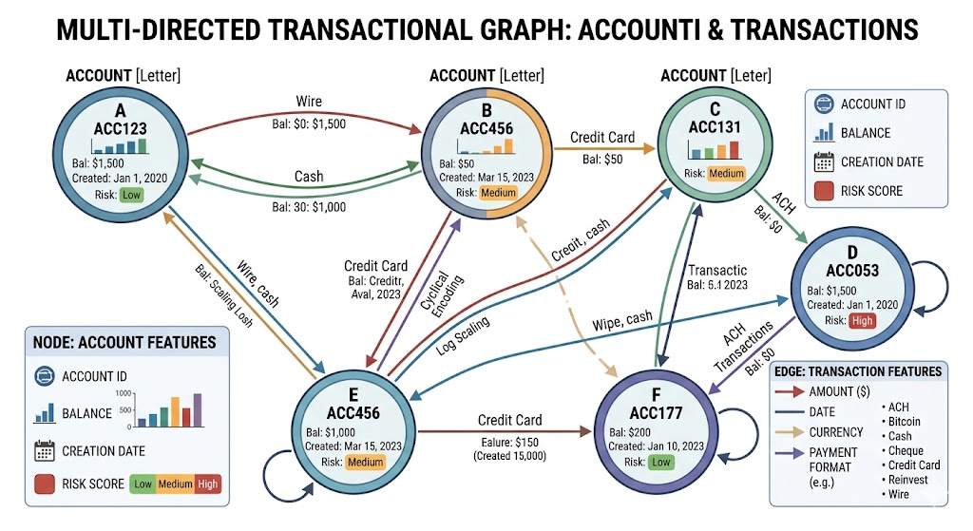
DATA — LAUNDERING TYPOLOGIES
Graph and 8 Base Laundering Pattern Types
No-leakage design · cumulative snapshot splits · edge classification task
Graph Temporal Split
Train (60%): 4,154,429 edges · 1,813 laundering (0.04%)
Val (20%): +1,384,810 edges · 827 laundering (0.06%)
Test (20%): +1,384,810 edges · 925 laundering (0.07%)

Slide 8
DATA PREPARATION
Feature Engineering & Graph Construction
No-leakage design · cumulative snapshot splits · edge classification task
Edge Features (16 dims)
Node Features (5 dims)
Amount_Log: log1p(Amount Paid) — compresses heavy tail
Currency_Mismatch: binary flag (1.43% of transactions)
Hour_Sin/Cos + DayOfWeek_Sin/Cos: cyclical encoding
Is_Weekend: binary (Saturday/Sunday 2× avg rate)
Is_ACH: binary — 0.33% laundering rate (6.4× avg)
Is_Self_Loop: sender == receiver (near-zero risk)
PayFmt_* (7 cols): one-hot payment format
Bank_ID_Norm: normalised bank identifier
EntType_* (4 cols): one-hot entity type
Train class ratio 2,290:1 · pos_weight in BCEWithLogitsLoss · Prior edges kept in val/test graphs to provide message-passing context

Slide 9
MODEL ARCHITECTURE
Encode–Decode Architecture
All architectures share the same pattern · Edge features used in EVERY message passing layer
Node &
Edge
Features
Linear
Projection
GNN Layer
×2
(MP)
Edge
Readout
(Decoder)
Score of Laundering
Input
node: 5→64
edge: 16→64
GINe/GATv2/PNA
MLP(h_src, h_dst, e_seed)
σ(logit)
Encoder
Decoder
node_proj: Linear(5 → 64)
edge_proj: Linear(16 → 64)
Per GNN layer: Conv → LayerNorm → ReLU → Dropout(0.3)
2 layers · hidden_dim=64
Edge features used in ALL GNN layers, not just decoder
For each seed edge (u→v): cat(h[u], h[v], e_seed) → [192]
MLP: Linear(192→64) → ReLU → LayerNorm → Dropout → Linear(64→1)
e_seed = ReLU(edge_proj(edge_label_attr))
Without e_seed: identical score for all transactions between same pair

Slide 10
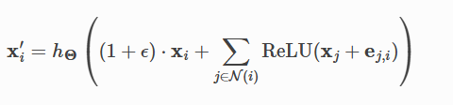




MODEL ARCHITECTURE
GNN Layers: GINe · GATv2 · PNA
All use edge features in message passing · 2 layers · hidden=64 · shared edge_proj
GINe (Graph Isomorphism Network + Edges)
GATv2 (Graph Attention Network v2)
[4 heads × 16 dims = 64 output · concat=True · add_self_loops=False]
PNA (Principal Neighborhood Aggregation)

Slide 11
EVALUATION
Evaluation Metrics for Imbalanced Classification
Standard accuracy meaningless at 1,941:1 imbalance — three specialised metrics used
PR-AUC
Precision-Recall Area Under Curve (Primary Metric)
Imbalance-robust: focuses on positive class. Random classifier → PR-AUC ≈ 0.05%
AUC( P(t) vs R(t) ) integrated over all thresholds
F1
F1 Score — Harmonic Mean of Precision & Recall
Balances false positives (costly investigations) and false negatives (missed crimes). Reported at validation-optimised threshold
F1 = 2·TP / (2·TP + FP + FN)
MCC
Matthews Correlation Coefficient
Uses all 4 confusion matrix cells. Range [-1,+1]; 0=random. Most reliable for severe imbalance
MCC = (TP·TN - FP·FN) / √( (TP+FP)(TP+FN)(TN+FP)(TN+FN) )

Slide 12
RESULTS — BASELINE
Baseline Model Results vs. Paper (Test Set)
Threshold optimised on validation set · Paper uses fixed threshold 0.5
Model | PR-AUC (%) | F1 (%) | MCC
Paper — GIN (Altman 2023) | — | 7.90 ± 2.78 | —
Paper — PNA | — | 16.45 ± 1.46 | —
Paper — GFP+XGBoost | — | 27.30 ± 0.33 | —
GINe Baseline (ours) | 3.46 | 9.62 | 13.02
GAT Baseline (ours) | 2.15 | 6.54 | 8.36
PNA Baseline (ours) | 21.73 | 24.88 | 30.54
PNA baseline (PR-AUC 21.73%) >> GINe (3.46%) >> GAT (2.15%)
4 aggregators + degree-aware scalers give PNA structural advantage without any extra features
GINe aligns with paper's GIN: 9.62% vs 7.90±2.78%

Slide 13
FEATURE ENGINEERING — GFP
Graph Feature Preprocessor (IBM SnapML)
Pre-computed edge-level structural patterns · Causal (only past edges used) · 61 additional dims
4 GFP Pattern Groups
Why GFP for AML?
Scatter-Gather Histogram (3 dims)
Time window: 6h · Bins: [2–3), [3–5), [5–∞)
Rapid gather-then-scatter pattern intensity
Temporal Cycle Histogram (3 dims)
Time window: 24h · Bins: [2–3), [3–5), [5–∞)
Round-trips A→B→A and ring cycles closing within 24h
Length-Constrained Cycle Histogram (3 dims)
24h window · max_len=6 (paper uses 10) · Bins: [2,3,5]
Simple cycles of length 2–6
Vertex Statistics (52 dims)
24h window · Source + dest · Out/In edges
fan, degree, ratio, avg, sum, var, skew, kurtosis per col
Columns: Timestamp + Amount_USD (FX-corrected to USD)
Directly encodes structures invisible to 1-WL GNNs
Scatter-Gather → canonical smurfing/layering signal
Temporal cycles → round-trips, rings (laundering red flags)
Vertex statistics → burst behaviour, sudden transaction volume spikes at unusual hours
Total: 16 baseline + 61 GFP = 77 edge feature dims

Slide 14
FEATURE ENGINEERING — RWPE
Random Walk Positional Encoding (RWPE)
Structural node identity · Directly addresses 1-WL symmetry at node level · K=8 walk steps
What RWPE Captures for AML
How RWPE Works
Transition matrix: Â = D⁻¹A
High p(vv)^2 → account involved in A→B→A round-trips
High p(vv)^3 → participant in 3-node laundering ring
High p(vv)^k → member of cycle of length k
Hub accounts have distinctive return probability profiles
Node-level signal: complements GFP's edge-level patterns
Peripheral accounts (1–2 transactions) have near-zero return probabilities at all k
RWPE(v) = [ (Â¹)_vv, (Â²)_vv, ..., (Âᴷ)_vv ] ∈ ℝᴷ
K=8: captures cycles of length 2–8
Applied per snapshot (train/val/test) using only that snapshot's edges — no temporal leakage
Node feature dim: 5 + 8 = 13
Implementation: AddRandomWalkPE from PyG transforms
Walk length interpretation:
k=2: A→B→A round-trips (simplest cycle)
k=3,4: 3-4 node laundering rings
k=5,6: multi-layer shell company chains
k=7,8: extended cross-jurisdiction cycles
Only change: node_proj = Linear(13→64) instead of Linear(5→64)

Slide 15
ARCHITECTURE — GFP SPLIT PROJECTION
GFP Split Projection — Injecting GFP Directly into the Decoder
"Enhanced" architecture · GFP bypasses message passing entirely · Best strategy for GINe & GAT
Standard GFP (all 77 dims through encoder)
Split Projection (GFP decode-only injection)
e0 = ReLU(edge_proj(edge_attr_77)) → GNN
Encoder: edge_proj_base(edge_attr[:,:16]) → GNN
Decoder: cat(h_src, h_dst, e_seed_77) → 3×64=192
Decoder: cat(h_src, h_dst, e_base, e_gfp) → 4×128=512
Problem: GFP's pre-computed structural summaries are re-processed through the same aggregation designed for raw features
May dilute the discriminative precision of GFP cycle scores and scatter-gather counts
GNN learns structural embeddings from raw transaction features only (clean encoder)
GFP's pattern scores injected directly at classification — MLP can combine both signals with full precision
GNN learns structural embeddings from raw transaction features only (clean encoder)
GFP's pattern scores injected directly at classification — MLP combines both with full precision
Component | Baseline | Standard GFP | GFP Split Projection
node_proj | Linear(5→64) | Linear(5→64) | Linear(5→128)
edge_proj (encoder) | Linear(16→64) | Linear(77→64) | Linear(16→128)
edge_proj_gfp (decoder only) | — | — | Linear(61→128)
Decoder input | 3×64=192 | 3×64=192 | 4×128=512

Slide 16
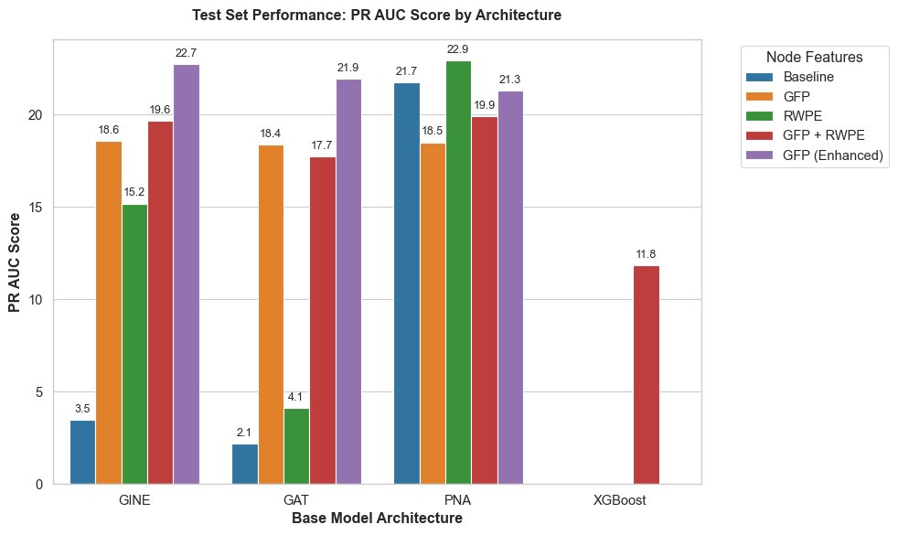
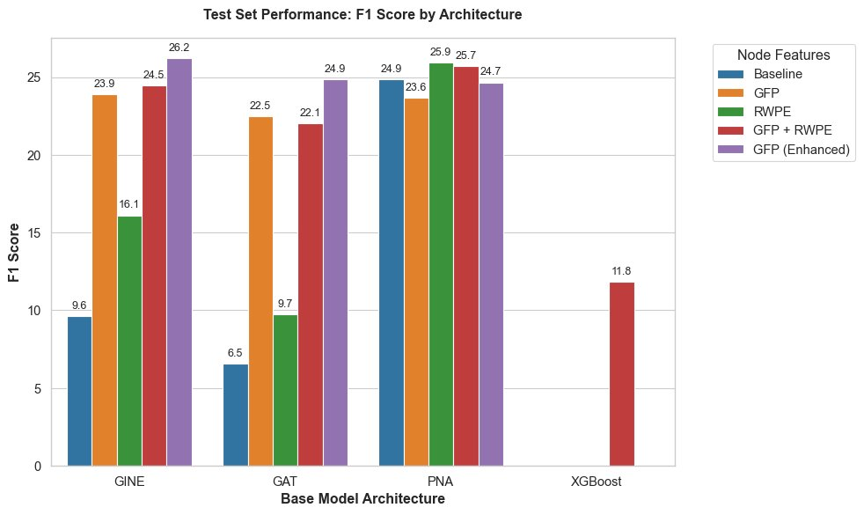
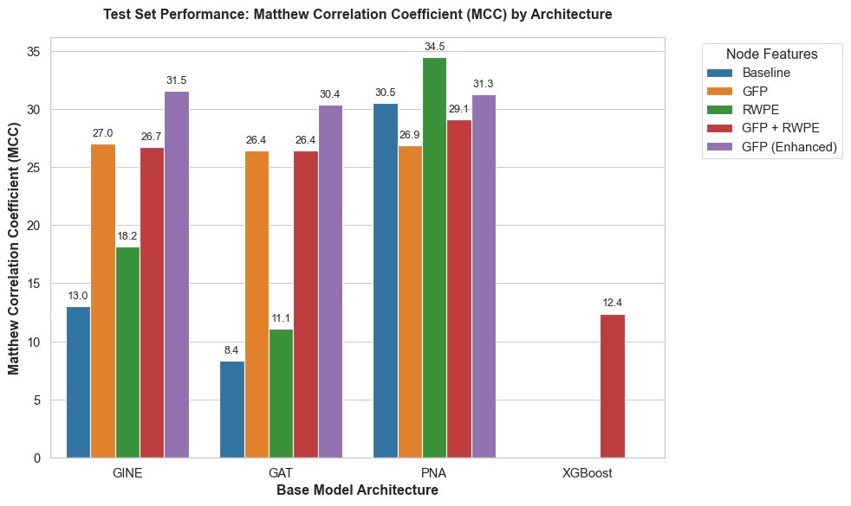
RESULTS — OVERALL
Test Set Performance: PR-AUC · F1 · MCC
All architectures × all feature configurations · threshold optimised on validation set
GINe
GAT
PNA
XGBoost
Best: GFP Split (Enh)
Best: GFP Split (Enh)
Best: RWPE
Best: GFP+RWPE
PR 22.7 F1 26.2 MCC 31.5
PR 21.9 F1 24.9 MCC 30.4
PR 22.9 F1 25.9 MCC 34.5
PR 11.8 F1 11.8 MCC 12.4
+19.3 pp PR
+19.8 pp PR
+3.95 MCC
reference
GFP Split Projection is best for GINe & GAT · RWPE is best for PNA · PNA+RWPE achieves highest MCC (34.5 = best class separability)

Slide 17
RESULTS — FULL COMPARISON
All Model Results — Test Set
Model | PR-AUC (%) | F1 (%) | MCC
GINe Baseline | 3.46 | 9.62 | 13.02
GINe + GFP | 18.56 | 23.88 | 27.02
GINe + RWPE | 15.17 | 16.11 | 18.18
GINe + GFP+RWPE | 19.65 | 24.46 | 26.70
GINe + GFP Split ★ | 22.73 | 26.24 | 31.54
GAT Baseline | 2.15 | 6.54 | 8.36
GAT + GFP | 18.38 | 22.47 | 26.44
GAT + RWPE | 4.09 | 9.72 | 11.07
GAT + GFP+RWPE | 17.70 | 22.05 | 26.41
GAT + GFP Split ★ | 21.91 | 24.87 | 30.35
PNA Baseline | 21.73 | 24.88 | 30.54
PNA + GFP | 18.49 | 23.65 | 26.87
PNA + RWPE ★ | 22.94 | 25.92 | 34.49
PNA + GFP+RWPE | 19.89 | 25.71 | 29.10
PNA + GFP Split | 21.27 | 24.66 | 31.28
★ Best per architecture · GFP Split Projection = GFP (Enhanced) · Highlighted in teal

Slide 18
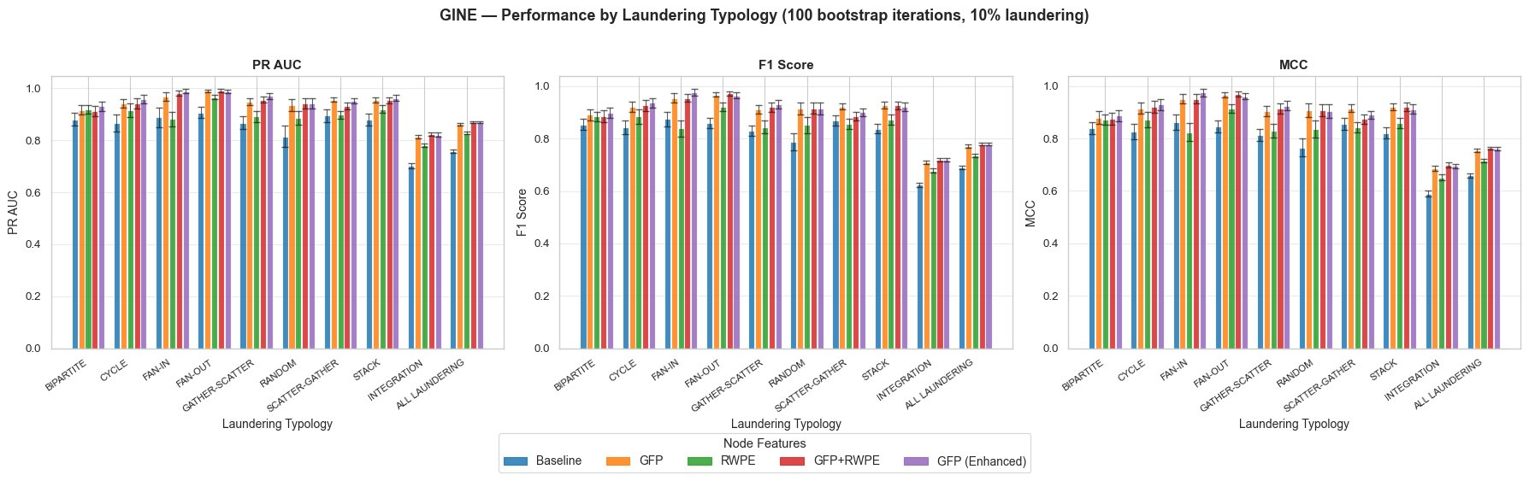
RESULTS — PER-TYPOLOGY ANALYSIS
GINe: Performance by Laundering Typology
100 bootstrap iterations · 10% laundering sampling · PR-AUC · F1 · MCC per pattern type
Key Observations for GINe
Fan-In/Fan-Out: GFP and GFP+RWPE approach ~1.0 PR-AUC — vertex statistics capture hub behaviour perfectly · Integration (layering transitions) and ALL LAUNDERING aggregate are harder (~0.7–0.85 PR-AUC) · GFP Enhanced (purple) consistently on top or near-top across all typologies · RWPE helps most for Cycle and Random patterns

Slide 19
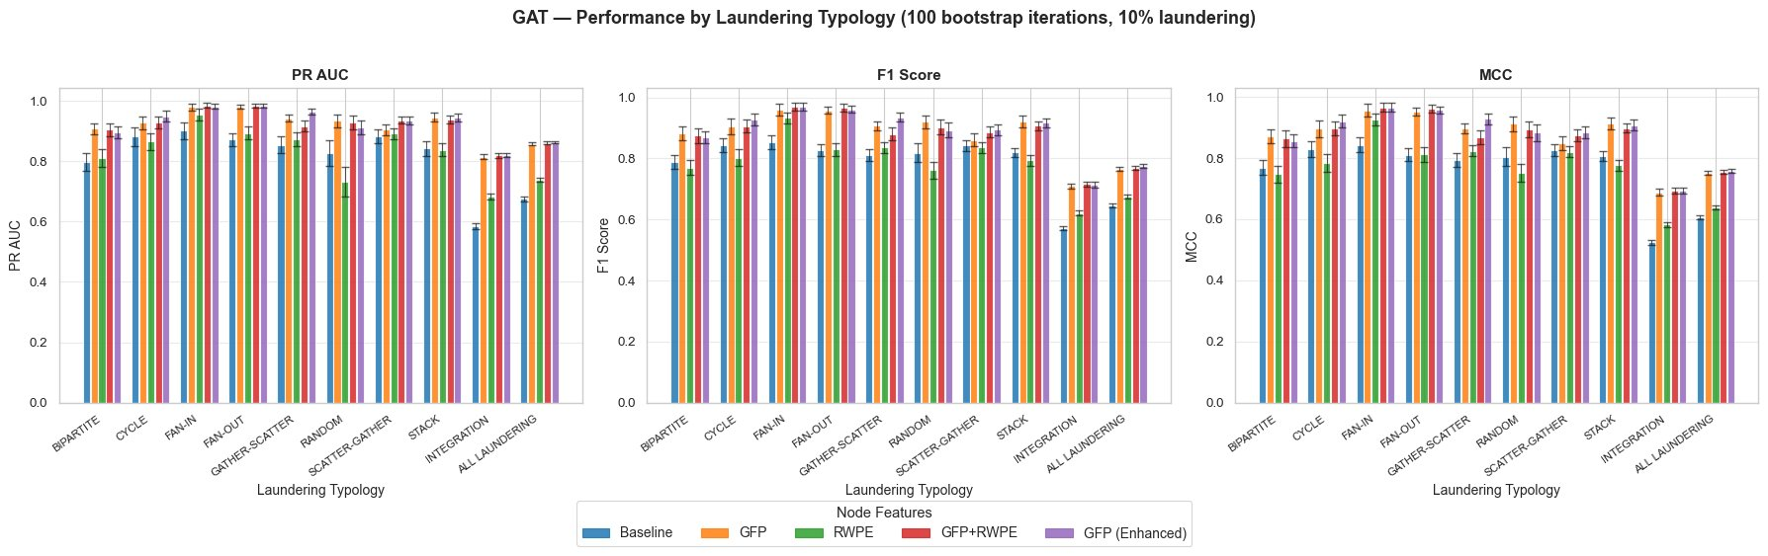
RESULTS — PER-TYPOLOGY ANALYSIS
GAT: Performance by Laundering Typology
100 bootstrap iterations · 10% laundering sampling · PR-AUC · F1 · MCC per pattern type
Key Observations for GAT
GAT baseline drops to ~0.58 PR-AUC for Integration — most dramatic weakness · GFP (orange) and GFP Enhanced (purple) strongly recover performance across all typologies · RWPE (green) alone provides modest gains — attention needs explicit structural patterns more than node position · GFP+RWPE does not consistently beat GFP alone for GAT

Slide 20
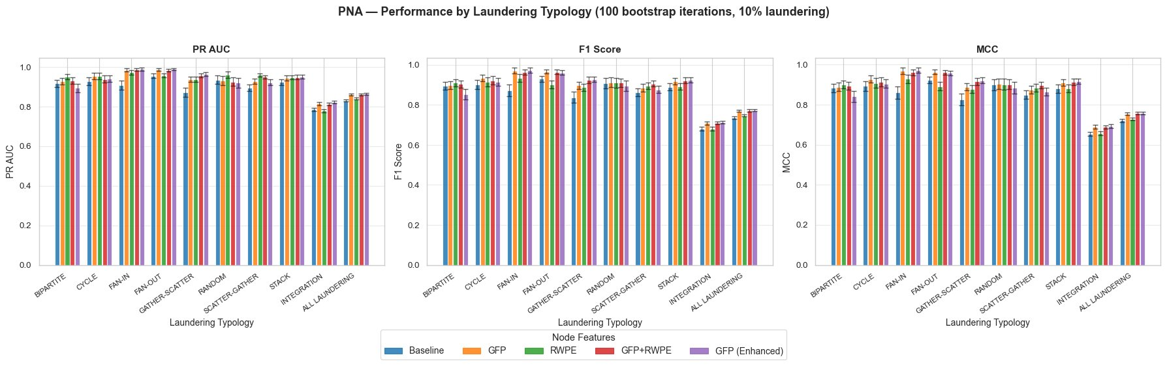
RESULTS — PER-TYPOLOGY ANALYSIS
PNA: Performance by Laundering Typology
100 bootstrap iterations · 10% laundering sampling · PR-AUC · F1 · MCC per pattern type
Key Observations for PNA
PNA baseline (blue) already strong (~0.9+ PR-AUC) across all typologies — multi-aggregators compensate for 1-WL · All configurations nearly indistinguishable per typology — RWPE's MCC gain (34.5) is aggregate, not typology-specific · Integration & ALL LAUNDERING hardest for all (~0.75–0.85 PR-AUC)

Slide 21
ANALYSIS & FINDINGS
Key Findings & Conclusions
What the experiments tell us about feature engineering and 1-WL limitations
✅ Feature engineering DOES mitigate 1-WL
🔀 Split Projection: best strategy for GINe & GAT
GFP and RWPE both provide meaningful uplift. GFP increases PR-AUC by +15–20 pp for GINe/GAT; RWPE gives PNA +3.95 MCC. Structures invisible to 1-WL are captured when pre-computed as features.
Bypassing GFP from the encoder and injecting directly into the decoder outperforms standard GFP for both architectures. GINe+GFP Split: PR-AUC 22.73%, MCC 31.54 — best GINE result.
📐 RWPE + PNA synergy is remarkable
🏆 PNA baseline is surprisingly strong
RWPE's structural node identity amplifies PNA's degree-aware scalers. PNA+RWPE achieves highest MCC (34.49) = best class separability. RWPE adds little to GAT/GINe without PNA's multi-aggregator framework.
PNA achieves PR-AUC 21.73% with no extra features — competitive with GFP-enhanced GINe/GAT. Multiple aggregators + degree-aware scalers inherently capture richer structure than single-aggregator GNNs.

Slide 22
FUTURE WORK
Future Directions
Open experiments and potential improvements
🔬 Primary Untested Experiment: GFP Split + RWPE
Combine split projection (clean encoder) with RWPE node embeddings (13-dim nodes + baseline 16-dim encoder). Decoder: cat(h_src, h_dst, e_base, e_gfp). Expected to combine best of both strategies — strongest predicted configuration for GINe and GAT especially.
📊 Higher-Order GNNs
🔧 Full GFP Config
🕐 Temporal GNNs
Test k-WL models (OSAN, NGNN) that provably exceed 1-WL — theoretical upper bound vs. feature engineering
lc-cycle max_len=10 (paper default vs. our 6) — capture longer laundering cycles spanning more jurisdictions
TGN / TGAT: explicit temporal modelling may better capture rapid layering within short time windows
🔀 Ensemble
📐 Feature Ablation
🏦 Real-World Data
GINe+GFP Split + PNA+RWPE ensemble — complementary strengths may achieve best precision-recall balance
Which GFP group contributes most? Cycles vs. scatter-gather vs. vertex stats — systematic ablation needed
Validate on real (non-synthetic) AML datasets — test if structural features generalise beyond IBM synthetic distribution

Slide 23
Thank you for your attention!
Graph Mining and Applications · Sapienza University of Rome · 2026 ·

