Slide 1
The Importance of Being Calibrated: A Study on Probability Calibration and Interval Estimation for Binary Classification
Elisa Terzini, Sezer Mezgil, Sandro Khizanishvili
Statistical Learning
Sapienza University of Rome
Sep 2025

Slide 2
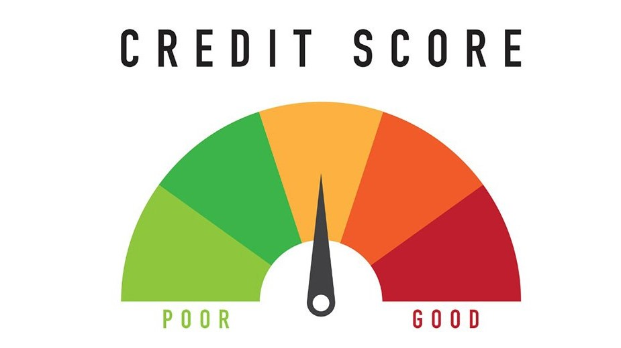
Agenda
Introduction & Motivation: Can We Trust a Model's Confidence?
Accuracy is Not Enough: Discrimination vs. Calibration
Calibration Methods: Platt, Isotonic, and Venn-Abers
Our Dataset & Experimental Setup
Credit Risk Data Preparation
Results on Credit Risk Data: Accuracy vs. Calibration
Simulated Data Generation
Results on Simulated Data
Probability Intervals
Conclusion & Key Takeaways
References
Statistical Learning - The Importance of Being Calibrated: A Study on Probability Calibration and Interval Estimation for Binary Classification

Slide 3
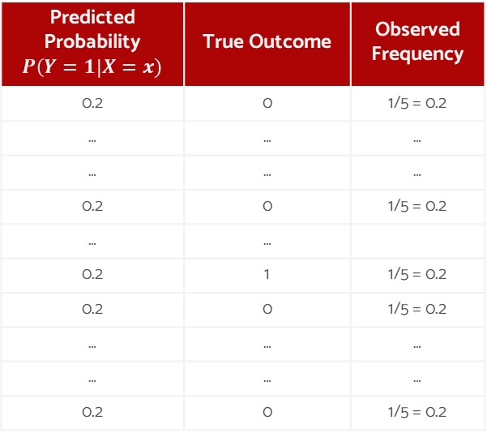
Introduction & Motivation: Can We Trust a Model's Confidence?
Question:
A model predicts a 20% chance of positive class. What does this actually mean?
For a well-calibrated model, over many predictions, a model that gives a 20% probability score should be correct approximately 20% of the time for similar predictions
Predicted Probability $P\left(Y=1\right|X=x)$ | True Outcome | Observed Frequency
0.2 | 0 | 1/5 = 0.2
… | … | …
… | … | …
0.2 | 0 | 1/5 = 0.2
… | …
0.2 | 1 | 1/5 = 0.2
0.2 | 0 | 1/5 = 0.2
… | … | …
… | … | …
0.2 | 0 | 1/5 = 0.2
But:
Most powerful modern algorithms (e.g., SVM, GBM, Random Forests, Logistic Regression ….) are naturally "scoring classifiers". They excel at discrimination (ranking instances) but are often poorly calibrated.
Statistical Learning - The Importance of Being Calibrated: A Study on Probability Calibration and Interval Estimation for Binary Classification

Slide 4
Agenda
Introduction & Motivation: Can We Trust a Model's Confidence?
Accuracy is Not Enough: Discrimination vs. Calibration
Calibration Methods: Platt, Isotonic, and Venn-Abers
Our Dataset & Experimental Setup
Credit Risk Data Preparation
Results on Credit Risk Data: Accuracy vs. Calibration
Simulated Data Generation
Results on Simulated Data
Probability Intervals: Bootstrap vs. Venn-Abers
Conclusion & Key Takeaways
References
Statistical Learning - The Importance of Being Calibrated: A Study on Probability Calibration and Interval Estimation for Binary Classification

Slide 5
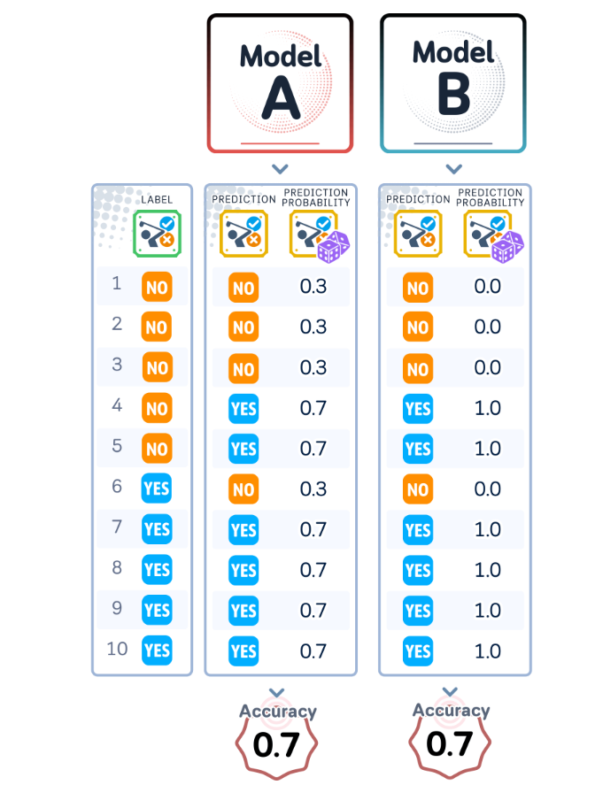
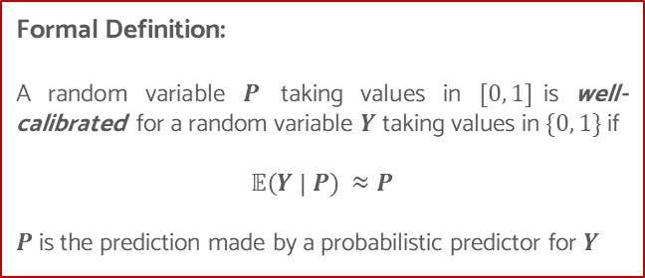
Accuracy is Not Enough: Discrimination vs. Calibration
Discrimination vs Calibration:
Two models that are equally accurate (70% correct) show different levels of confidence in their predictions. Model A uses well-calibrated probabilities while Model B only uses extreme probabilities.
Formal Definition:
A random variable $P$ taking values in $[0, 1]$is well-calibrated for a random variable $Y$ taking values in $\{0, 1\}$ if
$$𝔼\left(Y \right| P) ≈P$$
$P$is the prediction made by a probabilistic predictor for $Y$
Statistical Learning - The Importance of Being Calibrated: A Study on Probability Calibration and Interval Estimation for Binary Classification

Slide 6
Agenda
Introduction & Motivation: Can We Trust a Model's Confidence?
Accuracy is Not Enough: Discrimination vs. Calibration
Calibration Methods: Platt, Isotonic, and Venn-Abers
Our Dataset & Experimental Setup
Credit Risk Data Preparation
Results on Credit Risk Data: Accuracy vs. Calibration
Simulated Data Generation
Results on Simulated Data
Probability Intervals
Conclusion & Key Takeaways
References
Statistical Learning - The Importance of Being Calibrated: A Study on Probability Calibration and Interval Estimation for Binary Classification

Slide 7
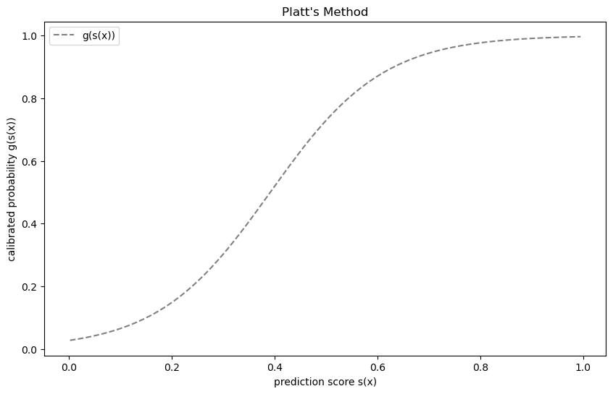
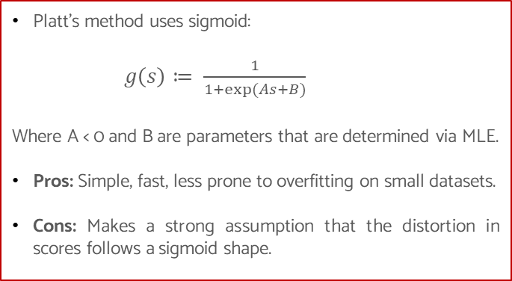
Calibration Methods: Platt’s method
Platt’s method uses sigmoid:
$g\left(s\right)≔ \frac{1}{1+exp⁡(As+B)}$
Where A < 0 and B are parameters that are determined via MLE.
Pros: Simple, fast, less prone to overfitting on small datasets.
Cons: Makes a strong assumption that the distortion in scores follows a sigmoid shape.
Statistical Learning - The Importance of Being Calibrated: A Study on Probability Calibration and Interval Estimation for Binary Classification

Slide 8
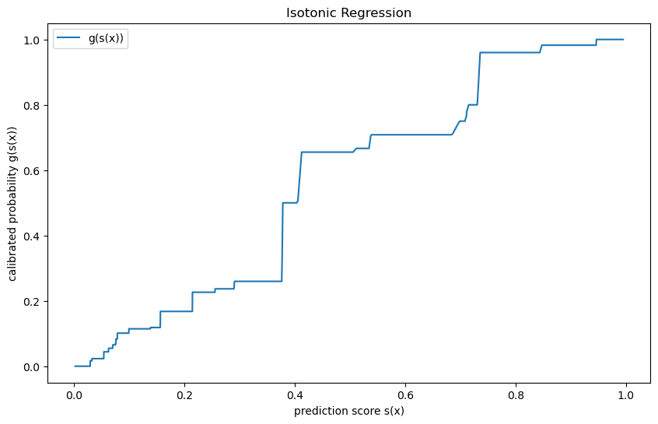
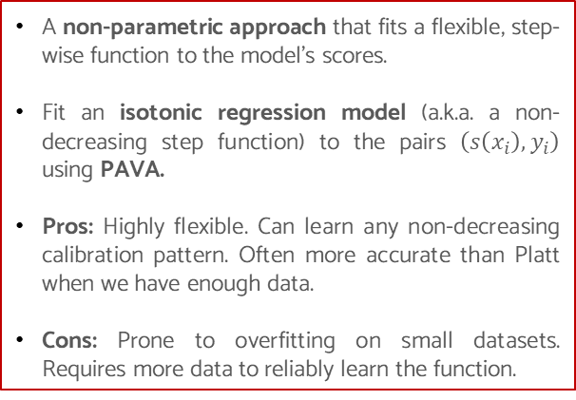
Calibration Methods: Isotonic Regression
A non-parametric approach that fits a flexible, step-wise function to the model's scores.
Fit an isotonic regression model (a.k.a. a non-decreasing step function) to the pairs $\left(s\left(x_{i}\right),y_{i}\right)$ using PAVA.
Pros: Highly flexible. Can learn any non-decreasing calibration pattern. Often more accurate than Platt when we have enough data.
Cons: Prone to overfitting on small datasets. Requires more data to reliably learn the function.
Statistical Learning - The Importance of Being Calibrated: A Study on Probability Calibration and Interval Estimation for Binary Classification

Slide 9
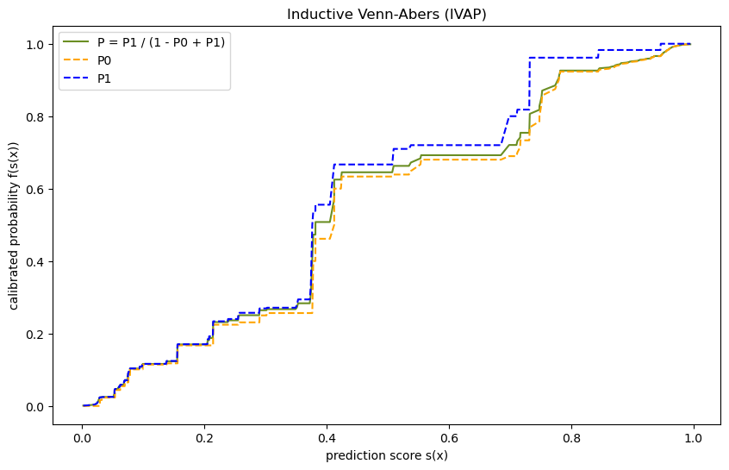
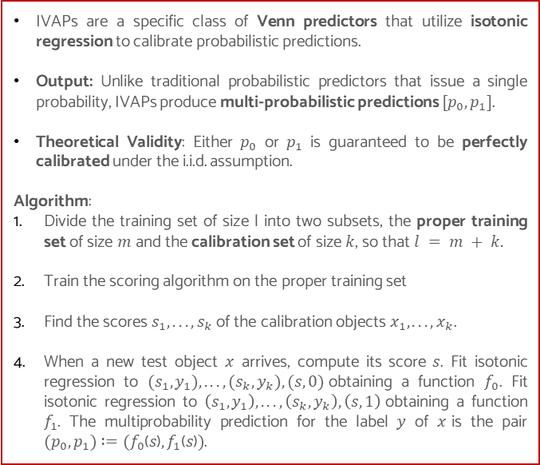
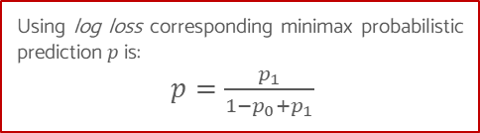
Calibration Methods: Inductive Venn-Abers predictors (IVAPs)
IVAPs are a specific class of Venn predictors that utilize isotonic regression to calibrate probabilistic predictions.
Output: Unlike traditional probabilistic predictors that issue a single probability, IVAPs produce multi-probabilistic predictions $[p_{0},p_{1}]$.
Theoretical Validity: Either $p_{0}$ or $p_{1}$ is guaranteed to be perfectly calibrated under the i.i.d. assumption.
Algorithm:
Divide the training set of size l into two subsets, the proper training set of size $m$ and the calibration set of size $k$, so that $l = m + k.$
Train the scoring algorithm on the proper training set
Find the scores $s_{1}, . . . ,s_{k}$of the calibration objects${ x}_{1}, . . . ,x_{k}$.
When a new test object $x$ arrives, compute its score $s$. Fit isotonic regression to $(s_{1},y_{1}), . . . ,(s_{k},y_{k}),(s, 0)$obtaining a function $f_{0}$. Fit isotonic regression to $\left(s_{1},y_{1}\right), . . . ,\left(s_{k},y_{k}\right),\left(s, 1\right)$obtaining a function $f_{1}$. The multiprobability prediction for the label $y$ of $x$is the pair $(p_{0},p_{1}) :=(f_{0}\text{(}s\text{)},f_{1}\text{(}s\text{)})$.
Using log loss corresponding minimax probabilistic prediction $p$ is:
$p=\frac{p_{1}}{1−p_{0}+p_{1}}$
Statistical Learning - The Importance of Being Calibrated: A Study on Probability Calibration and Interval Estimation for Binary Classification

Slide 10
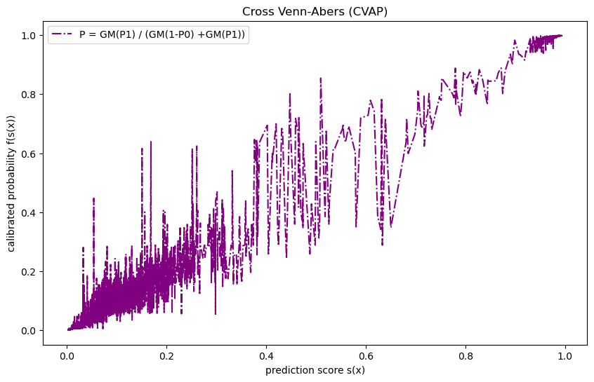
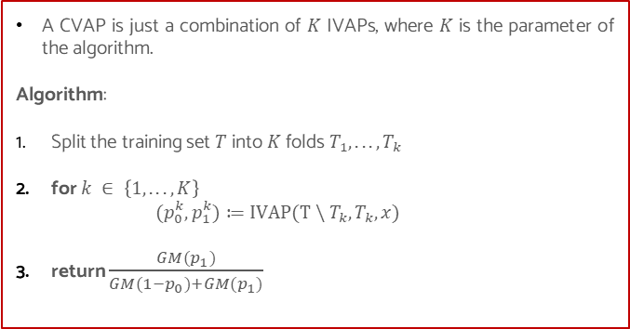
Calibration Methods: Cross Venn-Abers predictors (CVAPs)
A CVAP is just a combination of $K$ IVAPs, where $K$ is the parameter of the algorithm.
Algorithm:
Split the training set $T$ into $K$ folds $T_{1}, . . . ,T_{k}$
for $k ∈ \left\{1, . . . , K\right\}$
${(p}_{0}^{k},p_{1}^{k})≔IVAP(T \backslash T_{k}, T_{k}, x)$
return $\frac{GM(p_{1})}{GM(1−p_{0})+{GM(p}_{1})}$
Statistical Learning - The Importance of Being Calibrated: A Study on Probability Calibration and Interval Estimation for Binary Classification

Slide 11
Agenda
Introduction & Motivation: Can We Trust a Model's Confidence?
Accuracy is Not Enough: Discrimination vs. Calibration
Calibration Methods: Platt, Isotonic, and Venn-Abers
Our Dataset & Experimental Setup
Credit Risk Data Preparation
Results on Credit Risk Data: Accuracy vs. Calibration
Simulated Data Generation
Results on Simulated Data
Probability Intervals
Conclusion & Key Takeaways
References
Statistical Learning - The Importance of Being Calibrated: A Study on Probability Calibration and Interval Estimation for Binary Classification

Slide 12
Our Dataset & Experimental Setup
Data
Credit Risk Data
Source: Kaggle
Objective: Binary classification task to predict customer default (Default vs. No Default).
Size: 32,461 instances
Features: 11 features (e.g., income, loan amount, credit history)
Class Balance: 78% No Default (0); 22% Default (1)
Simulated Data
Source: Beta distribution
Objective: To study calibration in an idealized setting with known ground truth, we simulated 'model scores' from two distinct Beta distributions
Size: 1,000 / 10,000 / 50,000
Class Balance: 5%, 10%, 20%, 30%, 40%, 50%
Model | Calibration Methods Applied | Interval Estimation | Discrimination Evaluation Metrics | Calibration Evaluation Metrics
Logistic Regression | Platt’s Method Isotonic Regression Venn-Abers | Venn-Abers 500 samples Bootstrap (2.5% , 97.5%) | ROC AUC KS statistics Log Loss | Log Loss Brier Score ECE (Expected Calibration Error)
XGBoost |  | Venn-Abers
Statistical Learning - The Importance of Being Calibrated: A Study on Probability Calibration and Interval Estimation for Binary Classification

Slide 13
Agenda
Introduction & Motivation: Can We Trust a Model's Confidence?
Accuracy is Not Enough: Discrimination vs. Calibration
Calibration Methods: Platt, Isotonic, and Venn-Abers
Our Dataset & Experimental Setup
Credit Risk Data Preparation
Results on Credit Risk Data: Accuracy vs. Calibration
Simulated Data Generation
Results on Simulated Data
Probability Intervals
Conclusion & Key Takeaways
References
Statistical Learning - The Importance of Being Calibrated: A Study on Probability Calibration and Interval Estimation for Binary Classification

Slide 14
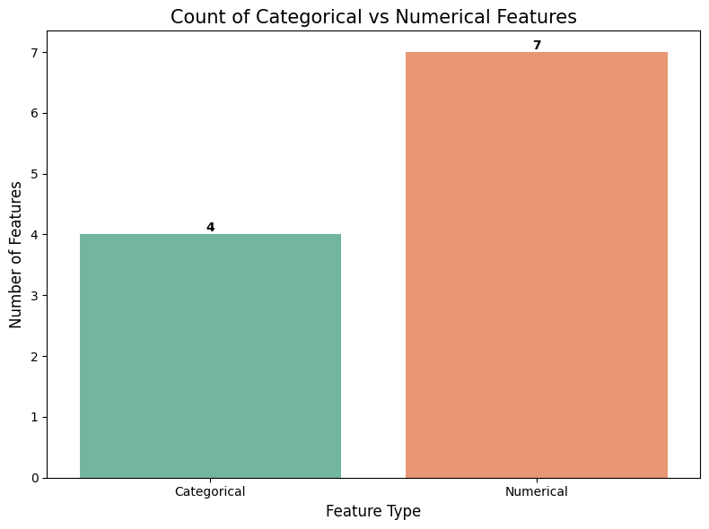
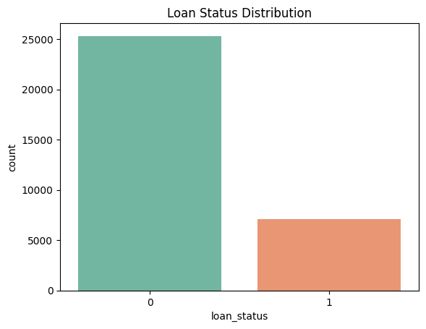
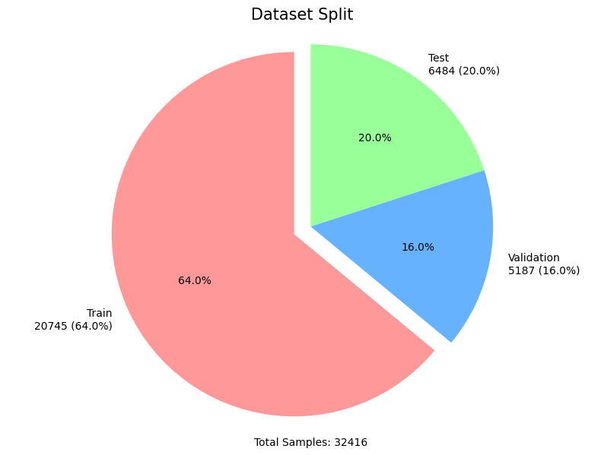
Credit Risk Data Preparation
EDA: Before any data preprocessing we explored our dataset.
Dataset Split: The dataset was first divided into three sets: training, validation, and test.
Outlier Capping: We capped outlier values in the features to reduce their impact on model performance.
Missing Value Imputation: Missing values in the dataset were handled by applying appropriate imputation methods to ensure data completeness.
Target Encoding for Categorical Features: Categorical features were encoded using target encoding, where the mean of the target variable for each category was used to represent the categorical feature.
person_age;
person_income;
person_emp_length;
loan_amnt;
loan_int_rate;
loan_percent_income;
cb_person_cred_hist_length;
home_ownership;
loan_intent;
loan_grade;
cb_person_default_on_file
Statistical Learning - The Importance of Being Calibrated: A Study on Probability Calibration and Interval Estimation for Binary Classification

Slide 15
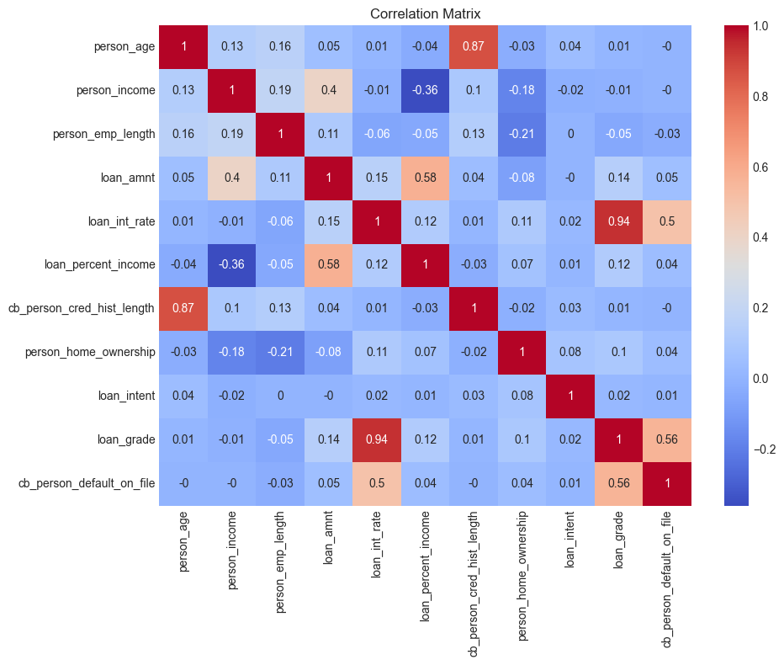
Credit Risk Data Preparation (Feature Selection)
Correlation Analysis: We calculated the correlations between features and identified highly correlated ones. Features with high correlation were dropped based on their relevance and interpretability.
Stability Check with PSI: To ensure feature stability, we used Population Stability Index (PSI) to compare feature distributions across the training and validation sets. This helped us identify features that might cause data drift or instability.
Correlation exclusion: ‘person_age’ , ‘loan_int_rate’
PSI exclusion: All features are stable!
Statistical Learning - The Importance of Being Calibrated: A Study on Probability Calibration and Interval Estimation for Binary Classification

Slide 16
Agenda
Introduction & Motivation: Can We Trust a Model's Confidence?
Accuracy is Not Enough: Discrimination vs. Calibration
Calibration Methods: Platt, Isotonic, and Venn-Abers
Our Dataset & Experimental Setup
Credit Risk Data Preparation
Results on Credit Risk Data: Accuracy vs. Calibration
Simulated Data Generation
Results on Simulated Data
Probability Intervals
Conclusion & Key Takeaways
References
Statistical Learning - The Importance of Being Calibrated: A Study on Probability Calibration and Interval Estimation for Binary Classification

Slide 17
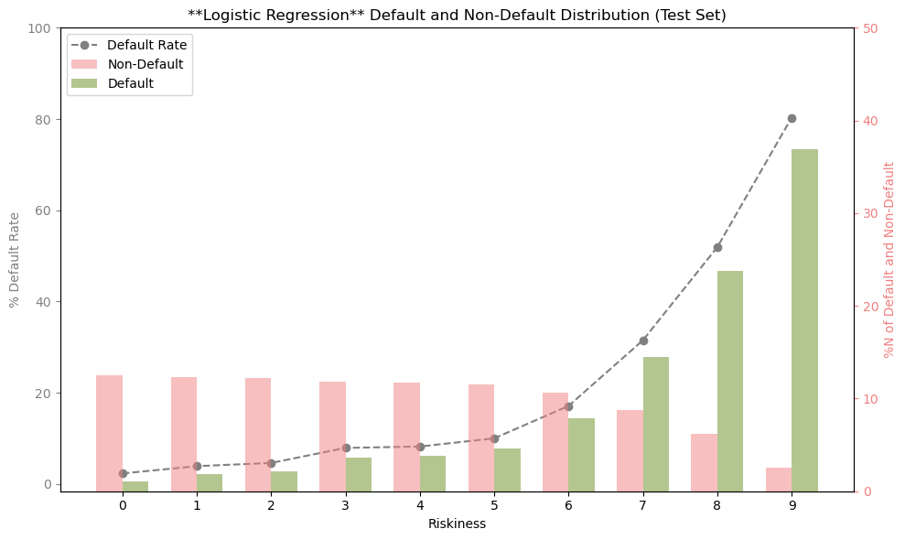
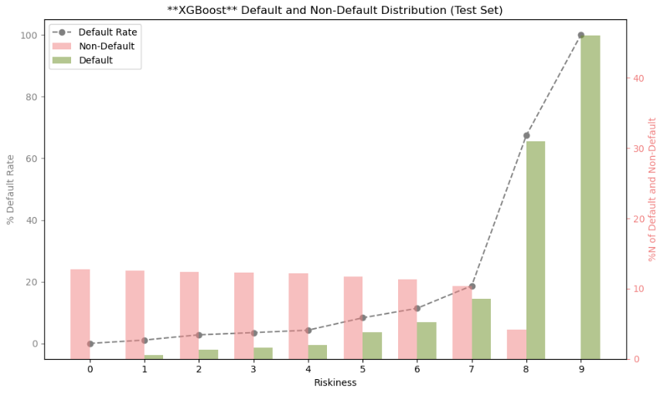
Results on Credit Risk Data: Accuracy
Logistic Regression
XGBoost
 | Train | Valid | Test
ROC AUC | 0.86 | 0.87 | 0.86
KS statistics | 0.56 | 0.58 | 0.58
Log Loss | 0.359 | 0.345 | 0.357
 | Train | Valid | Test
ROC AUC | 0.96 | 0.94 | 0.94
KS statistics | 0.77 | 0.74 | 0.73
Log Loss | 0.187 | 0.194 | 0.203
Statistical Learning - The Importance of Being Calibrated: A Study on Probability Calibration and Interval Estimation for Binary Classification

Slide 18
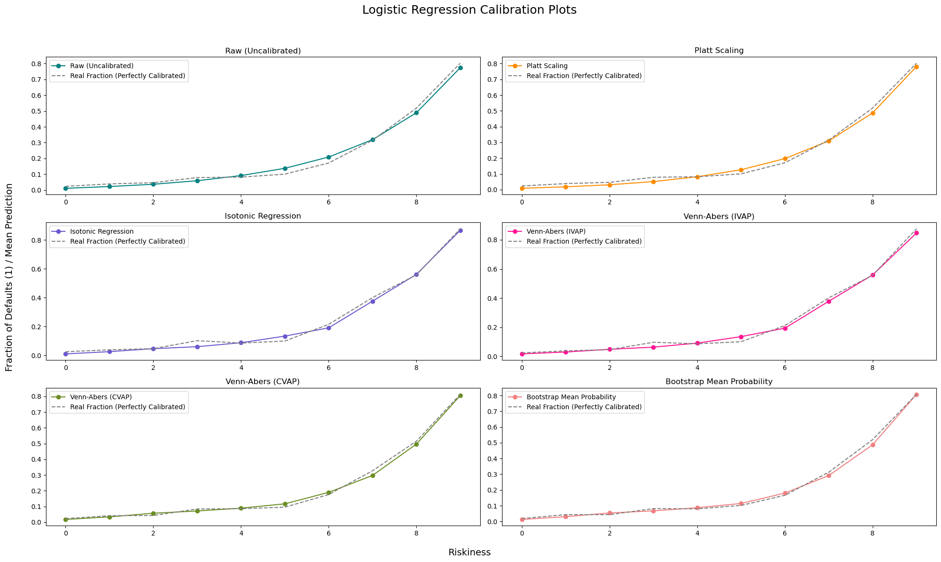
Results on Credit Risk Data: Calibration (Logistic Regression)
Valid/Calib Set
 | ECE | Log Loss | Brier Score
Raw | 0.017 | 0.345 | 0.106
Platt | 0.016 | 0.344 | 0.105
Isotonic | 0 | 0.337 | 0.104
IVAP | 0.005 | 0.339 | 0.104
CVAP | 0.012 | 0.343 | 0.105
Bootstrap | 0.009 | 0.341 | 0.105
Test Set
 | ECE | Log Loss | Brier Score
Raw | 0.022 | 0.357 | 0.109
Platt | 0.02 | 0.357 | 0.109
Isotonic | 0.015 | 0.385 | 0.109
IVAP | 0.016 | 0.356 | 0.109
CVAP | 0.013 | 0.354 | 0.108
Bootstrap | 0.013 | 0.359 | 0.108
Statistical Learning - The Importance of Being Calibrated: A Study on Probability Calibration and Interval Estimation for Binary Classification

Slide 19
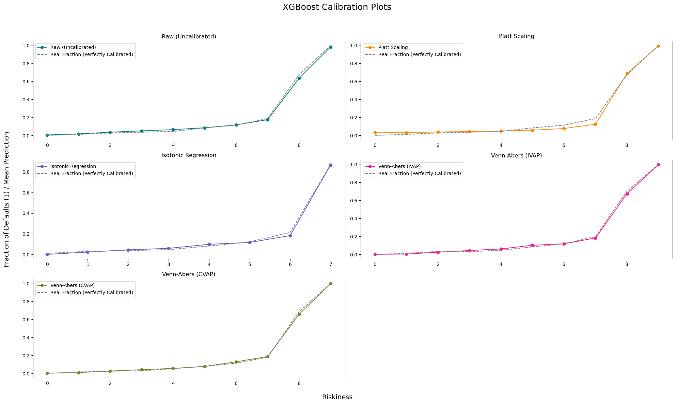
Results on Credit Risk Data: Calibration (XGBoost)
Valid/Calib Set
 | ECE | Log Loss | Brier Score
Raw | 0.015 | 0.194 | 0.053
Platt | 0.023 | 0.198 | 0.053
Isotonic | 0 | 0.183 | 0.052
IVAP | 0.004 | 0.186 | 0.052
CVAP | 0.019 | 0.172 | 0.048
Test Set
 | ECE | Log Loss | Brier Score
Raw | 0.013 | 0.203 | 0.056
Platt | 0.018 | 0.207 | 0.057
Isotonic | 0.010 | 0.267 | 0.056
IVAP | 0.010 | 0.201 | 0.056
CVAP | 0.008 | 0.1990 | 0.056
Statistical Learning - The Importance of Being Calibrated: A Study on Probability Calibration and Interval Estimation for Binary Classification

Slide 20
Agenda
Introduction & Motivation: Can We Trust a Model's Confidence?
Accuracy is Not Enough: Discrimination vs. Calibration
Calibration Methods: Platt, Isotonic, and Venn-Abers
Our Dataset & Experimental Setup
Credit Risk Data Preparation
Results on Credit Risk Data: Accuracy vs. Calibration
Simulated Data Generation
Results on Simulated Data
Probability Intervals
Conclusion & Key Takeaways
References
Statistical Learning - The Importance of Being Calibrated: A Study on Probability Calibration and Interval Estimation for Binary Classification

Slide 21
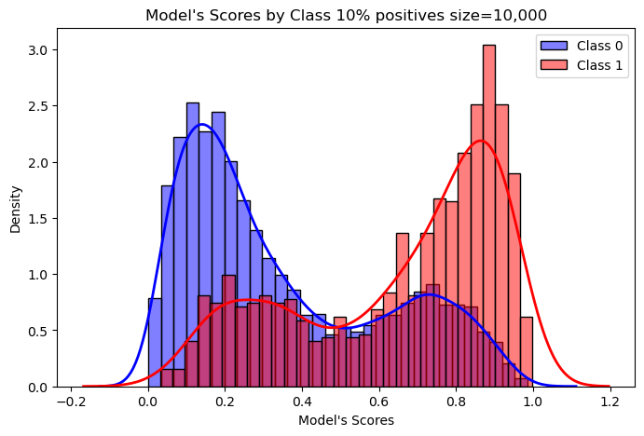
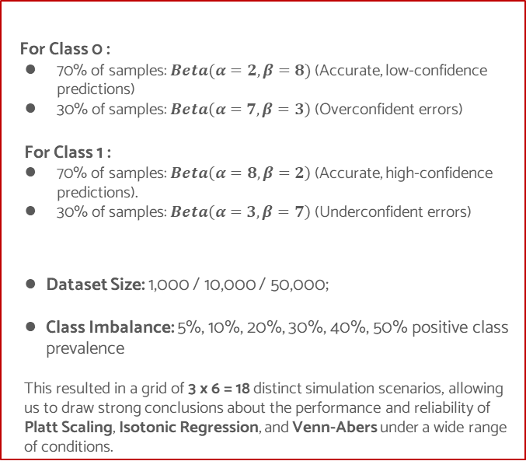
Simulated Data Generation
For Class 0 :
70% of samples: $Beta(α=2, β=8)$ (Accurate, low-confidence predictions)
30% of samples: $Beta\left(α=7, β=3\right)$ (Overconfident errors)
For Class 1 :
70% of samples: $Beta\left(α=8, β=2\right)$ (Accurate, high-confidence predictions).
30% of samples: $Beta\left(α=3, β=7\right)$(Underconfident errors)
Dataset Size: 1,000 / 10,000 / 50,000;
Class Imbalance: 5%, 10%, 20%, 30%, 40%, 50% positive class prevalence
This resulted in a grid of 3 x 6 = 18 distinct simulation scenarios, allowing us to draw strong conclusions about the performance and reliability of Platt Scaling, Isotonic Regression, and Venn-Abers under a wide range of conditions.
Data Generation Process
Simulation Scenarios
Statistical Learning - The Importance of Being Calibrated: A Study on Probability Calibration and Interval Estimation for Binary Classification

Slide 22
Agenda
Introduction & Motivation: Can We Trust a Model's Confidence?
Accuracy is Not Enough: Discrimination vs. Calibration
Calibration Methods: Platt, Isotonic, and Venn-Abers
Our Dataset & Experimental Setup
Credit Risk Data Preparation
Results on Credit Risk Data: Accuracy vs. Calibration
Simulated Data Generation
Results on Simulated Data
Probability Intervals
Conclusion & Key Takeaways
References
Statistical Learning - The Importance of Being Calibrated: A Study on Probability Calibration and Interval Estimation for Binary Classification

Slide 23
Results on Simulated Data
ECE
Size = 1,000
 | RW | PS | ISO | IVAP
5% | 0.309 | 0.015 | 0.015 | 0.015
10% | 0.302 | 0.042 | 0.050 | 0.048
20% | 0.232 | 0.052 | 0.035 | 0.052
30% | 0.140 | 0.037 | 0.032 | 0.025
40% | 0.083 | 0.059 | 0.070 | 0.066
50% | 0.090 | 0.067 | 0.073 | 0.050
ECE
Size = 10,000
 | RW | PS | ISO | IVAP
5% | 0.312 | 0.008 | 0.008 | 0.008
10% | 0.277 | 0.013 | 0.011 | 0.009
20% | 0.218 | 0.021 | 0.013 | 0.015
30% | 0.143 | 0.021 | 0.024 | 0.023
40% | 0.075 | 0.016 | 0.012 | 0.011
50% | 0.063 | 0.031 | 0.020 | 0.019
ECE
Size = 50,000
 | RW | PS | ISO | IVAP
5% | 0.314 | 0.005 | 0.004 | 0.004
10% | 0.277 | 0.014 | 0.006 | 0.006
20% | 0.207 | 0.014 | 0.008 | 0.008
30% | 0.139 | 0.017 | 0.011 | 0.012
40% | 0.073 | 0.026 | 0.013 | 0.012
50% | 0.053 | 0.015 | 0.012 | 0.012
Log Loss
Size = 1,000
 | RW | PS | ISO | IVAP
5% | 0.599 | 0.175 | 0.279 | 0.176
10% | 0.609 | 0.275 | 0.283 | 0.281
20% | 0.566 | 0.398 | 0.401 | 0.405
30% | 0.573 | 0.497 | 0.720 | 0.495
40% | 0.555 | 0.533 | 0.637 | 0.529
50% | 0.581 | 0.566 | 0.563 | 0.562
Log Loss
Size = 10,000
 | RW | PS | ISO | IVAP
5% | 0.562 | 0.176 | 0.176 | 0.176
10% | 0.561 | 0.274 | 0.274 | 0.274
20% | 0.560 | 0.395 | 0.395 | 0.395
30% | 0.551 | 0.478 | 0.490 | 0.479
40% | 0.574 | 0.547 | 0.549 | 0.549
50% | 0.568 | 0.558 | 0.555 | 0.555
Log Loss
Size = 50,000
 | RW | PS | ISO | IVAP
5% | 0.564 | 0.172 | 0.173 | 0.171
10% | 0.554 | 0.268 | 0.267 | 0.267
20% | 0.557 | 0.406 | 0.405 | 0.405
30% | 0.558 | 0.489 | 0.493 | 0.488
40% | 0.559 | 0.535 | 0.537 | 0.533
50% | 0.559 | 0.550 | 0.552 | 0.550
Statistical Learning - The Importance of Being Calibrated: A Study on Probability Calibration and Interval Estimation for Binary Classification

Slide 24
Results on Simulated Data
Brier Score
Size = 1,000
 | RW | PS | ISO | IVAP
5% | 0.190 | 0.043 | 0.043 | 0.043
10% | 0.206 | 0.079 | 0.082 | 0.081
20% | 0.190 | 0.124 | 0.125 | 0.126
30% | 0.194 | 0.165 | 0.166 | 0.164
40% | 0.188 | 0.178 | 0.177 | 0.177
50% | 0.199 | 0.193 | 0.193 | 0.192
Brier Score
Size = 10,000
 | RW | PS | ISO | IVAP
5% | 0.191 | 0.044 | 0.044 | 0.045
10% | 0.190 | 0.078 | 0.079 | 0.079
20% | 0.190 | 0.124 | 0.125 | 0.125
30% | 0.184 | 0.157 | 0.157 | 0.157
40% | 0.195 | 0.184 | 0.185 | 0.185
50% | 0.192 | 0.189 | 0.187 | 0.187
Brier Score
Size = 50,000
 | RW | PS | ISO | IVAP
5% | 0.191 | 0.044 | 0.044 | 0.044
10% | 0.187 | 0.077 | 0.077 | 0.077
20% | 0.188 | 0.128 | 0.128 | 0.128
30% | 0.189 | 0.161 | 0.161 | 0.161
40% | 0.189 | 0.179 | 0.179 | 0.179
50% | 0.188 | 0.185 | 0.185 | 0.185
Platt’s Scaling: ECE – 4/18; Log Loss - 9/18; Brier Score – 13/18;
Isotonic Regression: ECE – 12/18; Log Loss – 6/18; Brier Score – 11/18;
Inductive Venn-Abers: ECE – 12/18; Log Loss – 13/18; Brier Score – 13/18;
Overall Performance
Statistical Learning - The Importance of Being Calibrated: A Study on Probability Calibration and Interval Estimation for Binary Classification

Slide 25
Agenda
Introduction & Motivation: Can We Trust a Model's Confidence?
Accuracy is Not Enough: Discrimination vs. Calibration
Calibration Methods: Platt, Isotonic, and Venn-Abers
Our Dataset & Experimental Setup
Credit Risk Data Preparation
Results on Credit Risk Data: Accuracy vs. Calibration
Simulated Data Generation
Results on Simulated Data
Probability Intervals
Conclusion & Key Takeaways
References
Statistical Learning - The Importance of Being Calibrated: A Study on Probability Calibration and Interval Estimation for Binary Classification

Slide 26
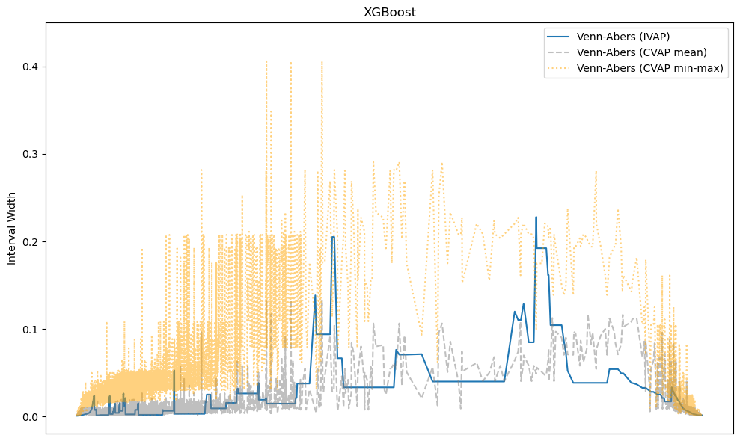
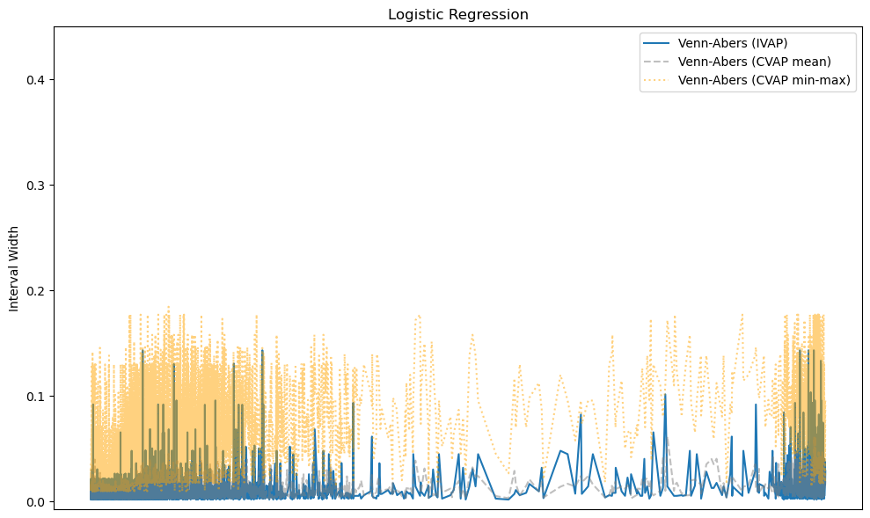
Probability Intervals
Model | Method | Average Interval Width
XGBoost | IVAP | 0.0067
XGBoost | CVAP (Mean) | 0.0069
Logistic Reg | IVAP | 0.0080
Logistic Reg | CVAP (Mean) | 0.0081
XGBoost | CVAP (Min, Max) | 0.0333
Logistic Reg | CVAP (Min, Max) | 0.0514
Logistic Reg (Bootstrap) | (2.5%, 97.5%) | 0.0627
Statistical Learning - The Importance of Being Calibrated: A Study on Probability Calibration and Interval Estimation for Binary Classification

Slide 27
Agenda
Introduction & Motivation: Can We Trust a Model's Confidence?
Accuracy is Not Enough: Discrimination vs. Calibration
Calibration Methods: Platt, Isotonic, and Venn-Abers
Our Dataset & Experimental Setup
Credit Risk Data Preparation
Results on Credit Risk Data: Accuracy vs. Calibration
Simulated Data Generation
Results on Simulated Data
Probability Intervals
Conclusion & Key Takeaways
References
Statistical Learning - The Importance of Being Calibrated: A Study on Probability Calibration and Interval Estimation for Binary Classification

Slide 28
Conclusion & Key Takeaways
Calibration is a Crucial, Separate Property from Accuracy: a model can be highly accurate yet poorly calibrated, making its probability scores misleading and untrustworthy for real-world risk assessment. Explicitly measuring and improving calibration is essential for any application relying on probabilistic predictions.
The Best Calibration Method is Context-Dependent:
Platt Scaling: A good, fast default for simple models like Logistic Regression.
Isotonic Regression: Powerful but can overfit on small datasets. Excellent for larger, well-behaved datasets.
Venn-Abers Predictors: Provide robust, distribution-free calibration guarantees and are highly competitive, especially on complex models like XGBoost. They offer a unique advantage: inherently valid probability intervals.
For Precise Uncertainty Quantification, Venn-Abers is Superior: Our results demonstrate that Venn-Abers predictors (IVAP and CVAP mean) generate prediction intervals that are significantly tighter than traditional bootstrap methods, while maintaining validity. This makes them ideal for applications requiring precise uncertainty estimates.
Statistical Learning - The Importance of Being Calibrated: A Study on Probability Calibration and Interval Estimation for Binary Classification

Slide 29
Agenda
Introduction & Motivation: Can We Trust a Model's Confidence?
Accuracy is Not Enough: Discrimination vs. Calibration
Calibration Methods: Platt, Isotonic, and Venn-Abers
Our Dataset & Experimental Setup
Credit Risk Data Preparation
Results on Credit Risk Data: Accuracy vs. Calibration
Simulated Data Generation
Results on Simulated Data
Probability Intervals
Conclusion & Key Takeaways
References
Statistical Learning - The Importance of Being Calibrated: A Study on Probability Calibration and Interval Estimation for Binary Classification

Slide 30
References
Dataset - https://www.kaggle.com/datasets/laotse/credit-risk-dataset
Vovk, Vladimir, Ivan Petej. "Venn-Abers predictors". Proceedings of the Thirtieth Conference on Uncertainty in Artificial Intelligence (2014) (arxiv version https://arxiv.org/pdf/1211.0025)
Vovk, Vladimir, Ivan Petej and Valentina Fedorova. "Large-scale probabilistic predictors with and without guarantees of validity." Advances in Neural Information Processing Systems 28 (2015) (arxiv version https://arxiv.org/pdf/1511.00213)
Model Calibration, Explained- https://towardsdatascience.com/model-calibration-explained-a-visual-guide-with-code-examples-for-beginners-55f368bafe72/
Venn-Abers implementation - https://github.com/ip200/venn-abers
Statistical Learning - The Importance of Being Calibrated: A Study on Probability Calibration and Interval Estimation for Binary Classification

Slide 31
Thank you for the attention!
Sep 2025

