Slide 1
Agenda

Slide 2
Generative AI Project Life Cycle

Slide 3
GenAI Life Cycle Project
1
2
3
4
Define a use case
Choose a model provider
Evaluate
Deploy & Optimize
Prompt Engineering
Fine-tune
Integrate with systems
Align with Human feedback
Observability
Monitoring

Slide 4
GenAI Life Cycle Project
1
Define a use case
Business First: Put efforts on what adds business value
Define: Functional and non-Functional requirements
Challenge : Don’t say 'yes' to everything

Slide 5
GenAI Life Cycle Project
2
Choose a model provider
Prioritize Serverless and Managed Services first
Do Not Over Engineer this ease the dev process and focuses on building solid project
Start Small and then complexify only if needed
Integrate with systems

Slide 6
GenAI Life Cycle Project
3
Evaluate
Define the metrics associated to the Functional and non-Functional requirements
Build Ground Truth datasets
You can change only what you see
Involve the business
Prompt Engineering
Fine-tune
Align with Human feedback
Observability

Slide 7
GenAI Life Cycle Project
4
Deploy & Optimize
Be obsessed by the Cost/Performance/Operation dimensions
Observe what is happening the power of the feedback loop
Monitor the infrastructure
Observability
Monitoring

Slide 8
GenAI Project Lifecycle
Your sales team wants an AI chatbot that can answer any customer question instantly and close deals automatically. The dev team is excited to start building.
What should be your FIRST priority as a project leader?
A) Define clear functional and non-functional requirements with measurable success criteria
B) Select the most powerful LLM model available to ensure quality
C) Start with a proof of concept using GPT-4
D) Benchmark different model providers for cost optimization
Notes:
Emphasize that business requirements must come first. Many GenAI projects fail because teams jump to implementation without clear success criteria.

Slide 9
Model Provider Selection
You're building an internal knowledge assistant. Requirements: 100K daily queries, 99.9% uptime, confidential data, <2s response, $3K/month budget.
What's your primary consideration for model selection?
A) Choose the highest-performing model on benchmarks
B) Balance performance, cost, latency, and data privacy requirements → Challenge the requirements
C) Always use open-source models for cost savings
D) Select the most popular provider for community support
Notes:
Model selection requires balancing multiple factors. The 'best' model on paper may not be best for your use case.

Slide 10
Prompt Engineering

Slide 11
1
2
3
4
Define a use case
Choose a model provider
Evaluate
Deploy & Optimize
Prompt Engineering
Fine-tune
Integrate with systems
Align with Human feedback
Observability
Monitoring

Slide 12
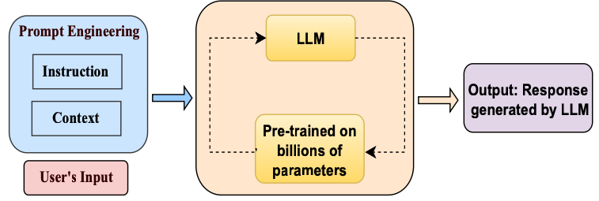
Prompt Definition
A Systematic Survey of Prompt Engineering - 2024

Slide 13
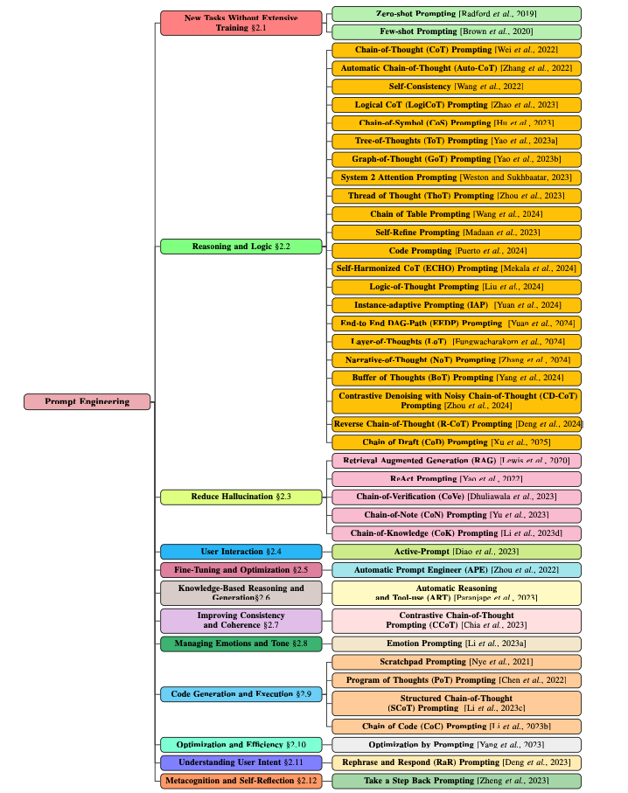
Measuring Agents in Production

Slide 14
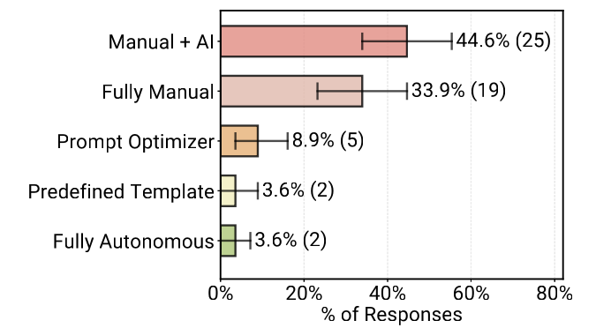
What happens with real use case?
Measuring Agents in Production - 2025

Slide 15
Why Prompt Engineering
1
Easiest way to control LLM output
2
Less technical concept, easy to grasp
3
Low cost / high impact

Slide 16
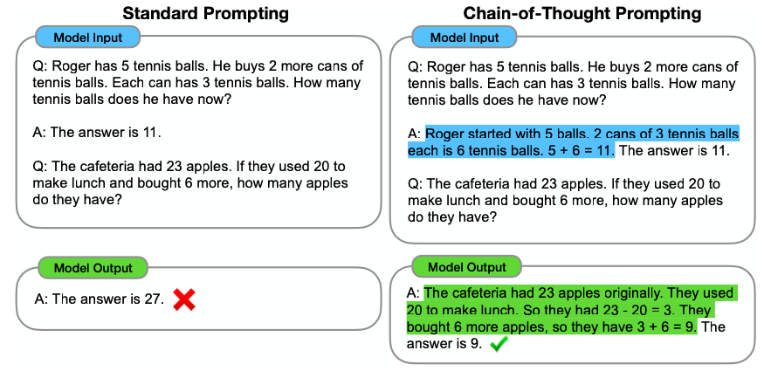
Chain-of-Thought
Chain-of-Thought Prompting Elicits Reasoning in Large Language Models - 2022
Notes:
Explain 0 Shot / Few Shot

Slide 17
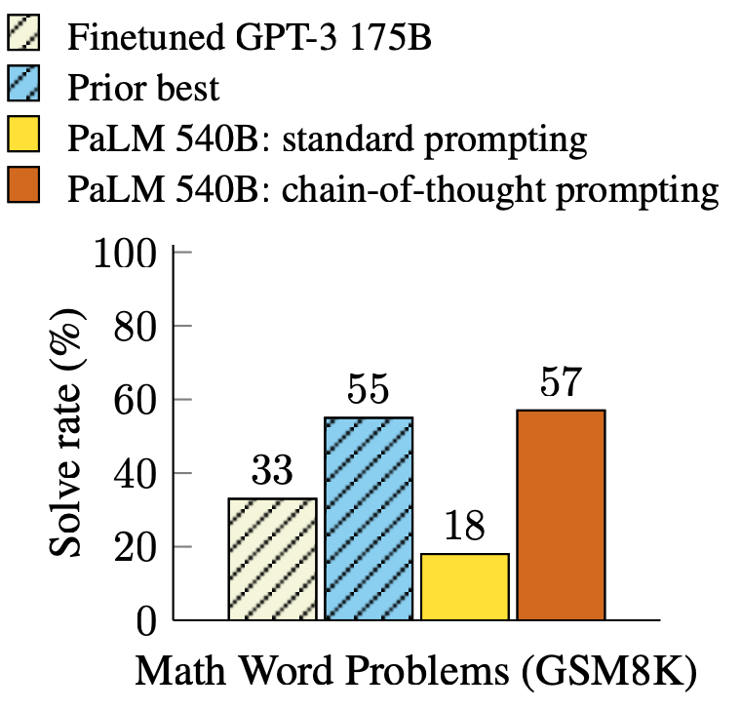
Chain of Thought
Chain-of-Thought Prompting Elicits Reasoning in Large Language Models - 2022

Slide 18
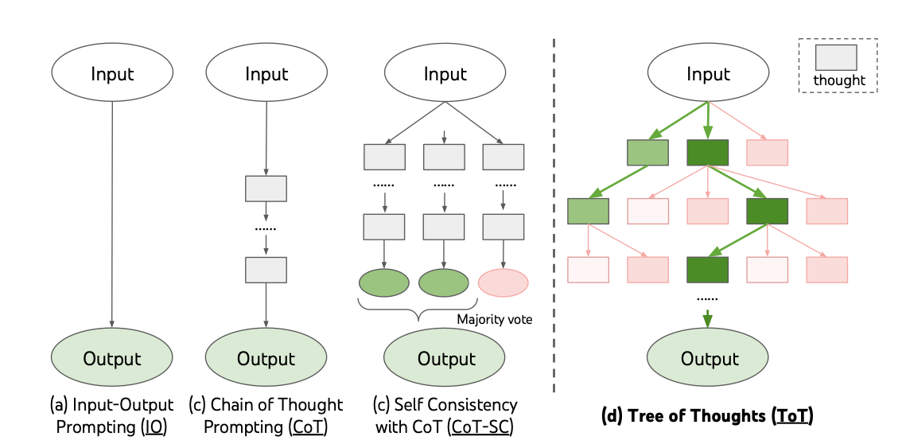
Tree-of-Though
! COST
Tree of Thoughts: Deliberate Problem Solving with Large Language Models – 2023

Slide 19
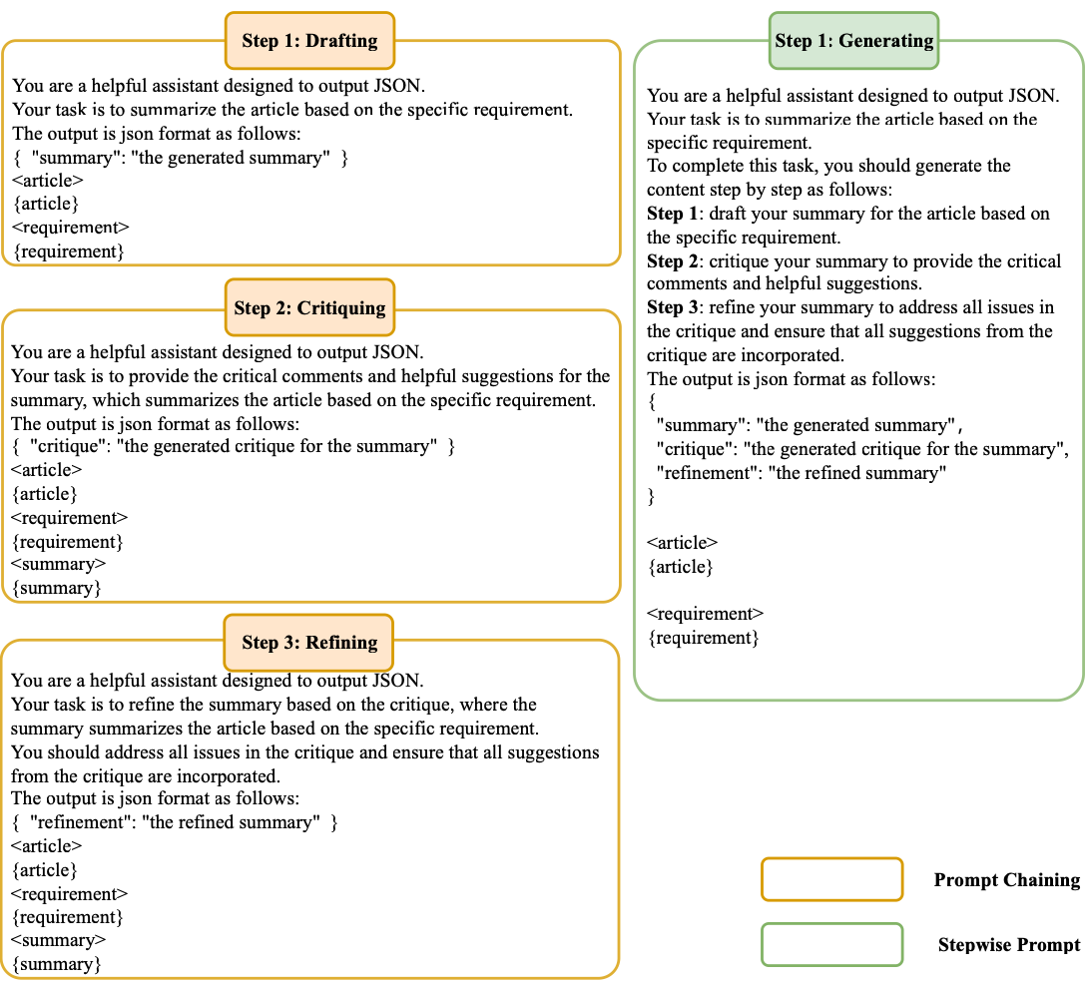


Prompt Chaining & Stepwise Prompt
“Experimental results
show that the prompt chaining
method can produce a
more favorable outcome”
Prompt Chaining or Stepwise Prompt? Refinement in Text Summarization

Slide 20
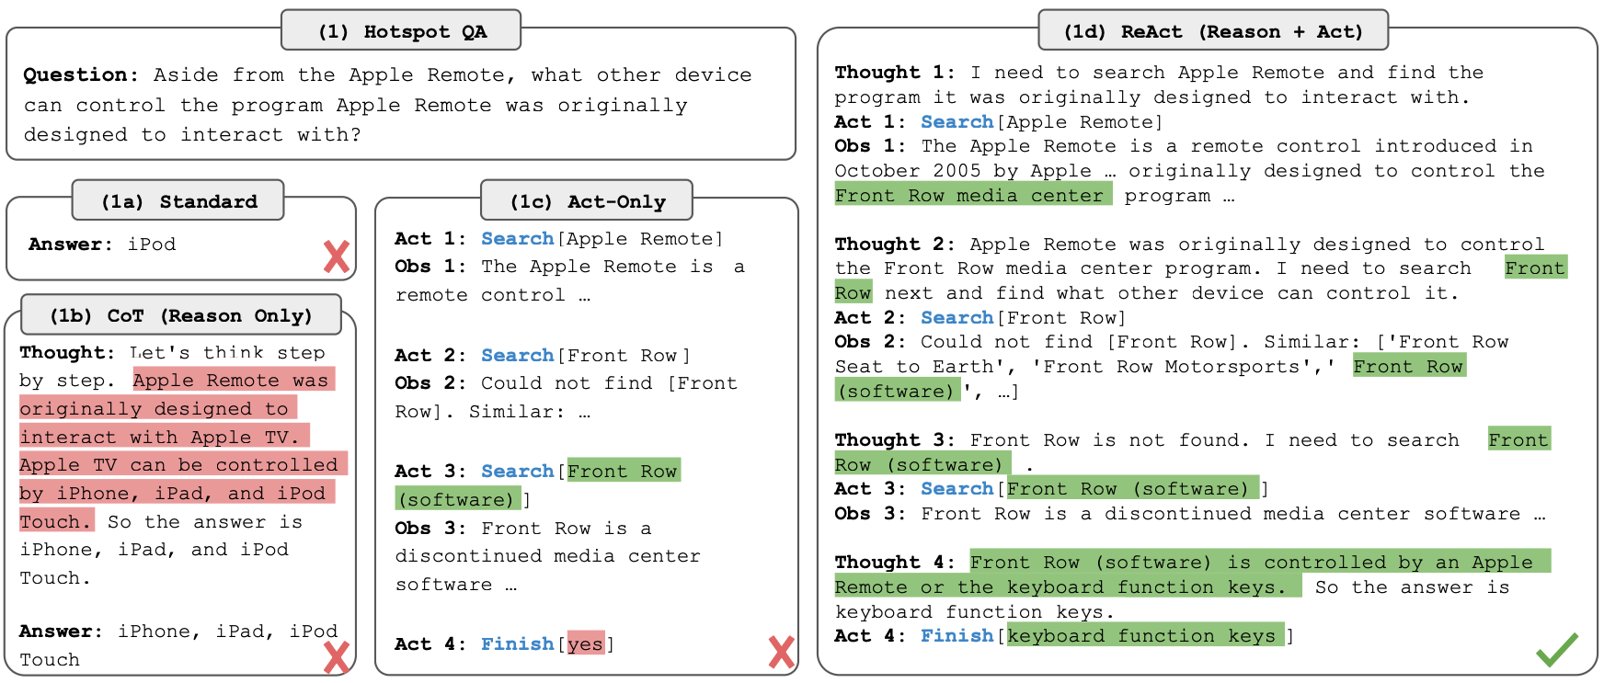
ReAct: Reason + Act
ReAct: Synergizing Reasoning and Acting in Language Models - 2022

Slide 21

Anthropic Prompt Guide
GUIDE

Slide 22

OpenAI Prompt Guide
GUIDE

Slide 23
Inference Parameters
Temperature [0:1]
High (e.g. >0.8)
beautiful
72%
beautiful
42%
beautiful
small
15%
39%
“The city of Paris is”
small
small
“More Creativity”
walkable
walkable
walkable
8%
11%
.
.
.
5%
.
.
.
9%
LLM input sequence
Output candidates T = 0.5

Slide 24
Inference Parameters
Temperature [0:1]
Low (e.g. <0.3)
beautiful
72%
beautiful
90%
beautiful
small
15%
7%
“The city of Paris is”
small
small
“Less Creativity”
walkable
walkable
walkable
8%
2%
.
.
.
5%
.
.
.
1%
LLM input sequence
Output candidates T = 0.5

Slide 25
Inference Parameters
Top P [0:1]
P = 0.9
beautiful
72%
beautiful
Cumulative sum inferior to 90%
small
15%
“The city of Paris is”
small
Less output candidates
walkable
walkable
8%
.
.
.
5%
LLM input sequence
Output candidates T = 0.5

Slide 26
Inference Parameters
Top K [0:1]
K = 3
beautiful
72%
beautiful
small
15%
K first token
“The city of Paris is”
small
Less output candidates
walkable
walkable
8%
.
.
.
5%
LLM input sequence
Output candidates T = 0.5

Slide 27
Prompt Engineering
Your AI needs to solve: 'A company has 3 offices. Office A has twice as many employees as Office B. Office C has 30 more employees than Office B. Together they have 330 employees. How many work in each office?'
Which prompting technique would be MOST effective and why?
A) Zero-shot: 'Solve this problem'
B) Few-shot with 3 similar examples but no reasoning steps
C) Chain-of-Thought: 'Let's solve this step-by-step. First, define variables...'
D) Tree-of-Thought: Explore multiple solution paths simultaneously
Notes:
Chain-of-Thought is optimal for mathematical problems requiring systematic reasoning. Tree-of-Thought is overkill for linear problems. Zero-shot lacks guidance, and few-shot without reasoning doesn't teach the problem-solving process.

Slide 28
Prompt Engineering
You need to: 1) Extract key points from a 50-page report, 2) Categorize them by department, 3) Generate action items, 4) Create an executive summary. The model struggles with the full task.
Single Prompt: 'Read this report and extract key points, categorize by dept, create actions, write summary'
What's the BEST approach to handle this complex task?
A) Increase model temperature to be more creative
B) Chain 4 prompts: Extract→Categorize→Generate→Summarize, passing outputs forward
C) Use Tree-of-Thought to explore different categorization schemes
D) Add more examples in a single few-shot prompt
Notes:
Prompt chaining breaks complex tasks into manageable steps, improving accuracy and allowing for intermediate validation. This is especially important for multi-stage document processing.

Slide 29
Retrieval Augmented Generation

Slide 30
1
2
3
4
Define a use case
Choose a model provider
Evaluate
Deploy & Optimize
Prompt Engineering
Fine-tune
Integrate with systems
Align with Human feedback
Observability
Monitoring

Slide 31

Why using RAG ?
1
Up-to-date Information & Reduce Information
2
Domain Adaptation and Customization
3
Control and Transparency

Slide 32
Retrieval Augmented Generation Phases
1
2
INGESTION
RETRIEVAL

Slide 33
Ingestion Phase
-----------
--------------
------------
-----------
--------------
------------
-----------
--------------
------------
-----------
Index
Embeddings
--------------
------------
-----------
--------------
------------
-----------
--------------
------------
1
2
3
4
Documents
Chunks
Vectorization
Vector DB

Slide 34

Retrieval
Index
Query
Embeddings
Top K Results
3
1
2
------------
+
--------------
Query
------------
4
Augmented prompt
--------------
-----------
LLM Response
6
5
LLM Inference

Slide 35
Re-Ranking
Re-rankers types: Cross-encoder, Multi-vector, LLM
Index
3
Top K Results
Query
------------
------------
--------------
Re-Ranker
--------------
+
Query
------------
------------
--------------
--------------
-----------
4
-----------
5
LLM Inference

Slide 36
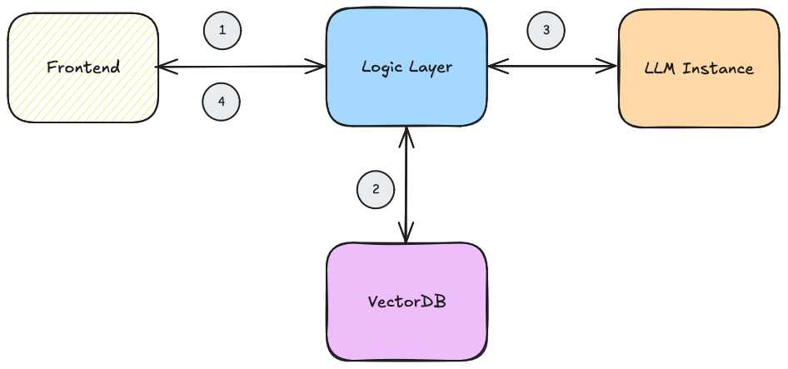
Architecture Example (running phase)
I don’t want to retrieve data every time I talk to my LLM. How can I do ?

Slide 37
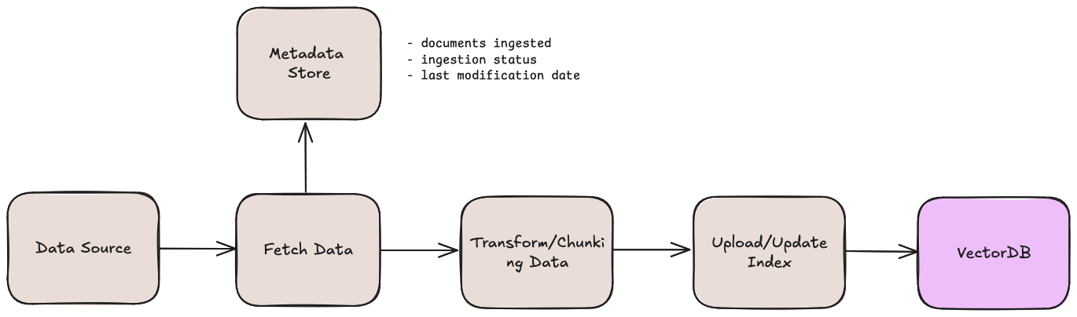
Architecture Example (Ingestion)

Slide 38
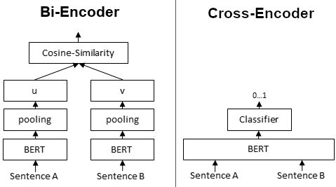
Re-Ranking
Top K Results
Re-ranker
source
Tradeoff between accuracy (cross-encoder) and efficiency (Bi-Encoder)

Slide 39
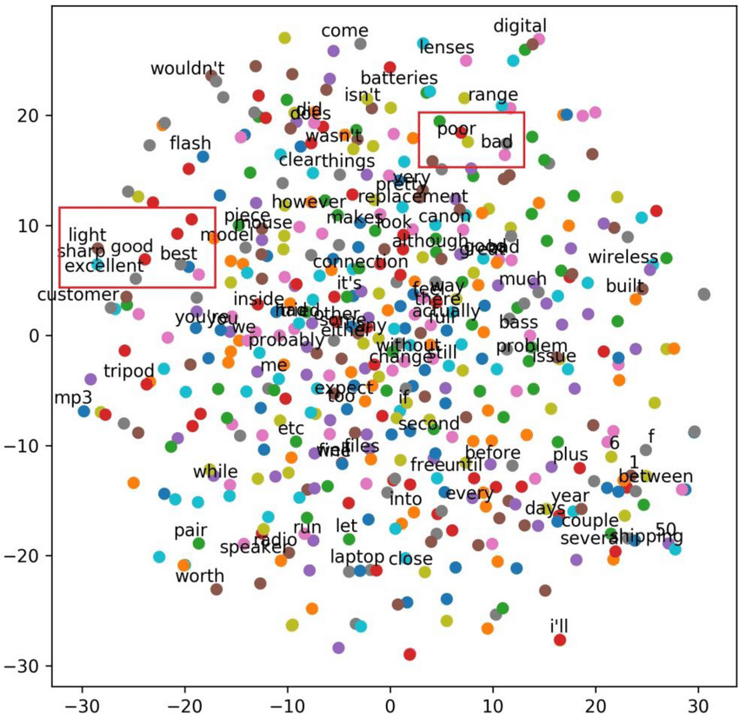

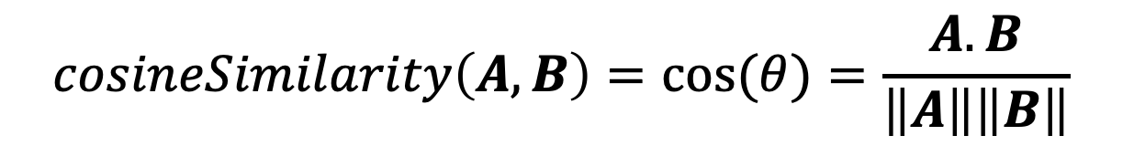


Cosine-Similarity
$$A$$
$$cosineSimilarity\left(A, B\right)=cos⁡(θ)=\frac{A.B}{\left\|A\right\|\left\|B\right\|}$$
$$B$$
$$θ$$
source

Slide 40
Chunking strategy: Fixed-size
overlap
Artificial intelligence is a technology that enables computers and machines to simulate human learning
Chunk 1
Chunk 2
Artificial intelligence is a technology that enables computers and.
that enables computers and machines to simulate human learning

Slide 41
Chunking strategy: Semantic Chunking
Initial First Chunck
-----------
--------------
------------
Segment Doc
(sentence/paragraph)
-----------
--------------
-----------
------------
…
-----------
Keep adding chunks
until cosine drops
--------------
Final Chunks
-----------
-----------
--------------
------------
--------------
--------------
Chunk 1
Chunk 2
Chunk 3

Slide 42



Chunking strategy: Other
Document structure-based chunking
Recursive chunking
LLM Based chunking

Slide 43
RAG Chunking Strategy
Your RAG system answers technical documentation queries. It retrieves relevant chunks but often loses important context from adjacent sections.
Which chunking improvement would help most?
A) Increase chunk size from 512 to 2048 tokens
B) Decrease chunk size to 128 tokens for precision
C) Implement overlapping chunks with semantic boundaries
D) Use LLM to regenerate all documentation first
Notes:
Chunking strategy significantly impacts RAG performance. Semantic boundaries and overlap prevent context loss.

Slide 44
RAG Evaluation
Index
Query
Embeddings
Top K Results
3
1
2
Chunk Retrieval
------------
+
--------------
Query
------------
4
Augmented prompt
--------------
-----------
Output Generation
LLM Response
6
5
LLM Inference

Slide 45
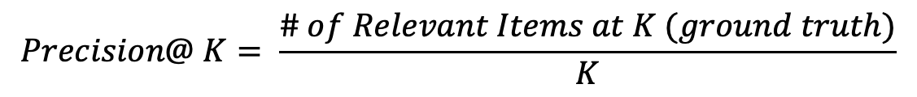
RAG Evaluation - Retrieval
Precision@ K
-----------
-----------
-----------
-----------
-----------
$$Precision@ K= \frac{\# of Relevant Items at K (ground truth)}{K}$$
K = 5
-----------
-----------
-----------
Relevant
-----------
Not Relevant

Slide 46
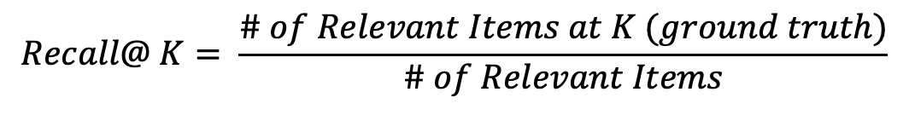
RAG Evaluation - Retrieval
Recall@ K
-----------
-----------
-----------
-----------
-----------
$$Recall@ K= \frac{\# of Relevant Items at K (ground truth)}{\# of Relevant Items}$$
K = 5
-----------
-----------
-----------
Relevant
-----------
Not Relevant

Slide 47

How to choose good metrics ?
1
Task-Appropriate Metrics
2
Practical Utility
3
Interpretability

Slide 48

How to constitute a good evaluation dasaset ?
1
Diversity of Task Types and Complexity
2
Coverage
3
Ground Truth Quality

Slide 49
RAG System Implementation
Your customer support AI is providing outdated product information despite having accurate data in your knowledge base. Support tickets are increasing.
Which RAG component should you investigate FIRST?
A) Increase the LLM model size for better comprehension
B) Review the chunking strategy and retrieval relevance metrics
C) Add more documents to the vector database
D) Switch to a different embedding model
Notes:
RAG retrieval quality is often the bottleneck. Poor chunking and retrieval can make even the best LLM produce bad results.

Slide 50
Cost & Performance Optimization
Your GenAI application costs $50,000/month. Usage shows 80% simple FAQs, 15% document search, 5% complex reasoning.
What's the most effective optimization strategy?
A) Negotiate better pricing with your current LLM provider
B) Implement caching to reduce redundant API calls
C) Use tiered models: smaller for FAQs, medium for search, large for complex tasks
D) Reduce the maximum token limit for all responses
Notes:
Model tiering is crucial for cost optimization. Using GPT-4 for simple FAQs is like using a Ferrari for grocery shopping.

Slide 51

Fine-Tuning

Slide 52
1
2
3
4
Define a use case
Choose a model provider
Evaluate
Deploy & Optimize
Prompt Engineering
Fine-tune
Integrate with systems
Align with Human feedback
Observability
Monitoring

Slide 53
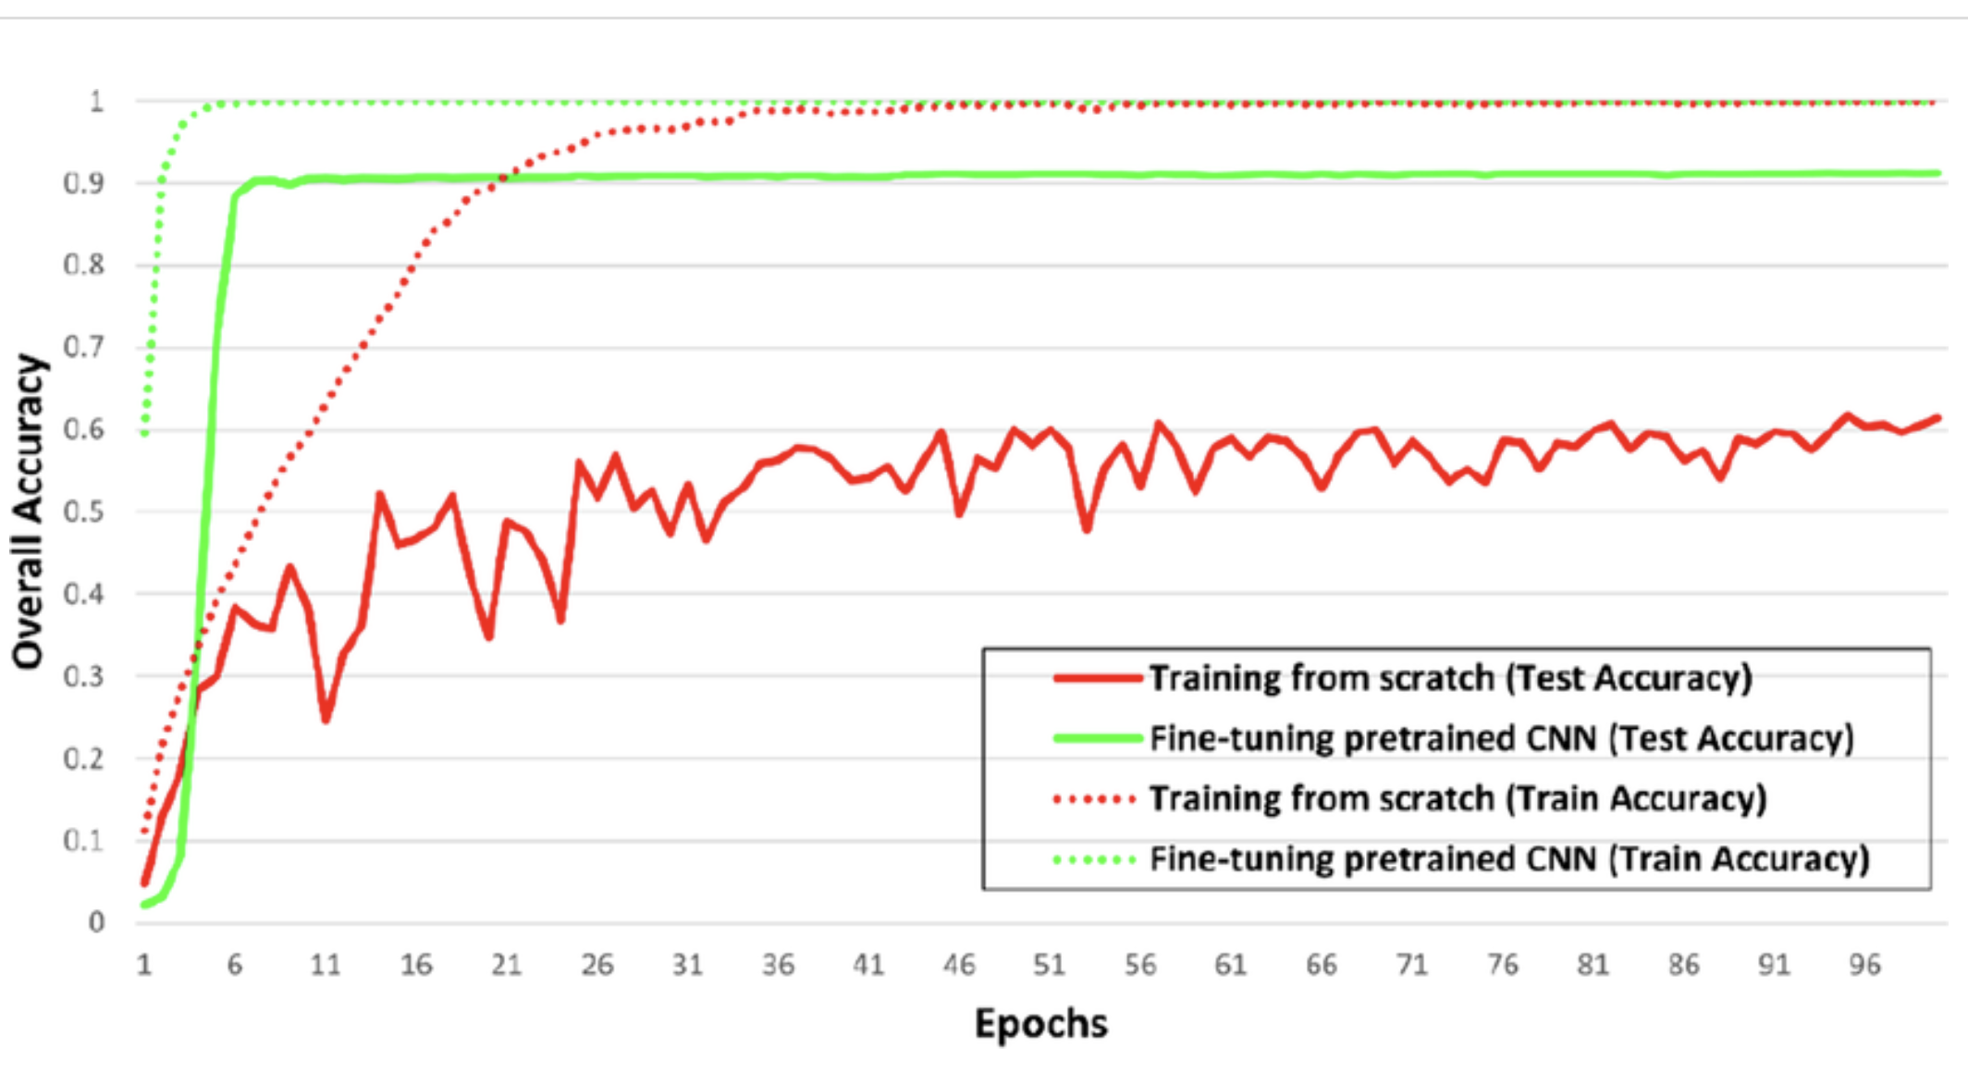
Pretraining vs Fine-tuning
Pretraining: self-supervised learning on vast amount of raw text.
Supervised Fine Tuning: labeled data to train domain-specific application
Training from scratch vs fine-tuning pretrained network (classification)
Source: Snapshot Ensemble‑Based Residual Network (SnapEnsemResNet) for Remote Sensing Image Scene Classification

Slide 54



Pre-trained models
Base models are not answer questions oriented
User: “Write a poem about flowers”
→ They only want to complete the text
Assistant: “ Write poem about summer
Write poem about water…”
Pre-trained models are used as the raw material to build Fine-tuned models for specific use case
Fondation Models

Slide 55
Challenges of Training LLMs models
1 parameter = 4 bytes (32-bit)
1B parameter = 4 GB
+ 8 bytes for Optimizer
+ 4 bytes for Gradient + 8 bytes for Temp Memory
Training requires 6 times more memory than actual size of the mode

Slide 56
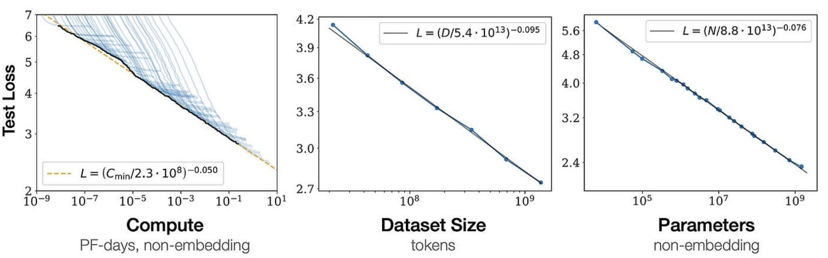
Scaling Law (Chinchilla Scaling Law)
Source: Training Compute-Optimal Large Language Models
Dataset Size = 20 x # Params

Slide 57

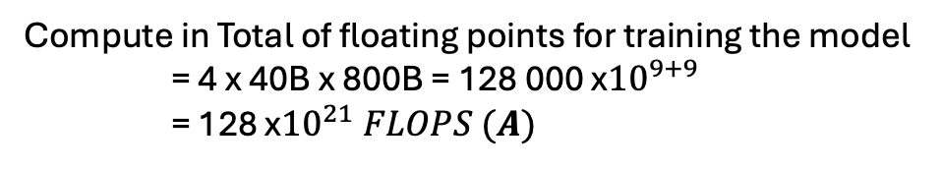


Challenges of Training LLMs models
Example (simplified)
- Llama 40B
Memory Required to train 40B parameter = 6*40 GB = 240GB
(1 single A100 GPU cannot host such model)
Dataset Size = 20 x 40 = 800B Token
Compute in Total of floating points for training the model = 4 x 40B x 800B = 128 000 x${10}^{9+9}$ = 128 x${10}^{21} FLOPS (A)$
(Assuming 4 FLOPs per parameter per token )
1 Nvidia A100 = 156 x${10}^{12} \text{FLOP}S \text{(}\text{B}\text{)}$
(1 TFLOP = 1 x${10}^{12}$ FLOPS)
Total Time to train = A / B = 82 x${10}^{7} seconds=$ 9 490 Days $\sim 26 Years$

Slide 58
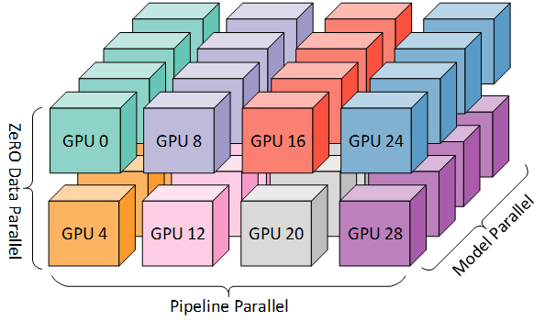
Challenges of Training LLMs models
Example
- Llama 40B
Memory Required to train 40B parameter = 6*40 GB = 240GB
Dataset Size = 20 x 40 = 800B Token
32 Bytes floating point (32 FP)
1 parameter = 4 bytes
16FB
1 parameter = 2 bytes
Parallelization
Quantization
Source: Hugging Face

Slide 59
Scaling Choices for Pre-training
Constraint
Compute Budget
Cost/Time/GPUs
Model Performance
Dataset Size
Model Size

Slide 60

Fine-tuning
Prompt: […], Completion:[…]
Prompt: […], Completion:[…]
Prompt: […], Completion:[…]
Prompt: […], Completion:[…]
Prompt: […], Completion:[…]
Prompt: […], Completion:[…]
Pre-trained LLM
+
Training
Fine-tuned LLM

Slide 61
Fine-tuning
Prompt
LLM Completion
Classify this product review:
“Really bad product”
Sentiment:
Pre-trained LLM
Classify this product review:
“Really bad product”
Sentiment: Neutral
Update All Weights
Expected Completion
Classify this product review:
“Really bad product”
Sentiment: Negative
Loss = Cross-Entropy

Slide 62
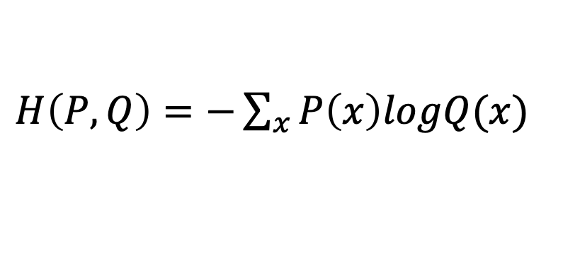
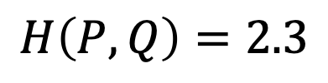
Cross Entropy
$H\left(P, Q\right)=−\sum_{x}{P\left(x\right)logQ(x)}$
P: true distribution of the data
Q: distribution of the model
Example:
0
0.1
0.1
0.6
0.15
0.05
Q
Pre-trained model output:
$$[ Really, Negative, Negative, Neutral, Positive, Really Positive]$$
0
0
1
0
0
0
P
Expected output:
$$[ Really, Negative, Negative, Neutral, Positive, Really Positive]$$
$H\left(P, Q\right)=0×\log\left(0.1\right)+0.2×$log(1) + …+ $0×\log\left(0.05\right)$
$$H\left(P, Q\right)=2.3$$

Slide 63
Fine-Tuning Risks
Catastrophic Forgetting : LLM learns better the task you ask it to complete, but then degrades
its performance on non-related tasks
Solutions:
Mutli-task Fine-Tuning
Parameter Efficient Fine-Tuning (PEFT)

Slide 64
PEFT
Original Weights
Additional Weight Layer
Pre-trained LLM
New layer to train on the task

Slide 65
PEFT
Original Weights
Summarize Task Layer
Pre-trained LLM
Pre-trained LLM
+
=
Task: summarize
MB of Weights
QA Task Layer
Pre-trained LLM
Pre-trained LLM
+
=
Task: QA
MB of Weights

Slide 66
PEFT: Low-Rank Adaptation (LoRA)
Standard
Encoder
Self-Attention Layer
Self-Attention Weights
Embeddings

Slide 67
PEFT: Low-Rank Adaptation (LoRA)
LoRA
2 rank decomposition matrices
Encoder
A
B
Self-Attention Layer
+
Self-Attention Weights
A * B
Train the model on these weights
Embeddings

Slide 68
PEFT: Low-Rank Adaptation (LoRA)
Base Transformer Reference Example:
# of weights = 512 (Embedding Size) x 512 (Embedding Size) x 64 (number of layers)
# of weights = 16 777 216 trainable parameters
*
With LoRA of rank size r = 8
A = r x 512 * 64 = 32 768 parameters
*
B = 512 x r * 64 = 32 768 parameters
*
Total Parameters to train = 65 536 trainable parameters
99.6% less parameters to train
*(Q K V + Projection) → 4 matrices like this

Slide 69
Fine-tuning Strategy
Your legal team needs an AI to draft contracts in your company's specific style. You have 500 example contracts. The base model produces generic but legally correct text.
When should you consider fine-tuning?
A) Immediately - fine-tuning always improves performance
B) After exhausting prompt engineering and few-shot learning approaches
C) Never - RAG is always sufficient for domain-specific tasks
D) Only when you have at least 10,000 examples
Notes:
Fine-tuning should be a last resort after prompt engineering. It's expensive and can cause catastrophic forgetting.

Slide 70
Fine-tuning Resource Management
You need to fine-tune a 7B parameter model for three departments (Legal, HR, Marketing). You have limited GPU resources and worry about catastrophic forgetting.
Which approach offers the best balance?
A) Train three separate full models, one for each department
B) Train one model on combined data from all departments
C) Use LoRA to create small specialized adapters for each department
D) Use prompt engineering instead of fine-tuning
Notes:
LoRA and PEFT techniques make fine-tuning practical. You can maintain multiple specialized models efficiently.

Slide 71
RHLF & Model Evaluation

Slide 72
1
2
3
4
Define a use case
Choose a model provider
Evaluate
Deploy & Optimize
Prompt Engineering
Fine-tune
Integrate with systems
Align with Human feedback
Observability
Monitoring

Slide 73



Definition
RLHF (Renforcement Learning from Human Feedback): is a machine learning approach that combines reinforcement learning with human-provided evaluations or preferences to guide and improve a model's behavior toward desired outcomes.

Slide 74
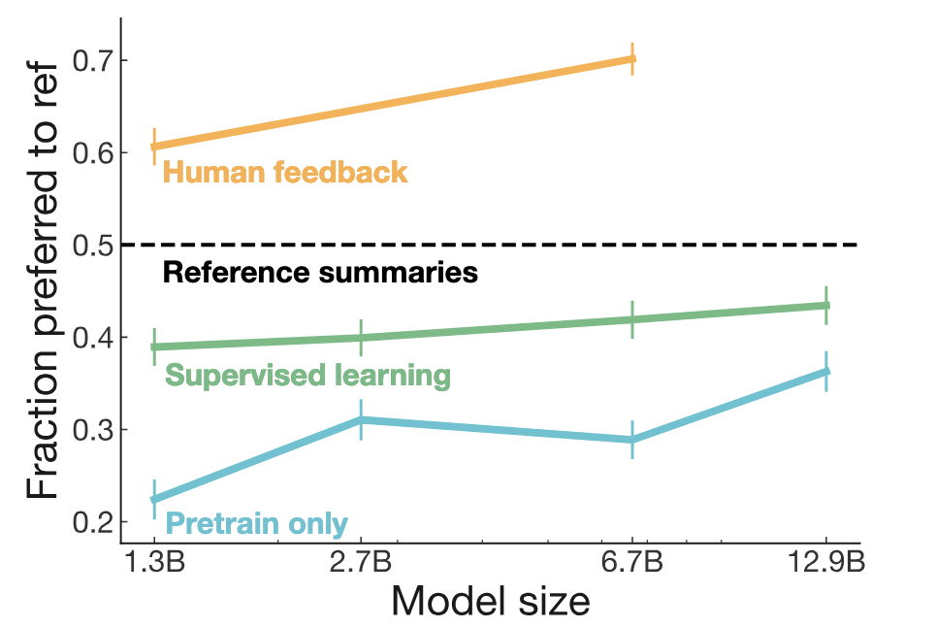
Why RLHF ?
Source: Learning to summarize from human feedback

Slide 75
RLHF
Fine-tuned LLM
Human Aligned LLM
RLHF
Goal : Maximize Helpfuless, Honesty, Harmless

Slide 76

RLHF
Goal : Maximize Helpfuless, Honesty, Harmless
Fine-tuned LLM
(updated by fb)
Update weights
RL Proximal Policy Optimization (PPO) Algorithm
Prompt Dataset
“ A dog is…“
“ …human’s best friends“
Reward model
+2,86
Read about PPO

Slide 77
RLHF
Goal : Maximize Helpfuless, Honesty, Harmless
Fine-tuned LLM
(updated by fb)
Update weights
RL Proximal Policy Optimization (PPO) Algorithm
Prompt Dataset
“ A dog is…“
“ …a useless animal“
Reward model
- 9,86
Read about PPO

Slide 78
RLHF – obtaining feedback from human
1. Define your criteria (ex: Helpfulness)
LLM Completion
“ I want to learn faster. You can’t do anything about it”
LLM
“ I want to learn faster. Read faster”
“ I want to learn faster .“
“ I want to learn faster. Try to teach someone the topic you learn”

Slide 79
RLHF – obtaining feedback from human
2. Rank Completion base on criteria
LLM Completion
LLM
Prompt Dataset

Slide 80
RLHF – obtaining feedback from human
2. Rank Completion base on criteria
LLM Completion
1
2
1
2
1
2
…
…
…

Slide 81
RLHF – obtaining feedback from human
2. Train Reward Model
Pairwise comparaison dataset
1
2
1
2
Reward model
Trained Reward model on Criteria
1
2
.
.
.

Slide 82
RLHF
Goal : Maximize Helpfuless, Honesty, Harmless
Fine-tuned LLM
(updated by fb)
Update weights
RL Proximal Policy Optimization (PPO) Algorithm
Prompt Dataset
“ A dog is…“
“ …human’s best friends“
Reward model
+2,86
Stopping Criteria:
# iterations
Success criteria
Read about PPO

Slide 83
Human Feedback & Alignment
Your customer service AI is technically accurate, but users complain it's 'robotic and unhelpful.' You need to improve empathy and solution-focus.
What's the most practical approach for a mid-sized company?
A) Implement full RLHF with PPO algorithm training
B) Collect feedback on responses and use for prompt refinement and few-shot examples
C) Switch to a model marketed as 'more human-like'
D) Add random variations to make responses less predictable
Notes:
RLHF is powerful but complex. For most companies, collecting feedback for prompt improvement is more practical.

Slide 84
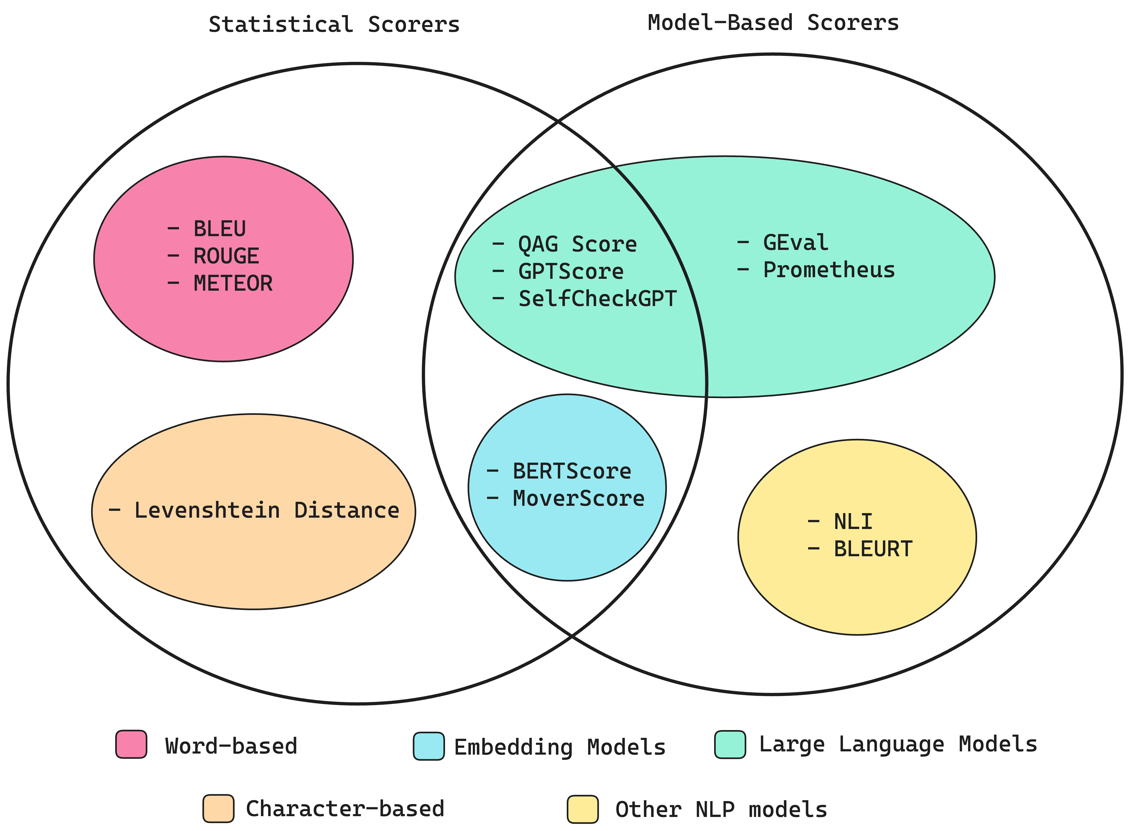
LLM Evaluation
Source: confident-ai

Slide 85
Statistical Scores
1. ROUGE & BLEU Score
Rouge
BLEU
Text summarization
Text Translation

Slide 86
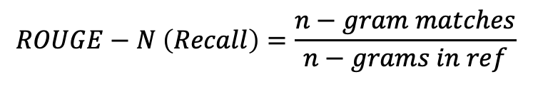
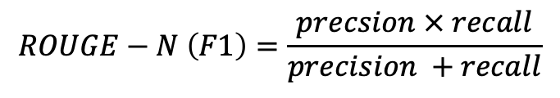
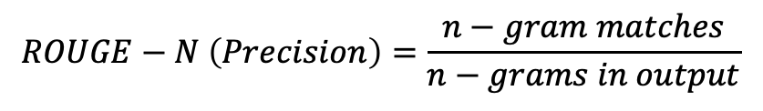
Statistical Scores
1. ROUGE & BLEU Score
$$ROUGE−N \left(Recall\right)=\frac{n−gram matches}{n−grams in ref}$$
Rouge
$$ROUGE−N \left(Precision\right)=\frac{n−gram matches}{n−grams in output}$$
$$ROUGE−N \left(F1\right)=\frac{precsion × recall}{precision +recall}$$

Slide 87
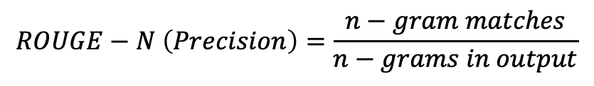
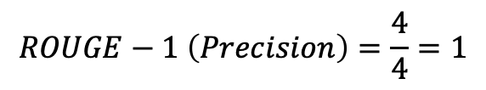
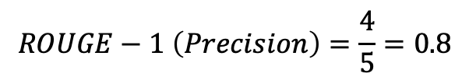
Statistical Scores
$$ROUGE−N \left(Precision\right)=\frac{n−gram matches}{n−grams in output}$$
1. ROUGE & BLEU Score
Reference (human): My name is Toto.
Generated Output:
My first name is Toto
Rouge
$$ROUGE−1 \left(Precision\right)=\frac{4}{5}=0.8$$
! Generated Output:
Toto Toto Toto Toto
$$ROUGE−1 \left(Precision\right)=\frac{4}{4}=1$$

Slide 88
Statistical Scores
1. ROUGE & BLEU Score
BLEU
$$BLEU=avg(precision across range of n−gram sizes)$$

Slide 89
Model Based and Statistical Scores
1. BERTScore
Expected Output
[ Expected Embedding]
Cosine Score
Pre-trained Contextual embedding from BERT model
LLM Output
[ LLM Output Embedding]

Slide 90
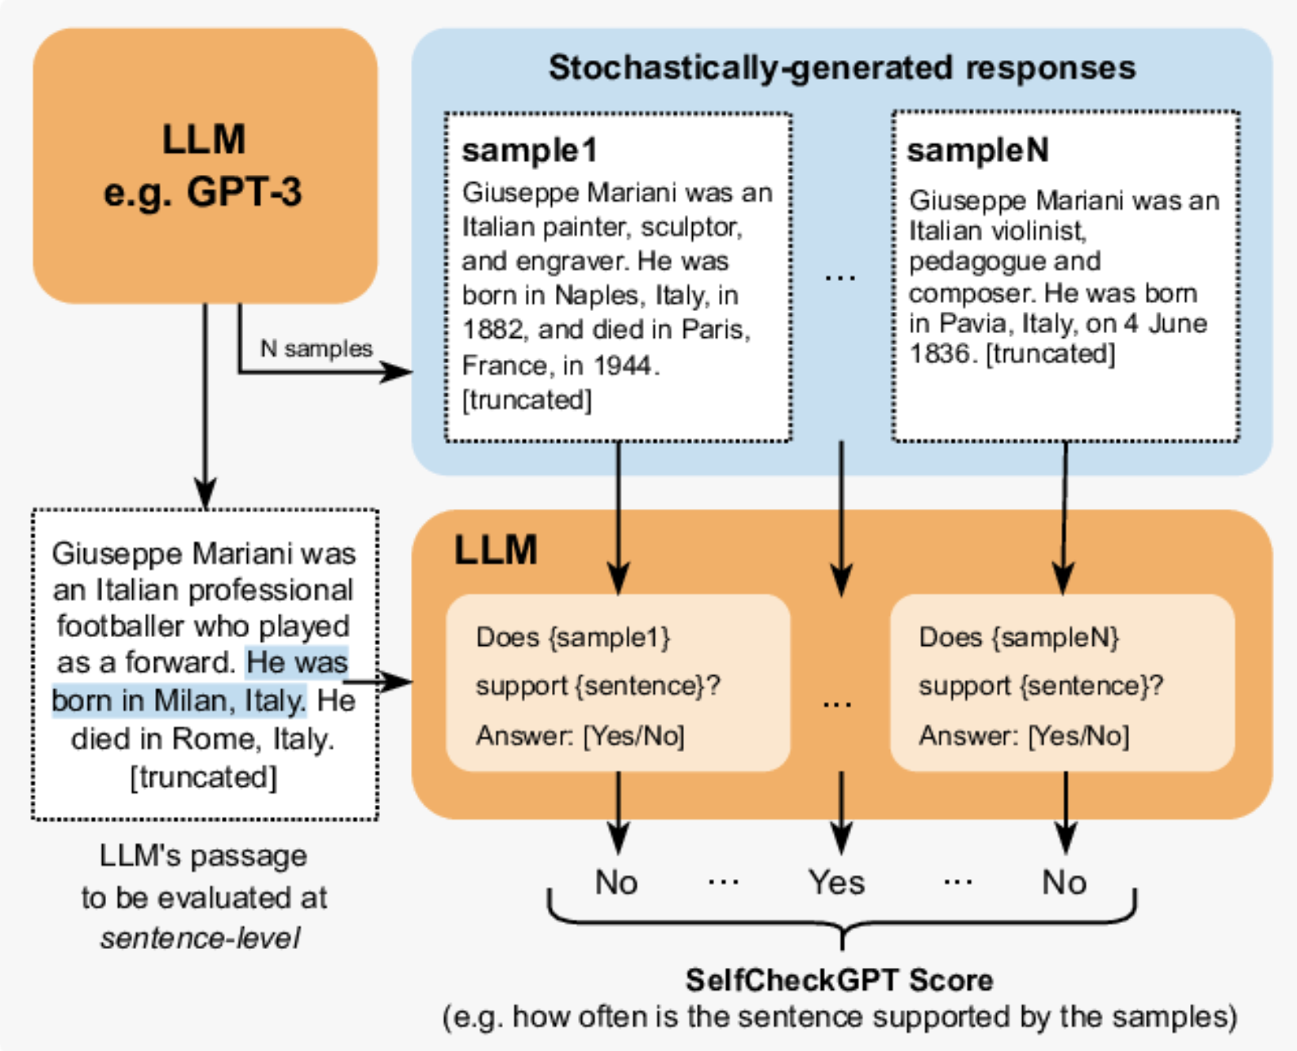
Model Based and Statistical Scores
2. SelfCheckGPT
Source: researchgate

Slide 91
Model Based and Statistical Scores
2. Question Answer Generation - Faithfulness
Prompt: “Who is Christophe Colomb?”
Retrieved Context: ex: (Wikipedia) Chunk 1: His expeditions were the first known European contact with the Caribbean and Central and South America
Chunk 2: completed four Spanish-based voyages across the Atlantic Ocean
LLM Answer: Columbus is a significant historical figure whose voyages had a profound impact on world history,
initiating the Columbian Exchange and European colonization of the Americas.
However, it's important to note that his legacy is complex and controversial
due to the devastating effects his expeditions had on indigenous populations in the Americas.

Slide 92
Model Based and Statistical Scores
2. Question Answer Generation - Faithfulness
Retrieved Context: ex: (Wikipedia) Chunk 1: His expeditions were the first known European contact with the Caribbean and Central and South America
Chunk 2: completed four Spanish-based voyages across the Atlantic Ocean
LLM Answer: Columbus is a significant historical figure whose voyages had a profound impact on world history,
initiating the Columbian Exchange and European colonization of the Americas.
However, it's important to note that his legacy is complex and controversial
due to the devastating effects his expeditions had on indigenous populations in the Americas.
Claim 1
Claim 2

Slide 93
Model Based and Statistical Scores
2. Question Answer Generation - Faithfulness
LLM as a Juge
Claim 1
Exists in the context. → OK
Score (ex: 50% Faithfulness)
Claim 2
Doesn’t exist in the context. → NOT OK
! Even if true
LLM Answer: Columbus is a significant historical figure whose voyages had a profound impact on world history,
initiating the Columbian Exchange and European colonization of the Americas.
However, it's important to note that his legacy is complex and controversial
due to the devastating effects his expeditions had on indigenous populations in the Americas.
Claim 1
Claim 2

Slide 94
Model Based and Statistical Scores
3. Answer Relevancy
Prompt: “Who is Christophe Colomb?”
LLM Answer: Columbus is a significant historical figure whose voyages had a profound impact on world history,
initiating the Columbian Exchange and European colonization of the Americas.
However, it's important to note that his legacy is complex and controversial
due to the devastating effects his expeditions had on indigenous populations in the Americas.
“Base on this answer generate possible question that could have resulted to this answer”
LLM
“What legacy did Christophe Colomb gave to Europe ?”
“What did Christopher Colombus colonized?”
“Who is Christopher Colombus ?”

Slide 95

Model Based and Statistical Scores
3. Answer Relevancy
Possible Questions
“What legacy did Christophe Colomb gave to Europe ?”
“What did Christopher Colombus colonized?”
Prompt: “Who is Christophe Colomb?”
“Who is Christopher Colombus ?”
$$×$$
$$Average(CosineSimilarity \left(Possible Questions, Prompt\right))$$

Slide 96


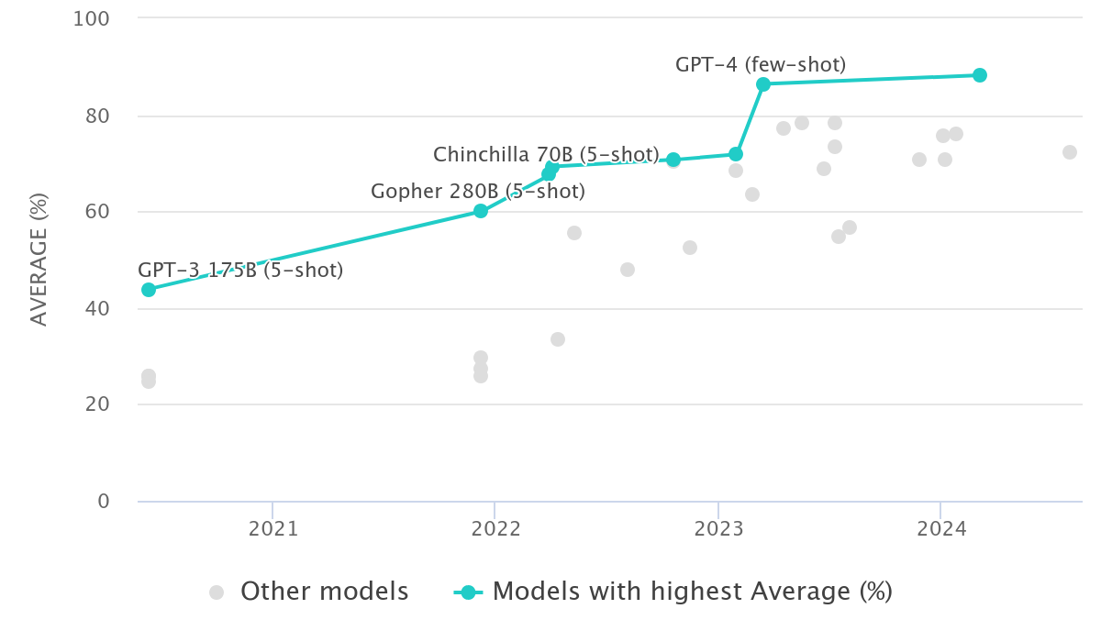
Evaluation Benchmarks
MMLU (Massive Multitask Language Understanding

Slide 97
Evaluation & Metrics
Your AI summarization tool shows 85% ROUGE score but users complain summaries miss key business insights. Stakeholders question the AI's value.
What's the root issue with your evaluation approach?
A) ROUGE score threshold is too low; aim for 95%+
B) Need more training data to improve the model
C) Statistical metrics don't capture business-relevant quality; need human evaluation
D) Should switch to BLEU score instead of ROUGE
Notes:
Business value metrics matter more than technical metrics. High ROUGE scores don't guarantee user satisfaction.

Slide 98
Evaluation Dataset Quality
Your team created an evaluation dataset with one intern writing 100 'typical questions.' The AI scores 95% accuracy but performs poorly with real customers.
What's wrong with your evaluation approach?
A) 100 questions is too small; need at least 1,000
B) Accuracy is the wrong metric; use F1 score instead
C) Dataset lacks diversity and doesn't represent real-world complexity
D) The model is overfitting; need more regularization
Notes:
Evaluation datasets must reflect real-world diversity. Synthetic or narrow datasets give false confidence.

Slide 99
Agentic AI & System Design

Slide 100
1
2
3
4
Define a use case
Choose a model provider
Evaluate
Deploy & Optimize
Prompt Engineering
Fine-tune
Integrate with systems
Align with Human feedback
Observability
Monitoring

Slide 101


Agentic AI - Definition
Agentic AI: AI systems that are designed to act autonomously to achieve specific goals or complete tasks with minimal human intervention.
Knowledge workers stretched, need productivity tools
LLM’s are powerful, but they can’t take actions
Integration of databases and systems is expensive and slow

Slide 102

Simplest agent has only a set of instructions
why did the AI
go to school?
Joke bot
to improve its
learning Rate
Instructions: “you are a funny agent that can only tell jokes. you refuse to do anything else. you always keep the jokes clean and not offensive. you can tell jokes about any topic.”
write an email message
I’m sorry, I’m just a funny bot who tells jokes
102

Slide 103
Agents use actions to get work done
Meeting assistant
list the action items from my meeting
Instructions: “you summarize meetings and send results”
Meeting Actions
Utility Actions
Here are the action items: 1/ …, 2/ …
List Meetings
In: date range
Out: [date, subject, meeting ID]
Send Email
In: subject, recipients, body
Out: status
send them to my team
Get Action Items
In: meeting ID
Out: [action items]
Get Team
Out: list of team member email addresses
Email sent
103

Slide 104
Agents use Knowledge Bases to find information
HR Policy Assistant
Instructions: “you are an HR agent, helping employees understand HR policies”
If I switch to part-time, will I still get vacation days?
HR Knowledge Base
Vacation Policy
Contains the entire vacation policy for the company
Sorry, part-time staff aren’t eligible for vacation days.
104

Slide 105
Agents can combine Actions and Knowledge Bases
HR Policy Assistant v2
how much vacation do I get per year?
Instructions: “you are an HR agent, helping employees understand HR policies and manage vacation time”
as a full-timer with 3 years tenure, you get 15 days
HR Knowledge Base
HR Actions
Vacation Policy
Contains the entire vacation policy for the company
Request Vacation
In: start date, end date Out: approval status, remaining balance
cool. I’d like to take off December 8 to 15
approved, enjoy. you have 8 more days available
105

Slide 106



Agents Workflow
HR Knowledge Base
Existing resources
search-HR-policy
HR Policy docs
Vacation Actions
get-Vacation-Balance
HR Time Off Agent
Vacation microservice
Vacation database
request-LOA
Leave of absence Actions
Leave of absence (LOA) database
106

Slide 107

Agent orchestration – Detailed flow
PROMPT Conversation history Actions, KBs Instructions Task
Step 1
Step 2
…
Step n
Chain of thought
API call
Results
Action Groups
Bedrock
model
Task
Bedrock
Agent
Results
Search
Results
Knowledge Bases
Task + results
Final response
Final response
Bedrock
model
Agent breaks task into subtasks, determines the right sequence,
and executes actions and knowledge searches on the fly
107

Slide 108



leads to challenges
Single Agent with many tools/actions
Coding gets complicated
Agent gets confused
Agent gets slower and more expensive
Complex prompts to limit hallucinations
Fragile, hard to maintain
Calling wrong tools
Passing wrong arguments
Inconsistent responses
Frontier models needed
Prompt sizes grow
Agents retry steps

Slide 109
Multi-Agent Workflow - Orchestrator
SubAgent 1
Input
Output
SubAgent 2
Master Agent
Synthesizer/Reasoning
SubAgent 3

Slide 110
Multi-Agent Workflow - Router
SubAgent 1
Input
Output
SubAgent 2
Master Agent
Routing/Passthrough
SubAgent 3

Slide 111
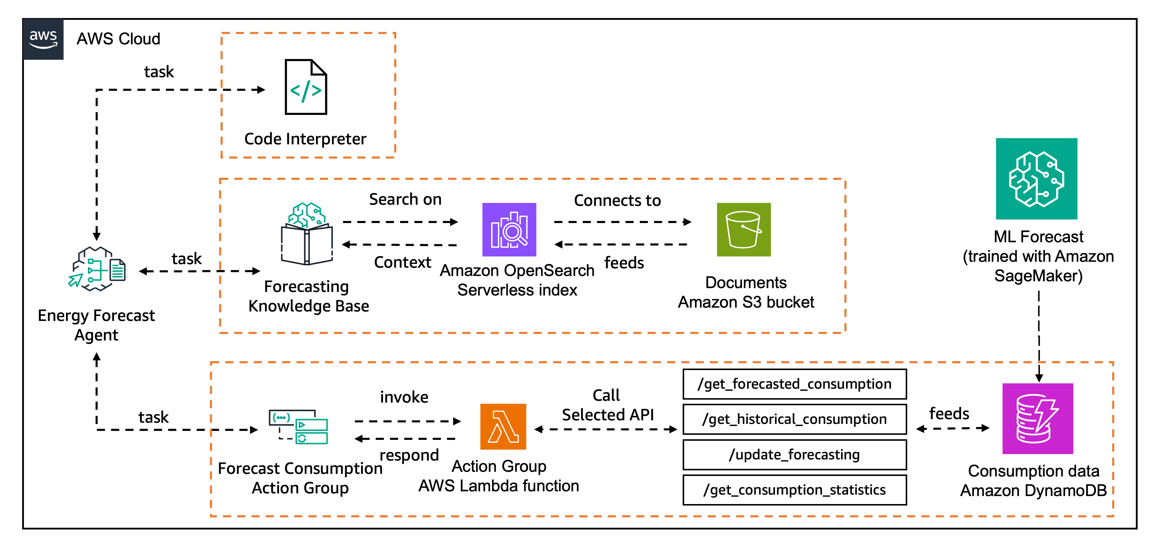
Multi-Agent Workflow - Example

Slide 112


MCP : Model Context Protocol
MCP Server A
Data Source
MCP Client
MCP Server B
Data Source
MCP Server C
LLM Provider
External API / Service

Slide 113

MCP : Model Context Protocol
1
Standardization
2
Reusability
3
Team Collaboration & Independence
MCP – Anthropic Blog

Slide 114
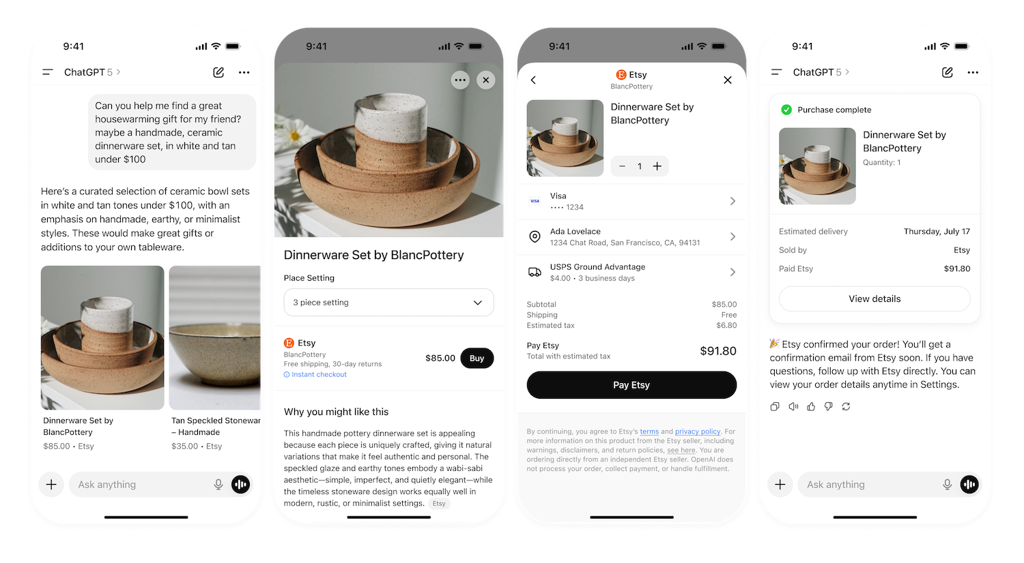


Agentic Commerce Protocol
Youtube
Stripe x OpenAI - Agentic Commerce Protocol

Slide 115


Some Low-Code Agent/Workflow Options
LangFLow
n8n
OpenAI AgentKit

Slide 116
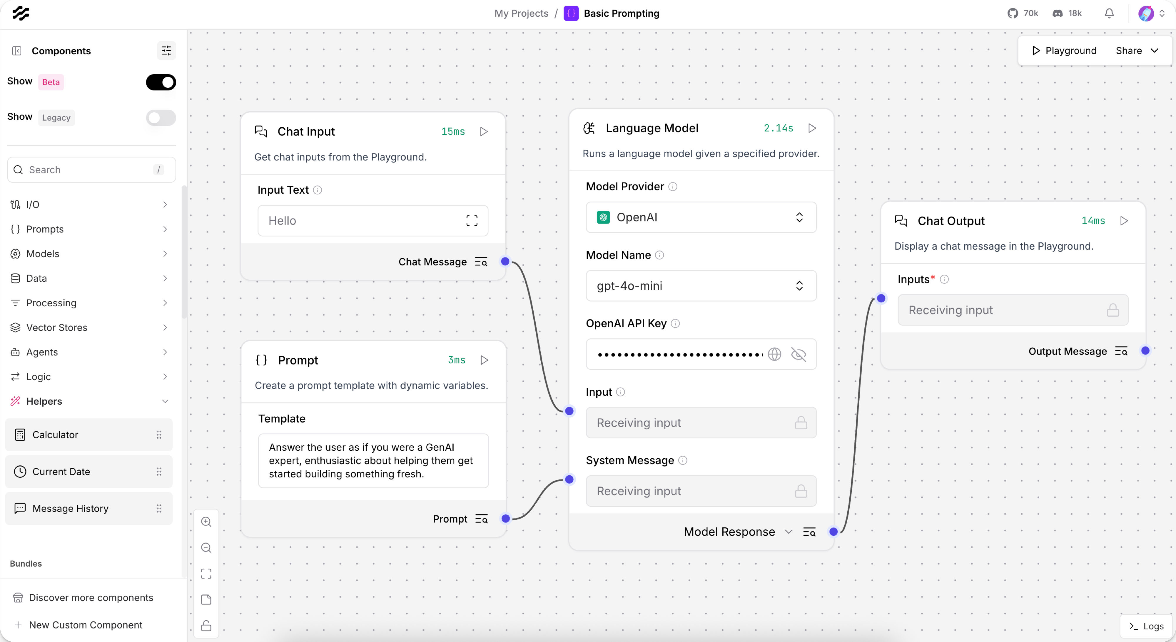
Some Low-Code Agent/Workflow Options

Slide 117
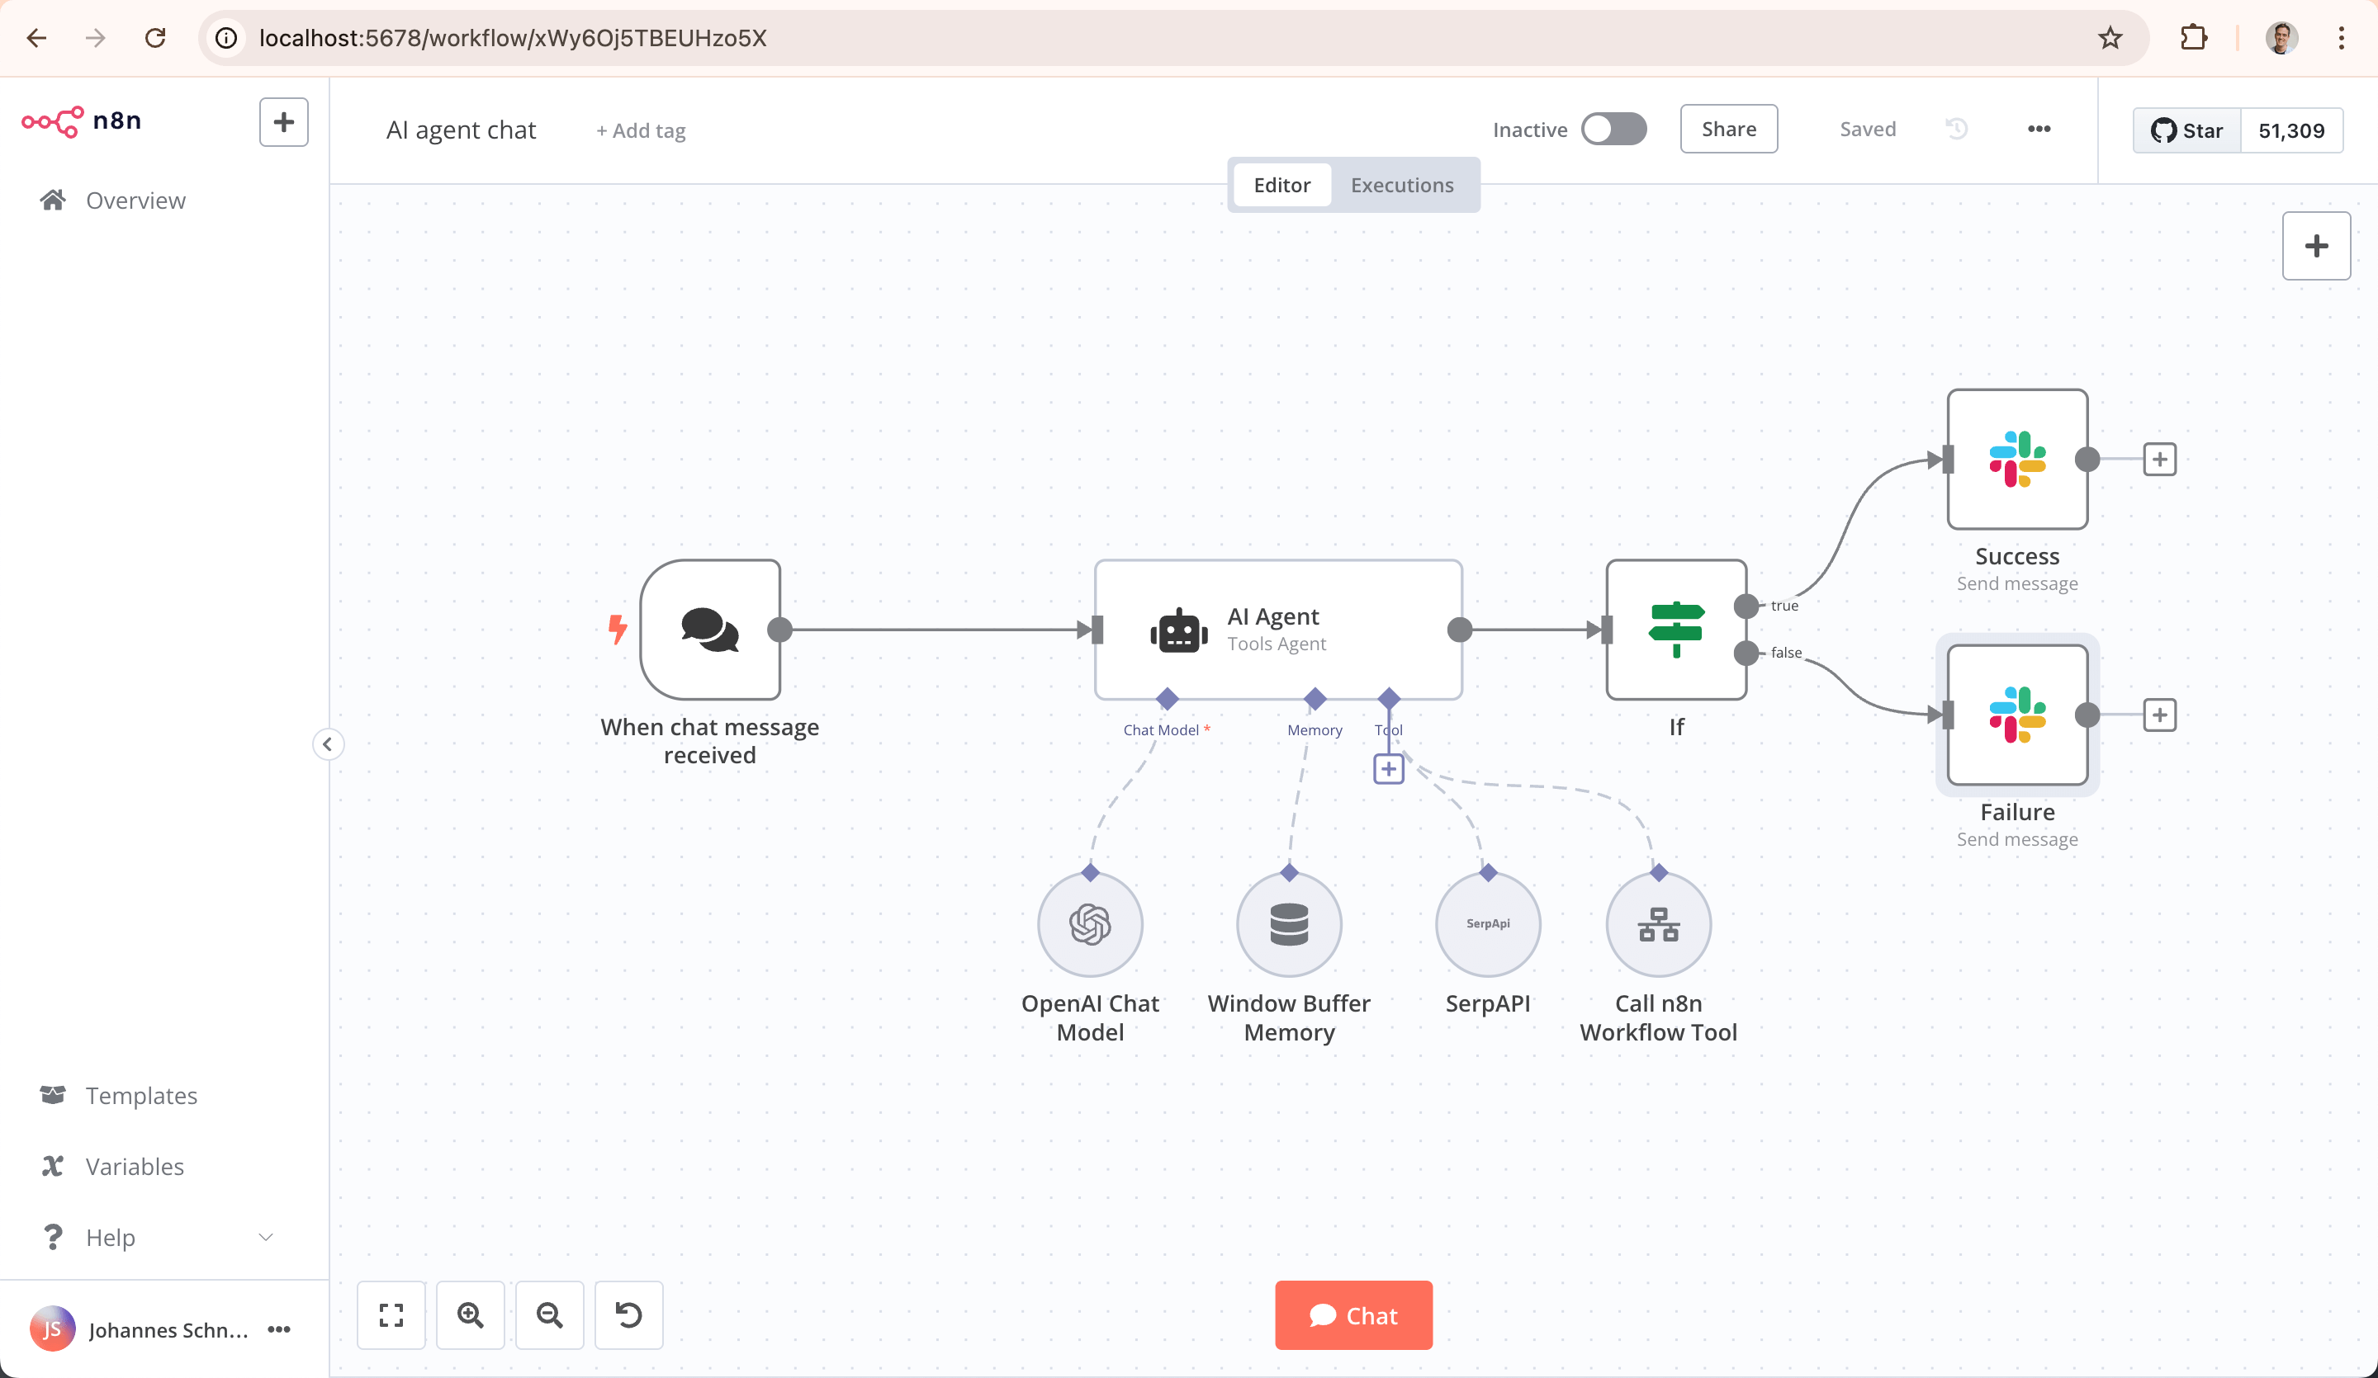
Some Low-Code Agent/Workflow Options

Slide 118

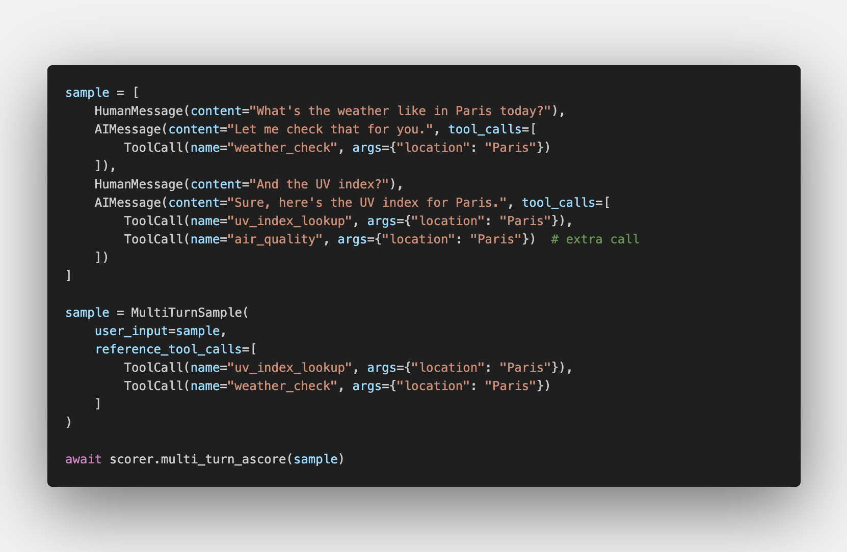
Agents Evaluation
→ Score Output: 0.67

Slide 119
Agentic AI Architecture
Your AI agent handles HR queries, IT support, expense reports, and project updates. It's slow, expensive (using GPT-4 for everything), and makes errors calling wrong tools.
What architectural change would best address these issues?
A) Add more detailed prompts to prevent tool confusion
B) Upgrade to an even more powerful model
C) Split into specialized sub-agents with a routing orchestrator
D) Implement stricter rate limiting and caching
Notes:
Multi-agent architectures solve the complexity problem. One agent trying to do everything is a recipe for failure.

Slide 120
System Architecture
Your MVP GenAI project was successful. Now the CEO wants to 'put AI everywhere' - CRM, ERP, email, documents. Your team proposes custom integrations for each.
What architectural principle should guide your expansion?
A) Build one monolithic AI system that connects to everything
B) Start with managed services and standard protocols (APIs, MCP) before custom builds
C) Create separate AI instances for each system
D) Wait for all systems to be AI-ready first
Notes:
Don't over-engineer integrations. Start with standards and managed services before building custom solutions.

Slide 121
Observability

Slide 122
1
2
3
4
Define a use case
Choose a model provider
Evaluate
Deploy & Optimize
Prompt Engineering
Fine-tune
Integrate with systems
Align with Human feedback
Observability
Monitoring

Slide 123

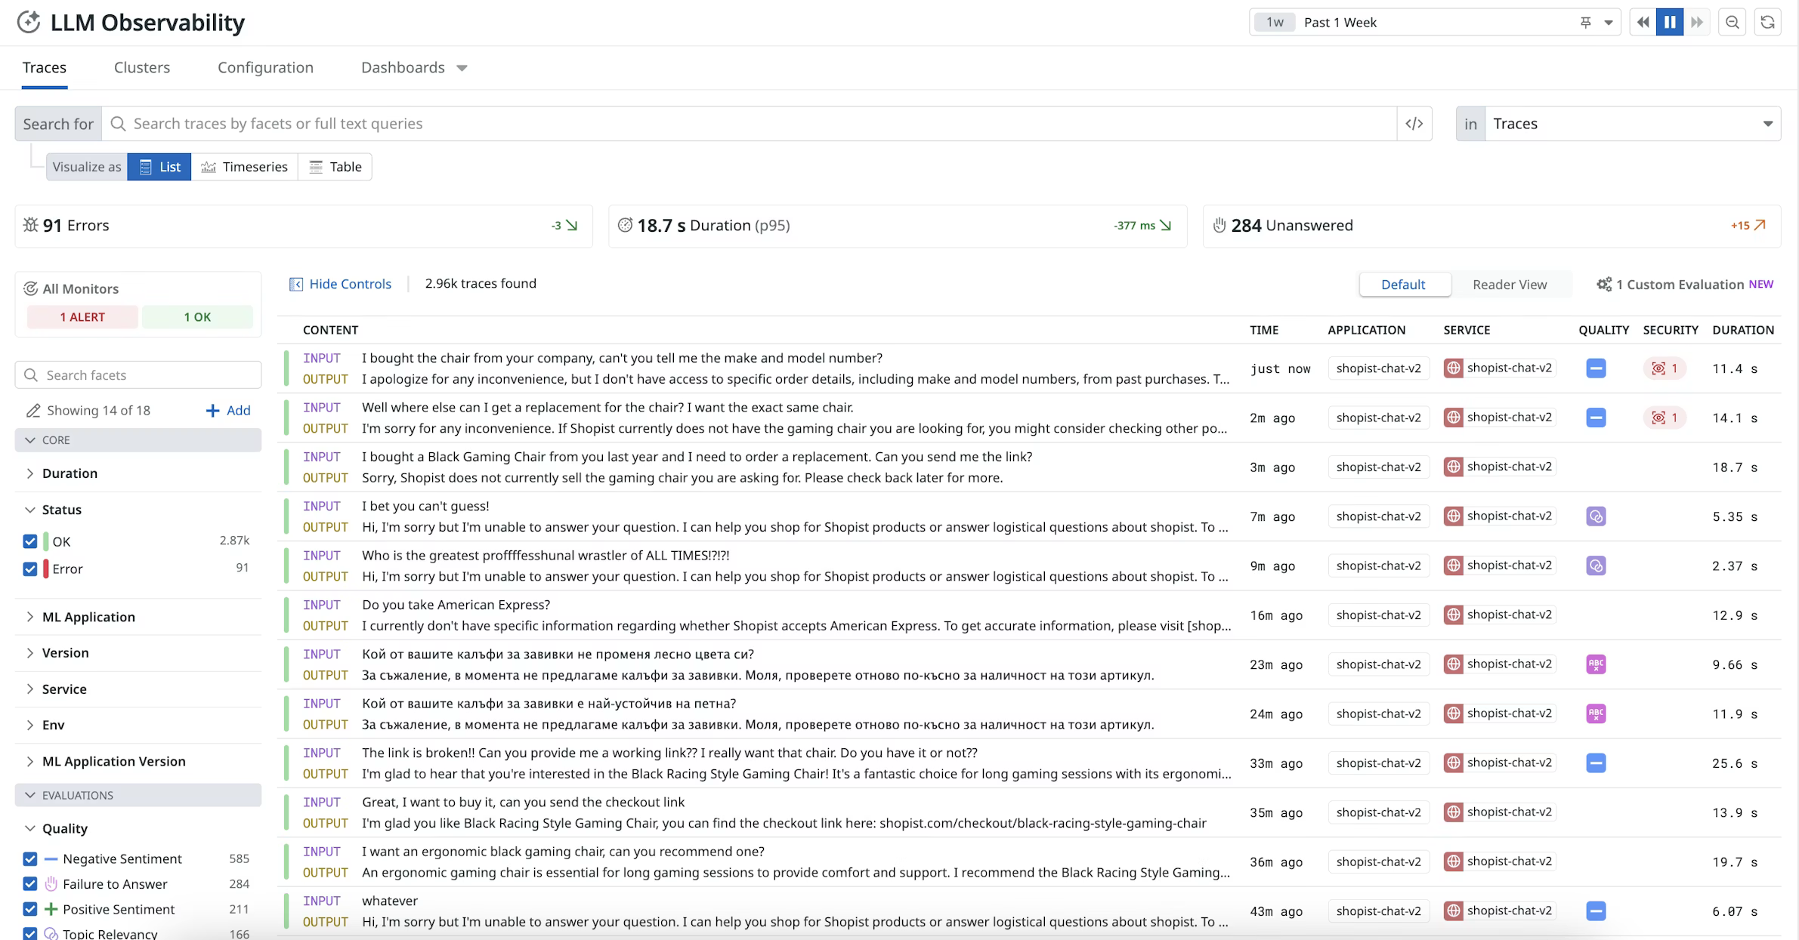
Trace Observability

Slide 124
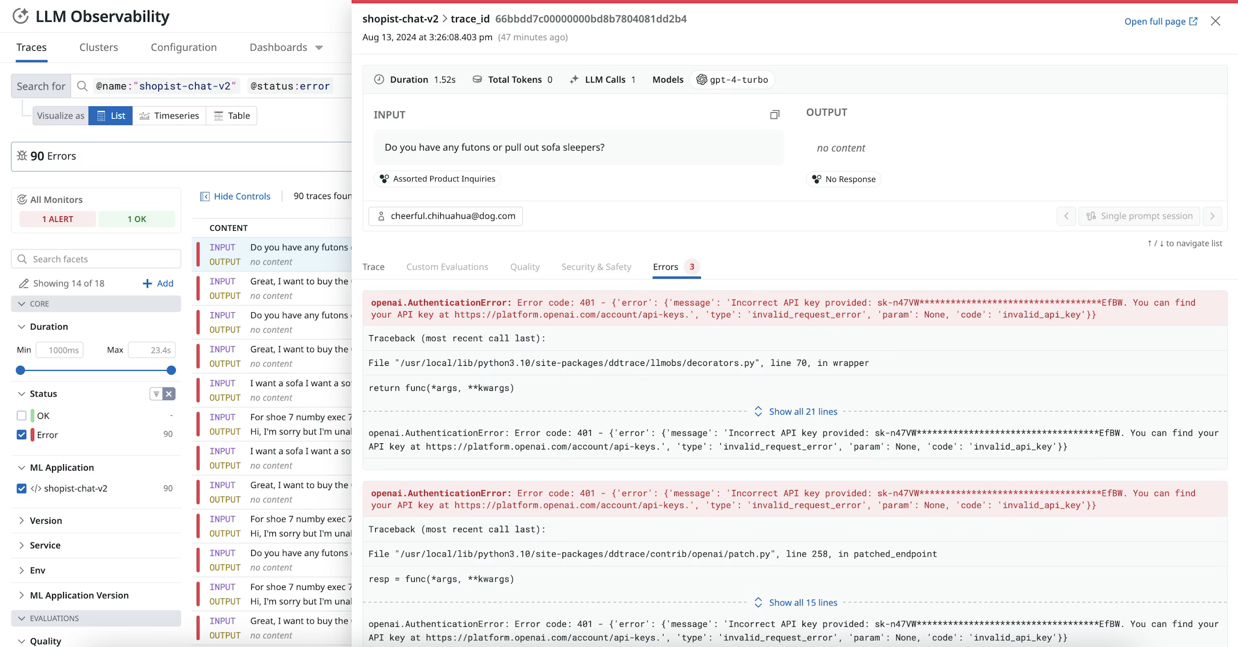
Trace Error Observability

Slide 125
Trace Error Observability

Slide 126
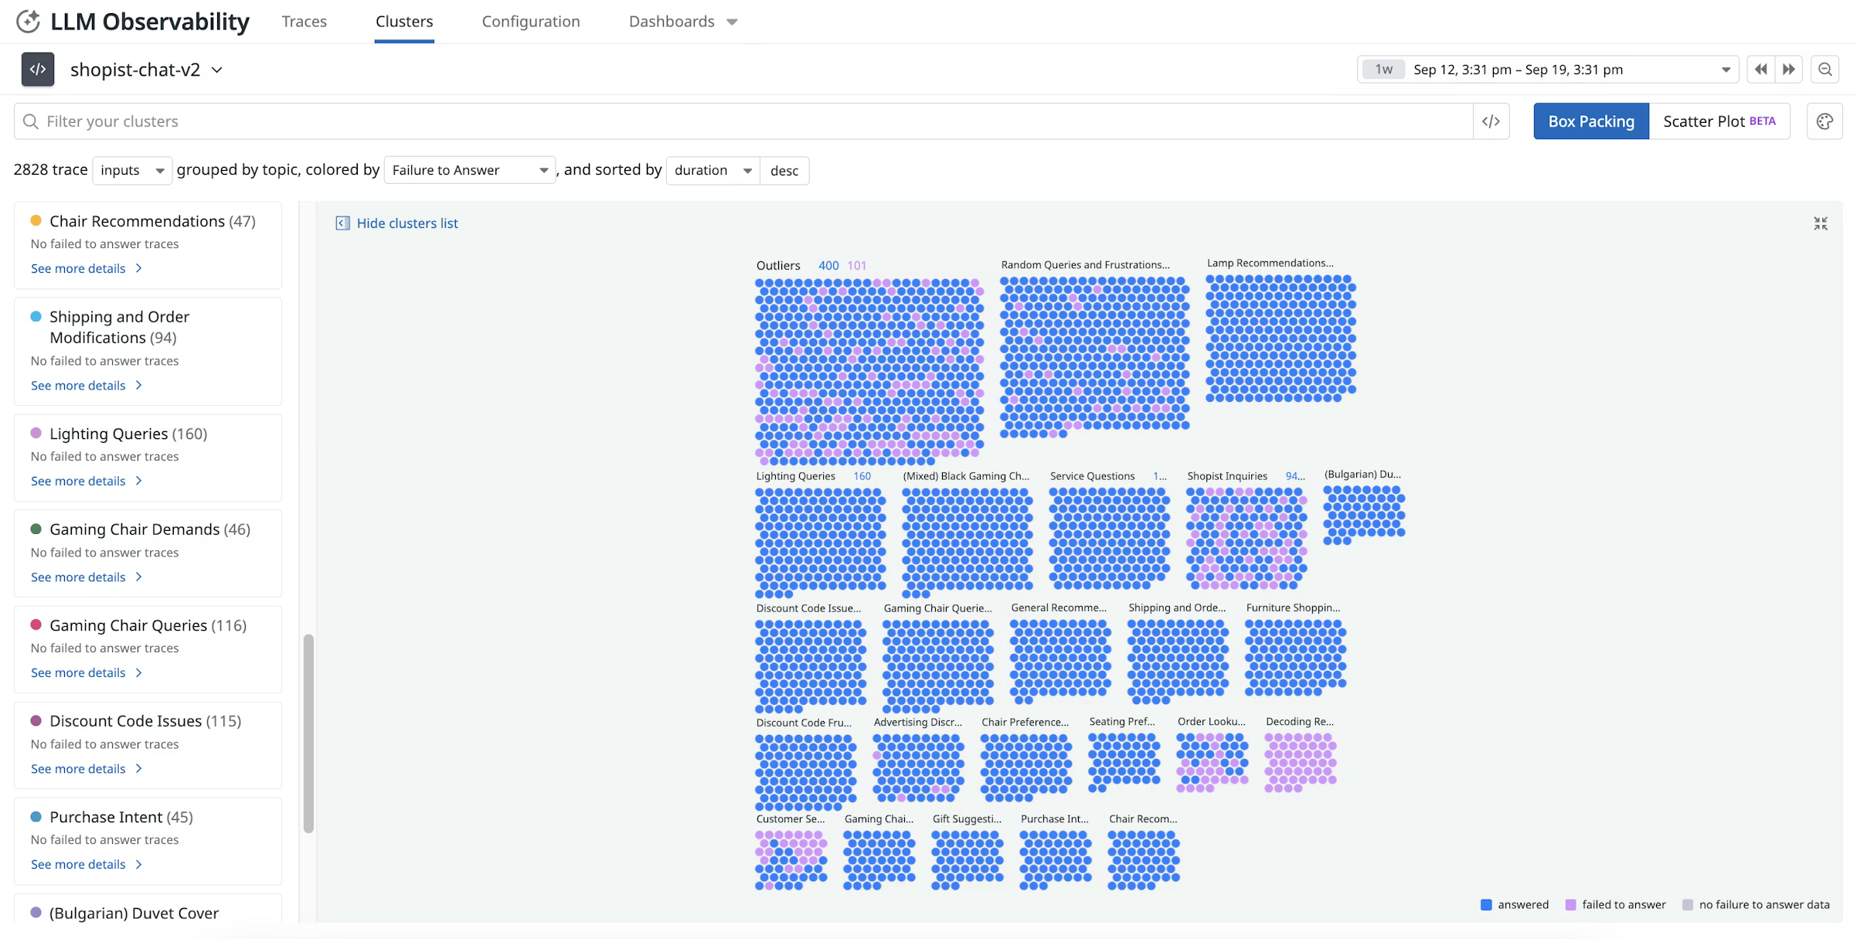
Topic Observability

Slide 127
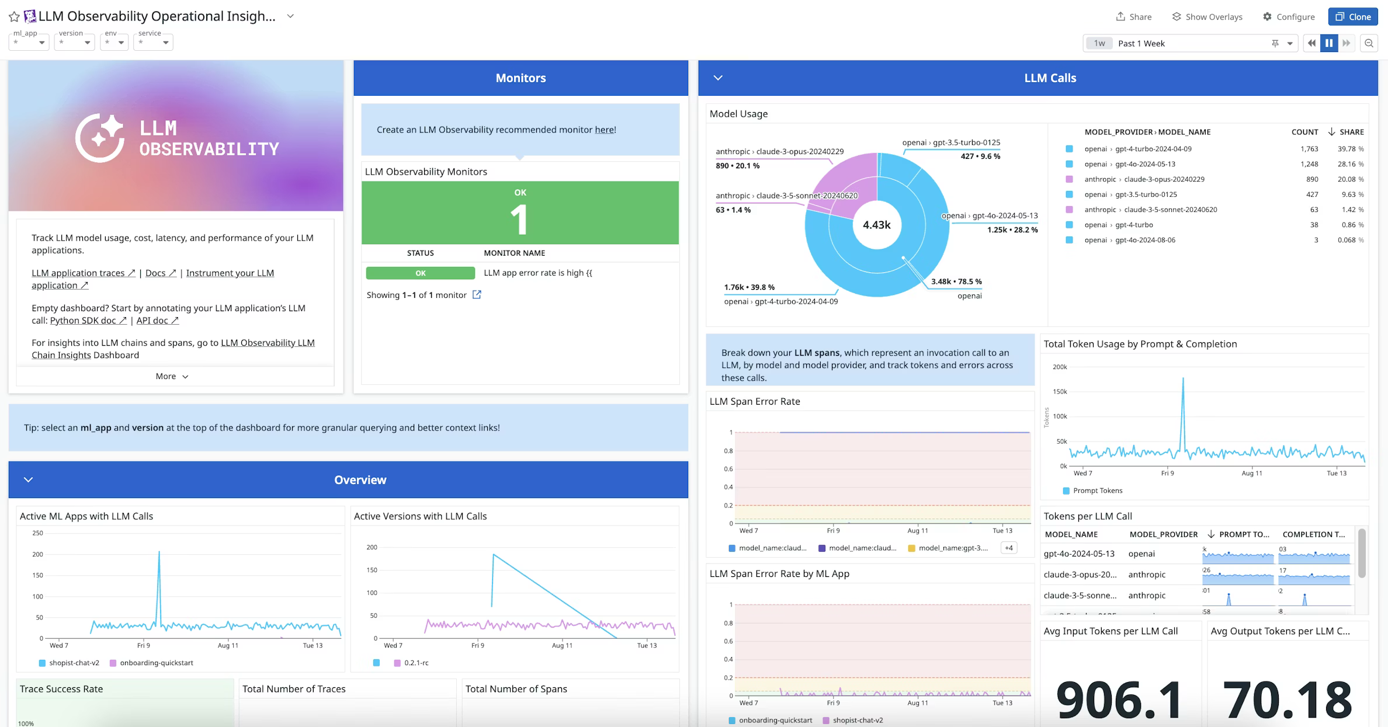
Metric Observability

Slide 128

Agentic Observability
Langfuse
Langfuse

Slide 129

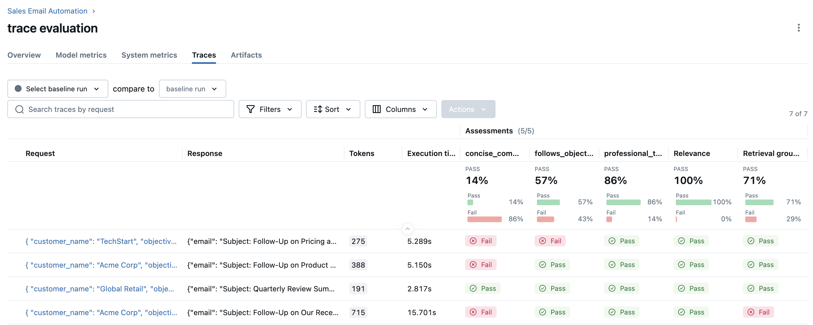
Evaluation Observability

Slide 130
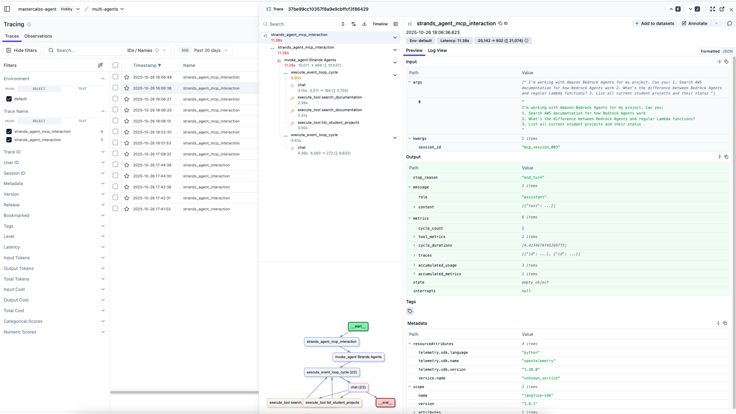
Agentic Observability

Slide 131
Observability & Monitoring
Users report 'the AI is getting worse' but you have no concrete data. Your team debates whether it's model drift, data quality, or user expectations.
What should you have implemented from day one?
A) A/B testing with multiple model versions
B) Daily model retraining pipeline
C) Comprehensive logging of inputs, outputs, latency, and user feedback metrics
D) Automated rollback to previous model versions
Notes:
Without observability, you're flying blind. You can't improve what you can't measure.

Slide 132
Optimizing and Deploying for Inference

Slide 133
1
2
3
4
Define a use case
Choose a model provider
Evaluate
Deploy & Optimize
Prompt Engineering
Fine-tune
Integrate with systems
Align with Human feedback
Observability
Monitoring

Slide 134
Inference – Important metrics
1
Throughput = query/s
More Throughput equals more concurrent users
The higher the better
2
Latency = s/token
Low latency allows faster response
The lower the better
3
Cost
$ always matter
The lower the better
We will only focus on the decoding part of the transformer after the prefill phase.

Slide 135

Inference – Important metrics
LLM
Size = # Parameters (P)
For one inference
Bounded by
$$\left(1\right)Floating point operations to operate= P×Batch_Size$$
Hardware Flops
$$\left(2\right) P memory movement$$
Hardware Memory Bandwidth
Time
$$Time for computation=\left(1\right)/hardaware_flops$$
$$Time to load model=\left(2\right)/hardaware_mem_bandwidth$$
Batch Size

Slide 136

Inference – Important metrics
Time
$$Time for computation=\left(1\right)/hardaware_flops$$
$$Time to load model=\left(2\right)/hardaware_mem_bandwidth$$
$$B^{∗}$$
Batch Size
Nvidia A100 GPU
$$B^{∗}= \frac{P×Batch_size×hardaware_mem_bandwidth}{P×hardaware_flops}=\frac{hardaware_mem_bandwidth}{hardaware_flops}=\frac{321e12}{1.5e12}\sim 208 Input Sequence$$

Slide 137



Inference – Important metrics
Time
Memory bound
Compute bound
$$Constant latency$$
$$Latency increase as \\ batch size increases$$
$$B^{∗}$$
Batch Size
$B^{∗}$: What maximizes throughput and minimize latency given a hardware
$B^{∗}$ = 208 Input Sequences (Nvidia A100 GPU)

Slide 138


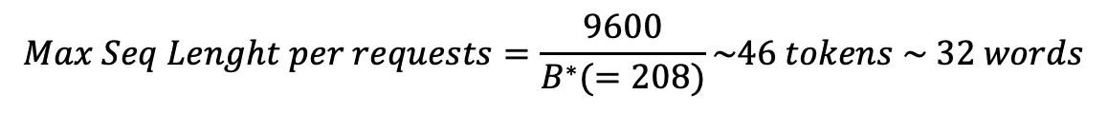
Inference – Important metrics
Two things we store in our GPUs — kv cache and weights
Size = # Parameters (P) = 10B
LLM
16fp
$$n_{layer}=64$$
Get the Max Sequence Length
$$d_{model}=8192$$
$$Bytes store in kv cache per token=2×2×n_{layer}×d_{model}$$
Nvidia A100 GPU
$$Bytes store in kv cacheper token=2,097,152=0.00209GB$$
$$Remaining Space=GPU_{space}−Model Size$$
$$Remaining Space=40GB −2×10GB=20GB$$
$$Total of tokens that can be stored=\frac{Remaining Space}{Bytes store per token}\sim 9600 tokens$$
$$Max Seq Lenght per requests=\frac{9600}{B^{∗}(=208)}\sim 46 tokens \sim 32 words$$

Slide 139
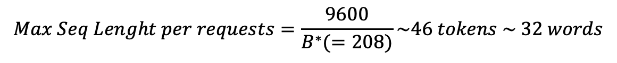
Inference – Important metrics
$$Max Seq Lenght per requests=\frac{9600}{B^{∗}(=208)}\sim 46 tokens \sim 32 words$$
At Optimal Batch Size $B^{∗}$ = 208, we can handle requests with a maximum of 46 tokens
Lower Batch Size = Higher Max Sequence Length but we will be Memory Bound
We won’t use the full capacity of the GPU Instance
More here

Slide 140
Deployment & Optimization
Your GenAI app works perfectly in testing but production shows 5x higher latency, 3x costs, and intermittent failures during peak hours (9-11 AM).
What's the most likely root cause?
A) The model quality degrades under load
B) Testing used different prompts than production
C) No load testing, rate limiting, or request batching implemented
D) Users ask more complex questions in production
Notes:
Production readiness requires proper infrastructure. Load testing and rate limiting are not optional.

Slide 141
Inference – Optimization
Distillation
Quantization
Pruning
LLM
Teacher
LLM
LLM
LLM
Student
32-bit
LLM
Pruned LLM
8-bit
More here

