Slide 1



EuroMLSys’ 26
Why Smaller Is Slower?
Dimensional Misalignment in Compressed LLMs
Jihao Xin Tian Lyu Qilong Pan Kesen Wang Marco Canini

Slide 2
Background: Post-training compression in LLMs
Large pre-trained models such as GPTs incur substantial computational and memory costs.
Post-training compression are proposed to reduce memory footprint
Popular approaches includes:
1
Low-rank Decomposition
2
Structured Pruning
3
Token Eviction

Slide 3
Problem: Post-training compression produces irregular LLM tensor dimensions
LLM dimensions are carefully designed to fit optimized GPU kernels
W
W’
Smaller might be slower!!!
=
▼
parameters
128
128
−15%
▲
prefill latency
+1%
128
107
Dimensional Misalignment
Degrades inference performance on GPUs
ρ = 15%, A100, S = 1024 ASVD[1] on Llama-3-8B
[1] Yuan, Zhihang, et al. "Asvd: Activation-aware singular value decomposition for compressing large language models." arXiv preprint arXiv:2312.05821 (2023).

Slide 4
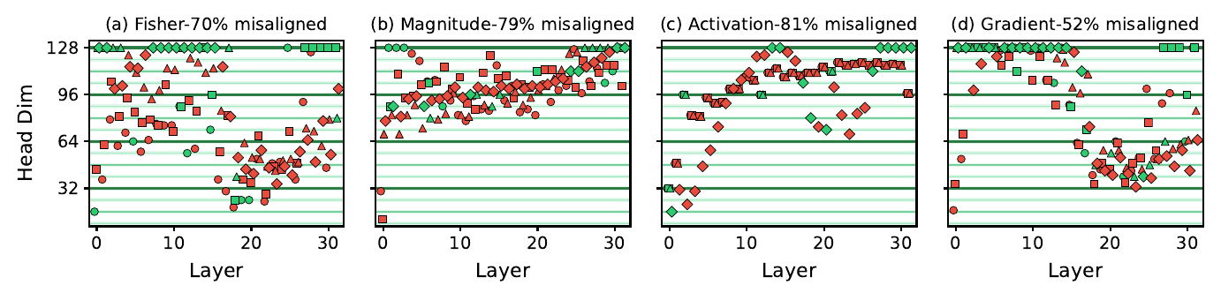
Investigation: Dimensional Misalignment consistently occurs in post-training compression
We find evidence of misalignment for different methods, compression ratios, allocation strategies
Example: 8-alignment LLama-3-8B at 20% compression
Aligned
Not aligned
● Q ▪ K ▲ V

Slide 5
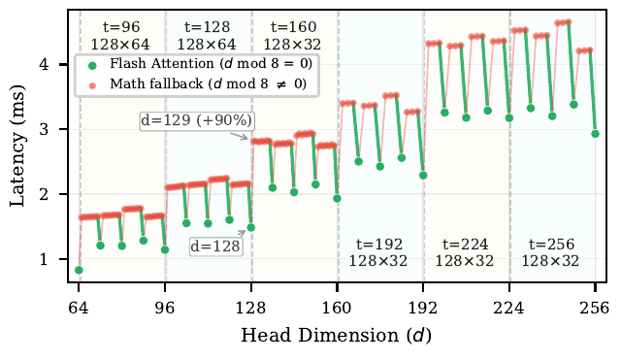
Why dimensional misalignment is a problem? Exemplified with SDPA
Scaled Dot Product Attention is a key kernel in LLM
Pytorch uses Flash Attention Backend only if dims are 8-aligned
When not 8-aligned, Pytorch fallbacks to naive Math Backend
💡
Backend fallback
+90% latency
PyTorch SDPA latency sweep · B=4, S=2048, H=32

Slide 6
Full Stack Root Cause Analysis
❍
Framework
⚙
Library
▦
Hardware
FlashAttn / Math
cuBLAS / CUTLASS
Tensor Core / L2 Cache
→
→
worst case
worst case
worst case
+90%
+30%
+70%
Alignment Constraints Table
Framework
SDPA backend
d % 8 = 0
~90%
Framework
FA2 template
d % 32 = 0
~30%
Library
cuBLAS GEMM
K, N % 8 = 0
~30%
Hardware
Tensor Core + L2
K % 16 = 0
~70%

Slide 7
Our Proposal GAC:GPU-Aligned Compression; Not a compressor, but a new compression paradigm,
∎
1
2
3
Input
Model
Compressor
Budget
Unconstrained
Compression
Dimension
Sweep
Dimension Alignment Adjustment
→
→
→
Run existing compressor as-is
Profile kernels Generate GPU-Aligned candidate dims
Constrained Optimization
DP Solver
✓
Output: 100%-aligned model with guaranteed speedup
one module, drop-in

Slide 8
Step 3: Dimension Alignment Adjustment
Constrained Optimization
Example of one weight
Input:
LLM Weights {w}
Each weight has an importance score
Each weight has a candidate dim set {c}
Total Budget
Target: Maximize total importance score
Constraint:
total params ≤ budget
only choose from candidate set 💡 Multi-Choice Knapsack – DP Solver
96
104
107
112
128
✕
d* = 107 (original)
✕
107 not aligned → excluded
✓
Cᵢ = {96, 104, 112, 128}
< 1 s
One-off

Slide 9
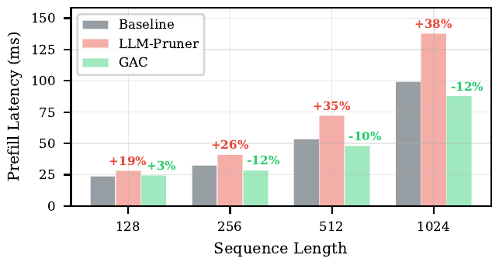
Preliminary Evaluation
Up to1.5×
100%
Preserve Acuracy
prefill speedup
alignment, any compressor
PPL & Zero-shot metric
Llama-3-8B, ρ = 15%, A100, B=1 S=1024, prefill
Method
Align
PPL
Lat (ms)
Speedup
Baseline
100%
6.14
99.6
—
ASVD
5%
34.7
100.5
-1%
ASVD (GAC)
100%
31.3
67.1
+49%
LLM-Pruner
83%
9.88
137.7
-38%
LLM-Pruner (GAC)
100%
9.87
88.0
+12%

Slide 10
Why Smaller Is Slower? Dimensional Misalignment in Compressed LLMs
Summary
◆
Problem
⚙
Analysis
✓
Solution
Dimensional misalignment in post-training compression
Root Cause across 3-layers.
GAC GPU-Aligned Compression
Thank you · Questions?
?
github.com/sands-lab/GAC

