Slide 1


Network-Accelerated Distributed Deep Learning
Omar Alama | Marco Canini | Jiawei Fei
Chen-Yu Ho | Jacob Nelson | Amedeo Sapio

Slide 2
Agenda
Session I
Distributed DNN training overview
When the network is the bottleneck
SwitchML: In-network aggregation
SwitchML hands-on
Training with SwitchML
SwitchML API
Session II
OmniReduce: Sparse collective communication
OmniReduce hands-on
GRACE: Gradient compression
GRACE hands-on
Implement and run a gradient compression algorithm

Slide 3
References
[SwitchML, NSDI ’21] Scaling Distributed Machine Learning with In-Network Aggregation A. Sapio, M. Canini, C.-Y. Ho, J. Nelson, P. Kalnis, C. Kim, A. Krishnamurthy, M. Moshref, D. R. K. Ports, P. Richtarik
[OmniReduce, SIGCOMM ’21] Efficient Sparse Collective Communication and its application to Accelerate Distributed Deep Learning J. Fei, C.-Y. Ho, A. N. Sahu, M. Canini, A. Sapio
[GRACE, ICDCS ’21] GRACE: A Compressed Communication Framework for Distributed Machine Learning H. Xu, C.-Y. Ho, A. M. Abdelmoniem, A. Dutta, E. H. Bergou, K. Karatsenidis, M. Canini, P. Kalnis

Slide 4
Agenda
Session I
Distributed DNN training overview
When the network is the bottleneck
SwitchML: In-network aggregation
SwitchML hands-on
Training with SwitchML
SwitchML API
Session II
OmniReduce: Sparse collective communication
OmniReduce hands-on
GRACE: Gradient compression
GRACE hands-on
Implement and run a gradient compression algorithm

Slide 5
Deep Learning
Increasingly sophisticated models
Increasingly larger datasets
Innovation fueled by leaps in (costly) infrastructure:
Clusters with hundreds of machines, each with many HW accelerators (GPUs, TPUs, etc.)
Compute requirements doubling every 3 months!
Training models is still very time-consuming: days or even weeks!
Notes:
Modern ML solutions are so successful because they can build increasingly sophisticated models to accurately represent real world problems, and, as models become more complex, they require training on increasingly larger datasets.
This increase in size and complexity made distributed training very common. With distributed training, large-scale clusters use hundreds of nodes to run training jobs, and each node can be equipped with multiple hardware accelerators. Nevertheless, a training job can still take many hours, days or even weeks.

Slide 6
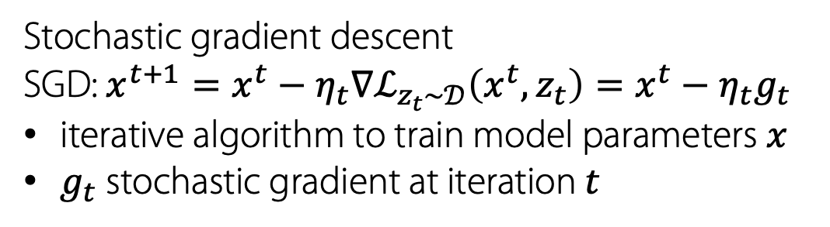
DNN training
Stochastic gradient descent
SGD: $x^{t+1}=x^{t}−η_{t}∇ℒ_{z_{t}\sim 𝒟}\left(x^{t},z_{t}\right)=x^{t}−η_{t}g_{t}$
iterative algorithm to train model parameters $x$
$g_{t}$ stochastic gradient at iteration $t$
DNN model
Forward pass
Backward pass
ℒ
Minibatch
Loss
Layer 1
Layer 2
Layer 3

Slide 7
Data-parallel distributed DNN training
ℒ
W₁
Data samples
Layer 1
Layer 2
Layer 3
ℒ
W₂
Layer 1
Layer 2
Layer 3
ℒ
W₃
Layer 1
Layer 2
Layer 3
ℒ
W₄
Layer 1
Layer 2
Layer 3

Slide 8


Compute-communication overlap
ℒ
W₁
Layer 1
Layer 2
Layer 3
Gradient synchronization
Wait on the network
Next iteration starts
1
2
3
3
2
1
1
3
2
1
Time

Slide 9
Data-parallel distributed DNN training
W₁
W₂
Data samples
All-to-all intensive communication pattern
Gradient synchronization
W₃
W₄

Slide 10
All-to-all reduction
W₁
W₂
Data samples
+
Gradient synchronization
W₃
W₄

Slide 11
All-to-all reduction
W₁
W₂
Data samples
+
+
+
Gradient synchronization
W₃
W₄

Slide 12
All-to-all reduction
W₁
W₂
Data samples
+
+
+
=
Gradient synchronization
W₃
W₄

Slide 13
All-to-all reduction
W₁
W₂
Data samples
+
Gradient synchronization
W₃
W₄

Slide 14
AllReduce
W₁
W₂
Data samples
Form a logical ring (or tree, etc.) and run peer-to-peer communication
Gradient synchronization
W₃
W₄

Slide 15
Parameter server (PS)
W₁
W₂
Data samples
Push gradients
Aggregate updates at PS
Pull aggregated gradients
(or updated model parameters)
PS
W₃
W₄

Slide 16
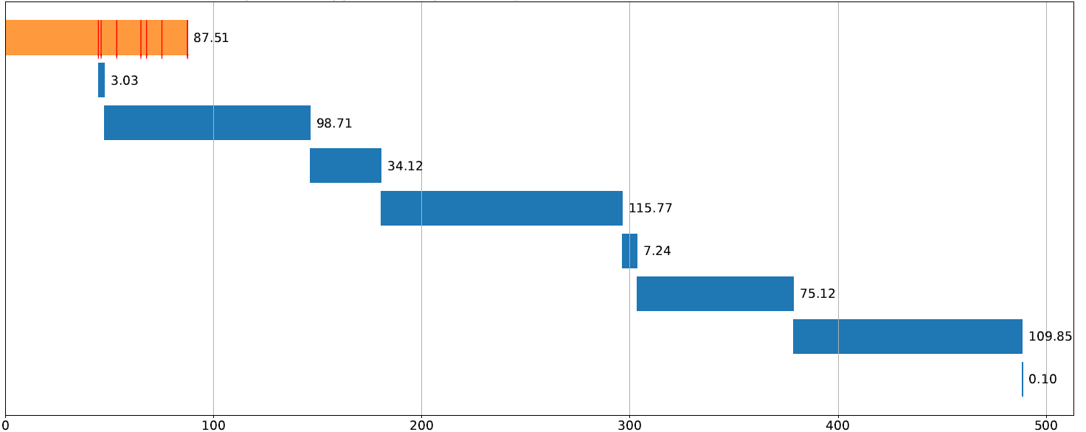
The network bottleneck
When is the network a bottleneck?
1st order: The ratio of communication to computation
2nd order: The non-overlappable communication
see Section 2.2 of SwitchML paper [NSDI ’21]
DeepLight training – 1 iteration
Overlap
No overlap
Time (ms)

Slide 17
The network bottleneck
Compute accelerators performance improvements have so far outpaced network bandwidth increases
Newer, larger DNN models spend more time on communication

Slide 18
The network bottleneck: hypothetical scaling
Faster GPU that leads to contiguous network saturation at 100 Gbps
(considering measured non-overlappable communication)

Slide 19
Questions?

Slide 20
First hands-on
Goal: Run your first distributed DNN training job with TF + Horovod
Horovod what?
Horovod is a distributed DL toolkit with a simple API
Does worker coordination and leverages NCCL, MPI or Gloo collectives
Will now train a simple MNIST classifier. Expect to see something like:
opt = hvd.DistributedOptimizer(opt, ...) # Wrap the optimizer
[1,0]<stderr>:I0827 10:26:35.182926 140002329507648 basic_session_run_hooks.py:260] loss = 0.04415287, step = 90 (0.765 sec)
[1,1]<stderr>:INFO:tensorflow:loss = 0.045447636, step = 90 (0.764 sec)
[1,1]<stderr>:I0827 10:26:35.182554 139970903414592 basic_session_run_hooks.py:260] loss = 0.045447636, step = 90 (0.764 sec)
[1,0]<stderr>:INFO:tensorflow:loss = 0.055977736, step = 100 (0.776 sec)
[1,0]<stderr>:I0827 10:26:35.958616 140002329507648 basic_session_run_hooks.py:260] loss = 0.055977736, step = 100 (0.776 sec)
[1,1]<stderr>:INFO:tensorflow:loss = 0.05445839, step = 100 (0.775 sec)
[1,1]<stderr>:I0827 10:26:35.957948 139970903414592 basic_session_run_hooks.py:260] loss = 0.05445839, step = 100 (0.775 sec)

Slide 21
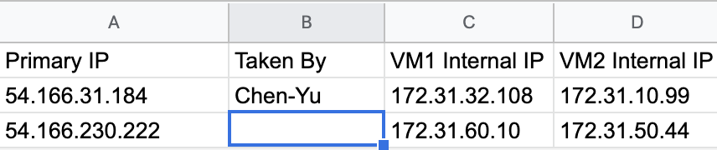
Setup and instructions
Will run on actual K80 GPU instances on AWS – 2 VMs per participant (up to our resource limit)
Download the net-accel-dl-tutorial.pem SSH private key from Slack channel
ensure right perms (chmod 0400)
Acquire a pair of FREE VMs by filling in your name
mind conflicts – try to spread out in the sheet
SSH to Primary IP and run the job
ssh –i net-accel-dl-tutorial.pem ubuntu@$PRIMARY_IP
~/scripts/1_tf_mnist.sh
All working well? Open the script ~/scripts/tensorflow_mnist.py
Can you identify the Horovod code?
Detailed instructions go to https://hackmd.io/@chenyuho/rknwow7WF

