Slide 1
Agenda
Session I
Distributed DNN training overview
When the network is the bottleneck
SwitchML: In-network aggregation
SwitchML hands-on
Training with SwitchML
SwitchML API
Session II
OmniReduce: Sparse collective communication
OmniReduce hands-on
GRACE: Gradient compression
GRACE hands-on
Implement and run a gradient compression algorithm

Slide 2

Communication overheads degrade scalability
Overheads increase with # nodes
Huge models scale poorly
10 Gbps network
$$Scaling factor=\frac{Time for N nodes}{N×Time for single node}$$

Slide 3
Many gradients are highly sparse
Model | Task | Model size | Gradient sparsity
DeepLight | CTR prediction | 2.26 GB | 99.73%
LSTM | Language modeling | 1.52 GB | 94.50%
BERT | Question answering | 1.28 GB | 9.31%
NCF | Recommendation | 680 MB | 84.60%
VGG19 | Image classification | 548 MB | 32.00%
ResNet152 | Image classification | 230 MB | 21.60%
Sparsity: the proportion of gradient elements equal to zero

Slide 4
Limitation of existing solutions
Existing collective libraries (NCCL and Gloo) have no native support for sparse data
W₁ | 0 | 0 | 0 | 0 | 1 | 0 | 0 | 1 | 0
0 | 0 | 0
0 | 1 | 0
W₂ | 1 | 1 | 0 | 0 | 0 | 0 | 0 | 0 | 0
1 | 1 | 0
0 | 0 | 0
0 | 0 | 0
W₃ | 1 | 0 | 0 | 0 | 0 | 0 | 0 | 0 | 0
0 | 0 | 0
Notes:
for example, I’m showing the first step of ring all-reduce algorithm.
one can observe that no matter how many zeros there are in a chunk, a worker needs to send it to its neighbor,
this causes suboptimal bandwidth usage

Slide 5
Limitation of existing solutions
Existing collective libraries (NCCL and Gloo) have no native support for sparse data
Existing sparse collective algorithm is inefficient
All-Gather based sparse (AGsparse) algorithm has poor scalability
Format conversion overheads for dense inputs
Slower than dense AllReduce if sparsity is not high enough
Can not take full advantage of the inbound and outbound bandwidth

Slide 6





Our Approach: OmniReduce
Goals
Design
High performance and scalability
Data-format universality
Flexibility
Coordinated aggregation
Block-wise method (and fusion)
Fine-grained parallelism and data pipelining
Both sever-based and in-switch implementation

Slide 7
Results
Training speedup up to 8.2× at 10 Gbps and 2.9× at 100 Gbps relative to NCCL

Slide 8
OmniReduce: sparse streaming aggregation
W₁ | 1 | 1 | 0 | 0 | 1 | 1 | 1 | 1
Split data into blocks
Stream non-zero blocks to aggregator
Keep global view of next block
High performance through fine-grained parallelization (pool of aggregation slots) and pipelining to saturate network bandwidth
1 | 1
next block: 2
2 | 2
0 | 0
1 | 1
next block: 3
1 | 1
1 | 1
next block: ∞
2 | 2
Aggregator
1 | 1
next block: 3
2 | 2
next block: 2
2 | 2
next block: 2
1 | 1
next block: 3
2 | 2
next block: ∞
global next block: 3
3 | 3
2 | 2
next block: ∞
global next block: 2
2 | 3
global next block: -∞
-∞ | -∞
global next block: -∞
-∞ | -∞
W₁
W₂
W₂ | 1 | 1 | 0 | 0 | 0 | 0 | 1 | 1
2 | 2
1 | 1
next block: 3
0 | 0
1 | 1
2 | 2
1 | 1
next block: ∞
Notes:
so, how do we exploit sparsity? We partition gradient updates into blocks, and include a tag indicating the next non-zero block index. We introduce a component called smart aggregator and here’s the idea: Every worker sends its update to the aggregator with an index of the next non-zero block it has. The aggregator does aggregation and finds the minimum index among all workers. After it receives updates from all workers, it sends back aggregated updates along with the next block index.
Now, a worker only sends its next block if there’s a match. In this particular example only worker 1 is sending block 1,
While 2 and 3 simply does nothing. The aggregator receives updates from worker 1 and it can conclude at this point that the updates for this block is ready because worker 2 and 3 have bigger next block index It can then broadcast the update with next block index 2 The same procedure goes on. This time, only worker 2 has non zero block 2 and sends its block 2
Similarly, the aggregator broadcasts the update with next block index 3
Note that worker 2 now has infinity next block index, indicating it has transmitted all its non-zero blocks
Finally, worker 1 and 3 sends block 3, and when a worker receives infinity next block index, the worker knows the aggregation process is done

Slide 9


Multi-slot and multi-thread
# of agg | # of worker | # of threads | # of slots per thread (worker)
2 | 2 | 2 | 4
Aggregator 0
Aggregator 1
Thread 0
Thread 1
Thread 0
Thread 1
Slot 0
Slot 1
Slot 2
Slot 3
Slot 0
Slot 1
Slot 2
Slot 3
Slot 0
Slot 1
Slot 2
Slot 3
Slot 4
Slot 5
Slot 6
Slot 7
Slot 0
Slot 1
Slot 2
Slot 3
Slot 4
Slot 5
Slot 6
Slot 7
Thread 0
Thread 1
Thread 0
Thread 1
Worker 0
Worker 1
Tensor
Tensor

Slide 10
DPDK Packet
UDP packet
UDP header
Current offset
Next offset
Slot index
Data type
Data block
 | Aggregator | Worker
Current offset | - | Where to write results
Next offset | When to multicast results | Send or not
Slot index | Where to aggregate | Where to find non-zero
Data type | How to aggregate | -

Slide 11
RDMA Packet
Opcode: IBV_WR_RDMA_WRITE_WITH_IMM
RDMA message
Data block
Next offset
Payload
32-bit Immediate
The slot index can be calculated by next offset
Worker records current offset locally
Worker and aggregator exchange metadata (data type, count) before aggregation

Slide 12
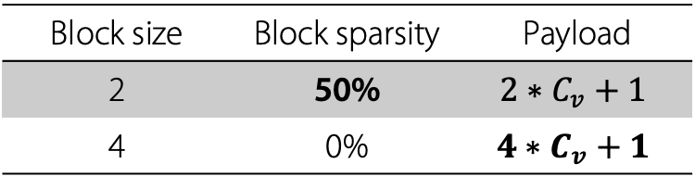
Limitation of the basic algorithm
How to choose block size?
Smaller block size increases block sparsity
Larger block size increases bandwidth usage due to larger payload
1 | 0 | 0 | 0 | 1 | 0 | 0 | 0
Block size | Block sparsity | Payload
2 | 50% | $$2∗C_{v}+1$$
4 | 0% | $$4∗C_{v}+1$$
$C_{v}$ refers to the number of bytes needed to represent a value
How to balance the trade-off between
block sparsity and bandwidth usage?

Slide 13
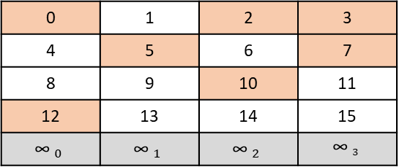


Solution: Block Fusion
Key idea: small block size and large packet size
One slot
Pack multiple blocks into a single packet
Data is viewed in a 2-dimensional layout
Payload size is not constant
0
2
3
0 | 1 | 2 | 3
4 | 5 | 6 | 7
8 | 9 | 10 | 11
12 | 13 | 14 | 15
$${\text{∞} }_{0}$$ | $${\text{∞} }_{1}$$ | $${\text{∞} }_{2}$$ | $${\text{∞} }_{3}$$
5
7
10
12
Find next block offset
Collect non-zero blocks
$${\text{∞} }_{1}$$
Packet
4
12 | $${\text{∞} }_{1}$$ | 10 | 7
Block num
Block data
Next offset
Notes:
The next block offset is found by scanning over the rows for each column
two blocks at the same column index cannot be fused into the same packet
As a result, the same logic of the basic solution remains unchanged and this scheme does not require transmitting any additional information

Slide 14
Multi-slot and multi-thread for Block Fusion
# of agg | # of worker | # of threads | # of slots per thread (worker) | # of blocks per slot
2 | 2 | 2 | 2 | 2
Aggregator 0
Aggregator 1
Thread 0
Thread 1
Thread 0
Thread 1
Slot 0
Slot 1
Slot 0
Slot 1
Slot 0
Slot 1
Slot 2
Slot 3
Slot 0
Slot 1
Slot 2
Slot 3
Thread 0
Thread 1
Thread 0
Thread 1
Worker 0
Worker 1
Tensor
Tensor

Slide 15
RDMA Packet for Block Fusion
Opcode: IBV_WR_RDMA_WRITE_WITH_IMM
RDMA message
4 bits
12 bits
16 bits
Data
blocks
Next offsets
Data type
# of blocks
Slot index
Payload
32-bit Immediate

Slide 16
Why OmniReduce is better?
We analyze performance of the following three AllReduce algorithms:
Ring AllReduce
AGsparse
AllGather keys and values
Local reduction on each worker
OmniReduce

Slide 17
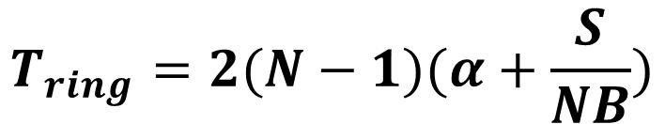
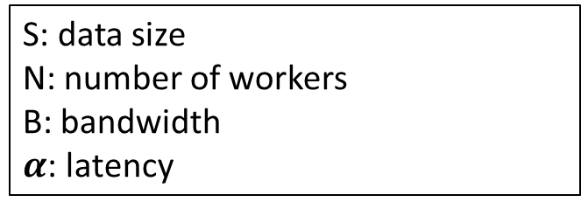
Why OmniReduce is better?
S: data size
N: number of workers
B: bandwidth
$α$: latency
$$T_{ring}=2(N−1)(α+\frac{S}{NB})$$
Ring AllReduce analysis https://github.com/NVIDIA/nccl-tests/blob/master/doc/PERFORMANCE.md

Slide 18
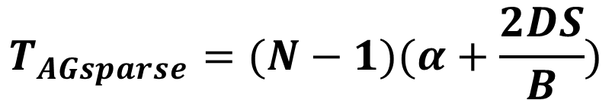
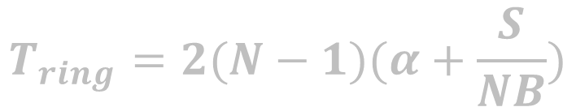
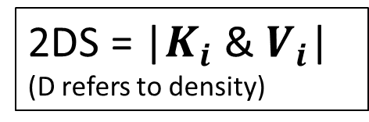
Why OmniReduce is better?
S: data size
N: number of workers
B: bandwidth
$α$: latency
$$T_{ring}=2(N−1)(α+\frac{S}{NB})$$
2DS = |$K_{i}$ & $V_{i}$|
(D refers to density)
$$T_{AGsparse}=(N−1)(α+\frac{2DS}{B})$$
K1 & V1
K1 & V1
K1 & V1
K1 & V1
Step 1
Step 2
K1 & V1
K1 & V1
K1 & V1
K1 & V1
K1 & V1
K1 & V1
K1 & V1
K1 & V1
K1 & V1
K1 & V1
K1 & V1
K1 & V1
K1 & V1
K1 & V1

Slide 19
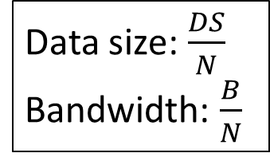
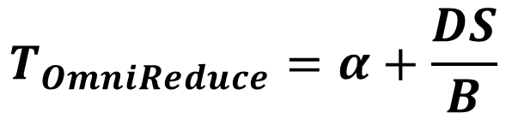
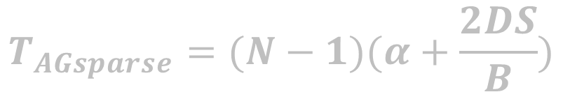
Why OmniReduce is better?
S: data size
N: number of workers
B: bandwidth
$α$: latency
$$T_{ring}=2(N−1)(α+\frac{S}{NB})$$
$$T_{AGsparse}=(N−1)(α+\frac{2DS}{B})$$
aggregators
$$T_{OmniReduce}=α+\frac{DS}{B}$$
Data size: $\frac{DS}{N}$
Bandwidth: $\frac{B}{N}$
workers

Slide 20
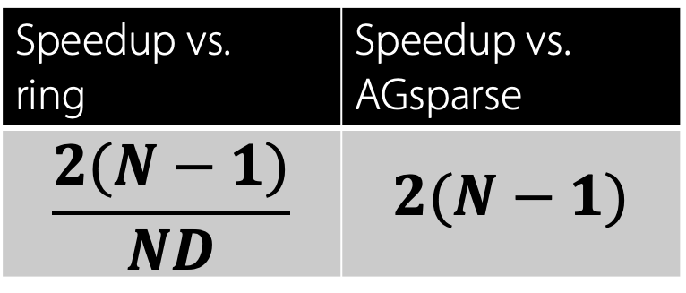
Why OmniReduce is better?
$$T_{ring}=2(N−1)(α+\frac{S}{NB})$$
Very sparse data
D is very small and latency dominates the bandwidth
Sparse to dense
Latency can be ignored
$$T_{AGsparse}=(N−1)(α+\frac{2DS}{B})$$
$$T_{OmniReduce}=α+\frac{DS}{B}$$
Speedup vs. ring | Speedup vs. AGsparse
$$\frac{2(N−1)}{ND}$$ | $$2(N−1)$$

Slide 21





Implementation
Support DPDK, RDMA and GPUDirect (GDR)
Integrated with PyTorch native distributed package and Horovod
Aggregator component implementation
Dedicated mode
Colocated mode
In-network aggregation: P4 program for Barefoot Tofino switch
RDMA
Remote Direct Memory Access
(using SwitchML quantization method)

Slide 22
Where OmniReduce works
User Script
User Script
User Script
TensorFlow
PyTorch
MxNet
Communication Module
Parameter Server
(Native)
AllReduce
TF/PyTorch/MxNet Native
Horovod
gRPC, ZeroMQ
MPI
NCCL
Gloo
OmniReduce
TCP/IP
RDMA (opt. with GDR)
DPDK

Slide 23
OmniReduce workflow
Aggregator logic
Slave thread N
…
Aggregator master thread
Slave thread 2
Slave thread 1
Start
Start
Init
Allocate buffer;
Establish connection;
New message?
N
Y
Aggregation aggregator logic
Create slave threads
Force exit ?
Completed ?
N
N
Y
Y
Multicast results
End

Slide 24
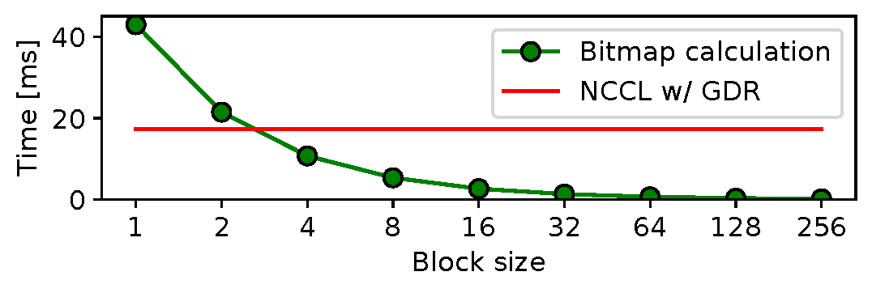
OmniReduce workflow
Worker logic
Worker master thread
Start
Slave thread N
…
To accelerate the search for next non-zero block
Computing bitmap is time consuming on CPU
Init
Allocate buffer;
Establish connection;
Slave thread 2
Slave thread 1
Start
Create slave threads
data_ready flag ?
N
N
New tensor ?
Y
Using GPU !
Y
Get a tensor chunk
Compute bitmap
Compute bitmap
Return result
Aggregation worker logic
Set data_ready flag
Set completed flag
Y
Completed flag ?
N
…

Slide 25
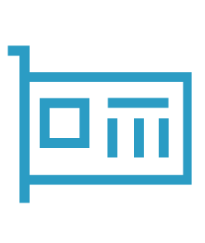
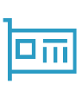
System with GDR support
Allocate a specific buffer in GPU memory for aggregation
Performing memory registration for RDMA isn't recommended in the data path because it is time consuming
Bandwidth for device-to-device memory copy is high
GPU memory
Buffer
Tensor
Non-zero
blocks
cudaMemcpyAsync
RDMA
NIC

Slide 26
System w/o GDR support
Allocate a specific buffer in host memory for aggregation
Memory copy between GPU and host is time consuming
Chunk prefetch to overlap memory copy and communication
GPU memory
Host memory
Chunk 0
Chunk 0
Chunk 1
Chunk 1
Non-zero
blocks
…
Chunk n
Buffer
cudaMemcpyAsync
memcpy
PCIE
NIC

Slide 27
Client APIs (Synchronous)
Setup
GPU tensor
CPU tensor
For CPU tensor, the bitmap needs to be provided by user
#include <switchml/context.h>
omnireduce::OmniContext& ctx = omnireduce::OmniContext::getInstance();
void ctx.AllReduce(int32_t* tensor, int count, cudaStream_t stream, int devID);
void ctx.AllReduce(float* tensor, int count, cudaStream_t stream, int devID);
void ctx.AllReduce(int32_t* tensor, int count, uint8_t* bitmap, int block_count);
void ctx.AllReduce(float* tensor, int count, uint8_t* bitmap, int block_count);

Slide 28
How to run
Edit configuration file (omnireduce.cfg) according to your cluster information
Run aggregator program on each aggregator machine
Run worker program on each worker machine

Slide 29
omnireduce.cfg
[omnireduce]
num_workers = 2
num_aggregators = 2
num_threads = 8
worker_cores = -1,-1,-1,-1,-1,-1,-1,-1
aggregator_cores = -1,-1,-1,-1,-1,-1,-1,-1
threshold = 0.0
buffer_size = 1024
chunk_size = 1048576
bitmap_chunk_size = 16777216
message_size = 256
block_size = 256
ib_hca = mlx5_1
ib_port = 1
gid_idx = 2
sl = 2
gpu_devId = 0
direct_memory = 1
adaptive_blocksize = 0
tcp_port = 19875
worker_ips = 192.168.10.201,192.168.10.202
aggregator_ips = 192.168.10.101,192.168.10.102
Number of workers and aggregators
Number of threads for communication
Set CPU affinity for threads :
Value -1 means no CPU affinity setting
Value > 0 means the core ids for different threads
Note: The number should be consistent with num_threads
Each worker and aggregator needs a copy of omnireduce.cfg
OmniReduce algorithm parameters:
threshold: threshold for calculating block bitmap
buffer_size: send/recv buffer size in MByte
GDR: GPU memory
RDMA only: host memory
chunk_size: chunk prefetch unit in Byte
message_size: number of elements in each packet
block_size: number of elements in each block
RDMA device parameters
GPU index and GDR using flag
Ip addresses and port number used for negotiation.
Note: The number of ip address should be consistent with num_workers and num_aggregators

Slide 30
Hands-on
Download and install our VMs
Set VM network to be in a subnet (you can set bridge mode)
Add RDMA device with the following command:
NOTE: You need to replace ens33 with your own interface name
Ensure that VMs can ssh each other without a password
Check IP address for each VM and update omnireduce.cfg
Run aggregators and then run workers
sudo rdma link add rxe_0 type rxe netdev ens33

