Slide 1
Design Variation + Performance Map Using SimericsMP
Python Script Solution

Slide 2
Design Variation + Performance Map Using SMP
Objectives:
Instantly create multiple CFturbo designs with varying design parameters for study of optimization and sensitivity.
Streamline the workflow that is running multiple simulations using SimericsMP to construct a performance map.
Prerequisites:
Cfturbo
https://cfturbo.com/software/download
SimericsMP
Python (3.10.1)
https://www.python.org/downloads/
Text Editor (Visual Studio Code)
https://code.visualstudio.com/download
Python Extension
Microsoft Excel
CFturbo Inc. Python Scripts
https://github.com/sandschristopher/master

Slide 3
Design Variation + Performance Map Using SMP
General Workflow:
Run steady-state simulations for each design variation
Analyze performance of each design variable to find optimal design
Run a full performance map for the optimal design
General Outline – Design Variation:
Create and Prepare Project Folder
Select Design Variation Parameters/Export to SimericsMP
User Modification of master.cftconf
Run master.py within Visual Studio Code
Fill in Design Parameter Values in .csv
Open Results .csv File for Post-Processing

Slide 4
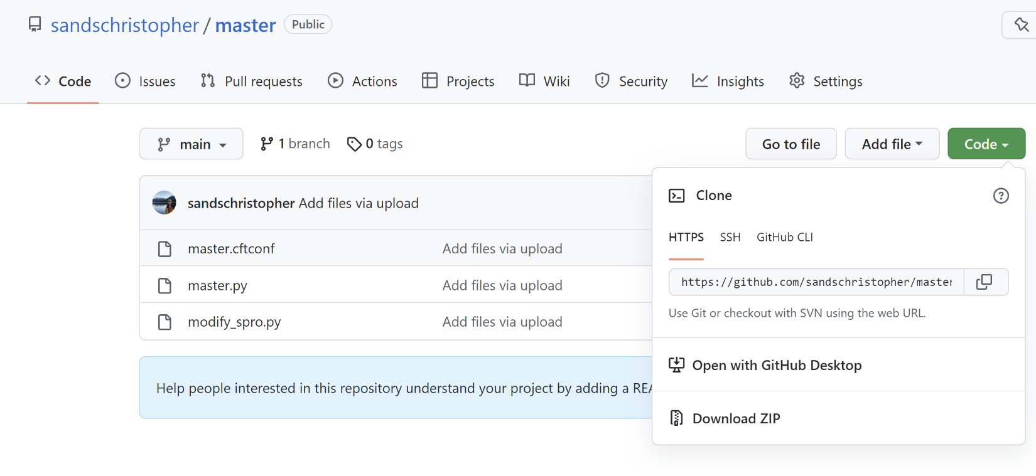
I. Create and Prepare Project Folder
Create and name a project folder accordingly (e.g. HT_single_stage)
Download the CFturbo python scripts from github repository and place within project folder:
master.cftconf
master.py
modify_spro.py
Ensure the Cfturbo Design File is also in the project folder, both with the same name!

Slide 5
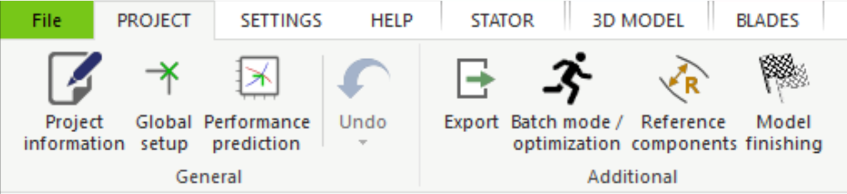
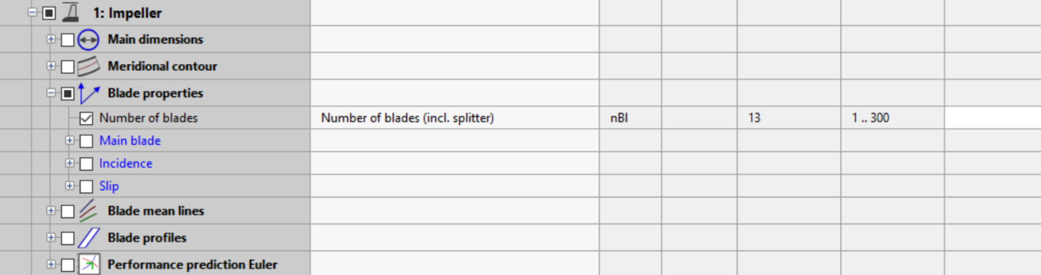
II. Select Design Variation Parameters/Export to SMP
After the design process within CFturbo, select Batch mode/optimization under the Project tab
Under the Parameters tab, check the box corresponding to each design parameter you wish to vary.

Slide 6
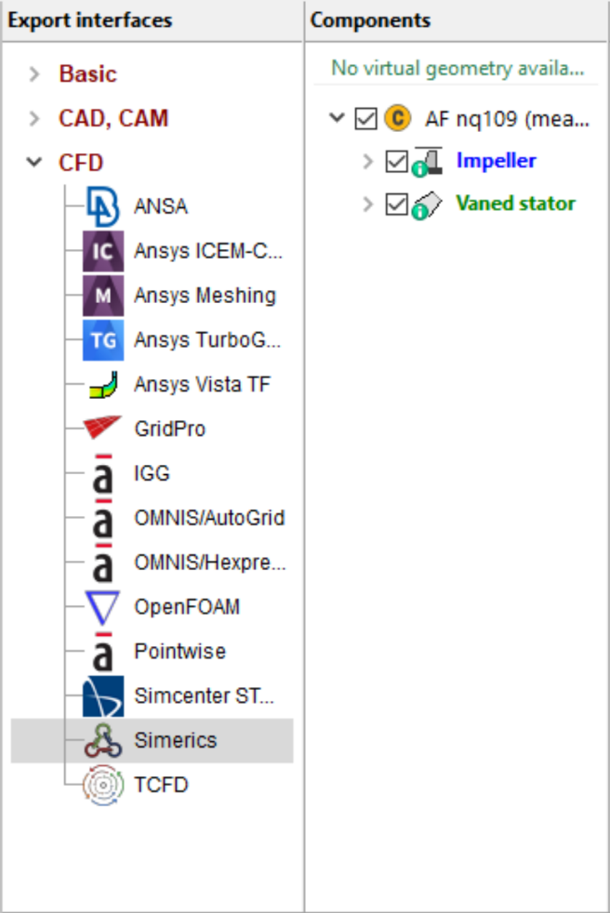
II. Select Design Variation Parameters/Export to SMP (cont.)
Under the Export actions tab:
Within the Export interfaces window, open CFD and highlight Simerics
Within the Components window, check the box corresponding to the design component you wish to include in the simulation geometry

Slide 7
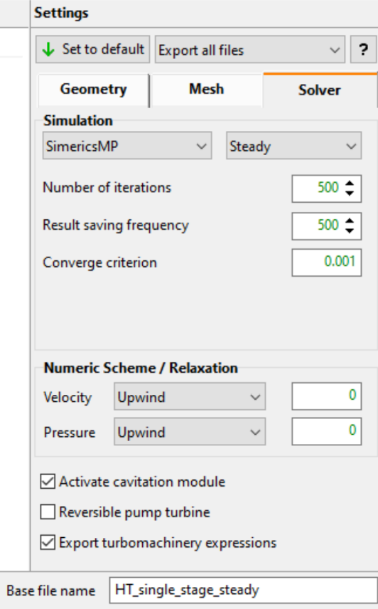
II. Select Design Variation Parameters/Export to SMP (cont.)
Within the Settings window, ensure Export all files is selected in the dropdown menu
Select Solver and choose the Steady solver type from the dropdown menu
Denote the base file name with a marker that suggests the steady solver type
Finally, click Add and then Save As... to manually place the Cfturbo batch file in the project folder

Slide 8
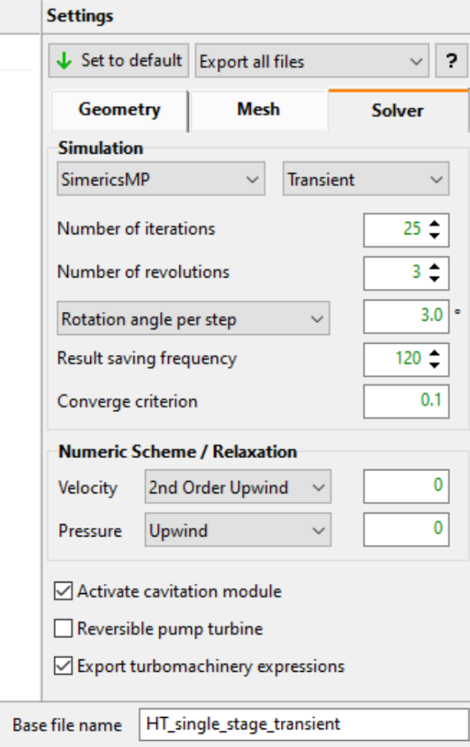
II. Select Design Variation Parameters/Export to SMP (cont.)
If transient simulation results are desired:
Within the Settings window, ensure Export all files is selected in the dropdown menu
Select Solver and choose the Transient solver type from the dropdown menu
Denote the base file name with a marker that suggests the transient solver type
Finally, click Add and then Save As... to manually place the Cfturbo batch file in the project folder

Slide 9
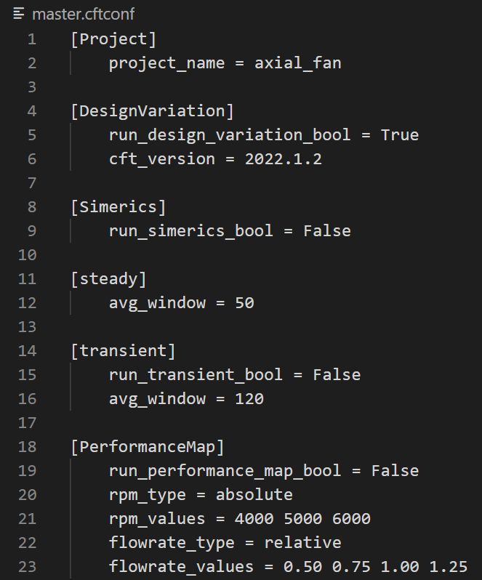
III. User Modification of master.cftconf
Open the project folder within the text editor and select the master.cftconf file

Slide 10
III. User Modification of master.cftconf (Cont.)
Under [Project]:
Assign the project name to project_name
This should be consistent with the base file name and project folder named previously
Under [DesignVariation]:
Set run_design_variation_bool to True
Set cft_version to the CFturbo version being used (e.g. 2022.1.2)
Under [Simerics]:
Set run_simerics_bool to True

Slide 11
III. User Modification of master.cftconf (Cont.)
Under [Steady]:
Set avg_window to an appropriate integer value for averaging of iterations
Under [Transient]:
Set run_transient_bool to False
Set avg_window to an appropriate integer value for averaging of timesteps

Slide 12
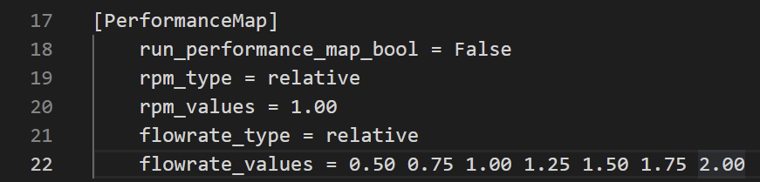
III. User Modification of master.cftconf (Cont.)
Under [PerformanceMap]:
Set run_performance_map_bool to False

Slide 13
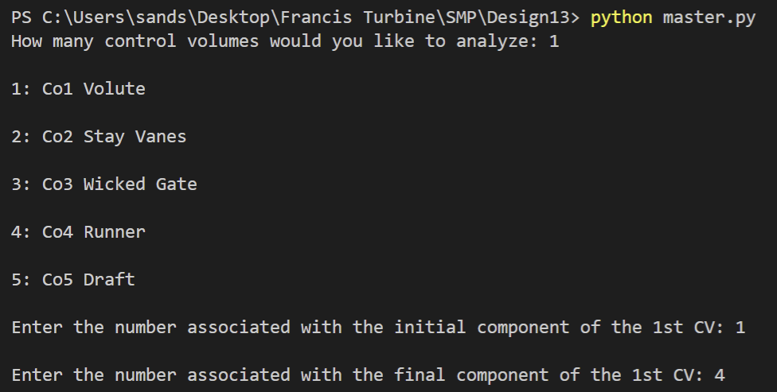
IV. Run master.py in VS Code
Within the text editor, open terminal and run the master.py
If using Visual Studio Code:
Select Terminal > New Terminal
Within the terminal type python master.py and click Enter on keyboard
Use the pip3 install [library] command to install the necessary libraries
The user is prompted to input information regarding subsecting control volumes within the flow path:
How many subsecting CVs they wish to examine
The number associated with the initial/final component of each subsecting CV

Slide 14
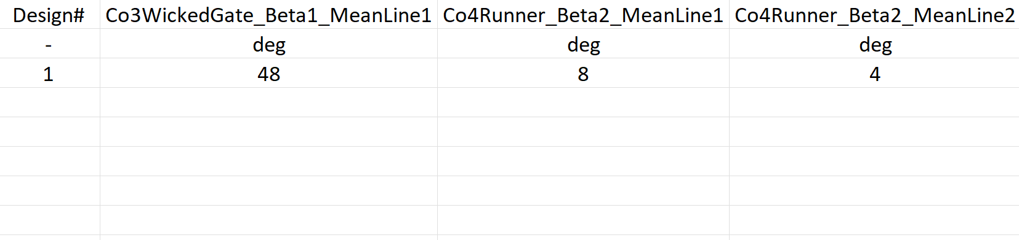
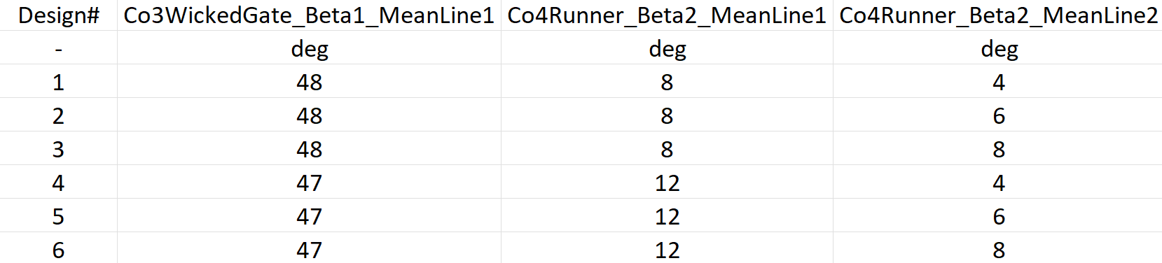
V. Fill in Design Parameter Values in .csv
Once python master.py is executed and the subsecting control volumes are defined, the user will be prompted to fill a resultant .csv file with respective values
Once done filling the .csv file with design parameter values, return to the Terminal and press <Enter>

Slide 15
VI. Open Results .csv File for Post-Processing
Manual convergence control can be analyzed simultaneously within the SimericsMP application
Wait for the program to finish
Within File Explorer, open the resultant .csv files
The averaged results of performance characteristics for each Cfturbo design are displayed
The user should examine the performance of each design and run the following performance map script for the optimal design

Slide 16
Design Variation + Performance Map Using SMP
General Outline - Performance Map:
Create and Prepare Project Folder
CFturbo Design Export to SimericsMP
User Modification of master.cftconf
Run master.py within Visual Studio Code
Open Results .csv File for Post-Processing

Slide 17
I. Create and Prepare Project Folder
Create and name a project folder accordingly
Download the CFturbo python scripts from github repository and place within project folder:
master.cftconf
master.py
modify_spro.py

Slide 18
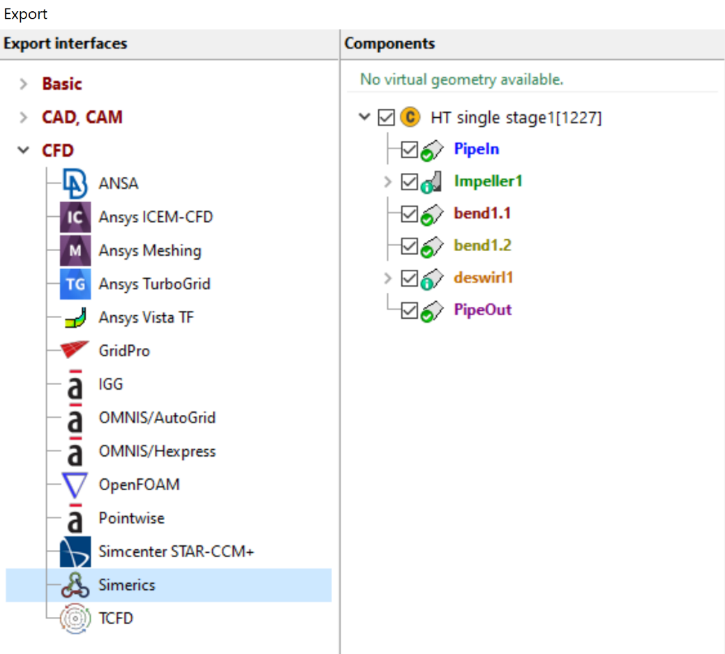
II. CFturbo Design Export to SimericsMP
Open the optimal design Cfturbo Design file, select Export
Under Export interfaces open CFD and select Simerics
Under Components check the design parts to include in the simulations geometry

Slide 19
II. CFturbo Design Export to SimericsMP (Cont.)
Under Settings, ensure Export all files is selected in the dropdown menu
Select Solver and choose solver type (Steady or Transient) from the dropdown menu
steady simulations are necessary to run transient simulations
Denote the base file name with a marker that suggests the type of simulation
1
2

Slide 20
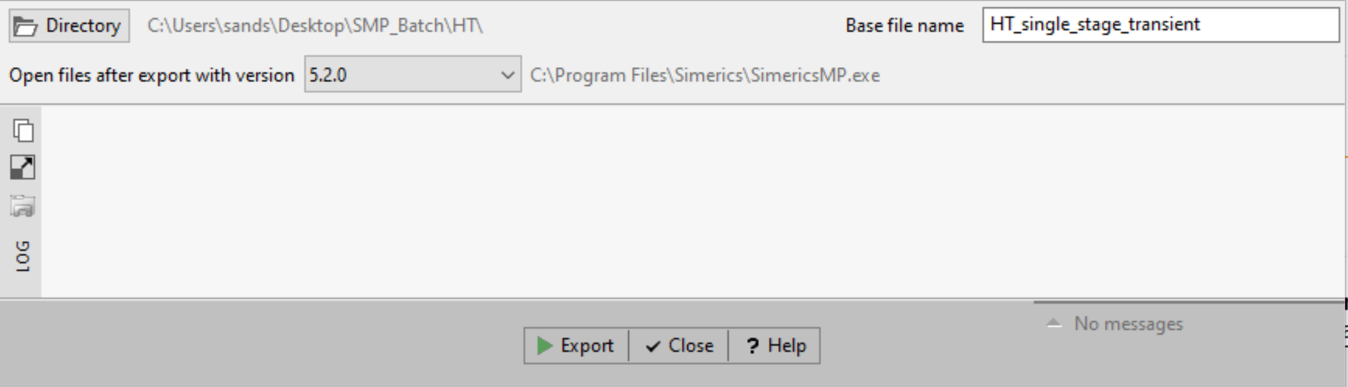
II. CFturbo Design Export to SimericsMP (Cont.)
Assign the project folder to the Directory
Select Export
Note: If Transient simulation results are desired, Steady simulations should be run

Slide 21
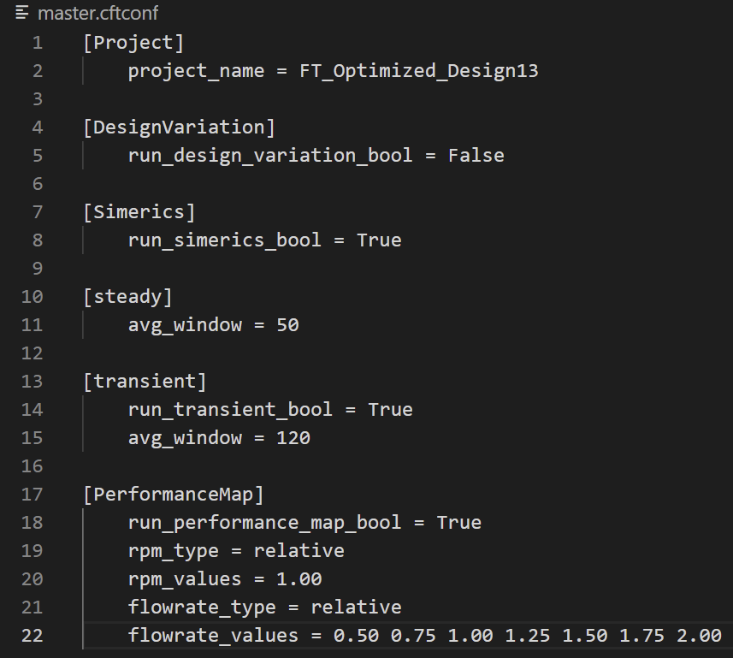
III. User Modification of master.cftconf
Open the project folder within the text editor and select the master.cftconf file

Slide 22
III. User Modification of master.cftconf (Cont.)
Under [Project]:
Assign the project name to project_name
This should be consistent with the base file name used previously
Under [DesignVariation]:
Set run_design_variation_bool to False
Under [Simerics]:
Set run_simerics_bool to True

Slide 23
III. User Modification of master.cftconf (Cont.)
Under [Steady]:
Set avg_window to an appropriate integer value for averaging
Under [Transient]:
Set run_transient_bool to True
Set avg_window to an appropriate integer value for averaging

Slide 24
III. User Modification of master.cftconf (Cont.)
Under [PerformanceMap]:
Set run_performance_map_bool to True
Set rpm_type to relative or absolute
Assign the respective values to rpm_values
Set flowrate_type to relative or absolute
Assign the respective values to flowrate_values
Note: If using absolute values for flowrate_values, the values must be in cubic meters per second

Slide 25
IV. Run master.py in VS Code
Within the text editor, open terminal and run the master.py
If using Visual Studio Code:
Select Terminal > New Terminal
Within the terminal type python master.py and click Enter on keyboard
Use the pip3 install [library] command to install the necessary libraries
The user is prompted to input information regarding subsecting control volumes within the flow path:
How many subsecting CVs they wish to examine
The number associated with the initial/final component of each subsecting CV

Slide 26
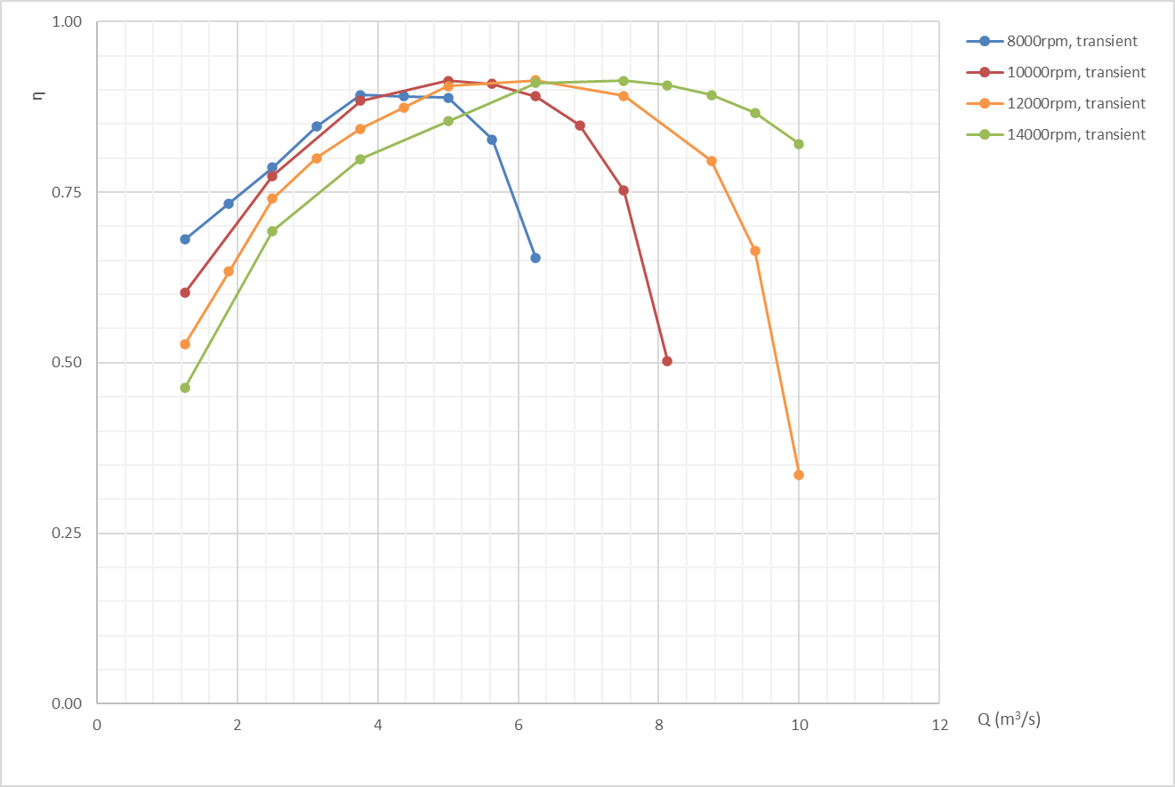
V. Open Results .csv File for Post-Processing
Wait for the program to finish
Within File Explorer, open the resultant .csv files
The averaged results of performance characteristics for each design point are displayed

