Slide 1
MICROECONOMICS
(BCS 2002 & BSE 2002)/BA]
SPRING-2024
Dr. S. Ghiasul Haq ghiasul786@gmail.com

Slide 2
(C) DEMAND AND SUPPLY

Slide 3
DEMAND
LECTURE-7(iii)
ELASTICITY OF DEMAND

Slide 4
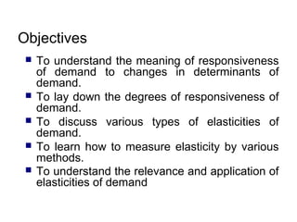

Slide 5
(1) What is Elasticity?
Normally elasticity is referred to as the responsiveness of the quantity demanded, as a result of a change in factor that affects the demand. In other words, it is the rate of change in the quantity demanded with respect to the rate of change in the factor.

Slide 6
… (1) Measurement of Elasticity
When we talk about elasticity of demand we generally refer to price elasticity of demand. However it can be measured with reference any other factor that affect the demand (e.g. Income, related goods).There are following two methods of measurement of elasticity.:
Point Method
Arc method

Slide 7
… (1) Measurement of Elasticity
The Point Elasticity method when the changes in price and quantity demanded is very small. Hence, it is easy to calculate the elasticity at a point. And because changes are quite little, one can take the original price and quantity, as a base.
What to do when the change is substantial? One can neither take the initial price nor the final price as a base. In such a case we use the Arc Elasticity method, wherein we take an average of both initial and final prices and quantities of demand.
{Note: Percentage change and proportionate change are equivalent (e.g. 12% or 0.12) and will give same value of elasticity estimate ]

Slide 8
..(2) PRICE ELASTICITY OF DEMAND
Price Elasticity of Demand is:
%ΔQ ÷ %ΔP
ΔQ=Change in quantity demanded
ΔP=Change in unit price

Slide 9
(3) POINT & ARC ELASTICITY
Elasticity =%ΔQ ÷ %ΔP
1. Point Elasticity:
[ΔQ/ Q]÷[ΔP/P]
2. Arc Elasticity:
[ΔQ/ (Q1+Q2)]÷[ΔP/(P1+P2)]
[Illustration with Example –Next Slide]

Slide 10
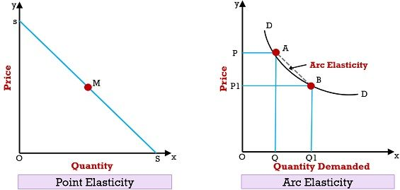
POINT & ARC ELASTICITY

Slide 11
..(3) POINT & ARC ELASTICITY
Price-20
Price 10
Quantity 10
Quantity 30

Slide 12
…(3) POINT & ARC ELASTICITY:
Price Increases from Rs-10 to Rs 20 per Unit & Demand decreases fro 30 to 10:
POINT ELASTICITY:
Ę=[ΔQ/ Q]÷[ΔP/P] = [-20/30] ÷[10/20]=-1.3
ARC ELASTICITY:
Ę=[ΔQ/ (Q1+Q2)]÷[ΔP/(P1+P2)]
=
[-20/(20+30] ÷[-10/10+20)]=-1.2

Slide 13
Price Increases from Rs-10 to Rs 20 per Unit & Demand decreases fro 30 to 10:
POINT ELASTICITY:
Ę=[ΔQ/ Q]÷[ΔP/P] = [-20/30] ÷[10/20]=-1.3
ARC ELASTICITY:
Ę=[ΔQ/ (Q1+Q2)]÷[ΔP/(P1+P2)]
=
[-20/(20+30] ÷[-10/10+20)]=-1.2

Slide 14
…(3) POINT & ARC ELASTICITY:
Conclusion:
The difference between point and arc elasticity lies in the size of the change in price and quantity demanded.
Therefore, Point Elasticity is true for small movements only from one point to another along the demand curve. Conversely, when the changes in price and quantity are discrete and large, we need to calculate elasticity over an arc of the demand curve (known as Arc Elasticity)

Slide 15
….3. ELASTICITY AT DIFFERENT POINTS OF
LINEAR DEMAND CURVE
E> 1
Price-20
E=1 [Middle point of the Demand Curve]
Price 10
E<1
Quantity 10
Quantity 30

Slide 16
…3.ELASTIC AND INELASTIC DEMAND
Perfectly elastic: infinity
Elastic: Greater than one
Unit elastic: One
Inelastic: Less than one
Perfectly inelastic: Zero
Note that except Zero and Infinity the sign of Elasticity will always be Negative

Slide 17
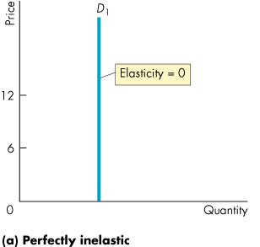
….3. Inelastic Demand

Slide 18
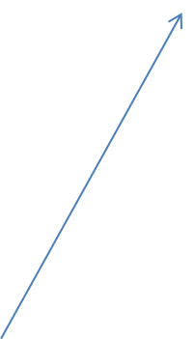
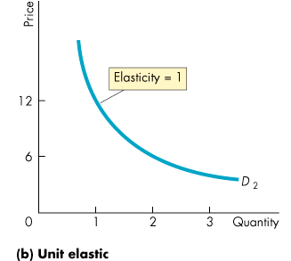
…..3. Unit Elastic Demand

Slide 19
.3…Demand Schedule of Appels [Price decreases by 20 % and Demand increases by 20%]
Price Per KG | Demand
[Rupees] | [KG]
400 | 5
333 | 6
278 | 7
231 | 9
193 | 10
161 | 12
134 | 15
112 | 18
93 | 21
78 | 26
65 | 31
54 | 37
45 | 45
37 | 53
31 | 64

Slide 20
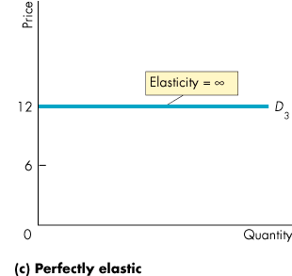
..3. Elastic Demand
Elastic Demand

Slide 21
…3. ELASTICITY OF DEMAND- LINEAR DEMAND EQUATION
Qd= a-bP Qd= 10-2P
From the Demand equation the elasticity can be measured using following formula:
The slope of the equation multiplied by the ratio of Price a(P) and quantity demanded (Qd) (i.e (P/Q)as shown blow
Point Elasticity = -bXP/Q
Point Elasticity = -2XP/Q If Price Rs.3 the associated Q will be 4 and :
Point Elasticity = -2X3/4 =-1.5 [>1]
[Note: PRICE ELACTICITY WILL ALWAYS BE NEGATIVE EVEN IF SIGN IS NIT MENTIONED] WHY?

Slide 22
5. ELASTICITY OF DEMAND & REVENUE/EXPENDITURE
Whether total revenue increases or decreases depends on how responsive the quantity demanded is to a change in price. For this purpose we need a measure of the responsiveness of the quantity demanded to price holding other things constant. This is known as price elasticity of demand .
The price elasticity of demand is the percentage change in the quantity demanded of a good divided by the percentage change in its price.

Slide 23
 |  | Elasticity of Demand
CASE |  |  | Demand | Change | Change | Elasticity
 |  | Price Per Unit |  | in Price | in Demand
A |  | 100 | 100 | 100 | -20 | -0.3
 |  | 200 | 80
B |  | 100 | 100 | 50 | -33.3 | -1.0
 |  | 150 | 66.7
C |  | 100 | 100 | 20 | -50 | -3.7
 |  | 120 | 50

Slide 24
Elasticity of Demand and Revenue/Expenditure
CASE |  | Price Per | Demand | Reve/Exp | Elasticity
 |  | Per Unit (Rs.)
A |  | 100 | 100 | 10000 | -0.3
 |  | 200 | 80 | 16000
B |  | 100 | 100 | 10000 | -1.0
 |  | 150 | 66.7 | 10000
C |  | 100 | 100 | 10000 | -3.7
 |  | 120 | 50 | 6000

Slide 25
6. Determinants of Elasticity of Demand
The Availability of Substitutes:
If a product has reliable substitutes in the market, its demand undergoes a significant change. The more substitutes available, the more elastic the demand for the good or service will be
The Proportion of Income Spent on Commodities:
One of the vital factors affecting price elasticity of demand is the proportion of a consumer's income that is spent on an item. For high-income households/consumers, the elasticity of demand is typically low but remains quite high for low-income-level groups.
The Time Frame:
The Time Frame refers to the pace at which the demand reacts to the change in price. Simply, the pace at which consumers can switch to another alternative. In the short term, buyers tend to stick to the same item, fail to find substitutes, leading to the product’s inelastic demand. However, in the long term, consumers may be able to find substitutes or adjust their consumption habits, leading to more elastic demand.

Slide 26
…(6) Determinants of Elasticity of Demand
4. The Degree of Necessity:
Necessities, such as food and housing, tend to have inelastic demand as consumers will continue to purchase them regardless of price changes because there is normally no other good substitute On the other hand, luxury goods, such as designer clothing and high-end cars, tend to have more elastic demand because consumers are more likely to cut back on purchases when prices increase.
5. Brand Loyalty:
Brand loyalty can also affect the price elasticity of demand. Consumers who are loyal to a particular brand may be less likely to switch to substitutes, even if prices increase, leading to inelastic demand.

Slide 27
…(4) Determinants of Elasticity of Demand
6. The Level of Competition:
In a market with high levels of competition, firms will have to be more responsive to changes in consumer demand, leading to more elastic demand. On the other hand, in a market with less competition, firms are able to charge higher prices without losing as many customers due to the commodities’ inelastic demand.
7. The Availability of Information:
The availability of information about a good or service is another factor influencing price elasticity of demand. When consumers have access to more information about a good or service,

Slide 28
7. Income Elasticity of Demand
Income elasticity of measures the responsiveness of quantity demand to a change in income. The income elasticity of demand is the percentage change in quantity demanded divided by the percentage change in income, as follows:
[ΔQ/ Q]÷[ΔY/Y]
WHERE Q and Y stand for Quantity Demanded and Income
​​For most products, the income elasticity of demand is positive: that is, a rise in income will cause an increase in the quantity demanded. These goods are referred to as normal goods. However, for a few goods, with an increase in income purchase might decline; and the income elasticity of demand is negative, Such good are called inferior good.

Slide 29
8.CROSS ELASTICITY
Cross price elasticity of demand measures the responsiveness of quantity demanded for good A to the change in the price of good B. This applies in case of Substitutes and Complementary Demand. While for substitute the sign is positive with Complementary products the sign is negative.
[ΔQx/ Qx]÷[ΔPY/PY]
WHERE QX and PY stand for Quantity Demanded of good X and Price per unit of goodY

Slide 30
9.CONSUMER SURPLUS
AS discussed, demand is the function that gives the number of units purchased as a function of the price. For an individual the difference between his/her willingness to pay and the amount he /she actually pays is known as consumer surplus. In other words Consumer Surplus is the value in Rupees of a good minus the actual price paid.
The Consumer Surplus for the full Market Demand Curve could be estimated by deducting the actual price paid from the price at which the total demand becomes ZERO, multiplied by the Quantity purchased. (See Next Slide)

Slide 31
….9. CONSUMER SURPLUS
The Consumer Surplus for the full Market Demand Curve could be estimated by deducting the actual price paid from the price at which the total demand becomes ZERO, multiplied by the Quantity purchased (as below):
Consumer Surplus = PDz-MP)XQd]/2
Where:
PDz = Price at which demand is ZERO
MP = Actual Market Price
(See Figure at Next Slide)

Slide 32
….7. CONSUMER SURPLUS
Demand Curve-Consumer Willingness to Pay
B
Price-40
Market Price
CS= ABC =Rs.450
A
C
Price 10
Q- 30
Consumer Surplus = [(40-10)X30]/2= Rs.450

