Slide 1
MICROECONOMICS
(BCS 2002 & BSE 2002)/BA]
SPRING-2024
Dr. S. Ghiasul Haq ghiasul786@gmail.com

Slide 2
CONSUMER BEHAVIOR
UTILITY AND THEORY OF UTILITY
INDIFFRENCE CURVE

Slide 3
UTILITY AND THEORY OF UTILITY
TOPICS:
CONSUMER BEHAVIOR [Theory of Utility & Indifference Curve Analysis]
WHAT IS UTILITY?
THEORY OF UTIITY
Marginal Utility
Total Utility
Law of Diminishing Marginal Utility
Utility Maximization & Assumptions
Law of Equi-Marginal Utility
Application of Equi-Marginal Utility
Criticism of the Utility Theory
Note: INDIFFERNCE CUREVA ANLYSIS NOT INCLUDED IN TESE SLIDES

Slide 4
CONSUMER BEHAVIOR
CONSUMER BEHAVIOR is the study of individual customers, organizations, or groups’ behavior while selecting, purchasing, using, and disposing of the goods, ideas, and services so they can meet their wants and needs. In simple terms, consumer behavior is the study of consumers’ actions and reactions in the marketplace and the reason behind their actions.
The concepts of Utility and Indifference Curves are two main instruments for analyzing the consumer behavior in economic perspective.
Note: [The discussion in these slides is only about the Utility and Theory of Utility. Indifference Curves will be presented as Lecture -6 slides]

Slide 5
(A) WHAT IS UTILITY?
The basic economic premises is that an individual always try to satisfy his/her needs/wants by spending his/her limited resources on goods and services to get maximum satisfaction. And Utility is the level of satisfaction he/she derives from consuming a these goods and services. When the product or service is useful to the consumer’s needs or wants, they can achieve a certain level of utility from its consumption.

Slide 6
(B) UTILITY THEORY
Utility is involved in everything wehn we get satisfaction from consuming or using goods or services. This is what utility theory is concerned with; explaining the behavior individuals. For Example:
Students choose to study because they want to be graduated in a particular discipline.
We eat something because we are hungry.
We drive a car to reach a certain destination.
We sleep to give our bodies some rest.
We buy a particular computer because it meets our requirement

Slide 7
…..(B) UTILITY THEORY
Utility is involved in everything we do and we get satisfaction from consuming or using goods or services. This is what utility theory is concerned with: explaining individuals’ choices and measuring the satisfaction level from consuming a good or service.
The level of satisfaction is measured in units called ‘utils.’

Slide 8
(C) MARGINAL UTILTY & TOTAL UTILITY
There are two different types of utility: (i) MARGINAL UTILITY and (ii)TOTAL UTILITY:
(i) MARGINAL UTILITY (MU)
Marginal utility is the satisfaction that a person receives from consuming an additional unit of the same good or service.
(See Table 1 and Figure 1 if someone starts drinking water at the time of Iftar with assumed units of utility (‘utils’) from each additional glass of water.

Slide 9
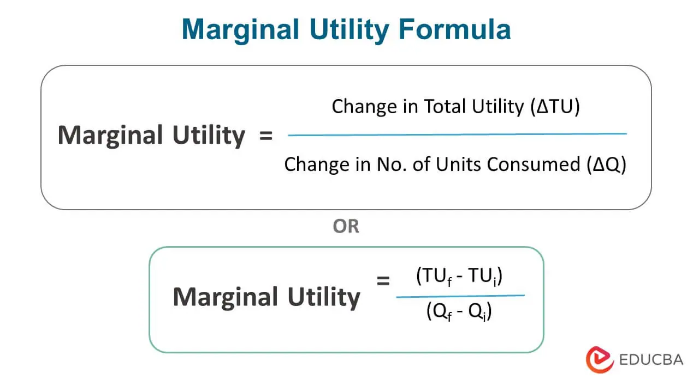
MARGINAL UTILITY

Slide 10
…(C) TOTAL UTILITY AND MARGINAL UTILITY
(ii) TOTAL UTILITY (TU)
Total utility is the aggregate satisfaction a person receives from the consumption of all the units of the same good or service.
The equation for total utility (TU) is:
TU =MU1+MU2+MU3+...MUN
(TU & MU stand for Total & Marginal Utility)
Total utility is derived from adding every marginal utility from each additional unit.
(See Table-1 & Figure2-Next slides)

Slide 11
Table-1 GLASSES OF WATTER CONSUMED
UNITS | MARGINAL | TOTAL
CONSUMED | UTILITY | UTILITY
0 | 0 | 0
1 | 500 | 500
2 | 370 | 870
3 | 120 | 990
4 | 0 | 990
5 | -120 | 870
6 | -280 | 590
7 | -450 | 140
Table 1 & Fig-1. Relationship between marginal utility and total utility

Slide 12

Fig:2 TOTAL & MARGINAL UTILITYUTILITY
MAXIMUM –TOTAL UUTILITYUTILITY
TOTAL UTILITY
MARGINAL UTILITY
ZERO MARIGINAL UTILITYUTILITY
Fig-2. Relationship between marginal utility and total utility

Slide 13
(D) UTILITY THEORY – (i)Marginal Utility
From the preceding slides and discussion we can conclude the following relationship between MU and TU:
As the number of consuming units increases, MU decreases, and TU increases.:
When TU reaches its maximum level, MU is 0. At that unit, the marginal utility is 0.
After point 2 MU starts to get negative and TU starts decreasing

Slide 14
(D)UTILITY THEORY – (ii)Law of Diminishing Marginal Utility
Economists believe that the utility reduces as the consumption of the same product or service increases. This known as The Law of Diminishing Marginal Utility
The Law of Diminishing Marginal Utility states that the level of satisfaction for an individual diminishes as the use of the same product increases. Eventually, the consumer either looks for an alternative or stops consuming the product.
According to the Law of Diminishing Marginal Utility, the consumption of the first unit gives the consumer highest level of utility. Then, the level of satisfaction starts reducing as the units increase. The consumer starts getting negative utility after a particular unit of consumption, which may vary from consumer to consumer.

Slide 15
..(D) UTILITY THEORY –(ii)Law of Diminishing Marginal Utility
Suppose Mr. X is very hungry and decides to eat a burger. The first burger satisfies his hunger. However, he is still hungry, so he buys another burger. This further satisfies his hunger. However, not as much as the first burger. He goes on to have a third burger to fill the little hunger he still has and gets fully satisfied. Any further burger will not satisfy Mr. X 's hunger and might be a bit too much for him to eat. It may make him feel too full and may also result in him feeling sick. Thus, the fourth burger may not give any satisfaction to Mr. X and instead give him a negative utility.

Slide 16
..(D) UTILITY THEORY –(iii) Utility Maximization
Utility maximization means that a consumer will try to get the highest level of satisfaction for consuming something they paid for. The utility may be different for every individual and cannot be stated as a single total unit.
Imagine you are paying a tutor to help you with some difficult subject five days per week. However, the tutor is not available at least two or three times per week as initially agreed. Would you be happy with that? Would you be satisfied with the tutor and willing to pay the same price? The answer is generally no. If someone is paying for five days a week tuition fee, they will expect to receive the tutoring hours they paid for. This is utility maximization.
However, even though consumers wish to have the maximum utility from the consumption of a product or service, sometimes they may have to make other choices due to constraints. (Discussed in Next Slides):

Slide 17
..(D) UTILITY THEORY –(iv) Assumptions
The Utility Theory discussed in preceding slides is based on following assumptions:
(1) Limited income:
Even though someone may like having the best of all products because it gives them the highest satisfaction, limited income may stop them from buying it.
You may like to have a brand new luxury car, your , his income is just enough fpr your basic needs of food, clothing, shelter, and a comparatively cheaper car. You have no budget for a luxury car, In your case, limited income stops you from having the car that will satisfy you the most.
(2) A given set of prices:
Some individuals like some products or services more than others. However, they may opt for a substitute or a similar product due to the set of prices. Although they will get the maximum utility from consuming the high-priced goods, they may not be willing to pay the given set of prices. Thus, they will look for alternatives.
Many people like Five Star Restaurants Dinners but , some decide not to go there because of high prices of foo served and therefore p to some alternate restaurants.

Slide 18
..(D) UTILITY THEORY –(iv) Assumptions
(3) Budget constraints:
Consumers’ choices are subject to their budget constraints. Budget refers to the total amount of money an individual is willing to spend, save, and borrow. Budget constraints can also be understood as limited income.
If the the man who wants a luxury car, has limited savings and is not willing to borrow money, his budget constraint will restrain him from buying the luxury car. His budget constraints don't allow him to make the choice that would maximize his utility.
(4)Limited time:
A major constraint consumers may face while making choices is the availability of time. Suppose an individual is willing to get the goods currently on sale. However, they could not go to the store to buy the goods on time for the sale. They will not enjoy the maximum utility they would have gained if they purchased the goods when the price was affordable for them.

Slide 19
….(D) UTILITY THEORY: LAW OF EQUI-MARGINAL UTILITY
The simple examples shows how the Equi-marginal Principle to maximize, utility or satisfaction,. This principle, therefore, serves as a practical guide, in rational economic decision makings. In order to maximize satisfaction with a limited amount of money a consumer has to compare the satisfaction obtained from each rupee that he spends on different commo­dities.
Example: Equi-Marginal Utility of Two Commodities
Suppose chocolates and ice-creams are two purchasable goods. Suppose further that the consumer has Rs. 700 to spend. Let us spend Rs. 300 on ice-creams and Rs. 400 on chocolates. And each Unit of Utility is worth Rs.100. The Utility will be maximized (28+ 18=46 ‘utils’) when 4 units of ice-cream and 3 units of chocolates are consumed. For no other combination does this utility amount to 46. [Table on Next Slide]
.

Slide 20
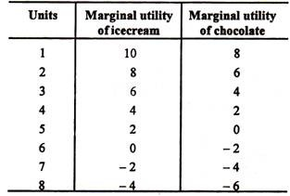
Table: Marginal Utility of Two Commodities
The conclusion is that maxi­mum satisfaction is obtained when the marginal utility from each good is equated by continuously substituting the more useful for the less useful commodity.

Slide 21
...(D) UTILITY THEORY: LAW OF EQUI-MARGINAL UTILITY
The Equi-marginal Principle, also known as the Law of Equi Marginal Utility or Gossen's Second Law, implies that a consumer will distribute his/her income on various commodities in a manner that marginal utility derived from the last unit of money spent on each good is equal
By adhering to the Equi-marginal principle, the best utilization of limited resources is achieved.
The mathematical expression of Equi-marginal Principle:
MU_{x}/P_{x} = MU_{y}/P_{y}
(Where MU_{x} and MU_{y} are the marginal utilities obtained from goods X and Y, while P_{x} and P_{y} are the prices of the goods, respectively).

Slide 22
...(D) UTILITY THEORY: Application of Equi-Marginal Utility
Consumer Behavior: It aids consumers in achieving maximum satisfaction with limited resources.
Production: Producers use this principle to decide the level of inputs for least cost combination and maximum output.
Public Finance: Government agencies use it to allocate budget funds to different sectors to ensure maximum economic welfare.
Trade: It is used in the distribution of resources for international and domestic markets.

Slide 23
(D) UTILITY THEORY :Criticism of the Utility Theory
The Cardinal Concept of Utility (the idea of measuring utility through imaginary units) is not realistic. The utility, being a subjective thing, cannot be quantified objectively.
The Marginal Utility of Money is not Constant
The law of equi­-marginal utility assumes too much rationality about the behavior of the consumer. In real life, consumers do not always make their purchases considering minutely the relative marginal utilities. customs, fashions, continuous change in prices, ignorance may lead to different decisions with little relevance to utility.
Continued Next Slide

Slide 24
...(D) UTILITY THEORY: Criticism of the Utility Theory
The law does not operate in the cases of the goods which cannot be divided into small parts or are not available in small units (e.g., motor cars, refrigerators, TV sets, etc.). Since in such cases the perfect adjustment of marginal utilities is not possible the law does not apply.
‘Utility’ and ‘Satisfaction’ may not be identical, though they are closely related, that an increase of utility would cause an increase in satisfaction.

