Slide 1
MICROECONOMICS
(BCS 2002 & BSE 2002)/BA]
SPRING-2024
Dr. S. Ghiasul Haq ghiasul786@gmail.com

Slide 2
PRODUCTION POSSIBILITY CURVE (PPC) - PRODUCTION POSSIBILITY FRONTIER (PPF)
OPPORTUNITY COST:
Definition – the cost expressed in terms of the next best alternative sacrificed
Helps us view the true cost of decision making
Implies valuing different choices

Slide 3
PRODUCTION POSSIBILITY CURVE & FRONTIERS
The production possibilities curve (PPC) is a graph that shows all of the different combinations of output that can be produced given current resources and technology. Sometimes called the production possibilities frontier (PPF), the PPC illustrates scarcity and tradeoffs
Show the different combinations of goods and services that can be produced with a given amount of resources
No ‘ideal’ point on the curve
Any point inside the curve – suggests resources are not being utilised efficiently- Inefficient point
Any point outside the curve – not attainable with the current level of resources- -Un attainable point
Useful to demonstrate economic growth and opportunity cost

Slide 4
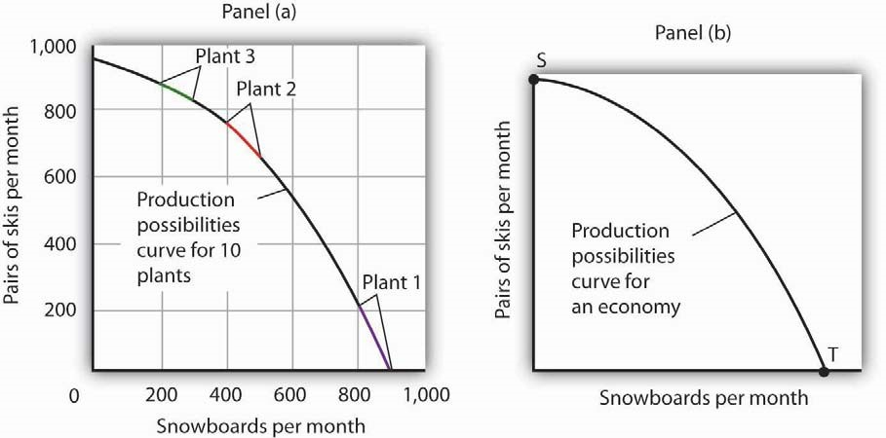
FIRM & ECONOMY PPC

Slide 5
ASSUMPTIONS OF PPC:
The basic assumptions of production possibility curve are:
The resources are given and remain constant.
The technology used in the production process remains constant.
The resources and technology are fully and efficiently utilized.
The technique of production remains constant.

Slide 6
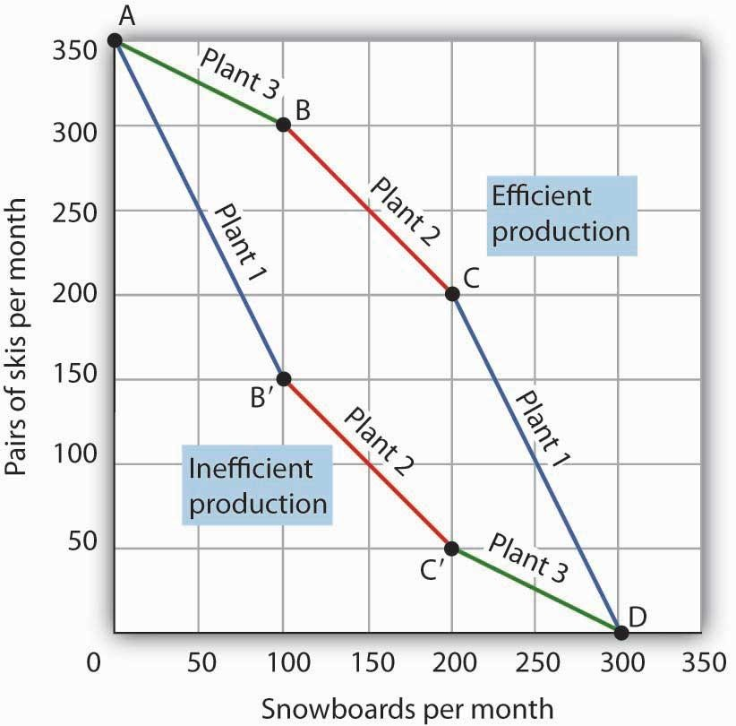
EFFICIENT & INEFFICIENT PRODUCTION

Slide 7
SHAPE PPC & MARGINAL RATE OF SUBSITUTION
PPC or production possibility curve tends to showcase the combination of two commodities along the curve and the concave (bowed out from the origin) shape of the PPC is due to the Increasing Marginal Rate of Substitution. The slope also tells about the opportunity cost of the additional one unit production of the commodity [Figure-next slide]
The opportunity cost of a good increases as its output increases, which is represented by the concave shape of PPC.
The PPC curve is also known as the transformative curve
(i) Producing only Milk (ii) Also starts producing Chees

Slide 8
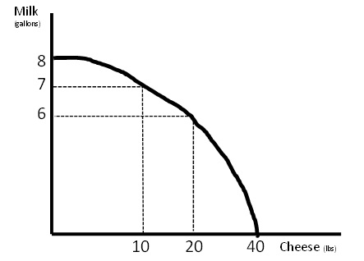
MARGINAL RATE OF SUBSITUTION
`MI-G | CH-Ib | CHANGE |  | MRS
 |  | `MI-G | CH-Ib
8 | 0
7 | 10 | 1 | 10 | 10
6 | 20 | 1 | 10 | 10
2 | 38 | 4 | 18 | 4.5
0 | 40 | 2 | 2 | 1
2
38

Slide 9
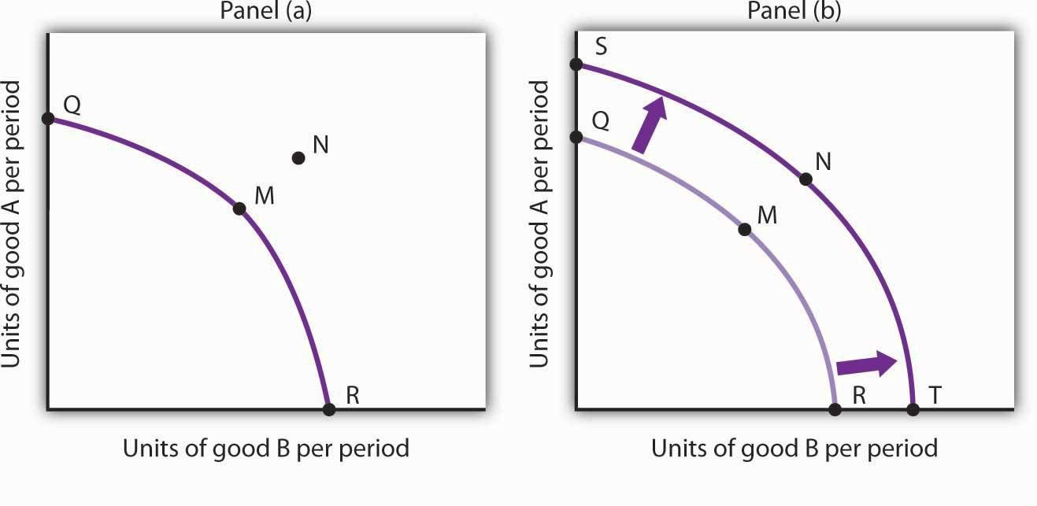
An outward shift in the PPC curve shows the economic growth
PROCESS OF ECONOMIC GROWTH

