Slide 1
DoS Attacks
..by Aleksei Zaitsenkov

Slide 2
OUTLINE
“DoS Attacks” – What Is
History
Types of Attacks
Main targets today
How to Defend
Prosecution
Conclusion

Slide 3
WHAT IS “DOS ATTACK”
Denial-Of-Service Attack = DOS Attack is a malicious attempt by a single person or a group of people to cause the victim, site or node to deny service to it customers.
DoS = when a single host attacks
DDoS = when multiple hosts attack simultaneously

Slide 4
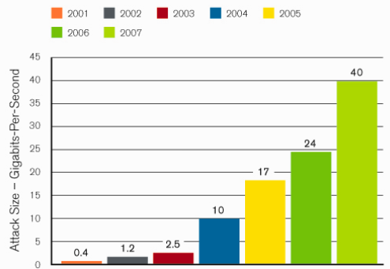
ATTACK SIZE IN GBITS-PER-SECOND

Slide 5
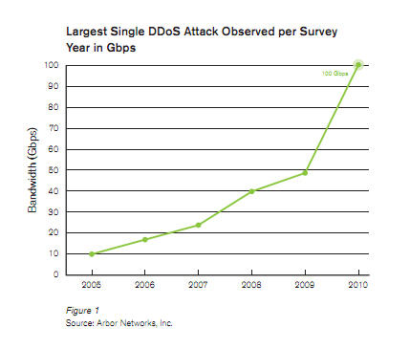
ATTACK SIZE IN GBITS-PER-SECOND

Slide 6
IDEA OF “DOS ATTACKS”
Purpose is to shut down a site, not penetrate it.
Purpose may be vandalism, extortion or social action (including terrorism) (Sports betting sites often extorted)
Modification of internal data, change of programs (Includes defacement of web sites)

Slide 7
HISTORY
Morris Worm (November 2, 1988)
First DDoS attack to cripple large amounts of network infrastructure
Self-replicating, self-propagating.
Exploited software commonality (monoculture)
    Fingerd buffer overﬂow exploit
    Sendmail root vulnerability
    Weak passwords

Slide 8
HISTORY
Morris Worm effect
Infected systems became “catatonic”
Took roughly three days to come under control
Ultimately infected 10% of Internet computers (6,000) and cost $ million to clean up.
Morris convicted under computer fraud and abuse act, three years probation, ﬁne of $10,000

Slide 9
HISTORY
SQL Slammer (January, 25 2003)
Exploited common software (Microsoft SQL Server) as well as hardware (Intel x86), spread rapidly in a distinct monoculture.
Non-destructive. Modified no data on infected system
Extremely simple in construction (376 bytes)
Devastating:
  120,000 computers infected at peak (1/26/2003)
  Exhausted network bandwidth
  Crashed network infrastructure (multicast state creation)
  Shut down communication (ﬁre-ﬁghting) capability

Slide 10
HISTORY
SQL Slammer effect
Extremely Virulent
Caused economic damage outside of IT infrastructure (multiple ATM outages)
Original perpetrators have never been identiﬁed or brought to justice

Slide 11
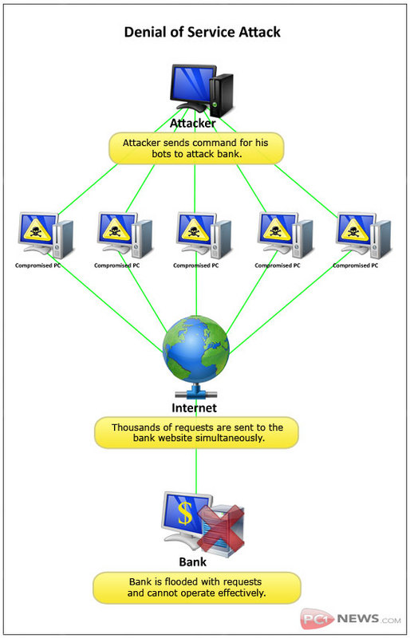
TYPES OF DOS ATTACKS

Slide 12
TYPES OF DOS ATTACKS
Penetration
Eavesdropping
Man-In-The-Middle
Flooding

Slide 13
TYPES OF DOS ATTACKS
Penetration
Attacker gets inside your machine
Can take over machine and do whatever he wants
Achieves entry via software flaw(s), stolen passwords or insider access

Slide 14
TYPES OF DOS ATTACKS
Eavesdropping
Attacker gains access to same network
Listens to traffic going in and out of your machine

Slide 15
TYPES OF DOS ATTACKS
Man-in-the-Middle
Attacker listens to output and controls output
Can substitute messages in both directions

Slide 16
TYPES OF DOS ATTACKS
Flooding
Attacker sends an overwhelming number of messages at your machine; great congestion
The congestion may occur in the path before your machine
Messages from legitimate users are crowded out
Usually called a Denial of Service (DoS) attack, because that’s the effect.
Usually involves a large number of machines, hence Distributed Denial of Service (DDoS) attack

Slide 17
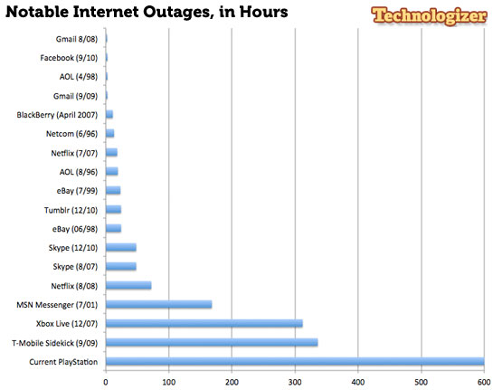
MAIN TARGETS

Slide 18
ESTONIAN CYBERWAR APRIL 27, 2007
Weeks of cyber attacks followed, targeting government and banks, ministries, newspapers and broadcasters Web sites of Estonia.
Some attacks took the form of distributed denial of service (DDoS) attacks (using ping floods to expensive rentals of botnets).
128 unique DDOS attacks (115 ICMP floods, 4 TCP SYN floods and 9 generic traffic floods).
Used hundreds or thousands of "zombie" computers and pelted Estonian Web sites with thousands of requests a second, boosting traffic far beyond normal levels.

Slide 19
ESTONIAN CYBERWAR APRIL 27, 2007
Inoperability of the following state and commercial sites:
  The Estonian presidency and its parliament.
  Almost all of the country’s government ministries.
  Political parties.
  Three news organizations.
  Two biggest banks and communication’s firms.
  Governmental ISP.
  Telecom companies.

Slide 20
ESTONIAN CYBERWAR APRIL 27, 2007
The attack heavily affected infrastructures of all network:
  Routers damaged.
  Routing tables changed.
  DNS servers overloaded.
  Email servers mainframes failure, and etc.

Slide 21
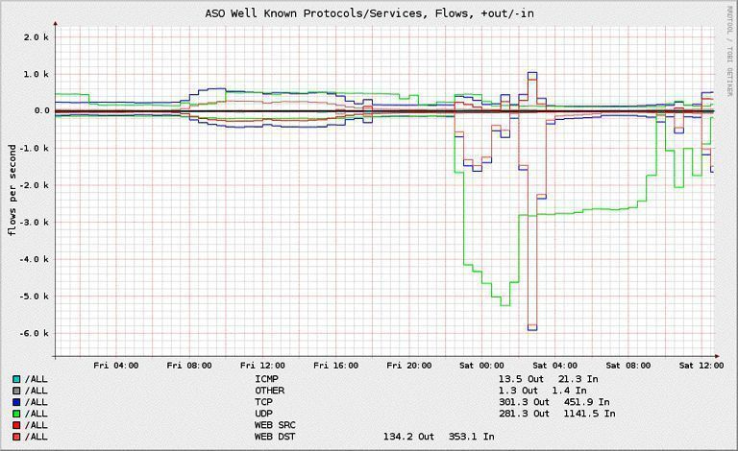
ESTONIAN CYBERWAR APRIL 27, 2007

Slide 22
HOW TO DEFEND
Firewalls - can effectively prevent users from launching simple flooding type attacks from machines behind the firewall.
Switches - Some switches provide automatic and/or system-wide rate limiting, traffic shaping, delayed binding to detect and remediate denial of service attacks
Routers - If you add rules to take flow statistics out of the router during the DoS attacks, they further slow down and complicate the matter
DDS based defense
Clean pipes

Slide 23
PROSECUTION
Different governmental legislation
Too expensive
National interests
Hard to prove who used the computer

Slide 24
CONCLUSION
Role of international boundaries - consoles located across international borders, law-enforcement problem
In the past, as the present, DDoS has been more a nuisance activity conducted by cyber vandals than an activity with speciﬁc socioeconomic aims
In the future, DDoS may be used as a disruptive force, with broad destabilization as its aim instead of the targeting of speciﬁc targets
Destabilization has a high (ROI) Return On Investment when compared to targeted attacks

Slide 25
QUESTIONS?
People are talking about the Internet as though
it is going to change the world. It's not going to change
the world. It's not going to change the way we think,
and it's not going to change the way we feel.
Peter Davison

