Slide 1
Cryptography and Network Security
Third Edition
by William Stallings
Lecture slides by Lawrie Brown

Slide 2
Chapter 12 – Hash Algorithms
Each of the messages, like each one he had ever read of Stern's commands, began with a number and ended with a number or row of numbers. No efforts on the part of Mungo or any of his experts had been able to break Stern's code, nor was there any clue as to what the preliminary number and those ultimate numbers signified.
—Talking to Strange Men, Ruth Rendell

Slide 3
Hash Algorithms
see similarities in the evolution of hash functions & block ciphers
  increasing power of brute-force attacks
  leading to evolution in algorithms
  from DES to AES in block ciphers
  from MD4 & MD5 to SHA-1 & RIPEMD-160 in hash algorithms
likewise tend to use common iterative structure as do block ciphers

Slide 4
MD5
designed by Ronald Rivest (the R in RSA)
latest in a series of MD2, MD4
produces a 128-bit hash value
until recently was the most widely used hash algorithm
  in recent times have both brute-force & cryptanalytic concerns
specified as Internet standard RFC1321
Notes:
MD5 is the current, and very widely used, member of Rivest’s family of hash functions.

Slide 5
MD5 Overview
pad message so its length is 448 mod 512
append a 64-bit length value to message
initialise 4-word (128-bit) MD buffer (A,B,C,D)
process message in 16-word (512-bit) blocks:
  using 4 rounds of 16 bit operations on message block & buffer
  add output to buffer input to form new buffer value
output hash value is the final buffer value
Notes:
The padded message is broken into 512-bit blocks, processed along with the buffer value using 4 rounds, and the result added to the input buffer to make the new buffer value. Repeat till run out of message, and use final buffer value as hash. nb. due to padding always have a full final block (with length in it).

Slide 6
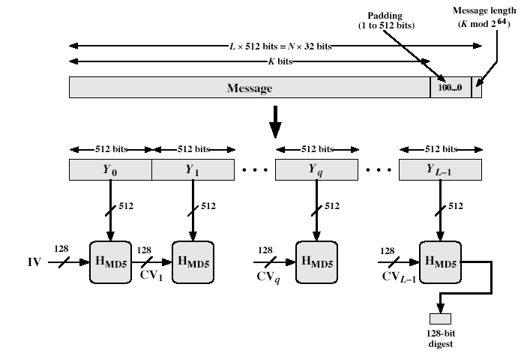
MD5 Overview
Notes:
Stallings Fig 12.1

Slide 7
MD5 Compression Function
each round has 16 steps of the form:
  a = b+((a+g(b,c,d)+X[k]+T[i])<<<s)
a,b,c,d refer to the 4 words of the buffer, but used in varying permutations
  note this updates 1 word only of the buffer
  after 16 steps each word is updated 4 times
where g(b,c,d) is a different nonlinear function in each round (F,G,H,I)
T[i] is a constant value derived from sin
Notes:
Each round mixes the buffer input with the next "word" of the message in a complex, non-linear manner. A different non-linear function is used in each of the 4 rounds (but the same function for all 16 steps in a round). The 4 buffer words (a,b,c,d) are rotated from step to step so all are used and updated. g is one of the primitive functions F,G,H,I for the 4 rounds respectively. X[k] is the kth 32-bit word in the current message block. T[i] is the ith entry in the matrix of constants T. The addition of varying constants T and the use of different shifts helps ensure it is extremely difficult to compute collisions.

Slide 8
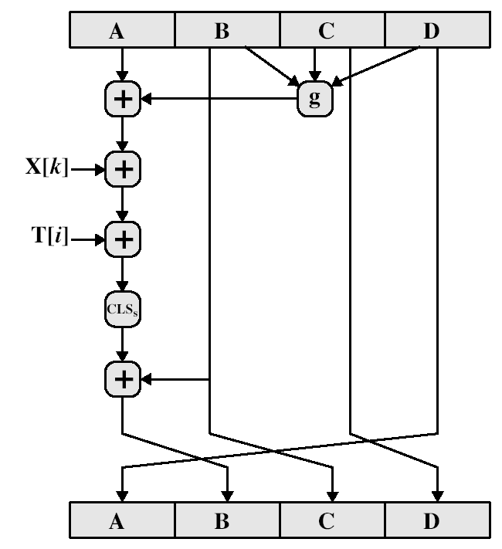
MD5 Compression Function

Slide 9
MD4
precursor to MD5
also produces a 128-bit hash of message
has 3 rounds of 16 steps vs 4 in MD5
design goals:
  collision resistant (hard to find collisions)
  direct security (no dependence on "hard" problems)
  fast, simple, compact
  favours little-endian systems (eg PCs)
Notes:
MD4 is the precursor to MD5, and was widely used. It uses 3 instead of 4 rounds, and the round functions are a little simpler. In creating MD5 Rivest aimed to strengthen the algorithms by introducing the extra round, and varying the constants used.

Slide 10
Strength of MD5
MD5 hash is dependent on all message bits
Rivest claims security is good as can be
known attacks are:
  Berson 92 attacked any 1 round using differential cryptanalysis (but can’t extend)
  Boer & Bosselaers 93 found a pseudo collision (again unable to extend)
  Dobbertin 96 created collisions on MD compression function (but initial constants prevent exploit)
conclusion is that MD5 looks vulnerable soon
Notes:
Some progress has been made analysing MD5, which along with the hash size of 128-bits means its starting to look too small. Hence interest in hash functions that create larger hashes.

Slide 11
Secure Hash Algorithm (SHA-1)
SHA was designed by NIST & NSA in 1993, revised 1995 as SHA-1
US standard for use with DSA signature scheme
  standard is FIPS 180-1 1995, also Internet RFC3174
  nb. the algorithm is SHA, the standard is SHS
produces 160-bit hash values
now the generally preferred hash algorithm
based on design of MD4 with key differences
Notes:
SHA is one of the newer generation of hash functions, more resistant to cryptanalysis, and now probably preferred for new applications.

Slide 12
SHA Overview
pad message so its length is 448 mod 512
append a 64-bit length value to message
initialise 5-word (160-bit) buffer (A,B,C,D,E) to
  (67452301,efcdab89,98badcfe,10325476,c3d2e1f0)
process message in 16-word (512-bit) chunks:
  expand 16 words into 80 words by mixing & shifting
  use 4 rounds of 20 bit operations on message block & buffer
  add output to input to form new buffer value
output hash value is the final buffer value
Notes:
Note that the SHA-1 Overview is very similar to that of MD5.

Slide 13
SHA-1 Compression Function
each round has 20 steps which replaces the 5 buffer words thus:
  (A,B,C,D,E) <-(E+f(t,B,C,D)+(A<<5)+W_{t}+K_{t}),A,(B<<30),C,D)
a,b,c,d refer to the 4 words of the buffer
t is the step number
f(t,B,C,D) is nonlinear function for round
W_{t} is derived from the message block
K_{t} is a constant value derived from sin
Notes:
Can see SHA shares much in common with MD4/5, but with 20 instead of 16 steps in each of the 4 rounds. Note the 4 constants are based on sqrt(2,3,5,10). Note also that instead of just splitting the input block into 32-bit words and using them directly, SHA-1 shuffles and mixes them using rotates & XOR’s to form a more complex input, and greatly increases the difficulty of finding collisions.

Slide 14
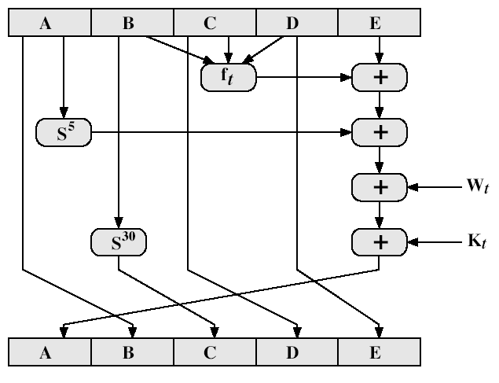
SHA-1 Compression Function

Slide 15
SHA-1 verses MD5
brute force attack is harder (160 vs 128 bits for MD5)
not vulnerable to any known attacks (compared to MD4/5)
a little slower than MD5 (80 vs 64 steps)
both designed as simple and compact
optimised for big endian CPU's (vs MD5 which is optimised for little endian CPU’s)
Notes:
Compare using the design goals listed earlier.
SHA-1 is probbaly the preferred hash function for new applications. Currently no problems are known with it.

Slide 16
Revised Secure Hash Standard
NIST have issued a revision FIPS 180-2
adds 3 additional hash algorithms
SHA-256, SHA-384, SHA-512
designed for compatibility with increased security provided by the AES cipher
structure & detail is similar to SHA-1
hence analysis should be similar
Notes:
See Stallings Tables 12.3 and 12.4 for details.

Slide 17
RIPEMD-160
RIPEMD-160 was developed in Europe as part of RIPE project in 96
by researchers involved in attacks on MD4/5
initial proposal strengthen following analysis to become RIPEMD-160
somewhat similar to MD5/SHA
uses 2 parallel lines of 5 rounds of 16 steps
creates a 160-bit hash value
slower, but probably more secure, than SHA

Slide 18
RIPEMD-160 Overview
pad message so its length is 448 mod 512
append a 64-bit length value to message
initialise 5-word (160-bit) buffer (A,B,C,D,E) to
  (67452301,efcdab89,98badcfe,10325476,c3d2e1f0)
process message in 16-word (512-bit) chunks:
  use 10 rounds of 16 bit operations on message block & buffer – in 2 parallel lines of 5
  add output to input to form new buffer value
output hash value is the final buffer value
Notes:
Note that the overall structure is quite similar to MD4/5 and SHA-1. Indeed the initialisation constants are the same as SHA-1.

Slide 19
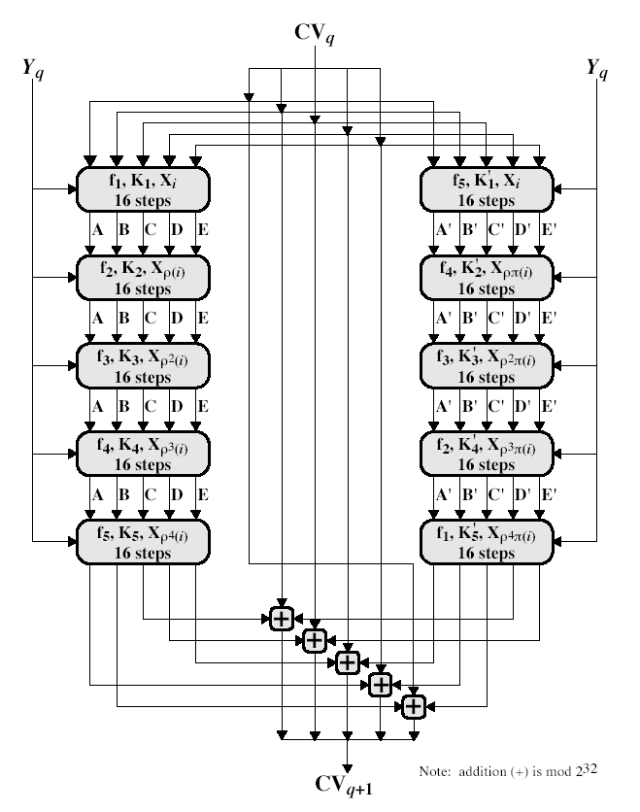
RIPEMD-160 Round

Slide 20
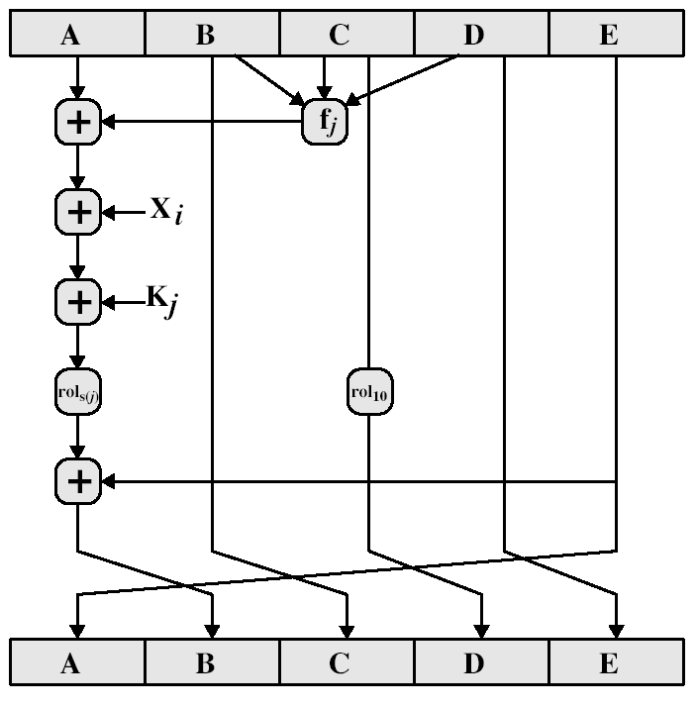
RIPEMD-160 Compression Function
Notes:
The compression function is rather more complex than SHA-1. See Stallings for details.

Slide 21
RIPEMD-160 Design Criteria
use 2 parallel lines of 5 rounds for increased complexity
for simplicity the 2 lines are very similar
step operation very close to MD5
permutation varies parts of message used
circular shifts designed for best results

Slide 22
RIPEMD-160 verses MD5 & SHA-1
brute force attack harder (160 like SHA-1 vs 128 bits for MD5)
not vulnerable to known attacks, like SHA-1 though stronger (compared to MD4/5)
slower than MD5 (more steps)
all designed as simple and compact
SHA-1 optimised for big endian CPU's vs RIPEMD-160 & MD5 optimised for little endian CPU’s
Notes:
RIPEMD-160 is probably the most secure of the hash algorithms, so would be chosen if that is of major concern.

Slide 23
Keyed Hash Functions as MACs
have desire to create a MAC using a hash function rather than a block cipher
  because hash functions are generally faster
  not limited by export controls unlike block ciphers
hash includes a key along with the message
original proposal:
  KeyedHash = Hash(Key|Message)
  some weaknesses were found with this
eventually led to development of HMAC

Slide 24
HMAC
specified as Internet standard RFC2104
uses hash function on the message:
  HMAC_{K} = Hash[(K⁺ XOR opad) ||
  Hash[(K⁺ XOR ipad)||M)]]
where K⁺ is the key padded out to size
and opad, ipad are specified padding constants
overhead is just 3 more hash calculations than the message needs alone
any of MD5, SHA-1, RIPEMD-160 can be used
Notes:
The idea of a keyed hash evolved into HMAC, designed to overcome some problems with the original proposals. Further have a design that has been shown to have the same security as the underlying hash alg. The hash function need only be used on 3 more blocks than when hashing just the original message (for the two keys + inner hash). Choose hash alg to use based on speed/security concerns.

Slide 25
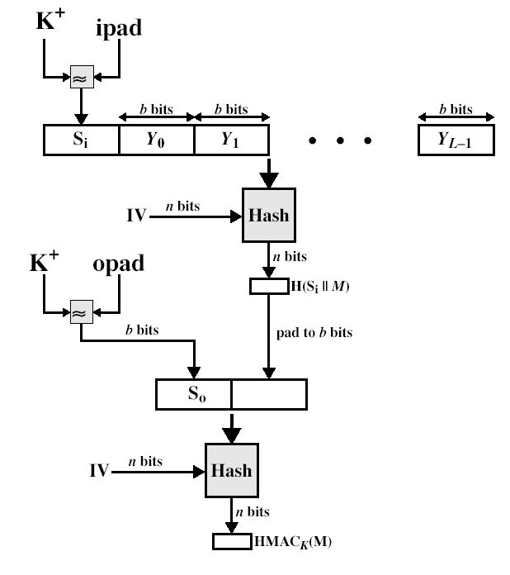
HMAC Overview

Slide 26
HMAC Security
know that the security of HMAC relates to that of the underlying hash algorithm
attacking HMAC requires either:
  brute force attack on key used
  birthday attack (but since keyed would need to observe a very large number of messages)
choose hash function used based on speed verses security constraints

Slide 27
Summary
have considered:
  some current hash algorithms: MD5, SHA-1, RIPEMD-160
  HMAC authentication using hash function

