Slide 1
Cryptography and Network Security
Third Edition
by William Stallings
Lecture slides by Lawrie Brown

Slide 2
Chapter 18 – Intruders
They agreed that Graham should set the test for Charles Mabledene. It was neither more nor less than that Dragon should get Stern's code. If he had the 'in' at Utting which he claimed to have this should be possible, only loyalty to Moscow Centre would prevent it. If he got the key to the code he would prove his loyalty to London Central beyond a doubt.
—Talking to Strange Men, Ruth Rendell

Slide 3
Intruders
significant issue for networked systems is hostile or unwanted access
either via network or local
can identify classes of intruders:
  masquerader
  misfeasor
  clandestine user
varying levels of competence

Slide 4
Intruders
clearly a growing publicized problem
  from “Wily Hacker” in 1986/87
  to clearly escalating CERT stats
may seem benign, but still cost resources
may use compromised system to launch other attacks

Slide 5
Intrusion Techniques
aim to increase privileges on system
basic attack methodology
  target acquisition and information gathering
  initial access
  privilege escalation
  covering tracks
key goal often is to acquire passwords
so then exercise access rights of owner

Slide 6
Password Guessing
one of the most common attacks
attacker knows a login (from email/web page etc)
then attempts to guess password for it
  try default passwords shipped with systems
  try all short passwords
  then try by searching dictionaries of common words
  intelligent searches try passwords associated with the user (variations on names, birthday, phone, common words/interests)
  before exhaustively searching all possible passwords
check by login attempt or against stolen password file
success depends on password chosen by user
surveys show many users choose poorly
Notes:
Password guessing is a common attack. If an attacker has obtained a poorly protected password file, then can mount attack off-line, so target is unaware of its progress. Some O/S take less care than others with their password files. If have to actually attempt to login to check guesses, then system should detect an abnormal number of failed logins, and hence trigger appropriate countermeasures by admins/security. Likelihood of success depends very much on how well the passwords are chosen. Unfortunately, users often don’t choose well.

Slide 7
Password Capture
another attack involves password capture
  watching over shoulder as password is entered
  using a trojan horse program to collect
  monitoring an insecure network login (eg. telnet, FTP, web, email)
  extracting recorded info after successful login (web history/cache, last number dialed etc)
using valid login/password can impersonate user
users need to be educated to use suitable precautions/countermeasures
Notes:
Have a range of ways of "capturing" a login/password pair, from the low-tech looking over the shoulder, to sophisticated network monitoring tools, or extracting recorded info after a successful login - say from web history or cache, or last number dialed memory on phones etc. Need to educate users to be aware of whose around, to check they really are interacting with the computer system (trusted path), to use secure network connections (HTTPS, SSH, SSL), to flush browser/phone histories after use etc

Slide 8
Intrusion Detection
inevitably will have security failures
so need also to detect intrusions so can
  block if detected quickly
  act as deterrent
  collect info to improve security
assume intruder will behave differently to a legitimate user
  but will have imperfect distinction between

Slide 9
Approaches to Intrusion Detection
statistical anomaly detection
  threshold
  profile based
rule-based detection
  anomaly
  penetration identification

Slide 10
Audit Records
fundamental tool for intrusion detection
native audit records
  part of all common multi-user O/S
  already present for use
  may not have info wanted in desired form
detection-specific audit records
  created specifically to collect wanted info
  at cost of additional overhead on system

Slide 11
Statistical Anomaly Detection
threshold detection
  count occurrences of specific event over time
  if exceed reasonable value assume intrusion
  alone is a crude & ineffective detector
profile based
  characterize past behavior of users
  detect significant deviations from this
  profile usually multi-parameter

Slide 12
Audit Record Analysis
foundation of statistical approaches
analyze records to get metrics over time
  counter, gauge, interval timer, resource use
use various tests on these to determine if current behavior is acceptable
  mean & standard deviation, multivariate, markov process, time series, operational
key advantage is no prior knowledge used
Notes:
cf. Stallings Tale 18.1 for examples of various metrics and models.

Slide 13
Rule-Based Intrusion Detection
observe events on system & apply rules to decide if activity is suspicious or not
rule-based anomaly detection
  analyze historical audit records to identify usage patterns & auto-generate rules for them
  then observe current behavior & match against rules to see if conforms
  like statistical anomaly detection does not require prior knowledge of security flaws

Slide 14
Rule-Based Intrusion Detection
rule-based penetration identification
  uses expert systems technology
  with rules identifying known penetration, weakness patterns, or suspicious behavior
  rules usually machine & O/S specific
  rules are generated by experts who interview & codify knowledge of security admins
  quality depends on how well this is done
  compare audit records or states against rules

Slide 15
Base-Rate Fallacy
practically an intrusion detection system needs to detect a substantial percentage of intrusions with few false alarms
  if too few intrusions detected -> false security
  if too many false alarms -> ignore / waste time
this is very hard to do
existing systems seem not to have a good record

Slide 16
Distributed Intrusion Detection
traditional focus is on single systems
but typically have networked systems
more effective defense has these working together to detect intrusions
issues
  dealing with varying audit record formats
  integrity & confidentiality of networked data
  centralized or decentralized architecture

Slide 17
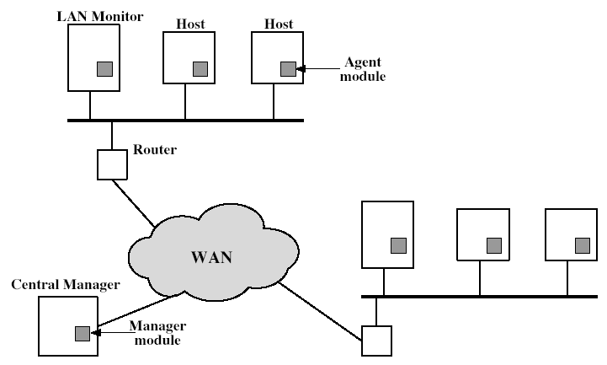
Distributed Intrusion Detection - Architecture
Notes:
Stallings Fig 18-2.

Slide 18
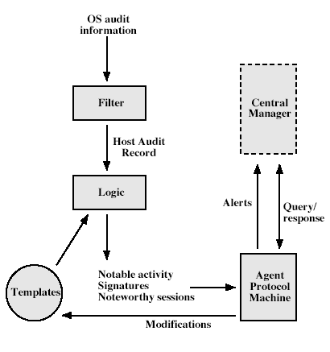
Distributed Intrusion Detection – Agent Implementation
Notes:
Stallings Fig 18-3.

Slide 19
Honeypots
decoy systems to lure attackers
  away from accessing critical systems
  to collect information of their activities
  to encourage attacker to stay on system so administrator can respond
are filled with fabricated information
instrumented to collect detailed information on attackers activities
may be single or multiple networked systems

Slide 20
Password Management
front-line defense against intruders
users supply both:
  login – determines privileges of that user
  password – to identify them
passwords often stored encrypted
  Unix uses multiple DES (variant with salt)
  more recent systems use crypto hash function

Slide 21
Managing Passwords
need policies and good user education
ensure every account has a default password
ensure users change the default passwords to something they can remember
protect password file from general access
set technical policies to enforce good passwords
  minimum length (>6)
  require a mix of upper & lower case letters, numbers, punctuation
  block know dictionary words
Notes:
Have a range of possibilities for helping users generate "good" passwords, but need their cooperation.

Slide 22
Managing Passwords
may reactively run password guessing tools
  note that good dictionaries exist for almost any language/interest group
may enforce periodic changing of passwords
have system monitor failed login attempts, & lockout account if see too many in a short period
do need to educate users and get support
balance requirements with user acceptance
be aware of social engineering attacks
Notes:
If requirements are too onerous, then they will be subverted (eg monthly change of password often means users add number/name to end of password; or write it down on sticky label on terminal) and actually weaken rather than strengthen security. Also need to be aware of social engineering attacks (eg. ring up admin, say lost password & have it reset to value you're told).

Slide 23
Proactive Password Checking
most promising approach to improving password security
allow users to select own password
but have system verify it is acceptable
  simple rule enforcement (see previous slide)
  compare against dictionary of bad passwords
  use algorithmic (markov model or bloom filter) to detect poor choices

Slide 24
Summary
have considered:
  problem of intrusion
  intrusion detection (statistical & rule-based)
  password management

