Slide 1
Communicating Information Through Visuals
© Prentice Hall, 2003
Business Communication Today
Chapter 11 - <number>

Slide 2

Planning Visuals
Decide What to Say
Develop a Story Line
Save Time
© Prentice Hall, 2003
Business Communication Today
Chapter 11 - <number>
Notes:
Suppose you've just completed the research for an important report or oral presentation, and you're about to begin the composition phase. Your first impulse might be to start with the introduction and proceed page by page until you've completed the text or script. Almost as an afterthought you might illustrate your words by throwing in a few visuals—tables, charts, graphs, schematic drawings, illustrations, photographs. Although fitting visuals to completed text makes sense, many experienced businesspeople prefer to begin with the visuals for three reasons:
First, much of the fact finding and analytical work is already in tabular or graphic form, so sorting through and refining your visuals will help you decide exactly what you're going to say.
Second, by starting with the visuals, you develop a graphic story line that can be used for your written report.
Third, because your text will explain and refer to any tables, charts, and diagrams you include, you save time by having them ready before beginning to compose your text, particularly if you plan to use quite a few visuals.

Slide 3

Preparing Visuals
Gain an
Advantage
Pick Points
to Visualize
Balance Words
and Visuals
Set a
Schedule
© Prentice Hall, 2003
Business Communication Today
Chapter 11 - <number>
Notes:
Carefully prepared visuals can make your report or presentation more interesting. But even more important, pictures are an effective way to communicate with the diverse audiences that are common in today's business environment. Moreover, in the numbers-oriented world of work, people rely heavily on trend lines, distribution curves, and percentages.
Once you have selected the information that you will include in your report, you must identify which points to illustrate visually.
Once you have identified which points require visual support, you must pare down your selection. Your goal is to achieve a reasonable balance between verbal and visual information. The ideal blend depends on the nature of your subject.
Another factor to consider when deciding on the number and types of visuals to include in a report is your production schedule.

Slide 4
The Right Visual for the Job
Tables
Line or Bar Charts
Pie or Area Charts
Bar Charts
Pie Charts
Line or Dot Charts
Maps
Flowcharts
Detailed, exact values
Trends over time
Frequencies or distributions
Comparison of items
Comparison of parts
Correlations
Geographic relationships
Processes or procedures
© Prentice Hall, 2003
Business Communication Today
Chapter 11 - <number>
Notes:
Once you've selected which points to illustrate visually, your next step is to select the type of visual that will present your data most clearly and effectively to your audience. Keep in mind that most visuals are not interchangeable. Some types of visuals depict certain kinds of data better than others:
To present detailed, exact values, use tables.
To illustrate trends over time, use a line chart or a bar chart.
To show frequency or distribution, use a pie chart, segmented bar chart, or area chart.
To compare one item with another, use a bar chart.
To compare one part with the whole, use a pie chart.
To show correlations, use a line chart, a bar chart, or a scatter (dot) chart.
To show geographic relationships, use a map.
To illustrate a process or a procedure, use a flowchart or a diagram.

Slide 5
The Parts of a Table
Multicolumn Head*
Single
Column
Head
Single
Column
Head
Stub head
Subhead
Subhead
Row head
Row head
Subhead
Subhead
Total
XXX
XX
XX
XXX
XXX
XXX
XXX
XXX
XX
XX
XX
XX
XX
XX
XX
XX
Source: (In the same format as a text footnote).
*Footnote (for explanation of elements in the table).
© Prentice Hall, 2003
Business Communication Today
Chapter 11 - <number>
Notes:
When you have to present detailed, specific information, choose a table, a systematic arrangement of data in columns and rows. Tables are ideal when the audience needs the information that would be either difficult or tedious to handle in the main text.
Most tables contain the standard parts illustrated above.

Slide 6
Preparing Numerical Tables
Use common, clearly identified units
Use the same units for all items in a column
Label column headings
Separate rows and columns
Provide column-to-row totals or averages
Document data sources
© Prentice Hall, 2003
Business Communication Today
Chapter 11 - <number>
Notes:
Many tables are strictly numerical. When preparing such tables, observe the following guidelines:
Use common, understandable units, and clearly identify the units you're using: dollars, percentages, price per ton, or whatever.
Express all items in a column in the same unit, and round off for simplicity.
Label column headings clearly, and use a subhead if necessary.
Separate columns or rows with lines or extra space to make the table easy to follow.
Provide column-to-row totals or averages when relevant.
Document the source of the data using the same format as a text footnote

Slide 7

Using Line Charts
and Surface Charts
Show
Changes
Indicate
Relationships
1996
1998
2000
2002
© Prentice Hall, 2003
Business Communication Today
Chapter 11 - <number>
Notes:
A line chart illustrates trends over time or plots the relationship of two variables. In line charts showing trends, the vertical, or y, axis shows the amount, and the horizontal, or x, axis shows the time or the quantity being measured. A surface chart, also called an area chart, is a form of line chart with a cumulative effect; all the lines add up to the top line, which represents the total.
The next slide shows a sample line chart.

Slide 8
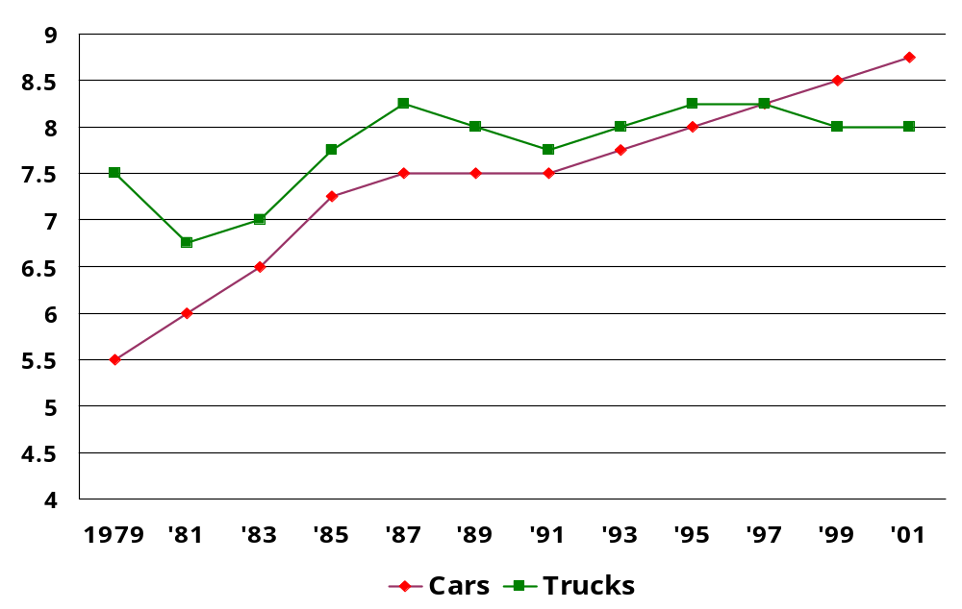
Average Age of Passenger Cars and Trucks in Use
Average Age of Vehicle (in years)
© Prentice Hall, 2003
Business Communication Today
Chapter 11 - <number>
Notes:
A simple line chart may be arranged in many ways. One of the most common is to plot several lines on the same chart for comparative purposes. Try to use no more than three lines on any given chart, particularly if the lines cross.
The sample line chart above shows the average age of passenger cars and trucks over the period of time from 1979 through 2001.
Prior to 1997, the average age of trucks exceeded the average age of passenger cars. Around 1997, the average age of passenger cars equaled the average age of trucks. The average age of passenger cars continued to rise after that, while the average age of trucks fell slightly and then leveled out.

Slide 9

Using Bar Charts
Compare Items
Show Changes
Indicate Composition
Show Relative Sizes
© Prentice Hall, 2003
Business Communication Today
Chapter 11 - <number>
Notes:
A bar chart portrays numbers by the height or length of its rectangular bars, making a series of numbers easy to read or understand. Bar charts are particularly valuable when you want to:
Compare the size of several items at one time.
Show changes in one item over time.
Indicate the composition of several items over time.
Show the relative size of components of a whole.
You can be creative with bar charts in many ways. You might align the bars either vertically or horizontally or you might even use bar charts to show both positive and negative quantities. Be careful, however, to keep all the bars in the chart the same width; different widths could suggest a relative importance to the viewer. In addition, space the bars evenly and place them in a logical order such as chronological or alphabetical.

Slide 10
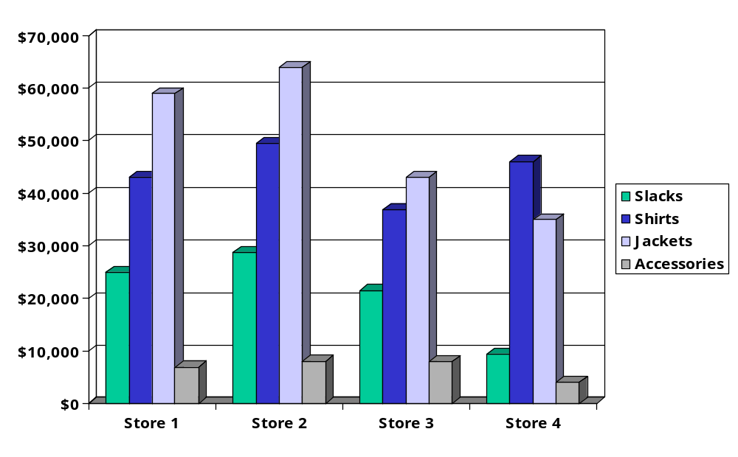
Average Monthly Sales at Waldo’s
© Prentice Hall, 2003
Business Communication Today
Chapter 11 - <number>
Notes:
The sample 3-D bar chart above compares average monthly sales at Waldo’s, a fictitious clothing store. The legend uses colors to relate the merchandise to the individual bars for stores 1, 2, 3, and 4.

Slide 11

Using Pictograms
Novelty
Impact
Visual
Appeal
© Prentice Hall, 2003
Business Communication Today
Chapter 11 - <number>
Notes:
A chart that uses symbols instead of words or numbers to portray data is known as a pictogram. The chief value of pictograms is their novelty and ability to convey a more literal, visual message. You can easily prepare pictograms by using software such as Excel and substituting a piece of clip art for the graphical bar. Although pictograms occasionally enhance a report, they tend to be less useful than other types of bar charts.

Slide 12

State Bank Pays More Interest
7%
6%
5%
4%
3%
2%
1%
State Bank
Union Bank
Trust Bank
City Bank
© Prentice Hall, 2003
Business Communication Today
Chapter 11 - <number>
Notes:
The sample pictogram above shows that State Bank pays more interest than Union Ban, Trust Bank, and City Bank.

Slide 13
Timeline Charts
Time
Schedules
Milestones
Completed
Tasks
Uncompleted
Tasks
© Prentice Hall, 2003
Business Communication Today
Chapter 11 - <number>
Notes:
Closely related to the bar chart is the timeline chart, which shows how much time is needed to complete each task in a given project. When you want to track progress toward completing a project, you can use a type of timeline chart known as a Gantt chart (named for management theorist Henry L. Gantt).

Slide 14
Marketing Research Timeline
Project Phase
Start
Date
End
Date
Duration
Percent
Done
June
July
Primary Research
Focus Groups
Interviews
Secondary Research
Business Plan
8/3/02
8/10/02
8/12/02
8/17/02
8/22/02
8/7/02
8/14/02
8/16/02
8/21/02
9/6/02
5d
5d
5d
5d
15d
100%
100%
100%
0.00%
0.00%
© Prentice Hall, 2003
Business Communication Today
Chapter 11 - <number>
Notes:
The Gantt chart above shows the activities involved in conducting marketing research. The black bars indicate completed tasks; the white bars indicate activities not yet completed.

Slide 15
Using Pie Charts
Limit the Number
of Slices
Arrange Slices Clockwise
Use a Variety of Colors
Show Numbers
or Percentages
© Prentice Hall, 2003
Business Communication Today
Chapter 11 - <number>
Notes:
Like segmented bar charts and area charts, a pie chart shows how parts of a whole are distributed. Each segment represents a slice of a complete circle, or pie. Pie charts are an effective way to show percentages or to compare one segment with another.
When composing pie charts, restrict the number of slices. Otherwise, the chart looks cluttered and is difficult to label. If necessary, lump the smallest pieces together in a "miscellaneous" category. Ideally, the largest or most important slice of the pie, the segment you want to emphasize, is placed at the twelve o'clock position; the rest are arranged clockwise either in order of size or in some other logical progression.
Use different colors or patterns to distinguish the various pieces. If you want to draw attention to the segment that is of the greatest interest to your readers, use a brighter color for that segment, draw an arrow to the segment, or explode it; that is, pull the segment away from the rest of the pie. In any case, label all the segments and indicate their value in either percentages or units of measure so that your readers will be able to judge the value of the wedges. Remember, the segments must add up to 100 percent if percentages are used or to the total number if numbers are used.

Slide 16
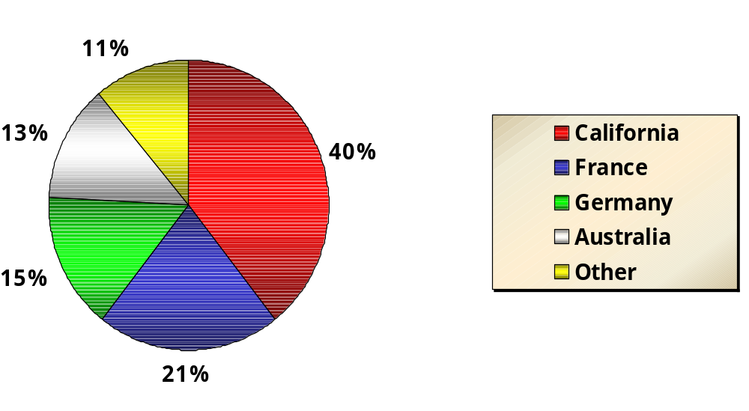
The French Quarter Vintner
January Sales of Wine by Region
© Prentice Hall, 2003
Business Communication Today
Chapter 11 - <number>
Notes:
The sample pie chart above shows total sales for The French Quarter Vintner for the month of January, broken down by various wine regions. We can see that wines from California wines sold the best.

Slide 17
Illustrating
Relationships
Organization
Charts
Flow
Charts
Positions
Processes
Units
Procedures
Functions
Sequences
© Prentice Hall, 2003
Business Communication Today
Chapter 11 - <number>
Notes:
If you need to show physical or conceptual relationships rather than numerical ones, you might want to use a flow chart or an organization chart.
As the name implies, an organization chart illustrates the positions, units, or functions of an organization and the way they interrelate. A flowchart illustrates a sequence of events from start to finish; it is indispensable when illustrating processes, procedures, and sequential relationships.

Slide 18
Flow Chart of the Report Writing Process
Keyboard
Input
First
Hard Copy
Next
Hard Copy
Edit
Edit
OK?
Yes
Yes
Submit
Report
No
Add?
Keyboard
Input/Edit
Keyboard
Input/Edit
No
Style and
Spelling
Style and
Spelling
© Prentice Hall, 2003
Business Communication Today
Chapter 11 - <number>
Notes:
The flow chart above diagrams the report-writing process. It shows that the various elements in the process you want to portray may be represented by pictorial symbols or geometric shapes.

Slide 19
The Chain of Command
Chief Executive
Officer
Executive
Vice President
President
Executive
Vice President
Vice
President
Vice
President
Vice
President
Vice
President
Vice
President
Region
1
Region
2
Region
3
Region
4
Region
5
District
A
District
B
District
C
District
D
District
E
District
F
District
G
© Prentice Hall, 2003
Business Communication Today
Chapter 11 - <number>
Notes:
An organization's normal communication channels are almost impossible to describe without the benefit of an organization chart like the one above.

Slide 20
Using Maps
Geographic
Areas
Regional
Differences
Key Markets
© Prentice Hall, 2003
Business Communication Today
Chapter 11 - <number>
Notes:
For certain applications, maps are ideal. One of the most common uses is to show concentrations of something by geographic area. In your own reports, you might use maps to show regional differences in such variables as your company's sales of a product, or you might indicate proposed plant sites and their relationship to key markets.

Slide 21
Other Business Graphics
Drawings
and Diagrams
Images
and Photographs
Functions
Realism
Operations
Visual Appeal
Selected Details
Ethical Concerns
© Prentice Hall, 2003
Business Communication Today
Chapter 11 - <number>
Notes:
Although less commonly used than other visual aids, drawings, diagrams, and photographs can also be valuable elements in business reports and presentations. Drawings and diagrams are most often used to show how something looks or operates. Photographs have always been popular in certain types of business documents, such as annual reports, where their visual appeal is used to capture reader interest. However, in some situations a photograph may show too much detail. This is one reason that repair manuals frequently use drawings instead of photos. With a drawing, you can select how much detail to show and focus the reader's attention on particular parts or places.
Technology makes it easier to use photographs in reports and presentations, but it also presents an important ethical concern. Software tools make it easy for computer users to make dramatic changes to photos—without leaving a clue that they’ve been altered. As you do when using other technological tools, stop and ask yourself where the truth lies before you start making changes.

Slide 22
Working With Computers
Advantages
Speed
Accuracy
Versatility
Challenges
Training
Artistic Skills
Time Requirements
© Prentice Hall, 2003
Business Communication Today
Chapter 11 - <number>
Notes:
With today's powerful computers, it's faster and easier than ever to produce good-looking visuals. Aside from speed, accuracy, and ease of use, another big advantage of using software to prepare visuals is the ability to save the results and use the visuals over and over again in various reports.
For all the power and possibilities they offer, computer-graphics tools are not without some potential drawbacks. Using this equipment efficiently and effectively requires skills that many businesspeople, including the ability to use hardware and software and to make good design decisions. Many software products have become easier to use, but most continue to offer more and more options—type of chart, color and design of the background, typefaces, line weights, and so on. Most businesspeople lack the visual arts training to make informed design decisions; moreover, making all those choices takes time.
Before you take advantage of any computer-graphics tools, think about the kind of image you want to project. The style of your visuals communicates a subtle message about your relationship with the audience. The image you want to project should determine the visual you create.

Slide 23

Computer
Graphics
Design Principles
Continuity
Contrast
Emphasis
Simplicity
Experience
© Prentice Hall, 2003
Business Communication Today
Chapter 11 - <number>
Notes:
To create effective visuals, become conscious of both the aesthetic and the symbolic aspects of graphic art so that you won't send the wrong message. Here are a few principles to be aware of:
Continuity. Readers view a series of visuals as a whole, assuming that design elements will be consistent from one page to the next.
Contrast. Readers expect visual distinctions to match verbal ones. To emphasize differences, depict items in contrasting colors: red and blue, black and white. But to emphasize similarities, make color difference more subtle.
Emphasis. Readers assume that the most important point will receive the most visual emphasis. So present the key item on the chart in the most prominent way—through color, position, size, or whatever. Visually downplay less important items.
Simplicity. Limit the number of colors and design elements you use, and take care to avoid chartjunk, decorative elements that clutter documents (and confuse readers) without adding any relevant information.
Experience. Culture and education condition people to expect things to look a certain way, including visuals.

Slide 24
Integrating Text and Graphics
Audience Attitudes
Production Issues
Clear
Introductions
Careful
Placement
Effective Titles
and Legends
Overall Purpose
Subject Matter
© Prentice Hall, 2003
Business Communication Today
Chapter 11 - <number>
Notes:
Every visual you use should be clearly referred to by number in the text of your report. Help your readers understand the significance of visuals by referring to them before they appear in the text. The reference helps readers understand why the table or chart is important.
Try to position your visuals so that your audience won't have to flip back and forth too much between the visuals and the text. Ideally, it’s best to place each visual right beside or right after the paragraph it illustrates so that readers can consult the explanation and the visual at the same time. Make sure each visual is clearly and correctly referred to in the text. If you have four or more visuals, prepare a separate list that can be placed with the table of contents at the front of the report.
One of the best ways to tie your visuals to the text is to choose titles (or captions) and descriptions (or legends) that reinforce the point you want to make, especially when text and visuals are widely separated. If you're using informative headings in your report, carry this style over into the titles and legends. Regardless of whether your titles and legends are informative or descriptive, phrase them consistently throughout the report. At the same time, be consistent in your format.

Slide 25
Checking Visual Aids
Typography
Honesty
Necessity
Coloring
Documentation
Accuracy
Alignment
© Prentice Hall, 2003
Business Communication Today
Chapter 11 - <number>
Notes:
Any visuals that you have included are present to help your readers absorb, understand, and accept your message. Their appearance is crucial to your message's success, so be sure to check visuals for mistakes such as typographical errors, inconsistent color treatment, and alignment. Also take a few extra minutes to make sure that your visuals are necessary, absolutely accurate, properly documented, and honest.

