Slide 1


Internship project
Intern : Alexandru Erhan
Data : 26.08.2021
Endava Presentation
Template

Slide 2
Steps
Choose the Database Management System
Find the dataset
Transformation of the dataset
Reporting using a BI tool
Endava Presentation
Template

Slide 3
PostgreSQL
New database to learn and to practice after the received trainings
Relevant and useful data types for the project (timestamp time-zone aware, interval)
JSON support
Endava Presentation
Template

Slide 4
Dataset
Russian airports data for August 2016 – August 2017
Postgres Pro Standard : Documentation: 10: J.2. Schema Diagram : Postgres Professional
8 tables, 2.5GB, millions of rows
Endava Presentation
Template

Slide 5
Transformation
With the goal to achieve a better schema for the reporting tool there was done :
Denormalization
Splitting columns
Adding relevant columns
Endava Presentation
Template

Slide 6
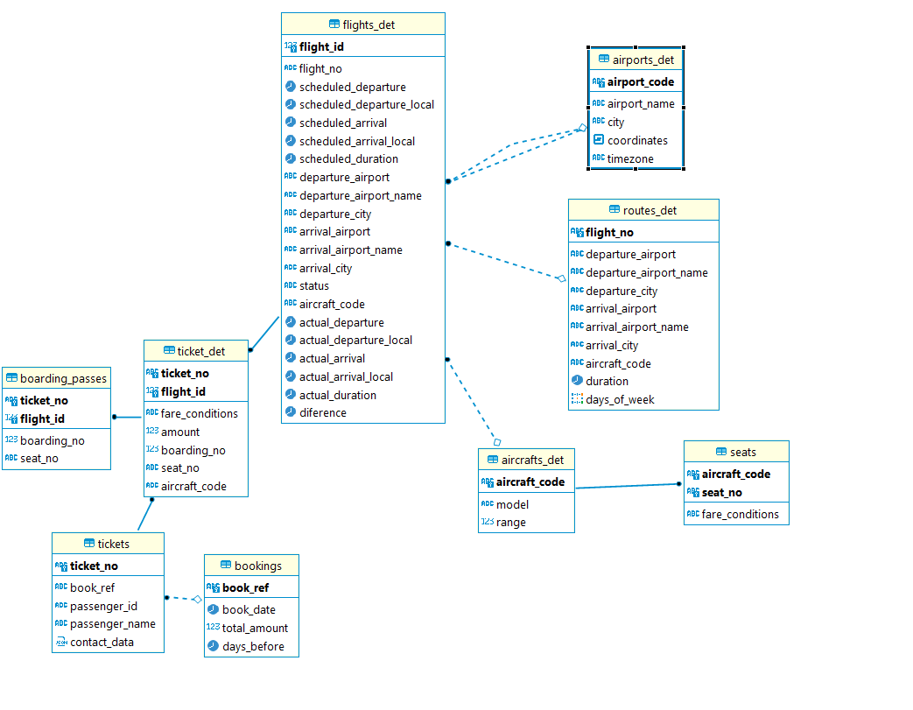
Transformation
Endava Presentation
Template

Slide 7
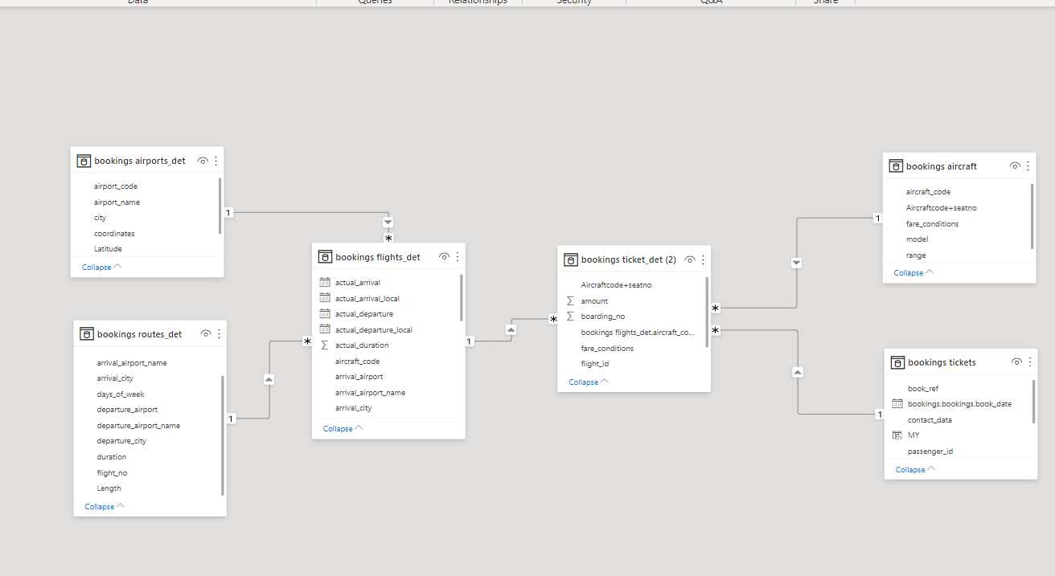
Transformation
Endava Presentation
Template

Slide 8
Transformation
Using SQL for denormalization, changing into a better star-schema for the reporting
Using Power Query from Power BI for :
Splitting coordinates
Frequency of the flights
Splitting and formatting the dates for a multi-year sort using DAX
Difference between scheduled and actual duration of the flight
Creating a multiple column relationship between two tables (relationships in power bi limited to a single column)
Endava Presentation
Template

Slide 9
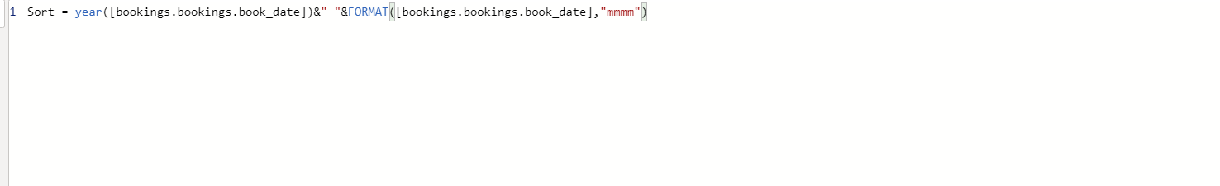
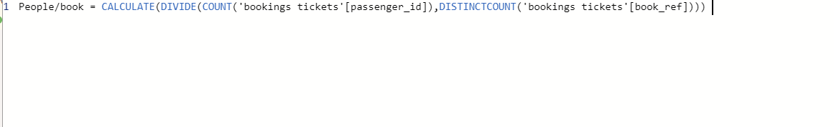
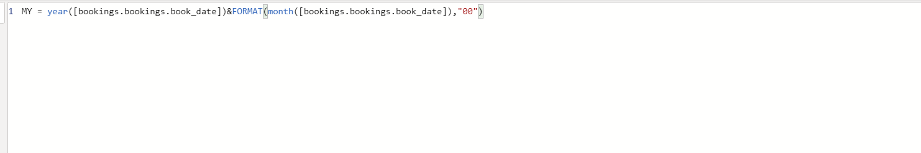
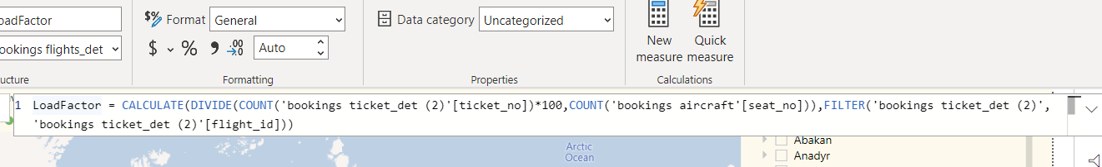
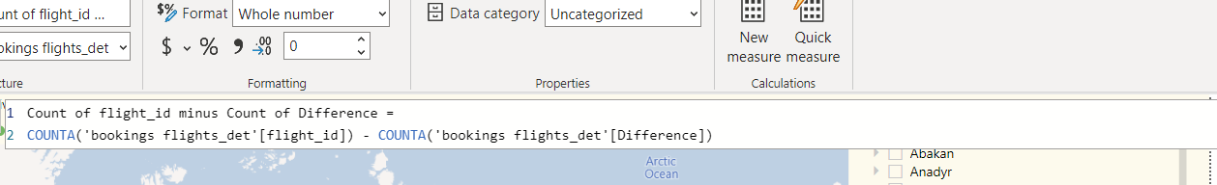
Measures
For a better reporting creating measures using DAX
Endava Presentation
Template

