Slide 1


Slide 2

United Nations General Assembly has declared 2012 as the International Year of Cooperatives:

Slide 3


Theme:

Slide 4

Purpose:
highlighting the contribution of cooperatives
to socio-economic development
Poverty reduction
Employment generation
Social integration

Slide 5

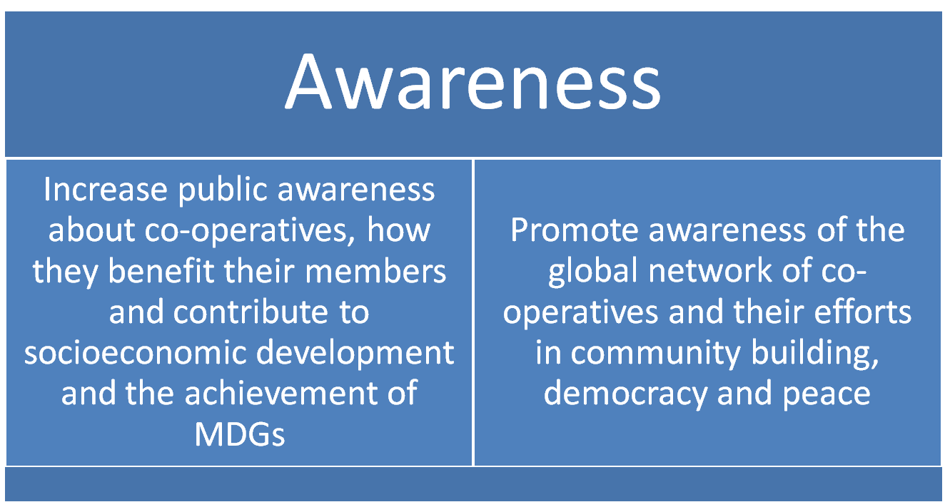
Aims

Slide 6

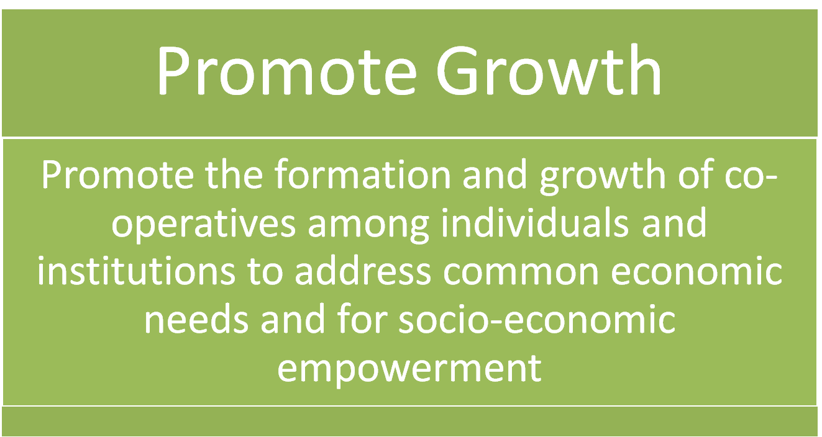
Aims

Slide 7


Aims

Slide 8

Activities for IYC?
publications, media events, preparation of films, video series, radio programmes and others.
initiating a change in policies requiring short and long-term lobbying campaigns,
Research, collecting statistics, and working with authorities at all levels.

Slide 9

Activities for IYC?
develop new relationships and partnerships with institutions, development partners, citizen groups, and other business enterprises.
Launching of co-operative foundations or support programmes
commemorative stamps, coins
events able to introduce various groups of people to co-operatives through sporting events, concerts, fairs, etc

Slide 10
Activities for IYC?
Press conference to present the Action plan for the IYC
Organize Essay, drawing, photo competition for school children, coop employees and members
Monthly IYC campaign at regional level in collaboration with the national coop associations
National workshop on cooperative contribution to the country’s socioeconomic development of people
Asian Credit Union Forum 2012 : Cooperative Enterprise Build Better World

Slide 11

IYC is an opportunity.
Be creative

Slide 12

ACCU
1 million outreach of the poor by 2012.

Slide 13
ACCU
60 million outreach of the Members by 2012.

