Slide 1
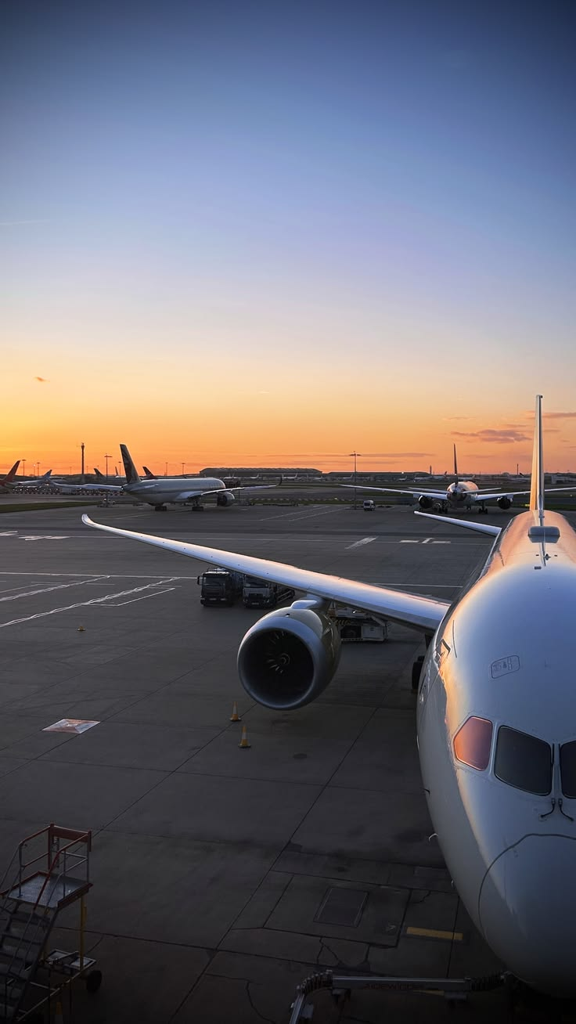
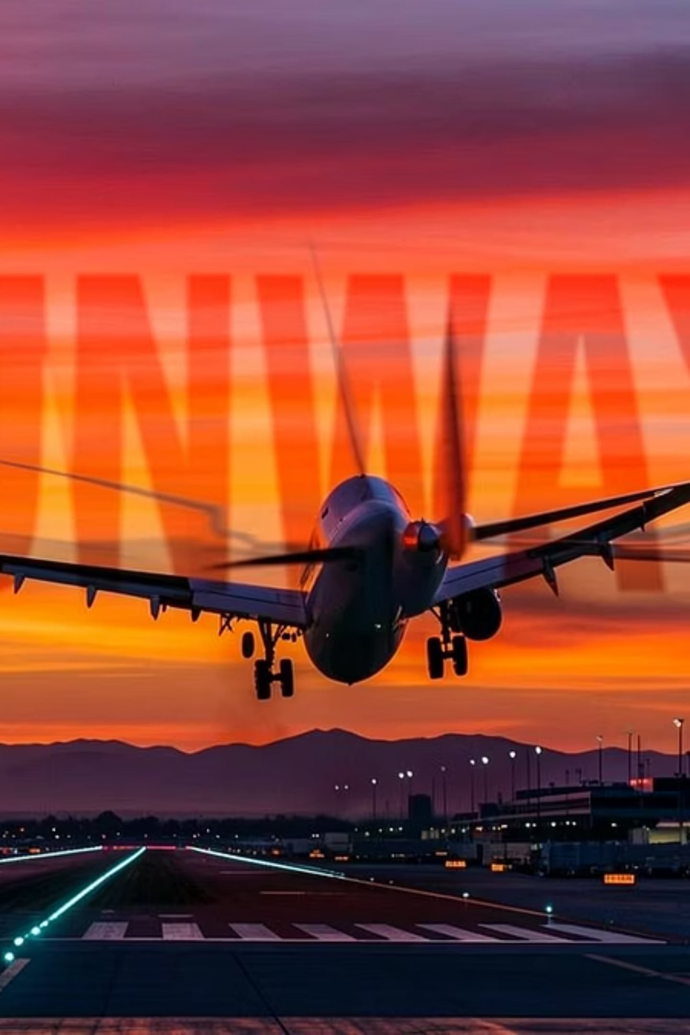
Airline Operational Performance & Passenger Satisfaction
Group 04, EDS2233

Slide 2

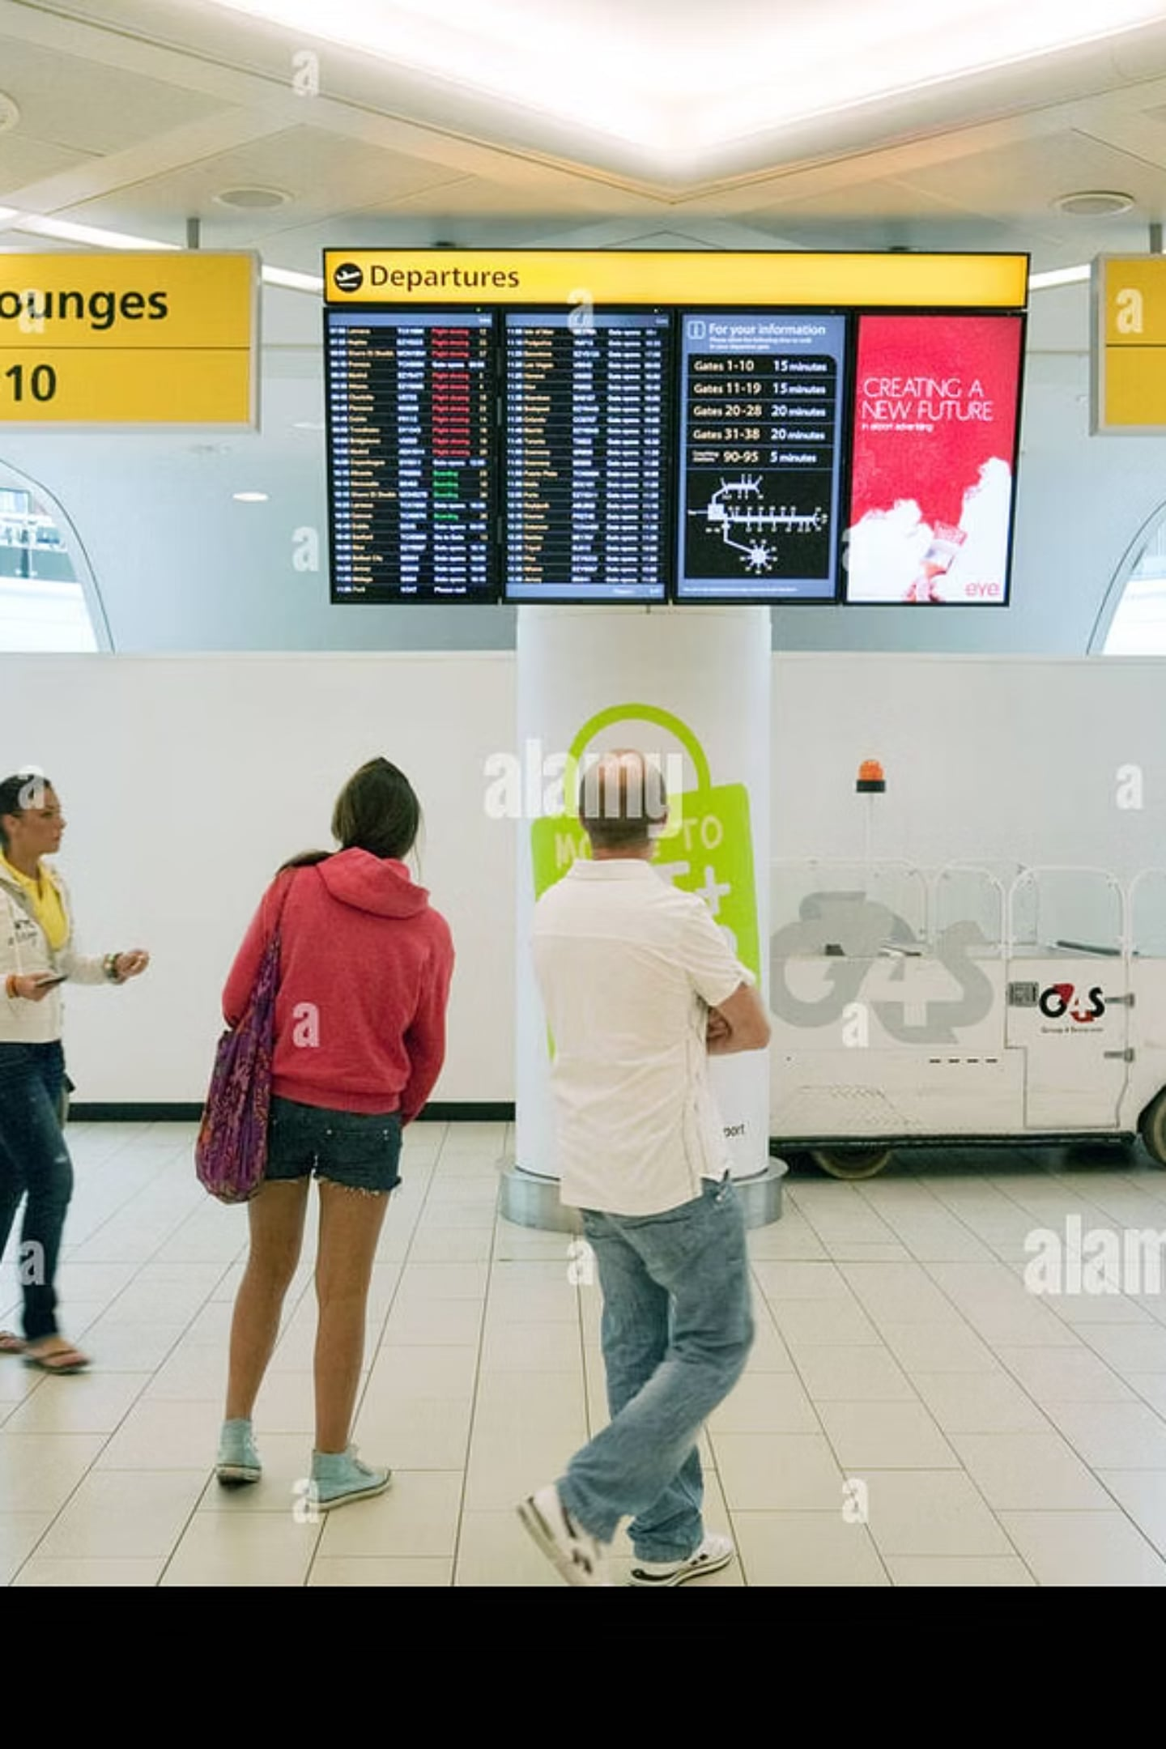
Business Question
Does airline operational performance (delays, cancellations) actually drive passenger satisfaction , and where should airlines focus improvement?

Slide 3
Data Sources
flights.csv
airlines.csv
satisfaction_survey.csv
1,405 flights, 2023
12 carriers
715 responses

Slide 4
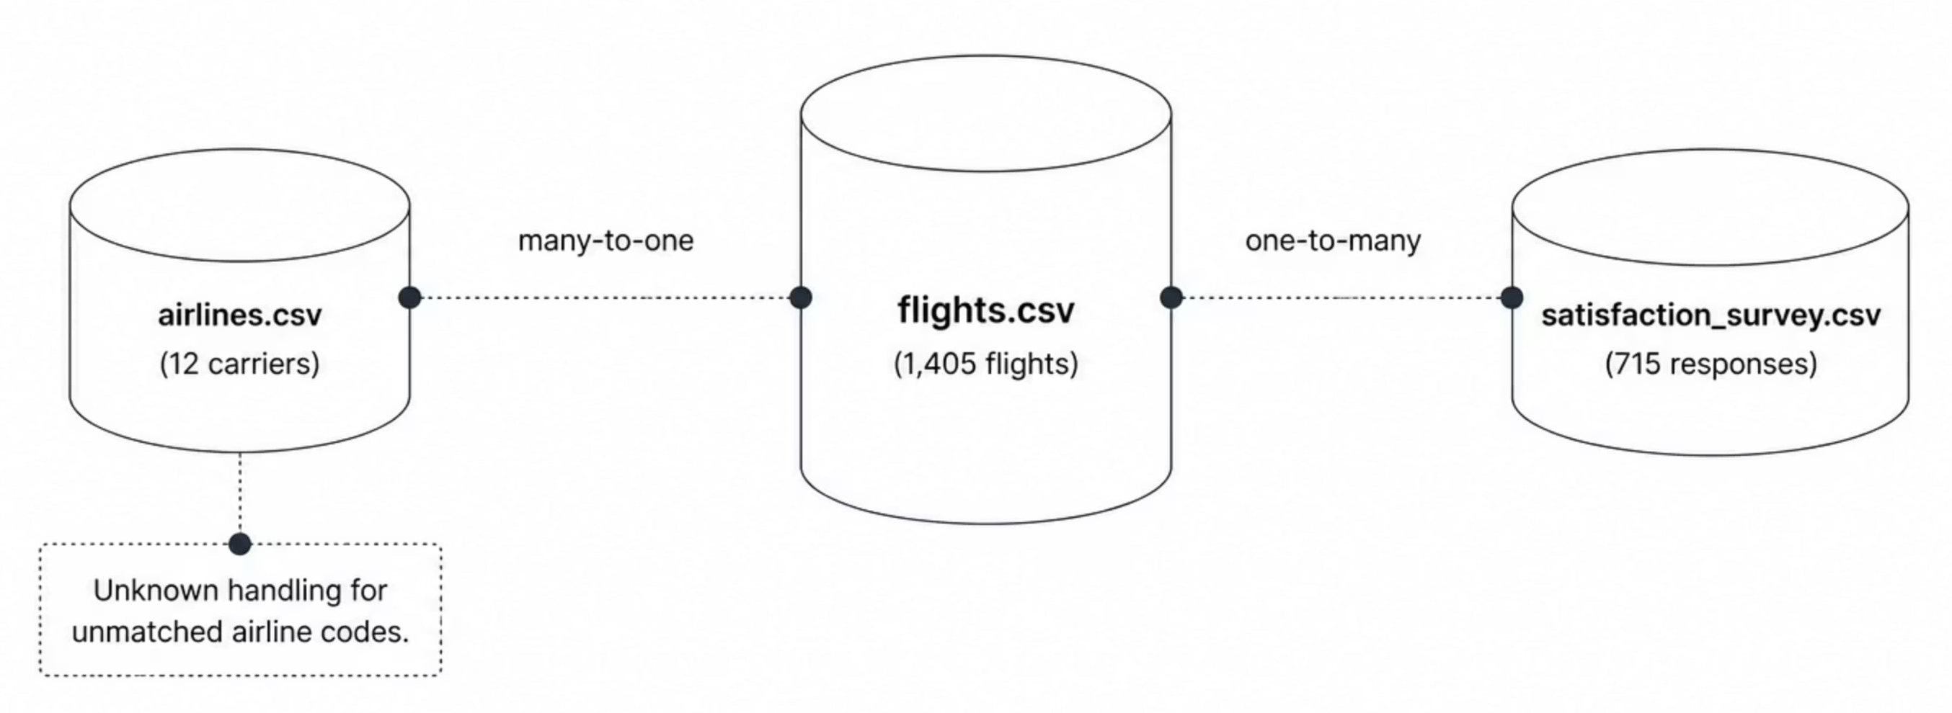
Data Model
The dataset contains unmatched records. Tableau relationships preserve these records without removing valid flight data. data."

Slide 5
Calculated Fields
Cancellation Rate, Delay Category (0-15/16-30/31-60/60+), Delay Status (Cancelled/On Time/Minor/Moderate/Severe), Survey Coverage — built to bucket continuous delay data into readable categories for the charts.
1
2
Cancellation Rate
Delay Category
0-15 / 16-30 / 31-60 / 60+
3
4
Delay Status
Survey Coverage
Cancelled / On Time / Minor / Moderate / Severe

Slide 6
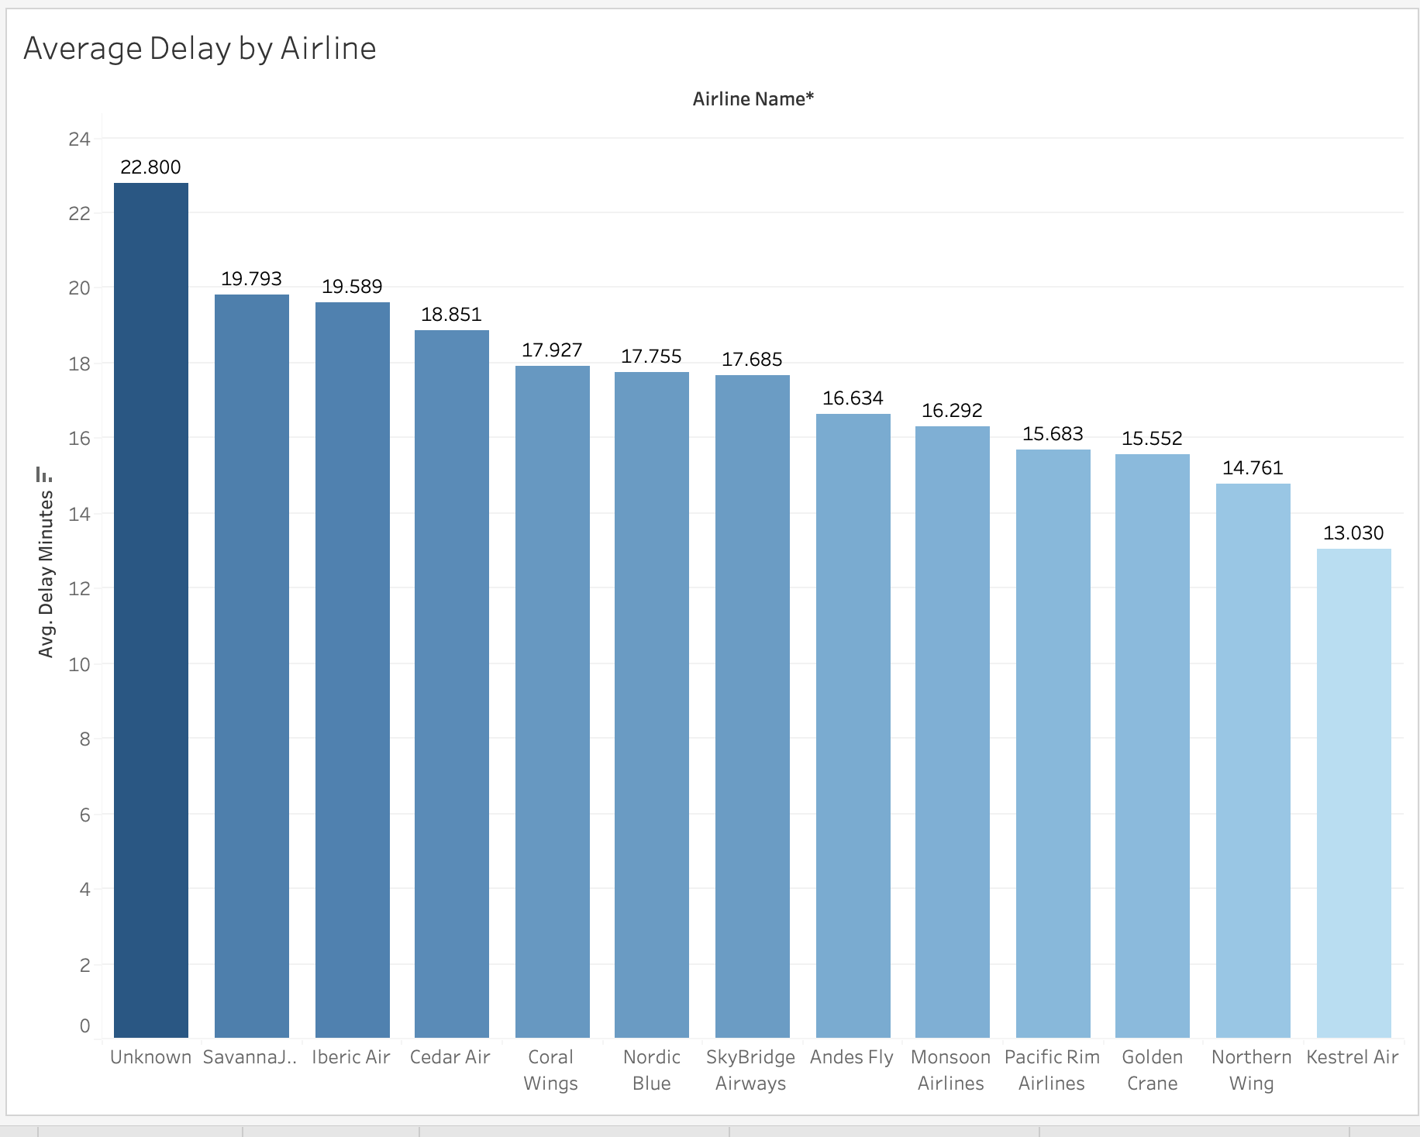
Average Delay by Airline
"This visualization compares the average departure delay across airlines to identify operational performance differences. Airlines with consistently higher average delays may experience scheduling or resource management challenges, which can negatively affect passenger satisfaction."

Slide 7
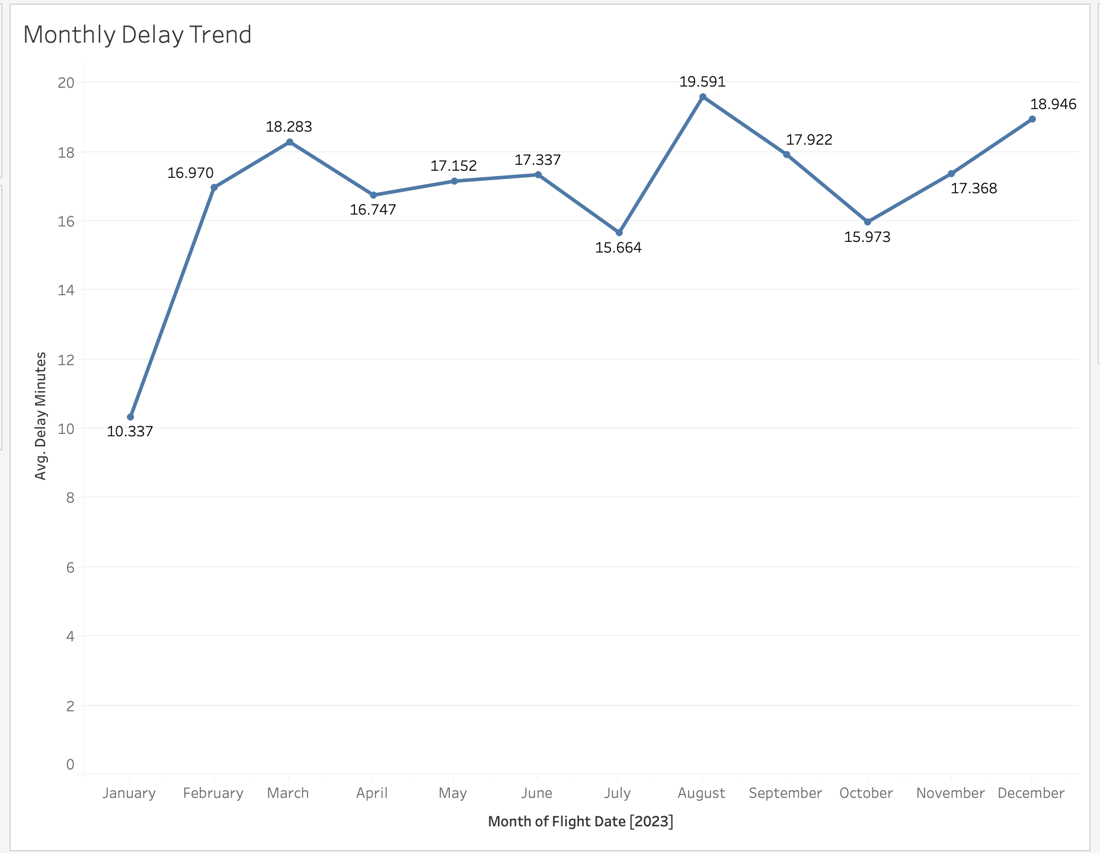
Monthly Delay Trend
"Shows how average departure delays change throughout the year — identifying seasonal or operational challenges affecting punctuality during peak travel periods."

Slide 8
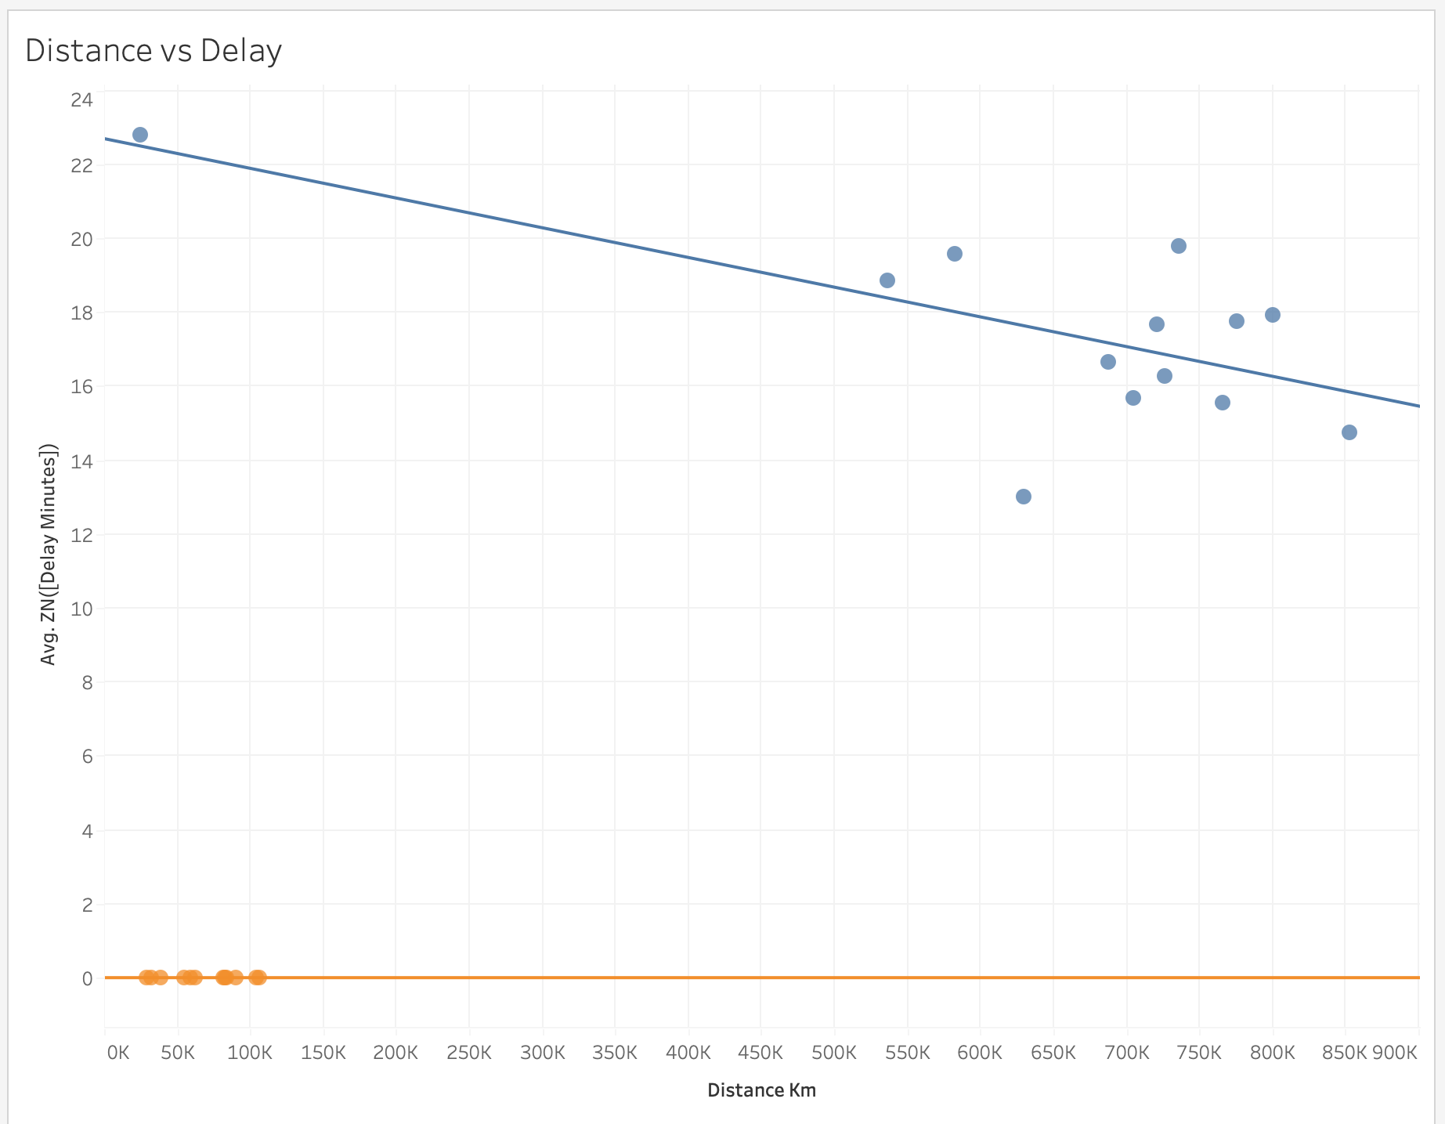
Distance vs Delay
"Scatter plot exploring the relationship between flight distance and departure delay, one point per flight, colored by cancellation status, with a trend line testing whether longer flights see more delay."

Slide 9
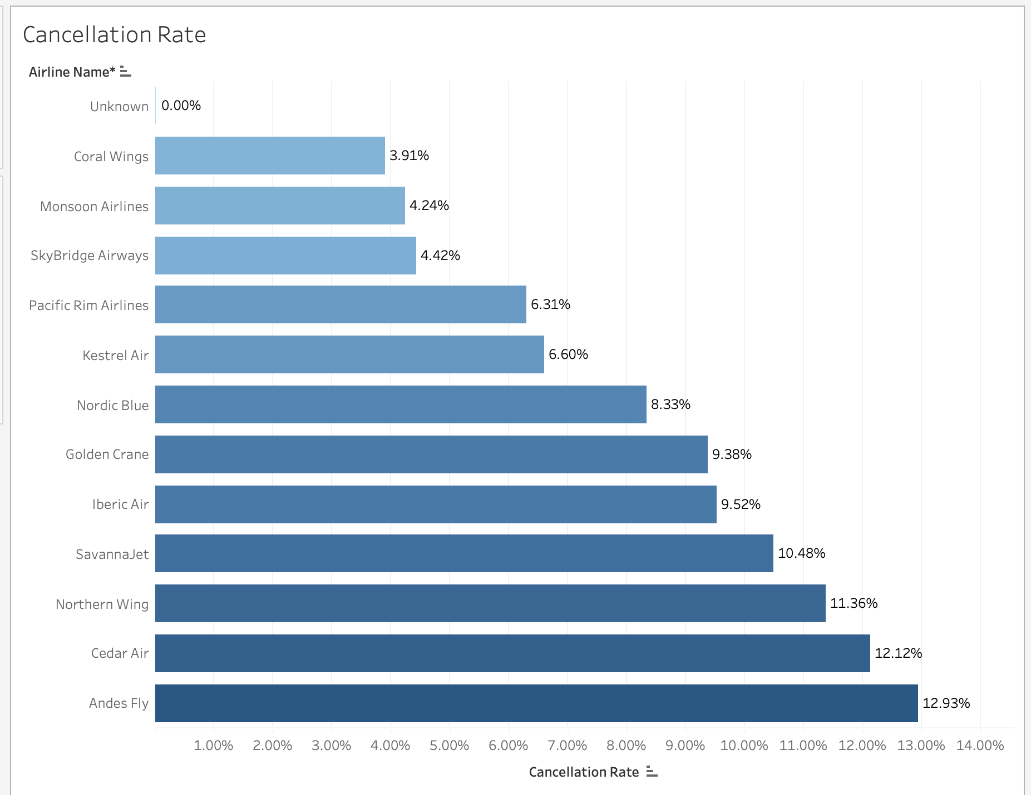
Cancellation Rate
"Compares cancellation rate by airline to evaluate operational reliability — a key inconvenience driver for passengers."

Slide 10
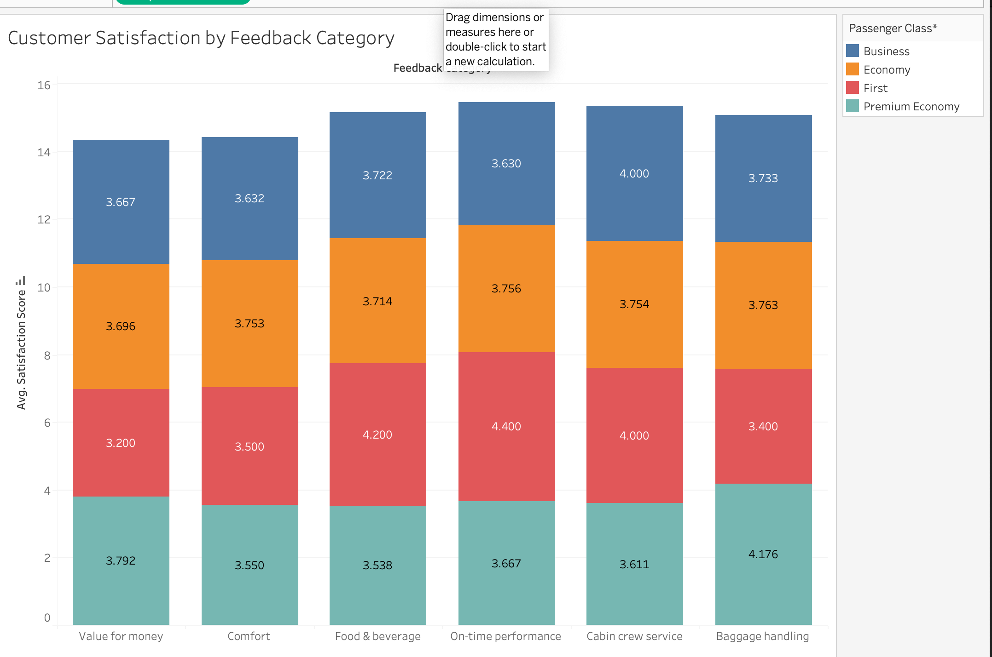
Satisfaction by
Feedback Category
"Examines average satisfaction across service categories
and passenger classes, identifying which touchpoints need
the most improvement."

Slide 11
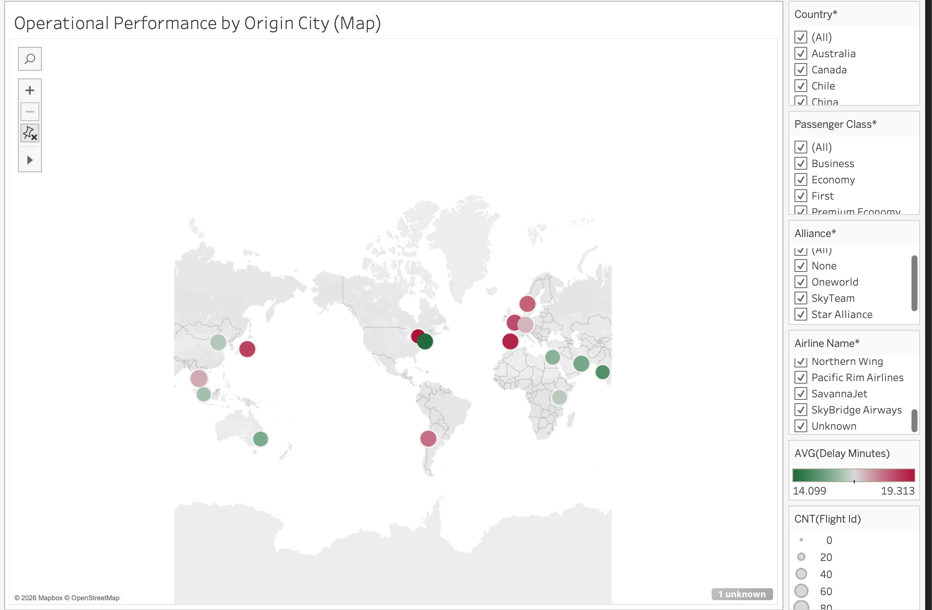
Map: Origin City Performance
"Circle size = flight volume, color = average delay, tooltip includes satisfaction and cancellation giving a geographic view of where operational problems cluster."

Slide 12
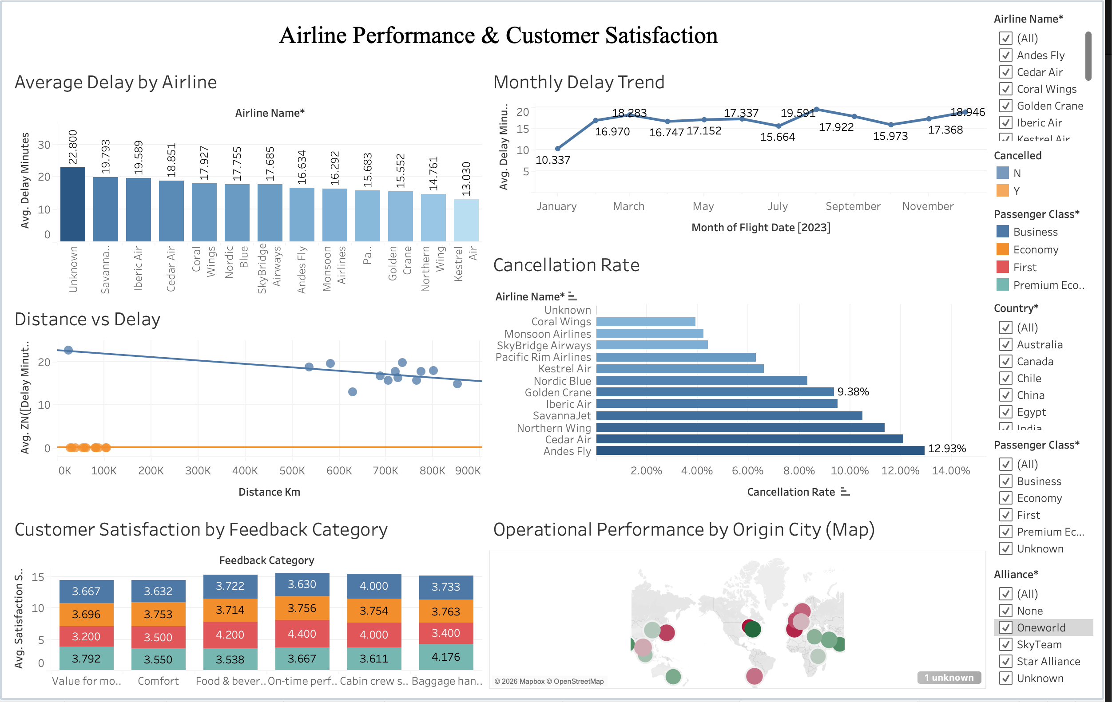
Combined Dashboard
& Interactivity
clicking any chart filters all the others (6 cross-filter actions),
letting a viewer drill from "high-delay airline" straight into
that airline's satisfaction and route data.

Slide 13
Conclusion
"Operational performance has a direct influence on passenger experience. Airlines with higher delays and cancellation rates see lower satisfaction. Reducing delays and improving reliability, especially in the lowest-rated service categories, is the clearest lever for improving customer loyalty."

Slide 14
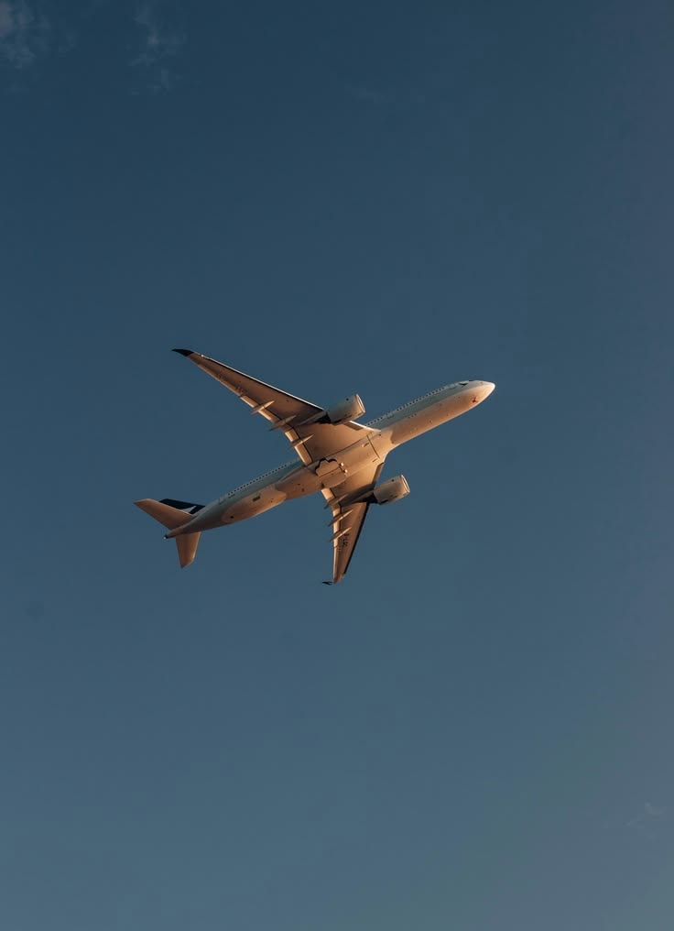
Thank You

