Slide 1
Microservices Architecture
Sanjay Dwivedi

Slide 2

Enable Agile Development & Continuous Delivery – Need for Speed
Customer
Feedback
Design
Develop
Test
Customer
Delivery

Slide 3
Enable Agile Development & Continuous Delivery – Need for Speed
Release #1
Waterfall
Organization!
Release #2
Prod Release #1
Release #3
Release #4
Agile Development
Prod Release #2
Release #5
Release #6
Small Release packages deployed with high frequency
Smaller Risk in each release
Prod
Release #3
Release #7
Release #8
Notes:
Reduction of product package size to increase speed of product delivery
1. Agile: Smaller batch or packages in project management
2. Lean: Smaller batches in product management
3. CI/CD: smaller batches in ops/deployment and QA
4. Microservices: smaller batches of design/architecture!
- Irakli
<number>

Slide 4
Reduction of batch size is the recurring theme for speed
Irakli Nadareishvili et. al. State in their book is next step in lean software engineering
Agile – smaller batches in project management.
Lean – smaller batches in product management.
CI/CD – smaller batches in ops/deployment and QA.
Microservices – smaller batches of design/architecture!
“Slay the monolith”: Microservices close the alignment loop!
Irakli Nadareishvili et. al.: Microservices Architecture: Aligning Principles, Practices, and Culture

Slide 5
Why Microservices?
Architecture Style that came about because Web architecture supporting eCommerce do not work in new Digital world!
They were pre-dominantly Monolithic Architectures
&
Deployed in company data centers

Slide 6
Why Microservices?
Microservices Architecture Style is first style developed:
POST Continuous Delivery
&
POST DevOps
&
POST Cloud Revolution
To Support Rapid Change in an Increasingly Digital World!

Slide 7
Microservices – A Distributed Software / Application Architecture
Microservices Architecture Style is fundamentally a distributed software / application architecture
8 Fallacies of Distributed Computing Apply
Foundational Building blocks of distributed system are required
Networks
Network Protocols
Application Protocols
Message Serialization/DeSerialization
IPC Mechanism: RPC or Messaging Mechanism
Service Registry & Discovery
Distributed Consensus Protocol to reason and arrive at a consensus on state of distributed system
Failure is guaranteed, architecture & design must model failure and bake in resiliency

Slide 8
Microservices: Definition
“Fine grained SOA architecture done the UNIX way” – James Lewis, Thoughtworks
Follow the Unix Philosophy
“Write programs that do one thing and do it well. Write programs to work together. Write programs to handle text streams, because that is a universal interface” - Doug McMcIlroy, Head of the Bell Labs CSRC & Inventor of the Unix pipe
The Unix philosophy emphasizes building short, simple, clear, modular, and extensible code that can be easily maintained and repurposed by developers other than its creators. The Unix philosophy favors composability as opposed to monolithic design.
Single Responsibility Principle!
Prefers Simplicity Over Complexity!

Slide 9
Microservices: Definition
The microservice architectural style is an approach to developing a single application
As a suite of small services
Each running in its own process
Communicating with lightweight mechanisms, often an HTTP resource API
These services are
built around business capabilities
independently deployable by fully automated deployment machinery
Services may be written in different programming languages and use different data storage technologies
There is a bare minimum of centralized management of these services
Martin Fowler: http://martinfowler.com/articles/microservices.html

Slide 10
Microservices: Definition
If every service has to be updated in concert, it’s not loosely coupled!
Loosely coupled service oriented architecture with bounded contexts
If you have to know about surrounding services you don’t have a bounded context.
Adrian Cockcroft: http://www.slideshare.net/adriancockcroft/dockercon-state-of-the-art-in-microservices

Slide 11
Microservices Architecture Characteristics
Characteristics of Microservices Architecture Style
Componentization via Services A component is a unit of software that is independently replaceable and upgradeable Main reason for using services as components (rather than libraries) is that services are independently deployable | Decentralized Data Management Bounded Context Master & Metadata Management becomes important
Organized around Business Capabilities Conway’s Law of system design & communication | Infrastructure Automation - DevOps Culture
Products not Projects A team should own a product over its full lifetime Amazon's notion of "you build, you run it" | Design for Failure - Highly distributed in nature and failure is expected, so design for failure
Smart endpoints and dump pipes Anti- ESB & SOA where pipes are complex, and intelligent | Evolutionary Design
Decentralized Governance Independent microservice capability evolution with forward compatible service contracts | Stateless & Immutable
Microservice Architectures are about both Technology & Business – Requires Cultural Change
Martin Fowler: http://martinfowler.com/articles/microservices.html

Slide 12
Benefits of Microservices Architecture Style
Architecture & Design Choices that inhibit these are deal breakers
Simple (but Hard)
Modularity based on Component Services
Not libraries
Loosely coupled
Enables Scaling of Development
Independent teams deliver features and services can evolve independently
Independent Deployments - Change cycles de-coupled / Enable Frequent Deploys
Smaller units to deploy!
Efficient Scaling
Scaling requires scaling services that require greater resource instead of entire app
Individual components less intimidating to new developers
Single responsibility principle! Easier to grasp!
Eliminates long-term commitments to technical stack
Microservices can be written in any language, use any database and run on any platform
No long term bets on single technology!

Slide 13
Organized Around Business Capabilities
Siloed
Functional Teams
organized by technology layer
Cross-
Functional Teams organized around business capability
Middleware
Specification
DBAs
Business Capability
UI Specification
Business Capability
Business Capability
Full Stack Engineering Teams
Siloed
Application Architectures
HTML
JavaScript
MVC
Microservice Architectures
Service
Service
Data Access
Monolithic Application
Martin Fowler: http://martinfowler.com/articles/microservices.html#OrganizedAroundBusinessCapabilities
Notes:
In Siloed functional teams organized around technology leads to business capability gets implemented in technology layer controlled by the team
Leads to leaky abstraction, business logic in PL SQL or in UI
<number>

Slide 14










Diversity of Clients
REST
REST
API Gateway
REST
REST
Neo4j
Microservices allow developing new customer experiences rapidly

Slide 15



Decentralized Data Management & Polygot Persistence
Each service manages its own data
Uses persistence technology that is most suitable for the service
Microservices do not share database
Allows for de-coupling, independent evolution and deployments
Redis
REST
REST
REST
REST
X
Composite
Apps
Neo4j
Notes:
Each services manages its own data
Uses persistence technology that is most suitable for the service
Microservices do not share database
Allows for de-coupling, independent evolution and deployments
<number>

Slide 16
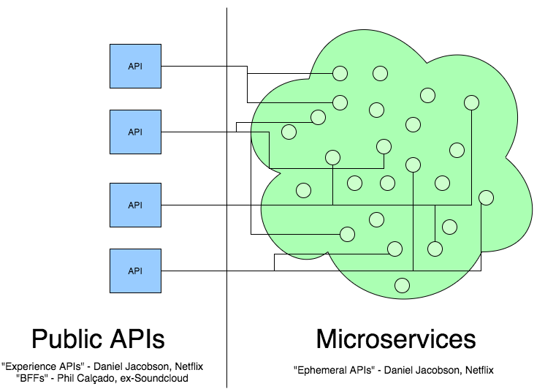
Microservices != APIs
Microservices are not your public APIs:
Web + Mobile App
Alexa
Voice Skill
Slack
Chatbot
Microservice architecture is the implementation of your system, it is not public API Interface of your system that external or most internal client should depend directly on – Irakli

Slide 17
Microservices Architecture Tradeoffs
Microservices architecture style bring costs and benefits
Many teams have found MSA to be productivity sapping burden!
Choose wisely!
Microservices provide benefits… | …But come with costs
Strong Module Boundaries: Microservices reinforce modular structure, which is particularly important for larger teams. | Distribution: Distributed systems are harder to program, since remote calls are slow and are always at risk of failure.
Independent Deployments: Simple services are easier to deploy, and since they are autonomous, are less likely to cause system failures when they go wrong. | Eventual Consistency: Maintaining strong consistency is extremely difficult for a distributed system, which means everyone has to manage eventual consistency.
Technology Diversity: With microservices you can mix multiple languages, development frameworks and data-storage technologies. | Operational Diversity: You need a mature operations team to manage lots of services, which are being redeployed regularly.
Martin Fowler: http://martinfowler.com/articles/microservice-trade-offs.html

Slide 18
Microservices – Not a Free Lunch
Significant Operations Overhead
Substantial DevOps Skills Required
Distributed System Complexity
8 Fallacies of Distributed Computing are very much relevant!
App composition using microservices requires discipline from developers
Failure is Expected: Service may not be available! Plan for it
Avoid cascading failures! (hint: circuit breakers!)
Implicit Interfaces & Public API backward compatibility!
Plan for service versioning
Duplication of Effort
Duplication of Data
Testability Challenges

Slide 19
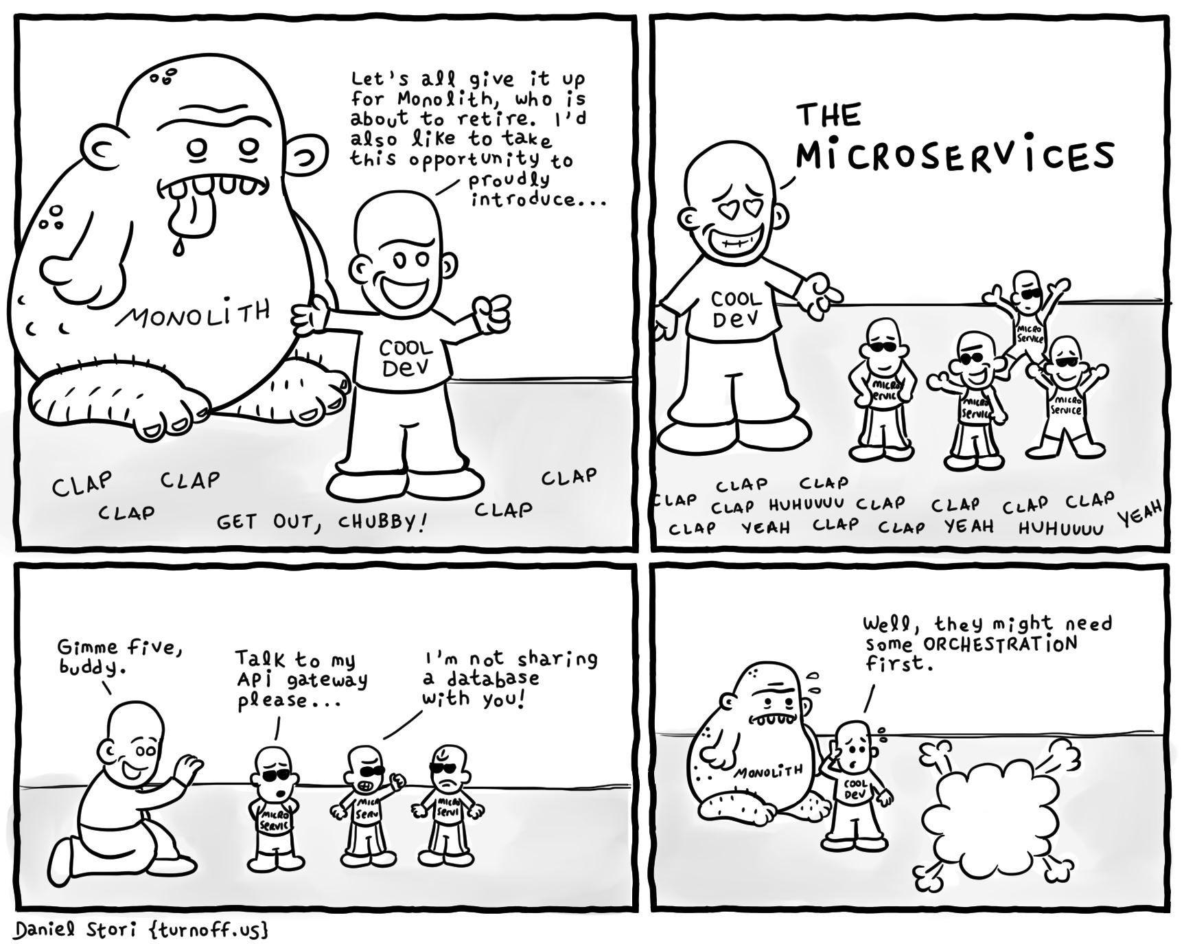
Need for Orchestration

Slide 20
Emergent Challenges with Microservices Architecture
(Externalized) Configuration Management
Communication Protocols (RPC, Messaging, Domain-Specific)
Service Registry & Discovery
Routing & Load Balancing
Resiliency (Circuit Breakers!)
Monitoring & Metrics
Environment Provisioning
On-Demand/Automatic Scaling
Container Management & Resource Scheduling
Monitoring/ Failover/Resiliency/Auto Restarts
Log Aggregation
Chris Richardson: http://microservices.io/patterns/index.html

Slide 21
Platform Services Needed for Microservices
Service
Registry/
Discovery
Messaging /
IPC /
API
Resiliency
Requires:
Container Management & Resource Scheduling
Log Aggregation
Monitoring
Distributed Tracing
Authentication/Authorization
API / IPC / Messaging
CI/CD Pipeline
Application / Service is unit of:
Resiliency
Scaling
Elasticity
Load Balancing
Discovery
Authentication/
Authorization
Monitoring
My
Microservice
Application
CI/CD
Pipeline
Tracing
Container
Management
Load
Balancing/
Scaling/
Elasticity
Logging

Slide 22






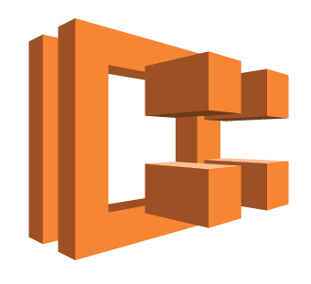
Microservices Toolkit – Spring Boot with Spring Cloud/Netflix OSS Components
Spring Cloud with Netflix OSS Components, built on Spring Boot offers a comprehensive Microservices toolkit for JVM with:
Externalized Config Management
Service Registry/Discovery via Eureka/Consul
Messaging: HTTP, gRPC, Kafka, AMQP, protobuf, thrift etc.
Resiliency/Circuit Breaker
Server side Load Balancing & Proxy
Monitoring/Metric via Spring Actuator
Zipkin based tracing
Container Management, Resource Scheduling, Self-Healing & Resiliency requires using other solutions
3rd party tools for CI/CD pipeline such as Netflix Spinnaker
Log Aggregation via PaaS or ELK/Splunk etc.
Spring Cloud
CONSUL/
ZOOKEEPER
SECURITY
OSS Community Contributions
SPRING BOOT µS
CONFIG SERVER
CLOUD BUS
SPRING BOOT ADMIN
SLEUTH(ZIPKIN )
DATA FLOW
TASK
MICROSERVICES DASHBOARD
STREAM
(Kafka, AMQP)
CLUSTER
(etcd, Hazelcast, Zookeeper)
CLI
DC/OS MESOS
ATLAS
HYSTRIX DASHBOARD
EUREKA
Container Management & Resource Scheduling
ZUUL
TURBINE
SPINNAKER
http://projects.spring.io/spring-cloud/
Notes:
Components that enable Microservices Style App Development
Distributed & Versioned Components
Service Registration & Discovery
Dynamic Routing
Load Balancing
Circuit Breakers
Distributed Messaging
Global Locks
<number>

Slide 23
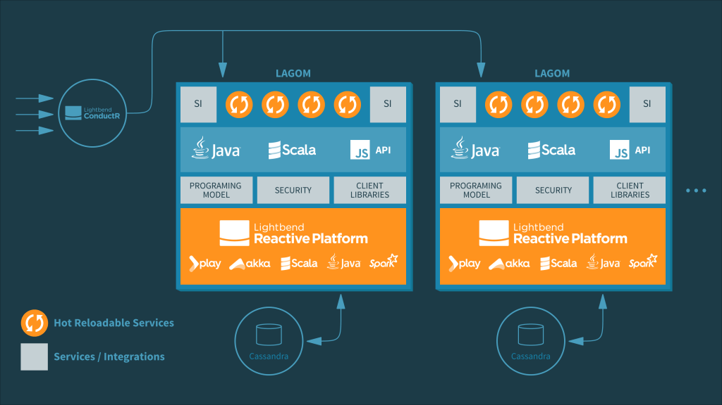
Microservices Platform & Toolkit - Lagom
A Reactive microservices framework for JVM with:
Support for CQRS, Event Sourcing
Resiliency, Scalability, Distributed clustering, async messaging from Akka
Service Registry/Discovery via 3rd party solutions like Consul, Eureka, ZooKeeper
Externalized Config via Persistence Services (Cassandra)
ConductR:
For infrastructure management, container orchestration, deployment, scaling & monitoring
Support for public & private clouds such as AWS, Azure, Google Cloud, DC/OS, Kubernetes, Docker, Cloud Foundry
https://www.lagomframework.com/

Slide 24
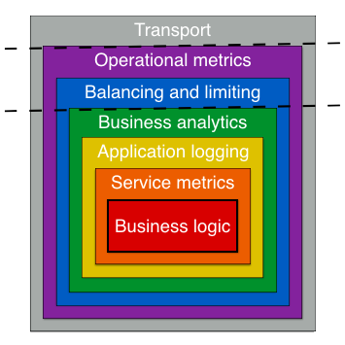
Microservice Toolkit: Go-kit
MSA toolkit for golang with:
Support for HTTP, TLS, gRPC, thrift, net/rpc, circuit breakers
Service Registry via Consul, etcd, DNS SRV records
Load balancing, Rate Limiting
Logging
Health, Metrics & Monitoring via Influxdb, prometheus, Graphite, statsd etc.
Support to run go-kit on Kubernetes, AWS ECS
https://gokit.io/
Notes:
<number>

Slide 25
You will need a PaaS!
Build your own using Open Source Components:
Using Cloud Native Computing Foundation (CNCF) Sponsored Projects (Kubernetes, Docker, Istio, etc.)
Build using Netflix OSS Components (Spinnaker + Docker or ECS or Mesos and so on)
Apache Mesos/Marathon/Chronos (or packaged distro from Mesosphere - DC/OS)
…
OR
Use one of several wonderful open source PaaS:
Cloud Foundry
OpenShift
Deis (Acquired by Microsoft)
…
OR
Commercial Products such as:
Apcera Platform, Pivotal Cloud Foundry, RedHat OpenShift Enterprise, CoreOS Tectonic, …
Notes:
<number>

