Slide 1
Interpretable-by-Design Language Models via Activation-Based Gradient Routing
Minor Project | Mid-Term Evaluation
Department of CSE, PEC
Team: [Name 1] · [Name 2] · [Name 3] · [Name 4]
Guide: [Guide name] | [Date]
Notes:
[0:00–1:00] (Presenter 1)
Good morning. We are [names], and this is our minor project: "Interpretable-by-Design Language Models via Activation-Based Gradient Routing".
That is a long title, so here is the plain version. The AI language models behind chatbots are black boxes: we cannot see where a skill is stored inside them. Our project asks whether a model can be trained so that it organises itself into specialised parts, a bit like the regions of a brain, so that we can look inside it.
In the next ten minutes we will explain the problem, what others have done, our idea, how we test it, what we have already built and measured, and what is left to do.

Slide 2
A language model is a black box
A language model predicts the next word. It learns by adjusting millions of numbers called weights.
A brain: specialised regions
A language model: no regions
Language
Vision
Movement
Grammar, math and code are mixed across every weight.
2 / 10
Notes:
[1:00–2:00]
A language model is a program that learns to predict the next word in a text. It does this by adjusting millions of numbers, called weights, while it reads lots of text. Our model learned from three kinds of text: children's stories, simple arithmetic, and Python code.
Here is the catch. In today's models, every skill is spread over all the weights, mixed together, like the coloured dots on the right.
Compare that with a human brain, on the left. A brain has specialised regions: one area for language, another for vision, another for movement. Doctors can tell which region is damaged from which ability is lost.
An AI model has no such regions. That is why we call it a black box: there is no place to look for "the math part".

Slide 3
Why the black box is a problem
1
2
3
Can't explain
Can't delete a skill
Forgets old skills
We cannot point to where an answer came from.
Unlearning: removing one skill, such as unsafe knowledge, without starting over.
Catastrophic forgetting: learning something new overwrites old knowledge.
Research question: can a model organise its own “brain regions” while it trains?
3 / 10
Notes:
[2:00–3:00]
This black-box design causes three concrete problems.
One: we cannot explain an answer. We cannot point to the part of the model that produced it.
Two: we cannot delete a skill. If a model learned something unsafe or private, "unlearning" it normally means retraining from scratch, because the knowledge is smeared everywhere.
Three: catastrophic forgetting. When we teach the model something new, it can overwrite what it knew before.
All three would be easier if skills lived in separate regions. So our research question is: can a model organise its own "brain regions" while it is training, without us telling it how?
▶ HANDOVER: Presenter 1 hands over to Presenter 2 for slide 4.

Slide 4
How our work differs from existing research
Approach | What decides the regions? | Goal | Needs human labels?
Mixture of Experts (Switch Transformer, Mixtral) | A learned router, word by word | Cheaper computing at large scale | No
Gradient Routing (Cloud et al., 2024) | Humans assign data to regions | Localise a skill, remove it later | Yes
EWC (Kirkpatrick et al., 2017) | An importance score for each weight | Don't forget old tasks | Task boundaries
Ours | The model's own activity | Self-organised regions we can switch off | No
The gap: Gradient Routing needs humans to assign data to regions. Ours lets the model decide.
4 / 10
Notes:
[3:00–4:00] (Presenter 2)
Three lines of existing research touch on this.
Mixture of Experts, used in Switch Transformer and Mixtral, splits the model into expert parts and uses a learned "router" to pick which experts handle each word. But its goal is cheaper computing, not understanding, and the Mixtral authors report that experts do not split up by subject.
Gradient Routing, by Cloud and colleagues in 2024, does localise skills in chosen parts of the model so they can be removed later. But humans have to decide which data goes to which part.
Elastic Weight Consolidation, from 2017, protects the important weights against forgetting, but it needs to know when the task changes.
So here is the gap: nobody lets the model decide the regions itself, without human labels. That is what we try.

Slide 5
Our idea: the most active blocks learn
Inside every layer, the MLP (the part that stores knowledge) is cut into 8 blocks.
block 1
block 2
block 3
block 4
block 5
block 6
block 7
block 8
blocked
blocked
learns
blocked
blocked
learns
blocked
blocked
Each batch: only the 2 most active blocks get the learning signal (gradient). Which 2 varies.
1
Measure
2
Select
3
Balance
How active is each block?
Top 2 learn, 6 are blocked
A nudge keeps idle blocks alive
Like brain regions: they specialise through use and competition.
5 / 10
Notes:
[4:00–5:00]
Here is our idea. Inside every layer there is a part called the MLP, which stores most of the model's knowledge. We cut it into 8 equal blocks.
For each batch of text, we measure how active each block is. Only the two most active blocks in each layer are allowed to learn from that batch: the learning signal, called the gradient, is blocked for the other six. All eight blocks still do their work when the model reads text. Only learning is restricted.
There is one problem. A block that loses could never come back, so we add a balancing nudge that keeps idle blocks alive.
The inspiration is the brain: regions specialise because they are used, and they compete. Our hope is that a block that wins on math keeps winning on math.
▶ HANDOVER: Presenter 2 hands over to Presenter 3 for slide 6.

Slide 6
How we test it: switch one block off
Like studying brain injury: damage one region and see which ability is lost.
ILLUSTRATIVE SKETCH, NOT REAL DATA
Each row: one block switched off.
Colour: how much the error rises for each skill.
Story
Math
Code
Story
Math
Code
Specialization score S
S = 0
skill shared by all
S = 1
one skill only
Dense model: every block matters a little for everything
Specialised model: each block matters for one skill
High S: switching off that block removes one skill.
6 / 10
Notes:
[5:00–6:00] (Presenter 3)
How do we know whether the blocks specialised? We copy what neurologists do: switch one part off and see what breaks.
We zero out one block at a time and measure how much the model's error rises on each of the three skills: stories, math and code. In the heatmap that we will show shortly, each row is one block, and the colour shows how much worse the model gets.
On the left is an illustrative sketch, not real data. In a normal, dense model, every block matters a little for everything, so the rows look the same. On the right is what a specialised model would look like: each block hurts mainly one skill.
We summarise this in one number, the specialization score S. Zero means a block's skill is shared across all domains. One means the block serves a single domain.

Slide 7
What we built
10.6M
Stories
Math
Code
learned numbers
(29.9M with word table)
TinyStories
Our own generator
CodeParrot (Python)
6 × 8 = 48
20.0M tokens
10.0M tokens
10.6M tokens
layers × blocks to study
“Once upon a time there lived a little girl…”
Q: 347 + 589 = A: 936
def add(a, b): …
19 min
to train on a free
Kaggle T4 GPU
Token = a word piece. 40.6M tokens in total.
Python
PyTorch
nanoGPT-style GPT
Kaggle T4 GPU
GitHub
14 / 14 tests pass
7 / 10
Notes:
[6:00–7:00]
What we built. The model is a small GPT-style language model, written in PyTorch following the nanoGPT design: 6 layers, 384 numbers wide, about 10.6 million learned numbers in the core, or 29.9 million counting the word table. With 8 blocks in each of the 6 layers, there are 48 blocks to study.
It trains on 40.6 million tokens, where a token is a word piece, from three sources: TinyStories for stories, 20 million tokens; our own generator for arithmetic lines like this one, 10 million; and CodeParrot for Python code, 10.6 million.
We trained on a free Kaggle T4 GPU; the baseline took about 19 minutes. Everything is on GitHub with an automated pipeline from data to plots, and all 14 automated tests pass, including tests that prove only the chosen two blocks receive the learning signal.

Slide 8
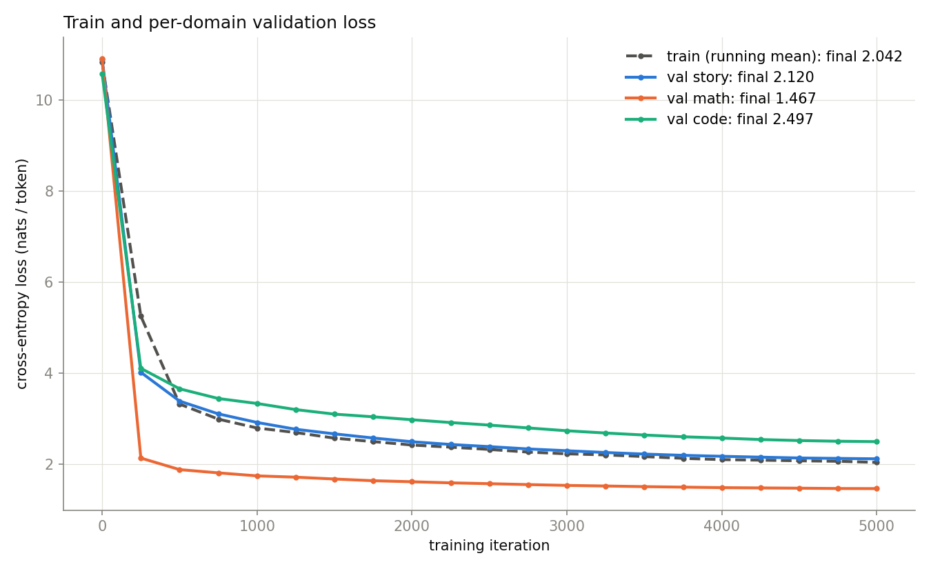
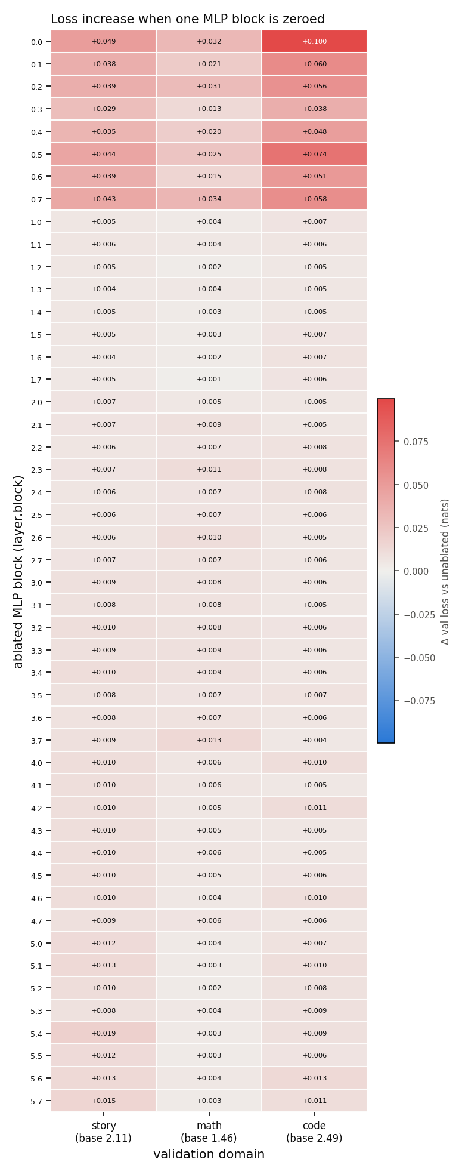
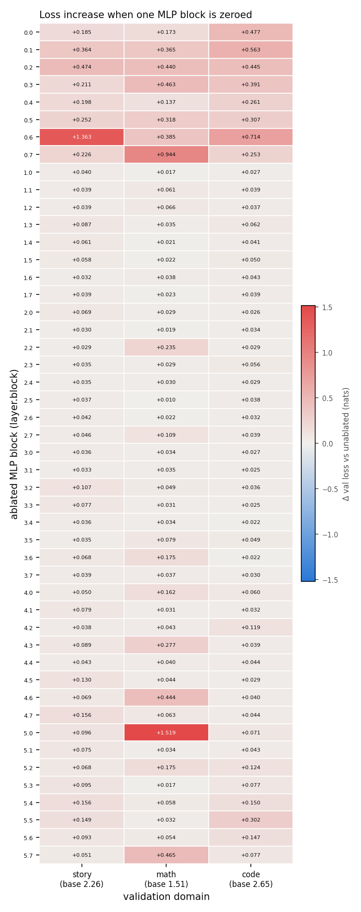
Results so far
Dense
Routed
Model output (dense)
Story
“Once upon a time there lived a tidy little girl. One day she went to the park with her mom.”
Math
Q: 26 - 5 = A: 21
Loss curves (dense): lower is better
 | Dense | Routed
Story loss | 2.120 | 2.270
Math loss | 1.467 | 1.510
Code loss | 2.497 | 2.659
Mean S | 0.051 | 0.110
Code
def add(a, b): o = b.read() … return o
(looks like code, not valid yet)
Rows: blocks switched off. Darker = more damage. Scales differ.
Takeaway: routing doubled specialization (S 0.05 → 0.11) for a 3–7% loss cost. One run each, so not yet proven.
8 / 10
Notes:
[7:00–8:00]
Results so far. Both models trained for 5,000 steps, about 20 minutes each. Top left, the loss curves: lower is better, and the model learns all three domains.
In the table, "dense" is the normal model and "routed" uses our method. Routing costs a little accuracy: story loss goes from 2.12 to 2.27, math from 1.47 to 1.51, code from 2.50 to 2.66, about 3 to 7 percent worse.
The key number is the specialization score: 0.051 for dense, 0.110 for routed. Routing roughly doubled it, and the routed heatmap shows a few dark, domain-specific blocks. The colour scales differ, so compare the shapes, not the shades.
On the right are real samples from the dense model: stories are readable, the math format is learned but answers are often wrong, and the code is not valid yet.
Honest caveat: one run per model, so we cannot yet prove the gap is not luck.
▶ HANDOVER: Presenter 3 hands over to Presenter 4 for slide 9.

Slide 9
A key finding, and what is still open
Before: naive masking
After: balancing signal not masked
9 of 16 blocks never selected (small test): the balancing signal was blocked too.
No block left behind. Full run: all 48 blocks used.
Known limitations
Dominant block
Mixed batches
Optimizer drift
Layer 0, block 6 took 70% of picks; most took 15–31%.
A batch holds stories, math and code, so each pick averages them.
AdamW still nudges blocks we blocked.
9 / 10
Notes:
[8:00–9:00] (Presenter 4)
An important finding along the way. In our first version, the balancing nudge was blocked too, along with everything else. In a small test, 9 of 16 blocks were never chosen at all. Once a block loses, it gets no learning signal, so it can never win again. We let the balancing signal bypass the block, so idle blocks keep getting nudged, and every block stays in use. In the full run, all 48 blocks were used. We kept the failure as an automated test.
What is still open. First, one block, block 6 in layer 0, was chosen 70 percent of the time, while most blocks were chosen 15 to 31 percent. Second, each batch mixes stories, math and code, so a block's pick averages over the domains. Third, the optimizer we use, AdamW, still slightly moves blocks whose learning signal we blocked, through momentum and weight decay.

Slide 10
Progress and next steps
Data pipeline
Next steps
Completed
41M tokens, 3 domains
1
Repeat with several seeds
Baseline training
2
Human-assigned regions baseline
Completed
5,000 steps on a T4
3
Fix dominant block and drift
Routing module
Completed
4
Consolidation phase
14 tests, 1 full run
5
Domain probes
Evaluation harness
Ongoing
Ablation done, probes pending
6
Unlearning and continual learning
Thank you · Questions?
10 / 10
Notes:
[9:00–10:00]
To summarise our progress. The data pipeline and baseline training are complete. The routing module is complete too: implemented, tested, and run once at full scale. The evaluation harness is ongoing: the switch-one-block-off test is done, but the probes that read what each block encodes are still pending.
Next, we will repeat the runs with several seeds, to see whether the doubling of S is real. Then a baseline where humans assign the regions, which is our upper bound. We will also fix the dominant block and the optimizer drift, add a consolidation phase, build the domain probes, and run unlearning and continual-learning experiments.
Thank you. We are happy to take your questions.

