Slide 1

COMP 472 – Assignment
Experiment with machine learning
Deliverd by:
Shadi Makdissi
Sandy Jarada
Toufik Rbaheh
1

Slide 2
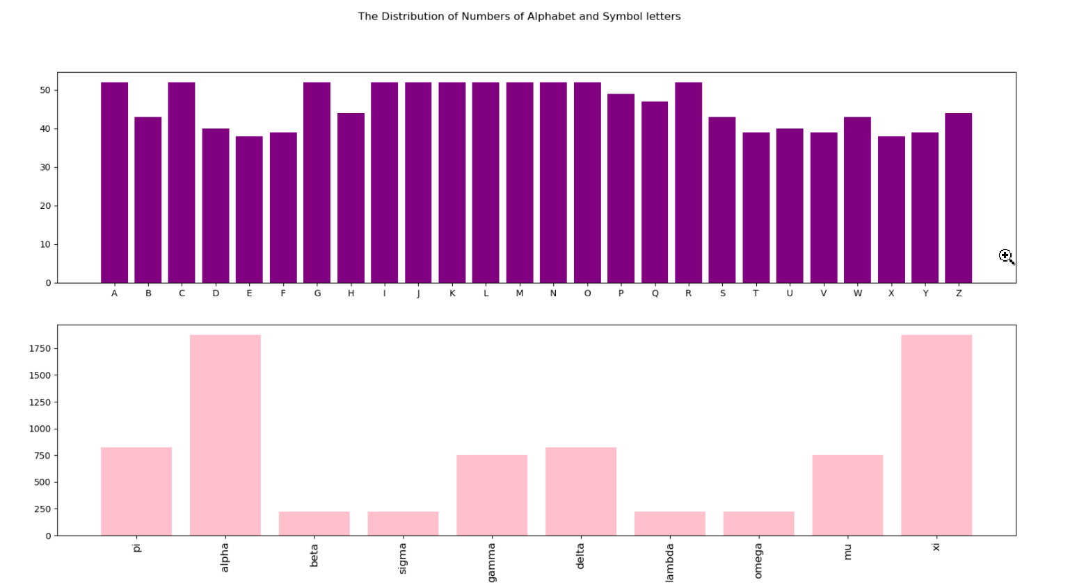
The distribution of the number of the instances in each class:

Slide 3

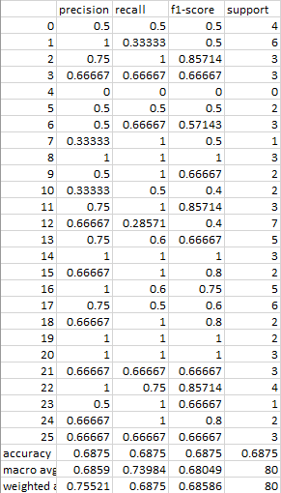
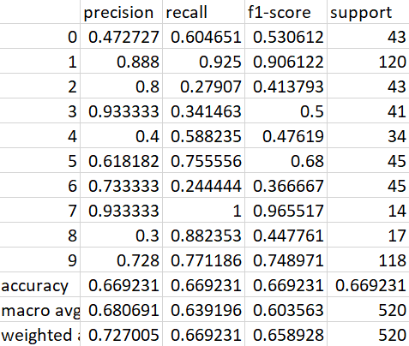
(a) GNB:
This model is good for text classification due to its relying on the prior and posterior probabilities.
More than 1750
Around 250

Slide 4
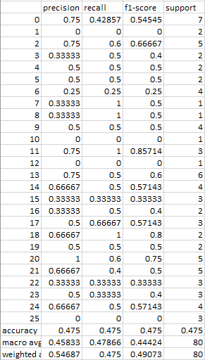
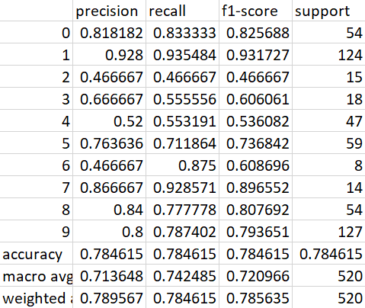
(b) Base-DT:
It is expected that DT is not that good for so many classes with few instances; while it is better with few classes

Slide 5
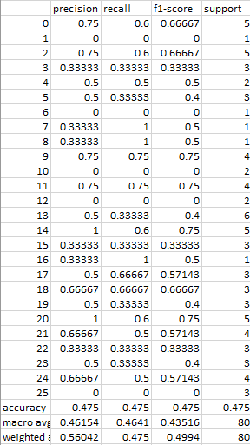
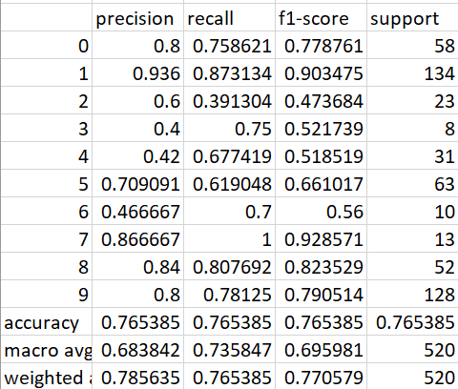
(c) Best-DT:
Entropy, max depth= None, min samples split= 3, min impurity dec = 0.001
Class weight = None

Slide 6
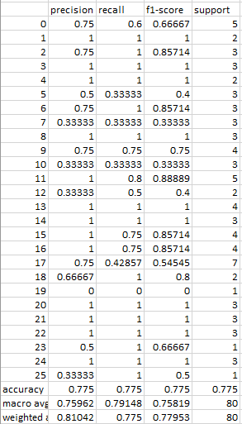
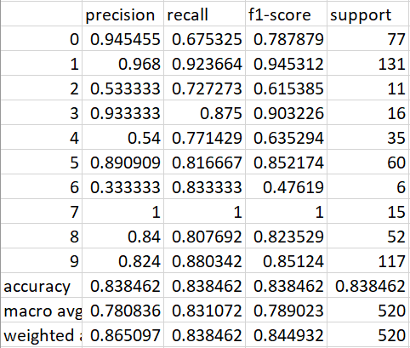
(d) PER:
This model is good because it keeps iterate until it gets the best results but the default iterations here are 1000.

Slide 7
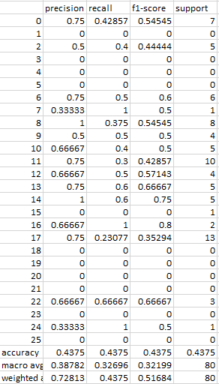
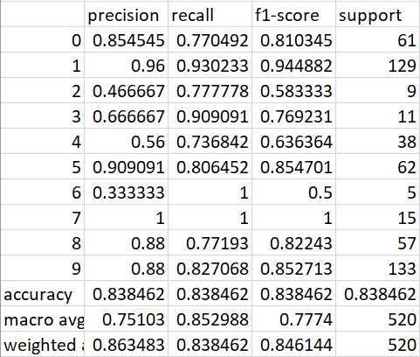
(e) Base-MLP:
1 hidden layer with 100 neurons, sigmoid activation function, and Adam solver.

Slide 8
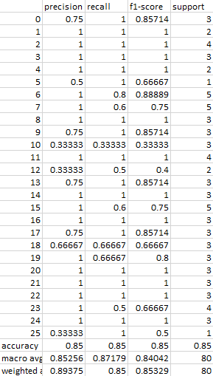
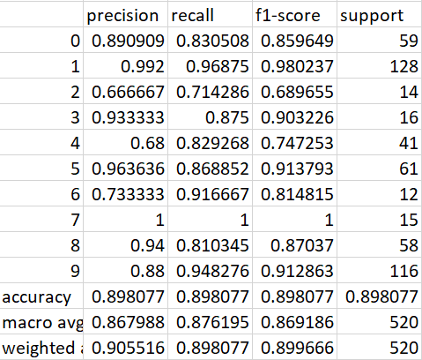
(f) Best-MLP:
The best activation function was the sigmoid in letters and tanh in Greek, 2 hidden layers (50, 50) and Adam solver.

Slide 9
Tasks distribution:
Toufik: distribution graphs and GNB + analysis
Shadi: Best_DT, the MultiFunctional.py and the demo file + analysis
Sandy: Base_DT, Perceptron, Base_MLP, Best_MLP + analysis

