Slide 1
1. Program Structure.
2. Code Sections
3. Anatomy of a python program.
4. Anatomy of a C program.
5. C++ Headers and useful libraries.
7. C++ STLs and use as a program-constructs
8. Code Environment.
9. Set Timeline.
10. Practice a Hacker-Rank Problem.
11. Why Competitive programming ??

Slide 2
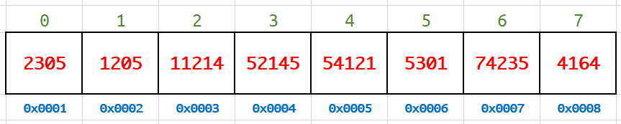
arr.front()
arr.back()
arr[2] → 11214
arr[5] = 5321; → [5] = 5321
*arr.begin() = 96325; ??
Iterator : arr.begin()
Iterator : arr.end()
std::vector<long long int> arr;
arr = {2305, 1205, 1121, 52145, 54121, 5301, 74235, 4164}
arr.push_back(1052);
arr.push_front(2254);
arr.pop_back();
arr.pop_front();
arr.resize(10);
arr.reserve(15);
std::stack <long long int> _stack;
_stack.push (90);
_stack.top() -> 90
_stack.push(60);
_stack.push(85);
_stack.top () -> ?
_stack.pop () -> ?
_stack.top () -> ?
std::queue <long long int> _queue;
std::deque <long long int> _deque;
std::stack <std::queue <long long int> > _stack_of_queues;
Stack has no [] operator. Deque can push-pop from both sides. Queue can push from one end and pop from the other.
Stack can push or pop from the top only. Each container has iterators like a vector container has.

Slide 3
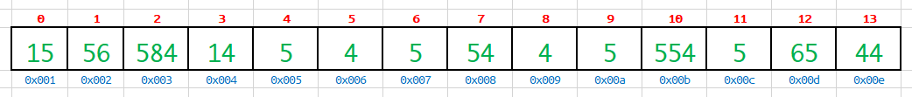
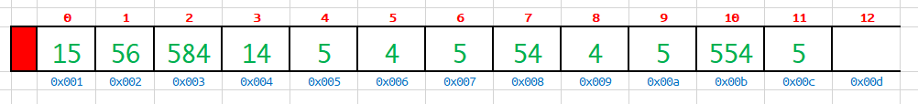
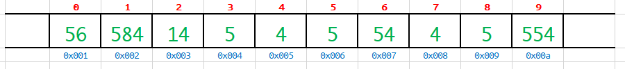
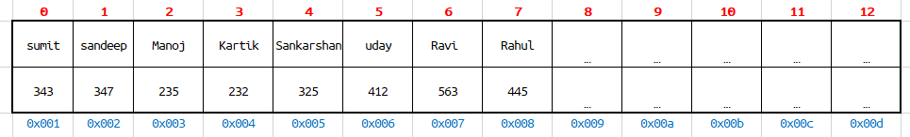
std::vector<int> arr;
arr.size(); → 13
arr.capacity(); → 50
arr.delete(6);
arr.remove (arr.begin() + 3);
arr.reserve (100); → capacity() ?
std::stack <int> _stack;
_stack.size(); → 11
_stack.top(); → 5
Are size(), capacity(), reserve() functions declared virtual ?
std::unordered_map <string, int> _my_name_marks_map;
_my_name_marks_map [“sumit”] = 343;
_my_name_marks_map.insert ( std::make_pair( “Sandeep”, 347) );
_my_name_marks_map[5]; → ??
_my_name_marks_map.delete (std::find(“uday”));

Slide 4
C++ Program
GCC (Lexical & Syntax analyzer)
GCC (Syntax Directed Trans)
GCC Gimple
Assembly
Assembly Code
Object Code
Linker & Loader
add $ebx, $eax, $eax
mov $eax, $edx
add $eax, $edx, edx,
subs $ecx, $edx, $ecx
lda $eax, #ebp+0x04
strp $edx, $eax+esp-0x50
1001 1010 1100 1100
1010 1100 1011
1001 1100 1011 1011
...
...
...
...
Object Code
Link-Go-Loader
Python Program
Python Interpreter Framework
Python
GOT Calculation
Python VM
Python Runtime JIT

Slide 5
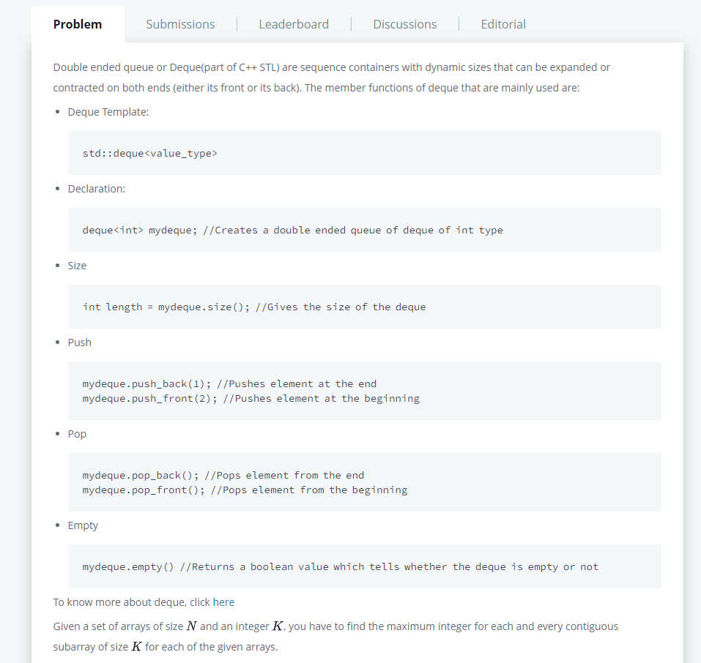
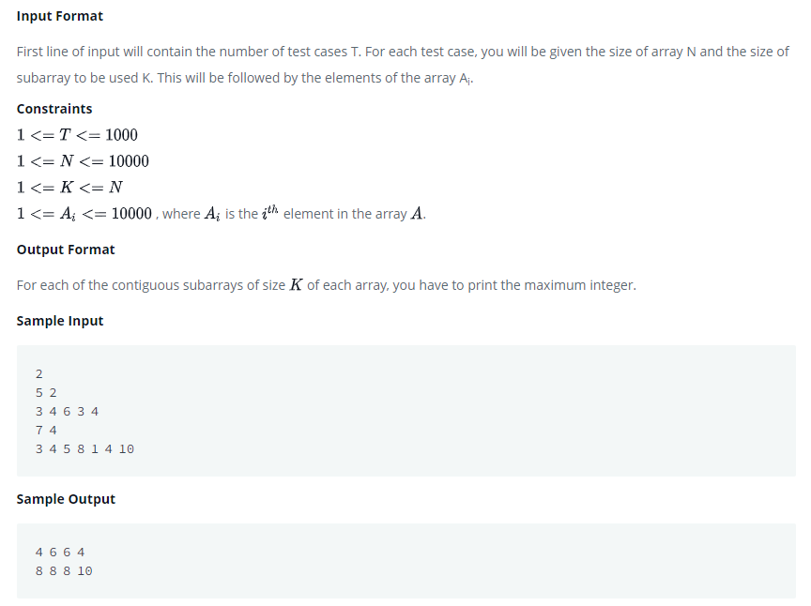
https://www.hackerrank.com/challenges/deque-stl/problem

Slide 6
#include <bits/stdc++.h>
using namespace std;
void print_K_max (int arr[], int n, int k){
std::deque<int> dq;
for (int i = 0; I < n; i++){
// base case for first element
if (dq.empty()) {
dq.push_back(i);
}
// remove elements outside the current window
if (dq.front() <= (i - k)){
dq.pop_front();
}
// move max element to the front
while (!dq.empty() && arr[i] >= arr[dq.back()]){
dq.pop_back();
}
dq.push_back(i);
// print out only when the first window is completed
if (i >= (k - 1)){
cout << arr[dq.front()] << " ";
}
}
cout << endl;
}
int main (void){
int t;
cin >> t;
while( t > 0) {
int n = 0, k = 0;
cin >> n >> k;
int i = 0;
int arr[n];
for(i = 0; i < n; i++)
cin >> arr[i];
print_K_max (arr, n, k);
t--;
}
return 0;
}

