Slide 1
Theory of Computation :
To follow a set of rules. A set of instructions to get to a final state. To compute something a value or expression. Abstract machine which moves from state to state in order to compute.
Five layers of Computation : Five models. Each one more superior in-terms of capability and capacity of handling. By superiority we don’t mean higher speed or more difficult problem-solving capability. Each model accepts / enumerates a valid language, that any other machine of the same model can accept or understand.
We are not interested in the physical construction of the machine, just the abstract idea of what the machine can or cannot do.
We start by defining an alphabet, string & language :
Computationally, Alphabet is the smallest recognizable character that a machine can write or read. Modern machines consists of only two alphabets [0, 1]. Quantum Machine consist of 6 alphabets : [0x, 0y, 0z, 1x, 1y, 1z]. See Microsoft Q# programming language. Q# coding contests are also held.
5. String is a valid stream of characters concatenated together.
string S = 011010001010010101 is a valid string.
string Z = 010010101003010010 is in-valid. (3) not recognizable.
6. Language is a set of strings. Languages like strings can be finite or in-finite.
Language L = {0, 1, 01, 10, 110, 1101, 11010, 100101, 1010101 ...} is an infinite language.
Language X = {0, 1, 101, 1001, 10001, 1000001} is a finite Language.

Slide 2
Theory of Computation.
Alphabet : alphabet-set : {a, b} , ϕ is a null character. Alphabet is always a finite set.
Strings : string-set : {ϕ, a, b, ab, aab, aba, bab, bba, bababb};
Language : language-set : {a, b, aab, aba, bab} (Subset of the set of all possible strings).
Universal Language : Set of all possible strings.
How many strings can be formed with 2 alphabets?
How many languages can be formed with sub-setting a set of all alphabets.
S* = {ϕ, a, b, ab, ba, aab, bab, aba, aaa, bbb, bba, abb, baa ... }. Kleen Closure.
Modern systems :
alphabet-set : {a, b, c, d, e, f, g, h ... A, B, C, D, E ... 1, 2, 3, 4, ... Μ μ }
strings-set : {is, am, are, was, def, main, int, char, float, etc...}
C Language : {void, main, int, char, float ...} Subset of above.
Note that in modern systems everything is a homomorphic mapping to the alphabet-set {0, 1} and related strings.

Slide 3
A Simplex Machine is one which has at max 2-3 states and can only check for correctness of few strings. States don’t have self loops.
Turing Machines
RE / REC
Undecidable Problems :
We recognize as problems and have a formal definition. But we don’t have a halting turing machine for it. So it is undecidable.
Simplex Machine
0/1 check
LBA
CSL
PDA
CFL
FSM
RL

Slide 4
Theory of Computation.
Alphabet set : {a, b, c}
Form a string that start with a and end with b. → ab, aaaab, aaabbbb, abbbb are valid.
Is aaa valid? Is abaaa valid? Is bbbb valid ? Is abaaabaaababab valid?
Language : Set of all strings that start with ‘a’ and end with ‘bb’ ➔
L = {abb, aabbb, abbb, abbabbabb ...}.
What will the Kleen closure of L? i.e what is L* ?
L* = {abb, abbaabbb, abbabbb ...}
Which one is bigger ? L or L* i.e n(L) compare n(L*).
Is L countable ?
Let’s move on to FSM :
A FSM is a finite state machine with a set of 5-tuples . It has a finite number or states that it can hold. It has no memory since it does not store any intermediate computation state or data anywhere. FSMs are not concerned as to how you reached that state.
They are known as Finite Automaton (FA). It is either an acceptor or rejects strings never an enumerator. At a given state, which state to go next when seeing a particular input on tape?

Slide 5
Input tape is static. Can’t jump around in input tape. Only move forward.
Can only change state on seeing an input symbol.
Cannot modify input tape. No output tape.
FA which writes an output symbol on a output tape on reaching a particular state is called a Moore Machine.
FA which writes an output symbol on output on taking a transition from one state to another is called a Mealy Machine.
FSM that accepts strings which → Starts with ‘a’
a, b
a, b
a
a, b
a
q₁
a
q₁
q₁
S
S
S
S
RegEx : a(a + b)*
b
a, b
q₁
S
RegEx : b(a + b)*
FSM that accepts strings which → Starts with ‘b’
FSM that accepts strings which → Ends with ‘b’
a, b
b
q₁
S
Input tape :
Grammar generates the string of a language.
S → aB;
B → a/b;
a
a | a | b | b | b | a | b | a | a | b
RegEx : is a small hand short mathematical notation of a FA.
Output tape :
0 | 0 | 1 | 1 | 1 | 0 | 1 | 0 | 0 | 1

Slide 6
Finite State Machine :
Start State : S;
Set of States = [S, q1, q2, q0, F]
Set of Final States = [F]
Reading characters = [a, b], Γ
Transition Table : δ
If State:q1 & inp:a
Move q1
If State:q1 & inp:b
Move q2
If State:q2 & inp:b
Move q2
If State:q2 & inp:a
Move F
...
a
a
a
b
S
b
a
S
S
q₁
q₂
q₁
q₁
F
Start : S
Move : a, q1, q1
Move : a, q1, q1
Move : b, q1, q2
Move : b, q2, q2
Move : b, q2, q2
Move : a, q2, F
Final Halt
Is it Okay??
What about the string [baab] still there in the input ?
Do we always halt when reaching the final state?
We missed something !!.
b
q₀
Input tape :
S
a | a | b | b | b | a | b | a | a | b
Complex Example : Starts with any character but has atleast one ‘b’ and ends on ‘a’.
Regular Expressions : a*bb*aa* (Short-hand).
Number : (digit)(digit)*
All names start with San → San(letter)*

Slide 7
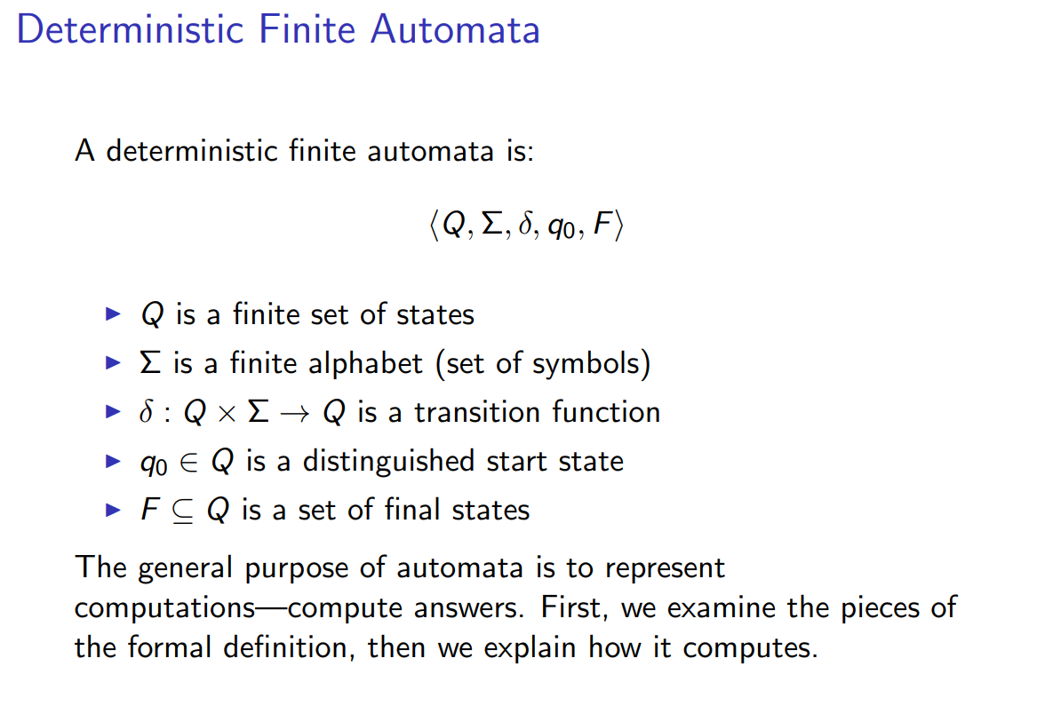

Slide 8
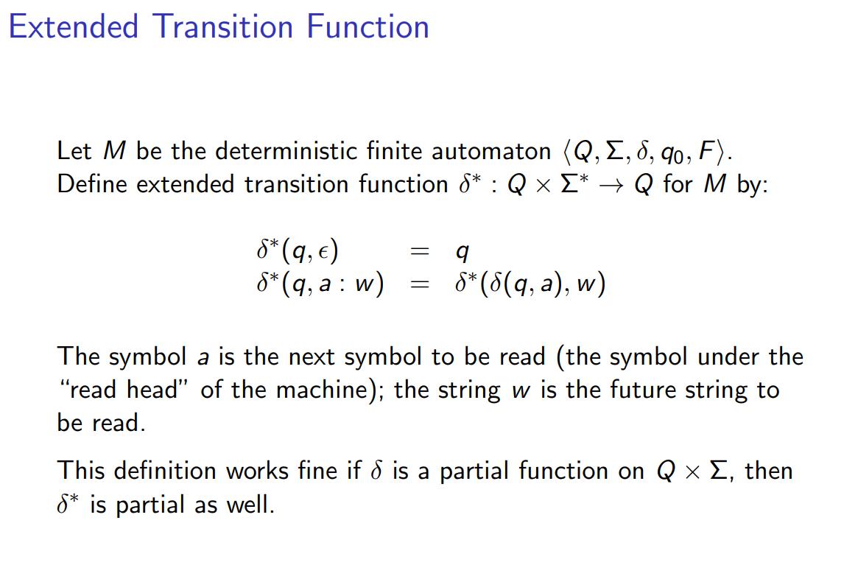

Slide 9
Different Problem :
Can have any number of a’s or b’s
RegEx : a*b* ??
1. All a’s need to be before b’s.
2. but needs to be equal in number.
n(a) == n(b);
Short-Expression : a^{n}b^{n} .
Note → a^{n}b^{n} != a*b*.
Eg : aabb, ab, aaaabbbb, aaabbb,
Not Valid : a, ba, bbaa, abab
Hint : Need to keep count of what the start character is and how many a’s seen till now.
a, b
F
S
Can an array help ?
Can a stack or queue help ?
SAW b → Error.
Else SAW a → Push a;
Keep repeating above step until we see b or reach end of string.
SAW b → Pop a.
Keep repeating above step until stack end or we exhaust all b’s
Empty Stack → Accept !!! Or Stack-not-empty → Reject !!!.

Slide 10
Push Down Automata :
On a particular state, based on certain criteria push a symbol on to the stack.
Fix when to push and when to pop.
How we accept the given string?
We accept by the empty stack.
This is known as the stack-property of PDAs.
PDAs → FA + Stack Memory.
Store the processing data in stacks and check accordingly.
Infinite stack but only stack is there. It cannot by used like a queue, by definition.
Z, a, Za;
a, a, aa;
a, b, pop;
S
q₁
q₂
F
a, b, Move q_{2,} pop;
Z, ϕ, Move F.
q₀
Error Halt.
a | a | a | a | a | b | b | b | b | b
Z
a
a
a
a
a

Slide 11
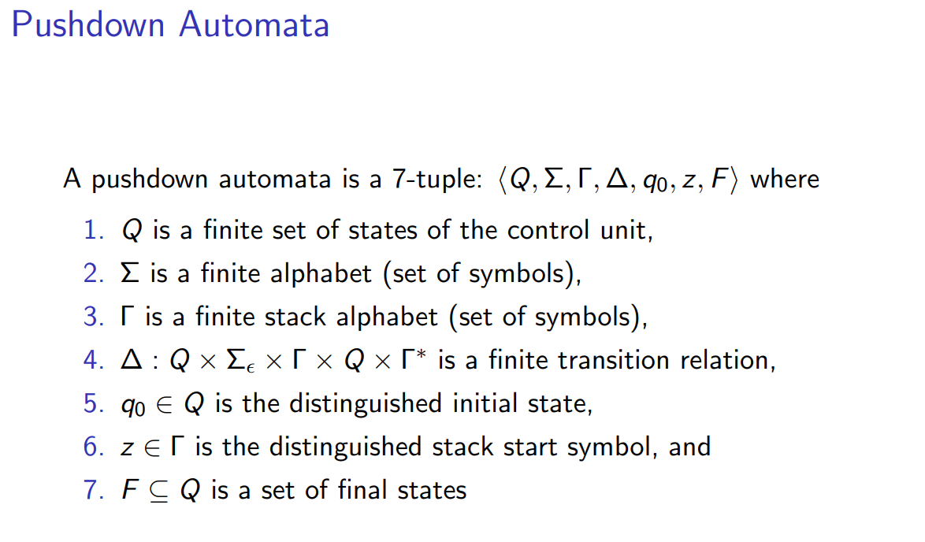

Slide 12
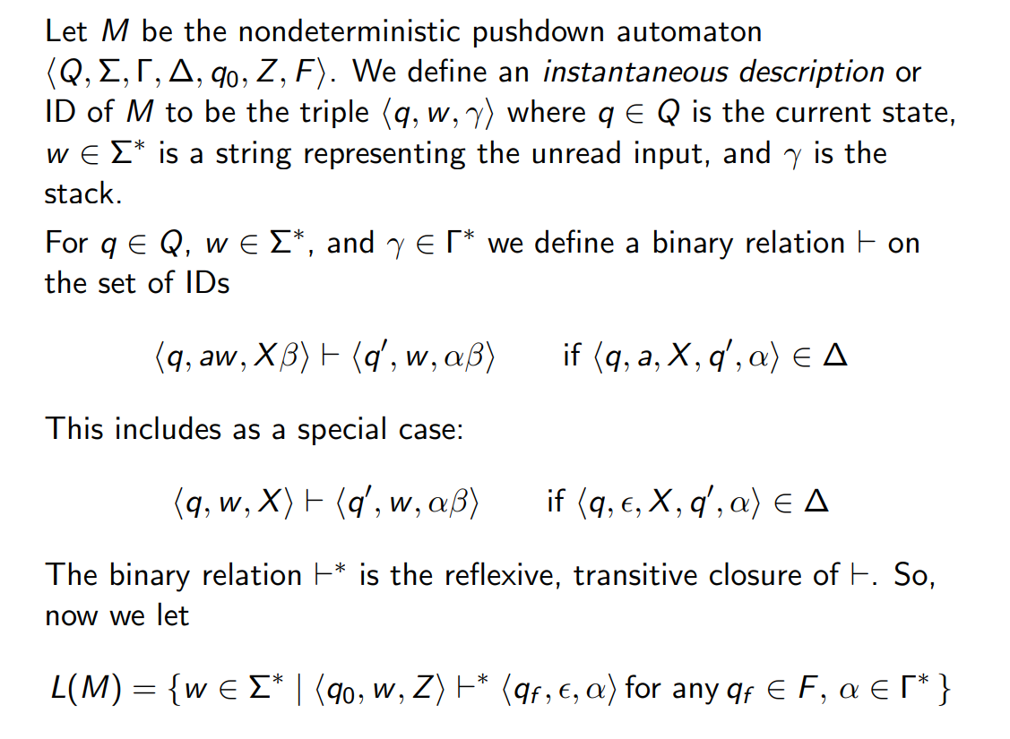

Slide 13
Interesting Problem :
Numbers are represented as 1111... , 3 → 111, 4 → 1111 etc.
Given two numbers add them to get the represent the number in above form.
Eg : 3 + 5 = 8; 111 + 11111 → 11111111, ‘b’ is a blank, no input. Blank symbol.
Input on tape : ...bbbbbb111000011111bbbbb... → ...bbbbb11111111bbbbbb...
Need to move left and right on the tape ??
Need to store count of the 1’s seen.
Need to output back the final result ??
Either modify the existing tape or have a separate output tape ??
How to generalize the gap zeros? 0000 or 0. Let’s see!
Solution using a PDA →
Read the number 1, push on to stack. Keep pushing till we get 1.
On seeing a 0, we do nothing just ignore.
Next again when we see the 1, we push it on to the stack. We keep pushing.
Finally what is left in the stack is 11111111. → 8.
We pop the 1’s onto a separate output tape ?? → Huge Error :>> We don’t have a write head ?? We are stuck with the output on the stack.

Slide 14
Turing Machine :
The input tape is now modifiable. It extends in both directions infinitely to left and right. Turing machine can be configured to read from any point.
The input tape symbol can be deleted and modified. The read/write head of the Turing Machine can move left or right on the tape as desired.
It was not possible with a PDA or FA.
We need to decide when to move right and left and what to write on the tape on each move either to the left or right.
Tape can be blank initially or be filled with data.
We decide based on certain criteria as to when to halt.
???? What did I write above ????
Turing Machine → FA + Vector (C++)
By definition, Turing Machine → FA + R/W Head + Tape (STACK, QUEUE, ARRAY) ANY.

Slide 15
Given two numbers add them to get the represent the number in above form.
Eg : 3 + 5 = 8; 111 + 11111 → 11111111
Input on tape : ...bbbbbb111011111bbbbb...
1, R, 0
0, N, b
1, R, 1
1, L, 1
S
q₁
0, R, 0
q₂
0, R, 1
q₃
b, H, *F
F
1, L, 1
Transition Table ➔
...bbbbbb111011111bbbbb...
Input Symbol | Current State | Next State | Movement
1 | q1 | q1 | R
0 | q1 | q2 | R
1 | q2 | q2 | L
0 | q2 | q3 | R (0 → 1)
1 | q3 | q2 | L
1 | q3 | q3 | R (1 → 0)
0 | q3 | q3 | No Moves
...bbbbbb111101111bbbbb...
...bbbbbb111110111bbbbb...
...bbbbbb111111011bbbbb...
...bbbbbb111111101bbbbb...
...bbbbbb111111110bbbbb...
...bbbbbb11111111bbbbbb...

Slide 16
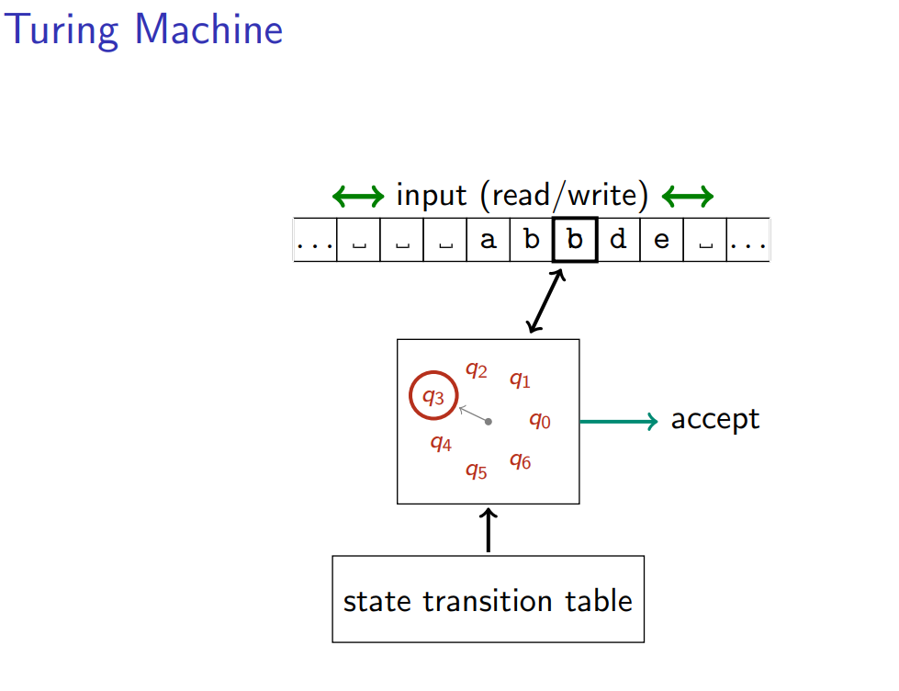

Slide 17
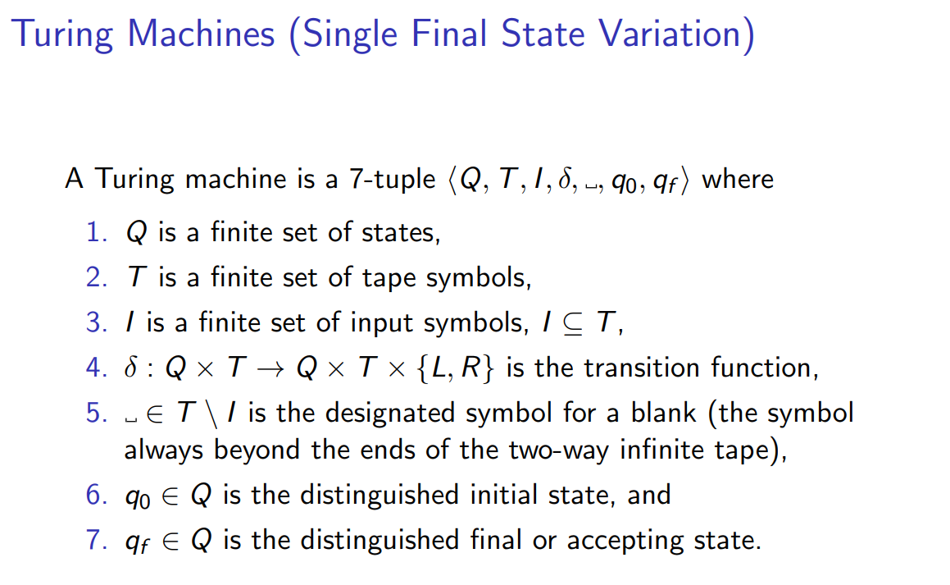

Slide 18
